Slide 1
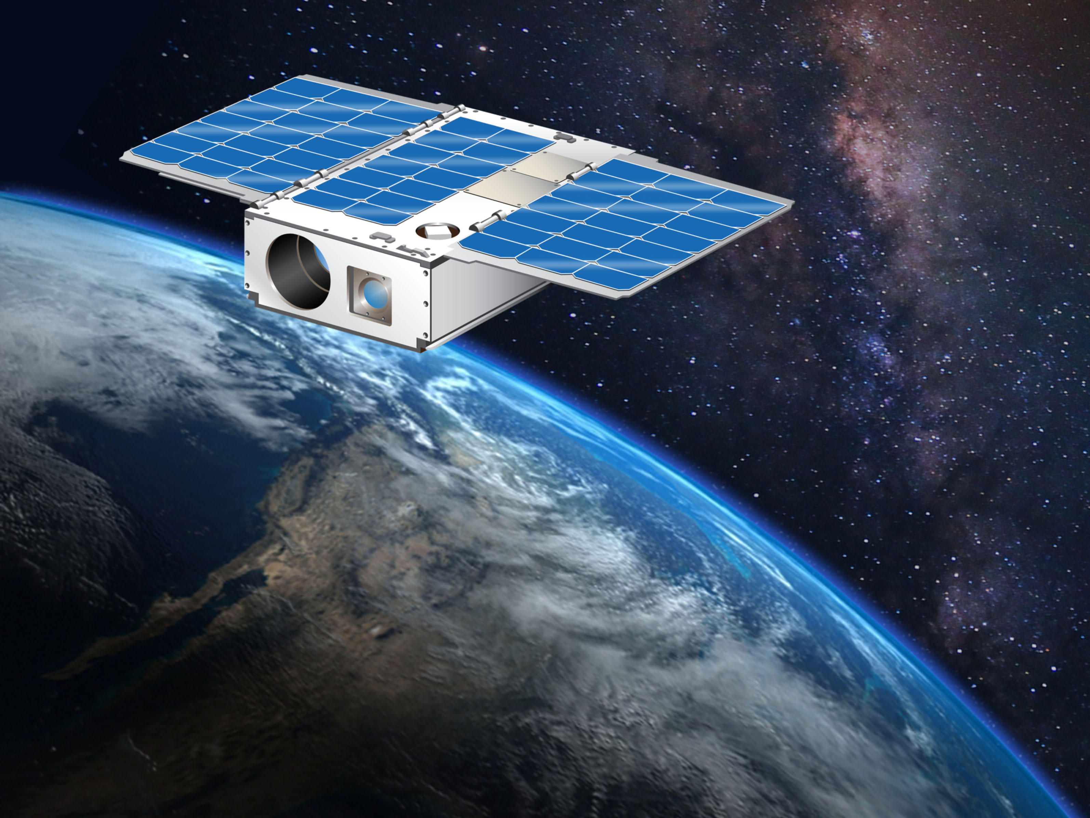


Arcsecond Space Telescope Enabling Research In Astronomy (ASTERIA)
Vanessa Bailey
Jet Propulsion Laboratory, California Institute of Technology
^{Jan 4, 2020}
© 2020 California Institute of Technology. Government sponsorship acknowledged. The research was carried out at the Jet Propulsion Laboratory, California Institute of Technology, under a contract with the National Aeronautics and Space Administration.

Slide 2
ASTERIA Team
JPL ASTERIA Team:
L. Fesq (PM), K. Hughes (MM), M. W. Smith, C. Pong, J. Krajewski, P. Di Pasquale, A. Donner, C. Colley, B. Campuzano, R. Bocchino, A. Babuscia, J. Loveland, J. Luu, C. Smith, J. Lee, M. White, S. Gavit, L. Altenbuchner, B. Barker, A. Rothstein-Dowden, C. Volk, P. Beauchamp, V. Bailey, M. Troesch, F. Mirza, B. Kennedy, R. Mackey, (+ many more)
Science Team:
S. Seager (PI), M. Knapp (PS), B. Demory, A. Krishnamurthy, V. Bailey
Morehead State University Ground Station:
B. Malphrus, C. D. Conner, R. T. Kroll, M. Combs, C. M. Hart, T. D. Gedenk, J. Kruth (+ additional student operators)
MIT Aero/Astro-EAPS Capstone Design Class (2010-2011)

Slide 3
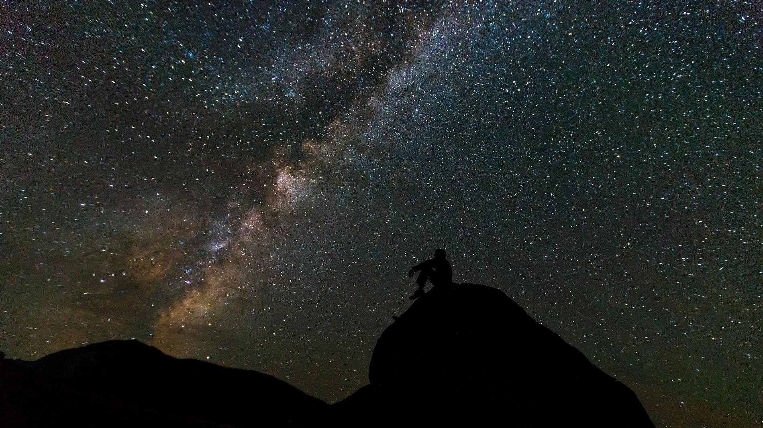
Most stars have planets
>4000 known exoplanets
Image credit: public domain, CC0 license

Slide 4
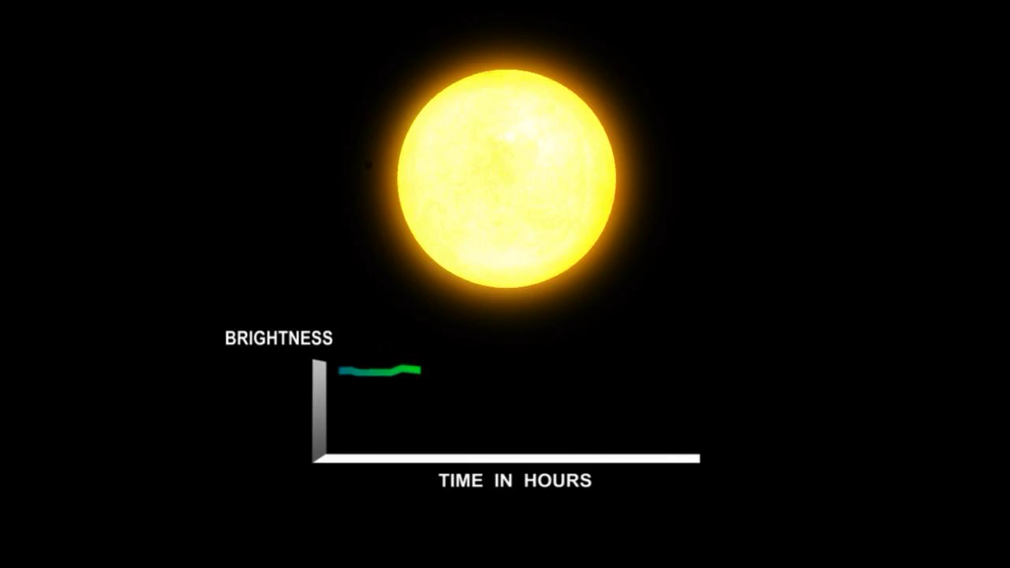
Credit: NASA Kepler Mission/Dana Berry

Slide 5
Challenge: detect small transiting exoplanets at lower cost
Earth-size planet & Sun-like star ~ 80ppm (parts per million)
Brightest
(V<7)
Faint
Star brightness
D = 10.5cm
D = 6cm
D~1m
ASTERIA
Kepler
TESS
Notes:
Tess is explorer-class mission

Slide 6
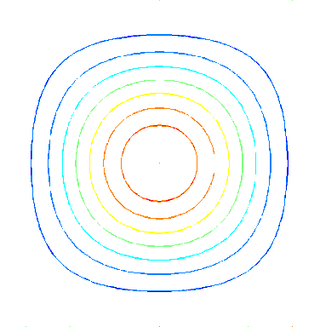
Systematic noise: pointing jitter
Slide credit: Mary Knapp
Intra/interpixel nonuniformity noise
Array detectors have intrapixel sensitivity variation on the order of 10%
Dynamic pointing errors cause image wander on the detector
Net effect: the photometric signal varies over time
t = t₁
t = t₂
t = t₃
t = t₄
Single
pixel
Star image
σ_{PRNU}
Signal
t₁
t₂
t₃
t₄
Notes:
This slide has been presented publicly in multiple venues

Slide 7
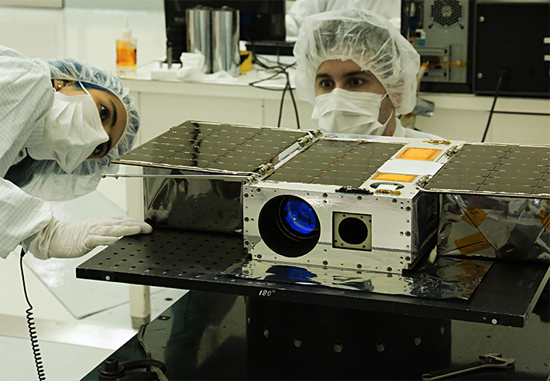
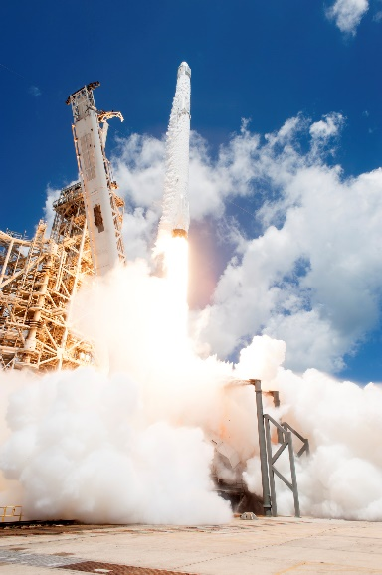
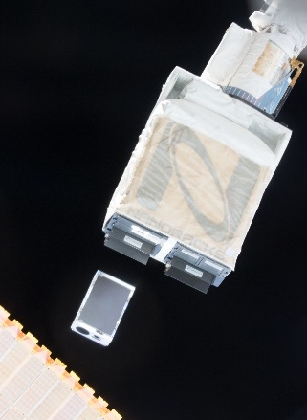
ASTERIA is a technology demonstration mission to advance CubeSat capabilities in technology areas that enable photometric studies of astrophysical phenomena.
6U CubeSat built, tested, operated by JPL, in collaboration with MIT
L1 Req: high-precision optical line-of-sight pointing (<5 arcsec RMS) over 20 min
L1 Req: high precision focal plane temperature control (±10 mK) over 20 min
Goal: Conduct photometric measurements of astrophysical sources on an opportunistic basis
Extended Mission(s)
Multiple science & autonomy experiments
Prime Mission
Complete
Feb 2018
Lost Contact
5 Dec 2019
Development
Dec 2014 through Jun 2017
Launch
14 Aug 2017
Deployed from ISS
20 Nov 2017

Slide 8
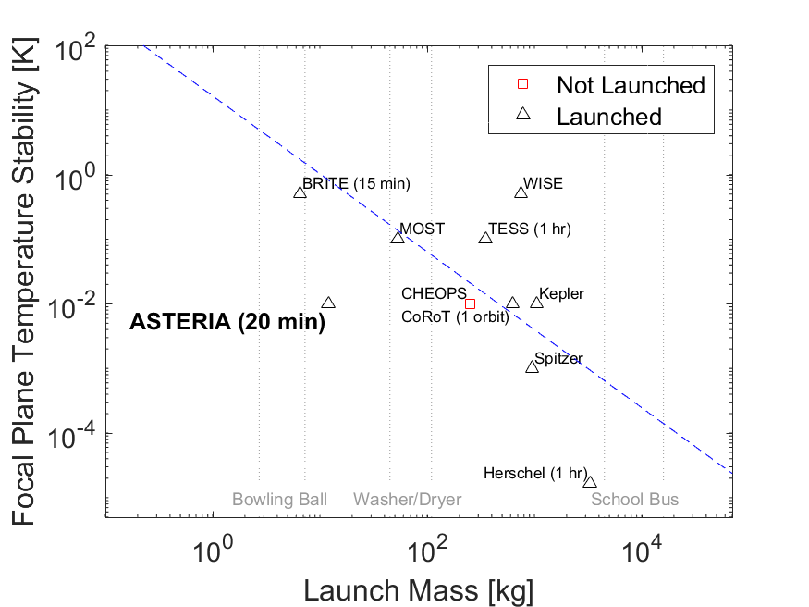
Demonstrated 10 mK control over 20 min
Flight performance
Plot by M. W. Smith

Slide 9
Two Stage Pointing Control
Slide credit: Mary Knapp
Notes:
This slide has been presented publicly in multiple venues

Slide 10
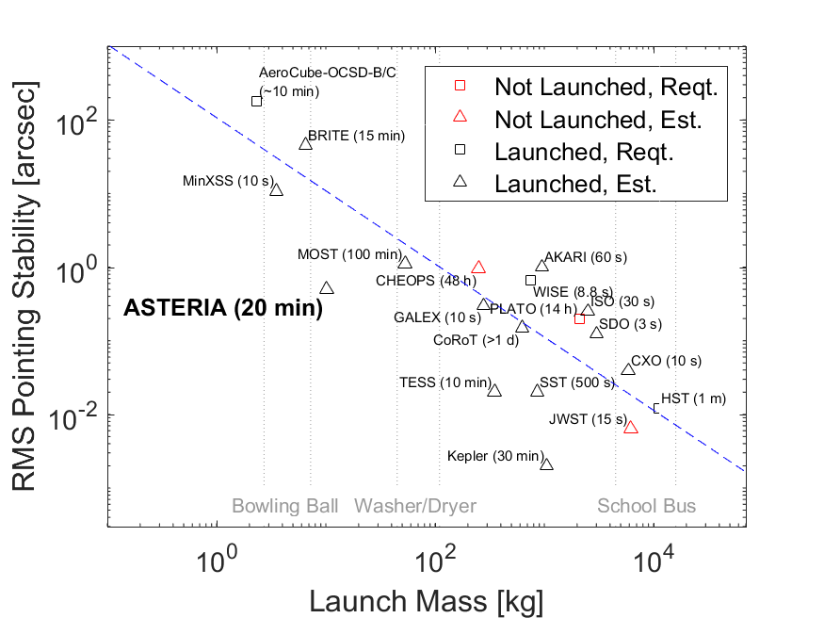
Exceeded pointing control goal by 10x
< 0.5 arcseconds RMS over 20 minutes
Flight performance
Plot by M. W. Smith
Notes:
This plot, or earlier versions, has appeared in several talks/posters presented in conferences

Slide 11
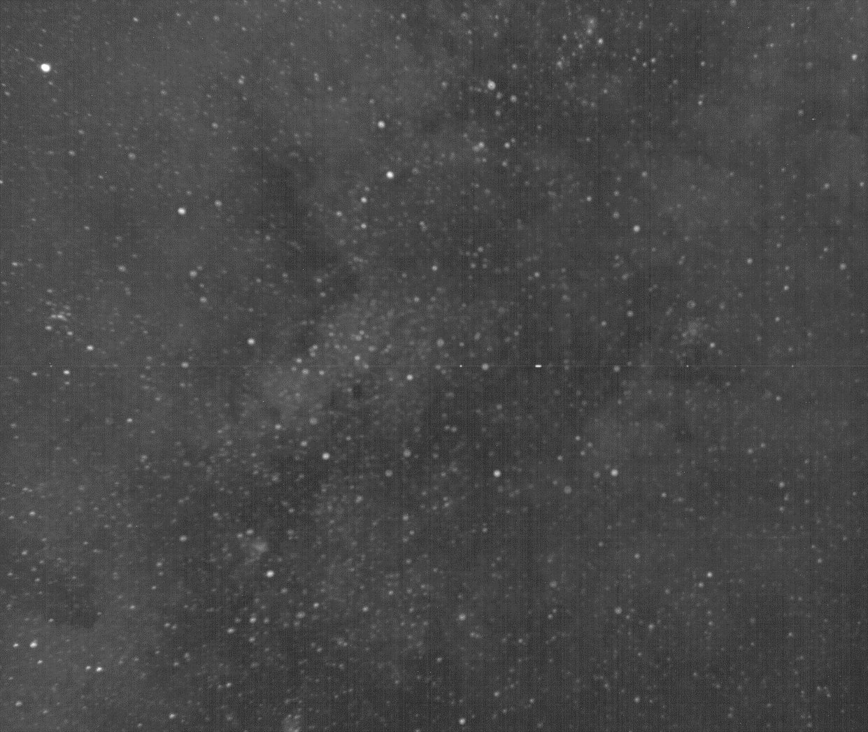
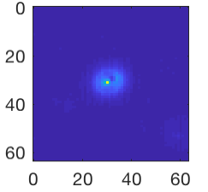
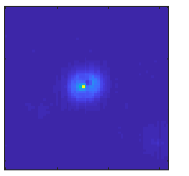
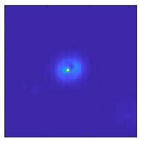
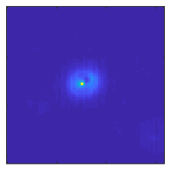

Photometry with ASTERIA
Slide credit: Mary Knapp
Full frame image (11.2° x 9.6°)
Saturn
Guide Stars
Images from 8x 64x64 pixel windows are collected at 20 Hz for up to 30 minutes
Target Star
Vesta
1200x 50 msec images are summed onboard to a 1-minute integration, which is then downlinked as a binary

Slide 12
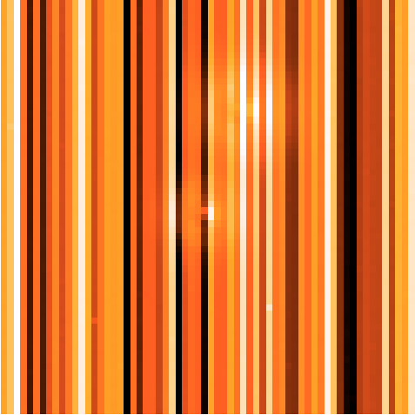
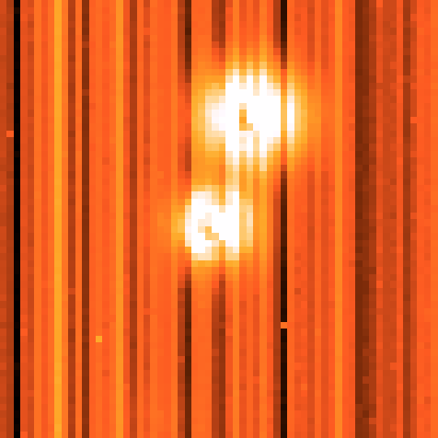
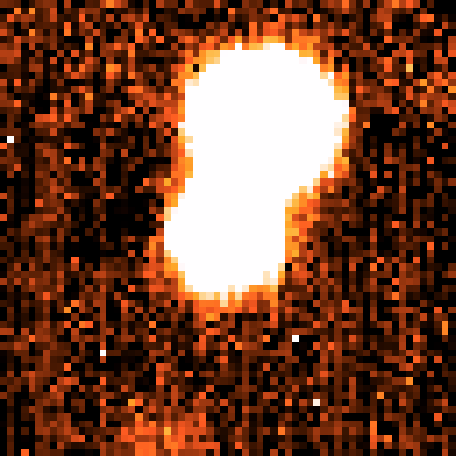
Photometric reduction: CMOS Column Effects
Slide credit: Mary Knapp
Raw windowed image (64 x 64 pix)
Basic column correction
Improved column correction
53 Cancri
55 Cancri
Contrast enhanced to highlight background

Slide 13
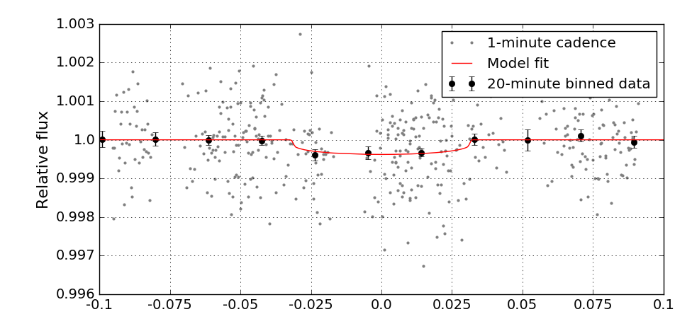
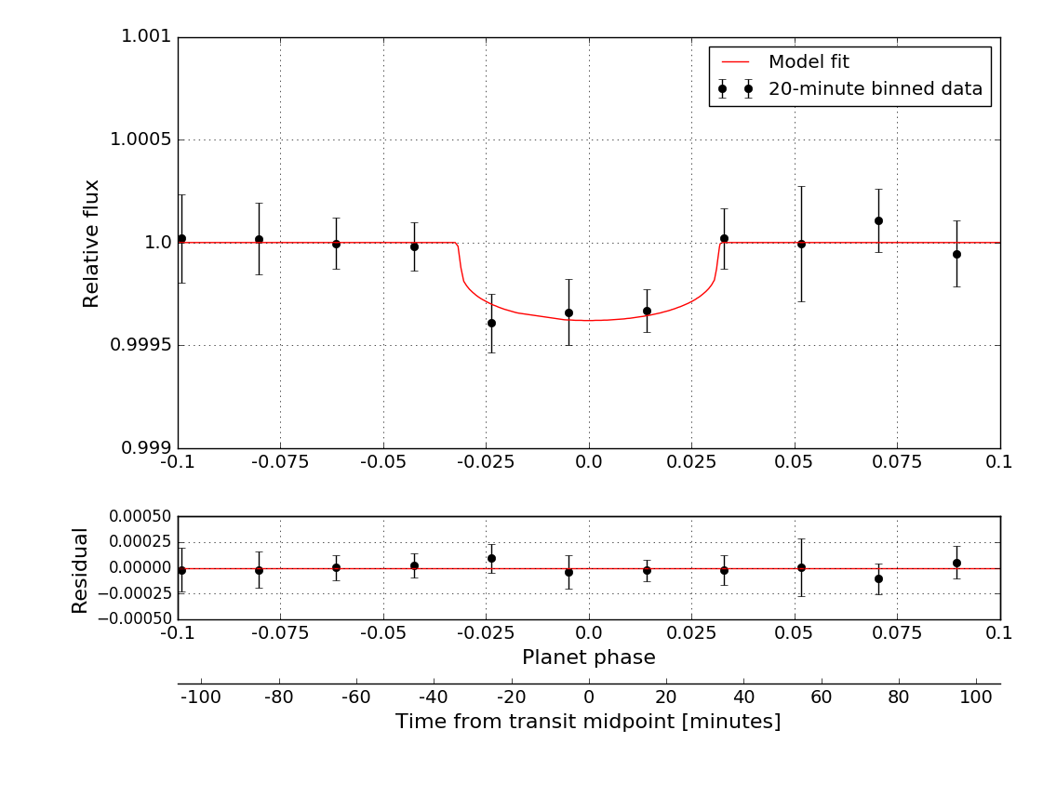
Detected transit of super-Earth 55 Cancri e
First exoplanet detection of an exoplanet with a CubeSat
Knapp et al., in revision
1.001
Relative flux
Relative flux
0.999
Planet phase
526 minutes of observation time,
phase folded to orbital period of 55 Cnc e
Photometric precision 726 - 1140 ppm/minute for V=5.95
Notes:
***FIRST CUBESAT TO DETECT EXOPLANET***
ASTERIA not built explicitly to do photometry, but when you have excellent pointing control and thermal control, high precision photometry is possible.

Slide 14
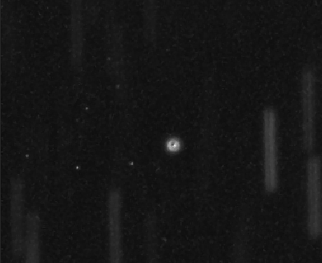
Autonav: determining LEO orbit without GPS
PI: Brian Kennedy
Star trails
Goal: orbit determination in Low Earth Orbit (LEO) without GPS.
  Use camera images only
  Onboard processing
Tested in flight with both asteroid and geo-stationary spacecraft
  Future work: refine algorithms on archival images
GEO satellite

Slide 15
Multi-mission EXECutive (MEXEC) Closed-Loop Task Execution
PI: Martina Troesch
Shift the paradigm to operate spacecraft from timed sequences to closed-loop task execution.
  Simpler commanding: WHAT not HOW+WHEN
    initialize camera (repeat as needed) vs. send 5 initialization commands 1 minute apart
  Check preconditions and postconditions of tasks
  Reduces idle time & improves robustness
Successful in-flight test: replicate behavior of existing fixed-time sequences using MEXEC framework
Future work:
  Flight tests of momentum management had been planned for Spring. Shift development to testbed-only.
  Evaluate AutoNav integration on testbed.
Notes:
Reduces time it takes to achieve tasks due to conservative estimates
Adapts to changing conditions of the spacecraft state
Optimizes resources
Parallelizes
Reduces unnecessary safing

Slide 16

ASTERIA as a test particle for Amazon Web Services (AWS) Ground Station (GS)
New ground station service, launched Fall 2018
Used for uplink and downlink during Fall 2019
  Ohio, Oregon locations
  Used individually and in “handover” passes
Significant step for demonstrating potential for future CubeSat missions
  Provide more flexibility in operations
  Reduce costs : pay-by-minute model
https://aws.amazon.com/ground-station/
Notes:
Rough Schedule for AWS Adaptation
Signal lock to AWS GS (done)
Frame sync with AWS GS (Soon)
Telemetry Processing and Verification of Downlink (Soon)
1-3 in real-time delivered to ASTERIA AWS account. (Primary GS Preview downlink path)
Set up Cloud-based GDS Downlink in AWS (1-2 weeks)
After licensing demonstrate full-cloud operations with AWS GS (3-6 months)
1-3 in real-time delivered to JPL MOC via hosted FEP (primary preview uplink path, future general service for downlink)
Demonstrate traditional MOC downlink with AWS GS (3-6 months)
After licensing demonstrate full-operations with AWS GS and traditional MOC (3-6 months)
Integrate other AWS ground stations into mission operations and regular scheduling and contacts into procedures (3-6 months)
Separately:
Complete Licensing with NTIA for uplink via AWS GS, enabling 4b, 5b, and 6. (3-6 months)
Transition from GS Preview to Operations (Spring 2019)
Transition to Govcloud implementation of GS (TBD but in the pipe)
Document the AWS GDS design, identify steps that would need to be completed for a new project adaptation that weren’t for ASTERIA.

Slide 17
Summary
ASTERIA demonstrated key capabilities for precision photometry in CubeSats: 0.5” pointing, 10 mK thermal control, visible light CMOS
Extended missions have very good ROI
  90 days prime vs 2 years extended
  Greater flexibility to test new capabilities in flight
ASTERIA executed multiple experiments beyond prime mission
  Exoplanet exploration
  Jitter Characterization
  Task-level execution
  Autonav for LEO w/o GPS
  NASA HQ/ESTO AWS Ground Station testing

Slide 19
Fast Facts
Slide credit: Mary Knapp
6U CubeSat (30 x 20 x 10 cm, 10 kg)
3-axis stabilization (reaction wheels)
Deployable solar panels
Refractive optical telescope
CMOS detector
ISS-like orbit (400 km, 51.6° inclination)
S-band telecom via MSU 21-meter dish
3-month nominal mission
Funded through the JPL Phaeton program for training early career engineers

Slide 20
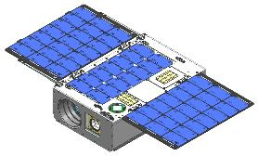
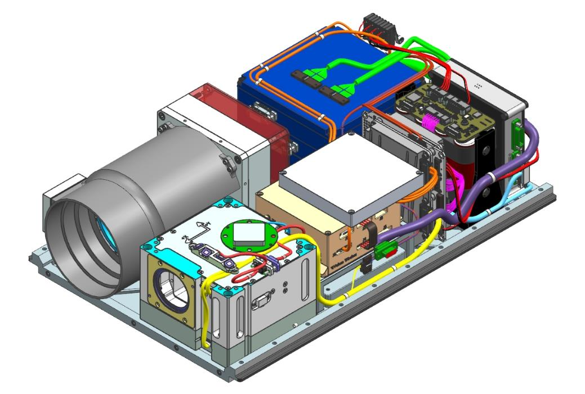
Spacecraft Design
Slide credit: Mary Knapp
Chassis
Payload Electronics Assembly
239 mm
Solar Array
Optical Telescope Assembly
116 mm
366 mm
Bus
Electronics
Payload
Optical Assembly
Payload Electronics Assembly
Bus
Bus Electronics
Radio Assembly
ADCS Assembly
Chassis
Solar Array
Radio
Assembly
+Y
ADCS
Assembly
+X
+Z

Slide 21
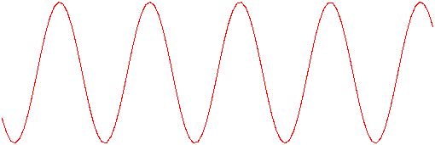
Thermal Control
Slide credit: Mary Knapp
Passive cooling, active heating:
Thermal isolation of the payload
Closed loop control of heaters on baffle and focal plane
Stability goal (single point): 0.01°C
Heater closed loop control set point
Focal plane orbit-to-orbit variation
(~2-4° C)
Temperature
Time

Slide 22
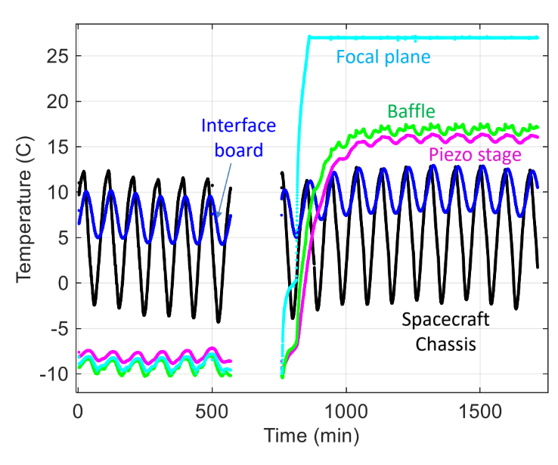
Thermal Control
Isolate the optical telescope from the spacecraft
Use the baffle as a radiator
Closed-loop heating at two locations
Achieved focal plane thermal control < ±0.01 C over 20 minutes
Temperature is controlled using sensor FP2 only
Black line is a moving window average over 1 minute
20 minutes
Figure credits: M. Smith, C. Smith

Slide 23
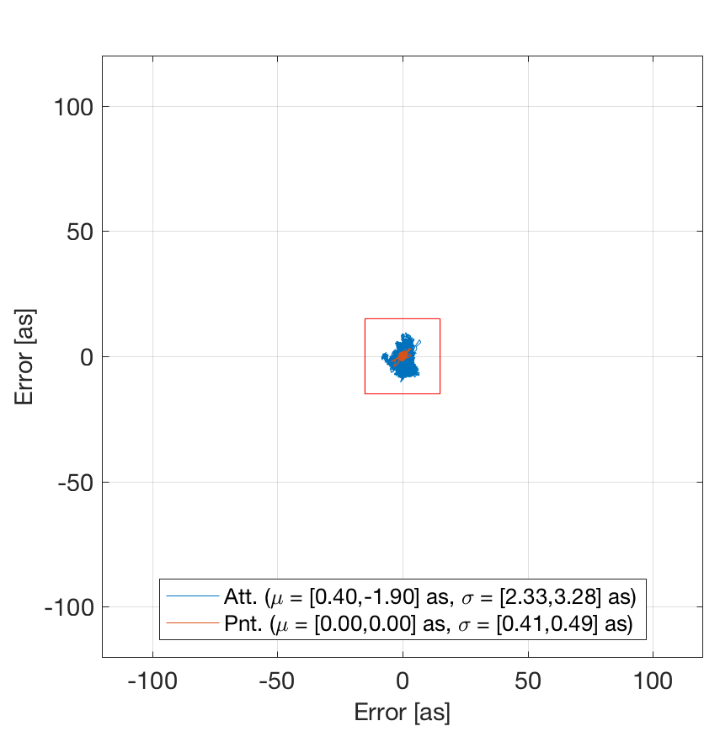
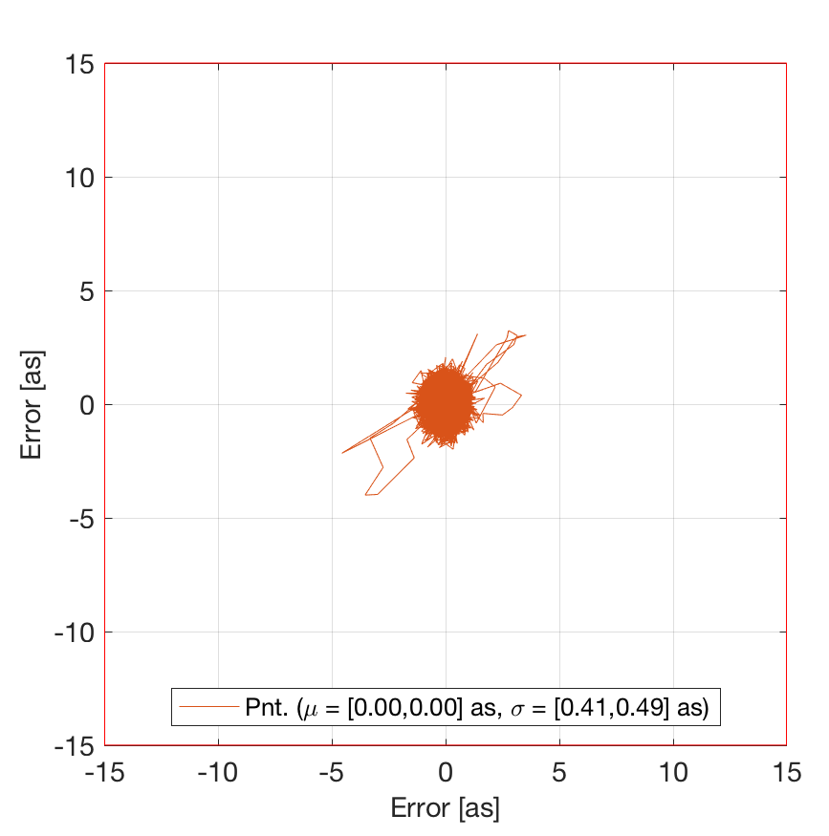
Exceeded pointing control goal by 10x
Slide credit: Matt W. Smith
< 0.5 arcseconds RMS over 20 minutes
Sub
Arcsecond
Space
Telescope Enabling
Research
In
Astrophysics
Christopher Pong (3433)
Christopher Pong (3433)

