Slide 1
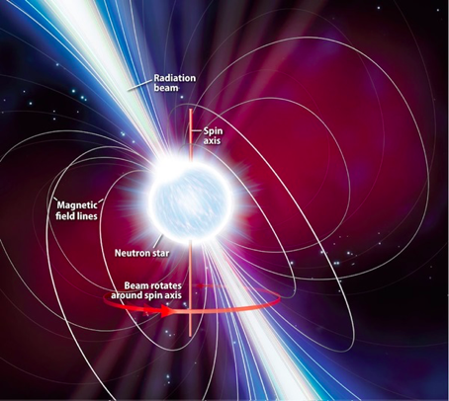
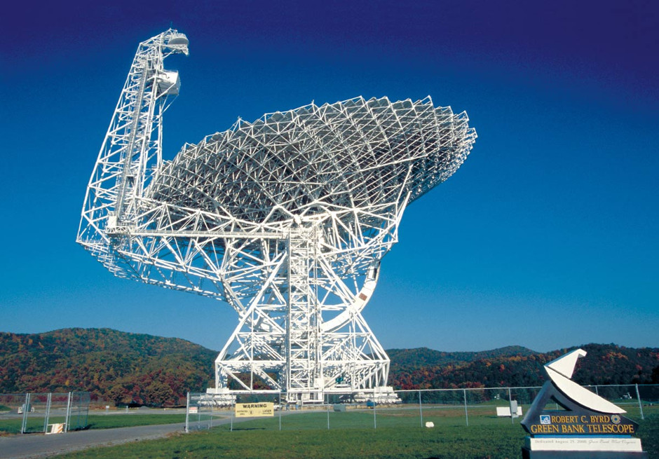
Searching for Pulsars
Beatrice Millar

Slide 2
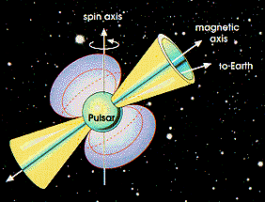
Searching for Pulsars
Introduction to the Pulsar Search Collaboratory
ATNF Pulsar Catalogue
Dispersion measure
PSC Database
How pulsar plots are made
How pulsar plots are analysed
My discoveries

Slide 3
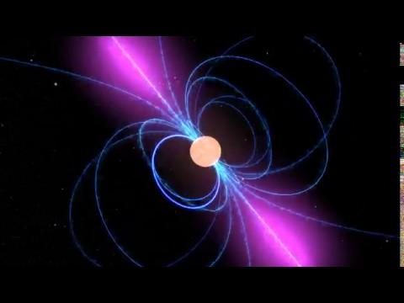
Notes:
Beatrice’s animation

Slide 4
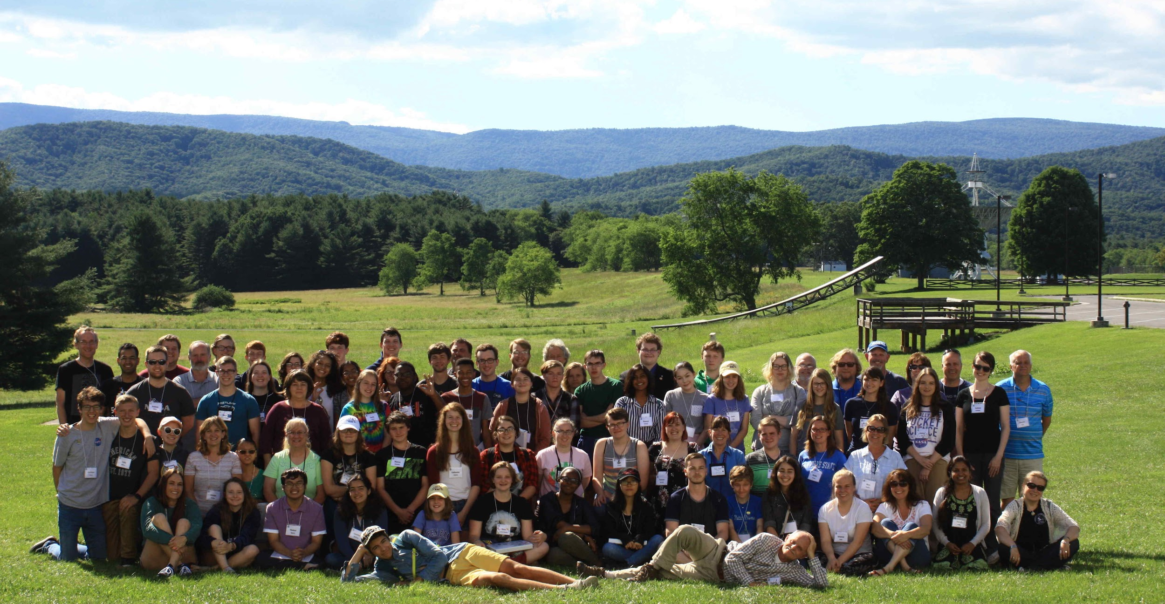
Pulsar Search Collaboratory
The PSC is a citizen science project for students and teachers
PSC members gain access to Green Bank Telescope radio data
PSC students analyse new data that has not been analysed by other scientists

Slide 5
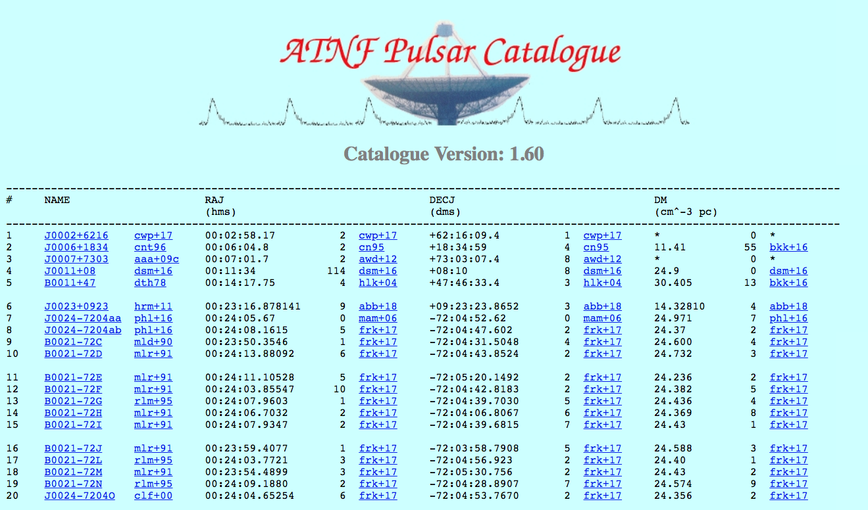

Slide 6
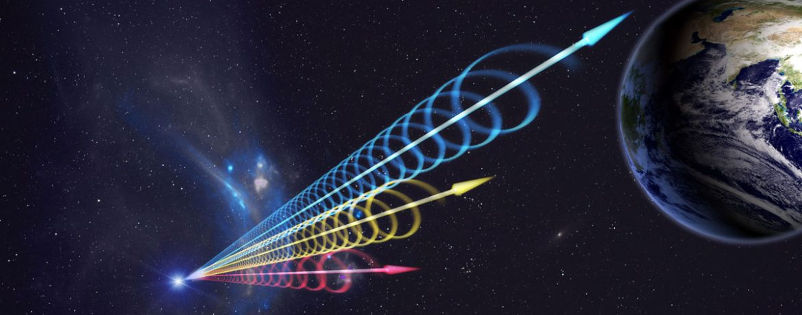
Dispersion Measure
DM=<n_{e}>d
Radio signals from Earth will have a DM of 0
Radio signals from a potential pulsar will always have a non-zero DM

Slide 7
Dispersion Measure

Slide 8
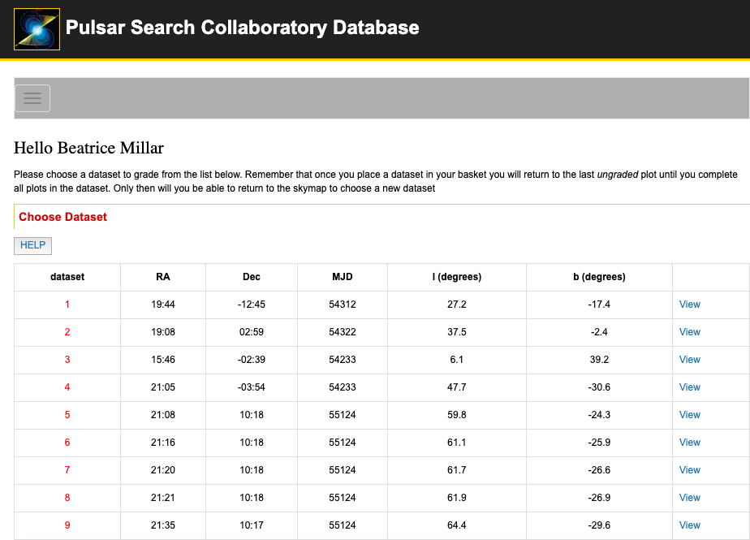
PSC Database

Slide 9
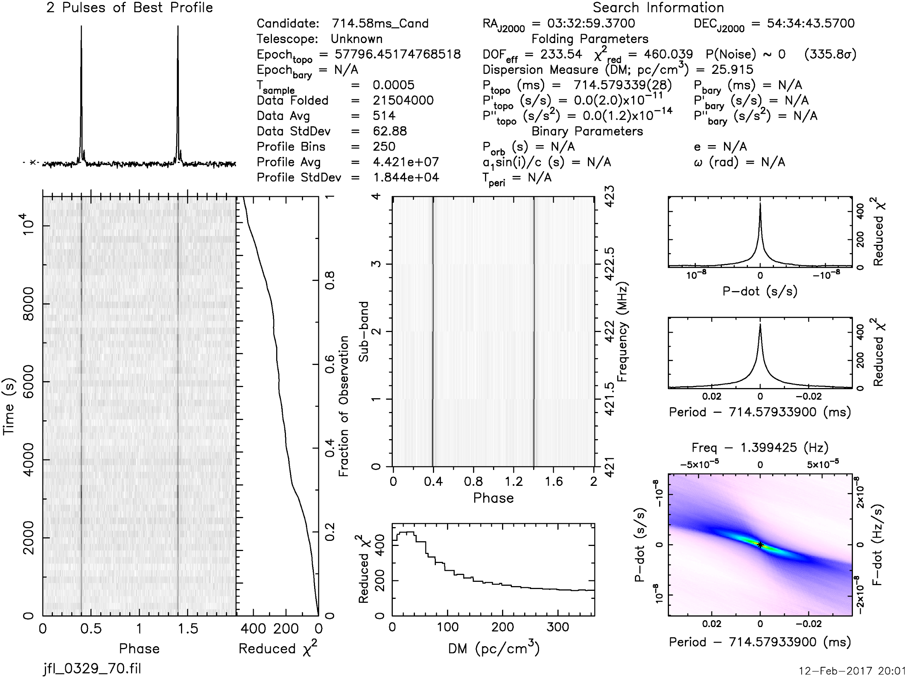
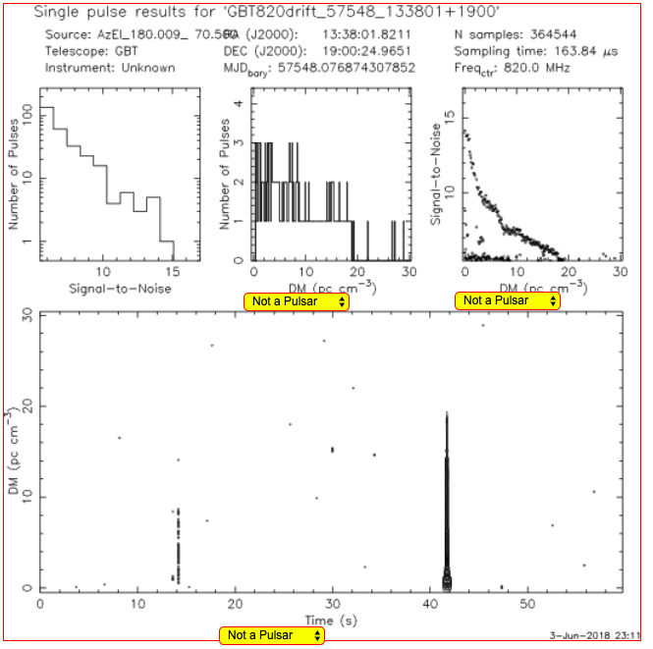
Prepfold
Single Pulse

Slide 10
How Prepfold Plots Are Made

Slide 11
Prepfold Plots
Sub-band
Time (s)
Phase
Phase
Reduced χ²
DM (pc/cm³)

Slide 12
Weaker Pulsar Plot

Slide 13
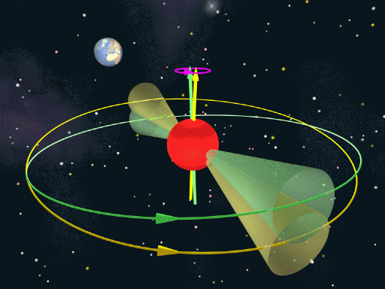
2 Peaks Per Period

Slide 14
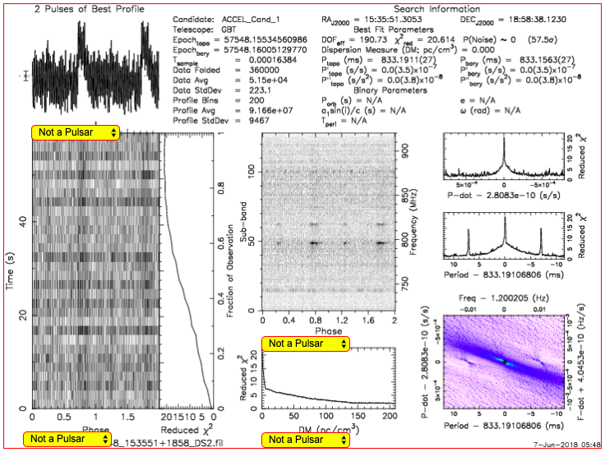
Radio Frequency Interference

Slide 15
Single Pulse Plots
Number of Pulses
Number of Pulses
Signal-to-noise
Signal-to-Noise
DM (pc/cm³)
DM (pc/cm³)
DM (pc/cm³)
Time (s)

Slide 16
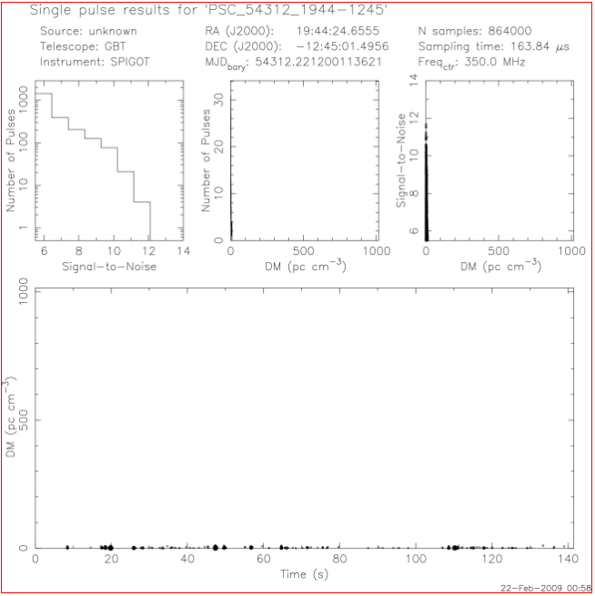

Slide 17
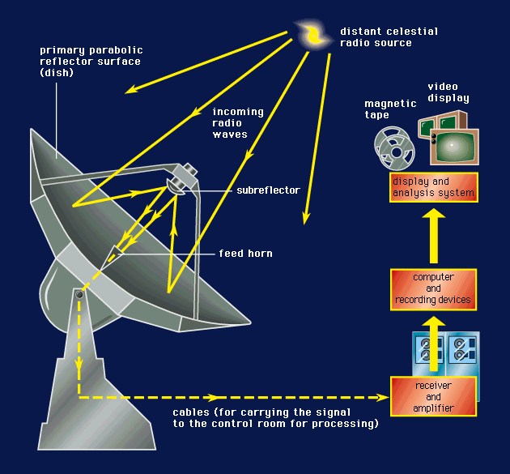
Future Work

