Slide 1
Building the NASA Citizen Science Community
Dr. Marc Kuchner
Citizen Science Officer
Science Mission Directorate

Slide 2
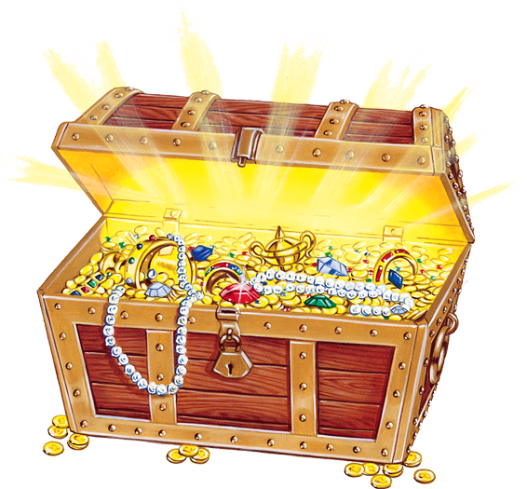
NASA Funded Citizen Science Projects Have Discovered:
400,000 Martian Seasonal Fans (Planet Four)
54,000 Circumstellar Disks (Disk Detective)
18,000 Mosquito Breeding Sites (Mosquito Habitat Mapper)
1200 Brown Dwarfs (Backyard Worlds: Planet 9)
6 Interstellar Dust Grains (Stardust@Home)
4 Meteorites (Desert Fireball Network)
1 Near Earth Asteroid (IASC)
Notes:
Want to be in the next verse?

Slide 3

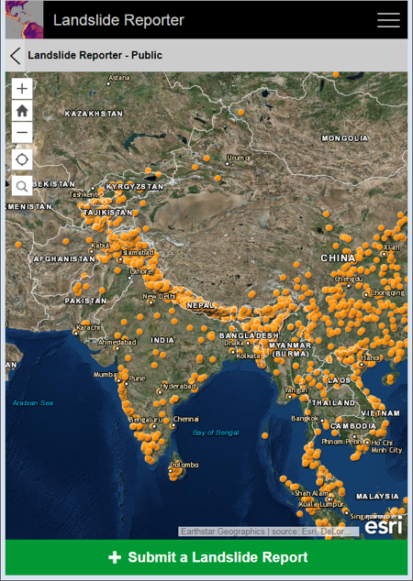

Landslides kill thousands of people and cause billions of dollars in proper damage each year.
Some NASA Citizen Science Projects Save Lives!
Submit new points or polygons
Landslide Reporter
landslides.nasa.gov
PI Dalia Kirschbaum

Slide 4
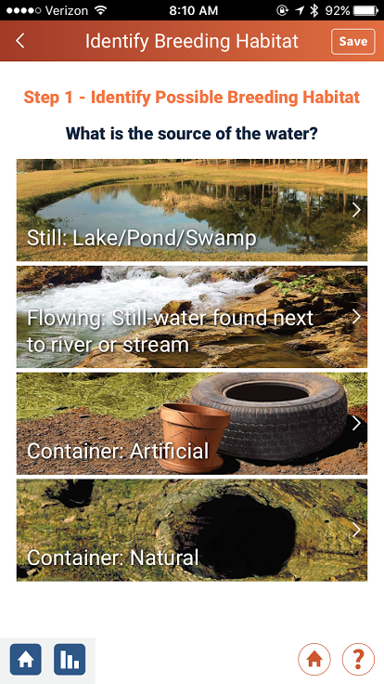

Some NASA Citizen Science Projects Save Lives!

Slide 5
Most of them have yielded surprises!
NASA Funded Citizen Science Projects Have Discovered:
Most of the long period (>2 yr) extrasolar planets (Planet Hunters)
Most of the known comets (Sungrazer Project)
The oldest white dwarf with a disk (Backyard Worlds: Planet 9)
The oldest planet-forming disk (Disk Detective)
The “Dipper” star phenomenon (Planet Hunters)
A new kind of aurora (Aurorasaurus)
Notes:
Want to be in the next verse?

Slide 6

116 NASA Citizen Scientists Have Become
Named Co-Authors on Scientific Papers
(Not to mention those mentioned in
posters, conference proceedings,
acknowledgements, etc.)

Slide 7
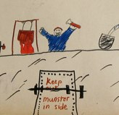
At the same time, citizen science helps the public
take ownership of science.
Draw a Scientist Test
Some children believe science is done by and for the benefit of others.
David Wade
Chambers 1983

Slide 8


How American Science is Faltering: A Tale of
Two Airport Newsstands
“Wissenschaft”
= Science
“Style”
≠ Science
Dresden Airport, Germany
Dulles Airport, U.S.A.

Slide 9
NASA Needs You to Lead Citizen Science Projects!

Slide 10

Making Discoveries
Publishing Papers
Writing Proposals
AND
Teaching Citizen Scientists
Social Networking
Blogging
Web Development
Educating Management
Citizen Science Project PI

Slide 11
New Opportunities!
i.e., How We’re Trying To Help You

Slide 12
If you are at an EPSCoR institution
and can get this in by TOMORROW.
Office of STEM Engagement
FY 2020 NASA Cooperative Agreement Notice (CAN)
Established Program to Stimulate Competitive Research (EPSCoR)
Rapid Response Research
Announcement Number: NNH20ZHA001C
“SMD requests that EPSCoR include research opportunities in
areas of…Citizen Science”
2-3 page proposal due Jan 6.
Approx. 20 awards of up to $100K each.
One Year period of Performance.
POC: James Harrington
james.l.harrington@nasa.gov

Slide 13
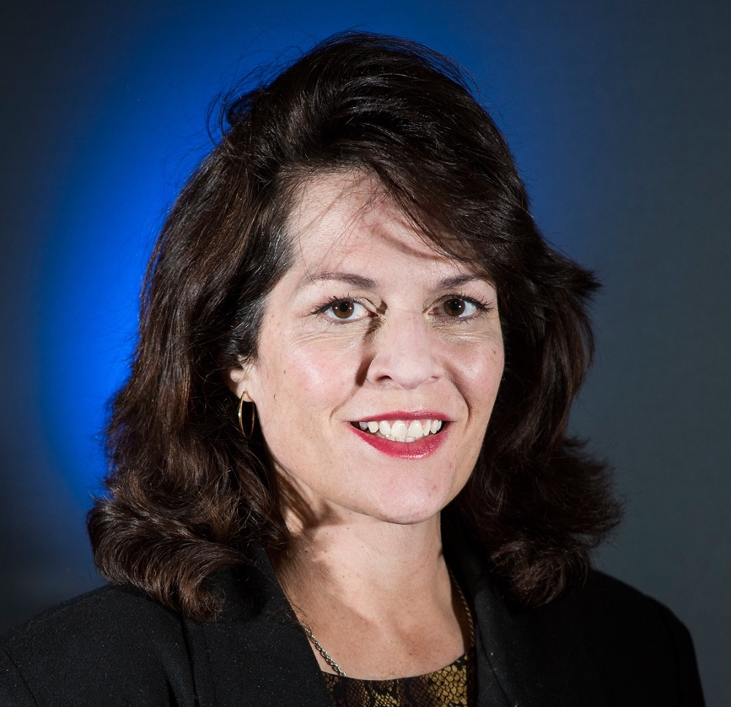
Science Engagement
and Partnerships
$1 million FY 2020 for Citizen Science
ROSES proposals
Conferences
Citizen Science Officer

Slide 14
Citizen Science Projects are science projects that rely on volunteers.¹
1. SPD-33, the New NASA Science Mission Directorate Policy
Notes:
These citizen science projects can be components of larger projects.

Slide 15
Each SMD science division shall invest in citizen science projects and report annually on their plans for soliciting, selecting, and funding citizen science projects.¹
1. SPD-33, the New NASA Science Mission Directorate Policy
Notes:
These citizen science projects can be components of larger projects.

Slide 16
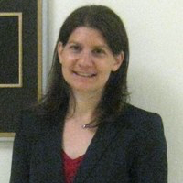
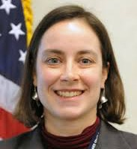
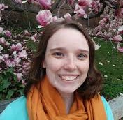

SMD Citizen Science Leads
Allison Leidner
Earth Science
Liz MacDonald
Heliophysics
Marc Kuchner
Citizen Science Officer
Becky Rench
Planetary Science
Marc Kuchner
Astrophysics

Slide 17
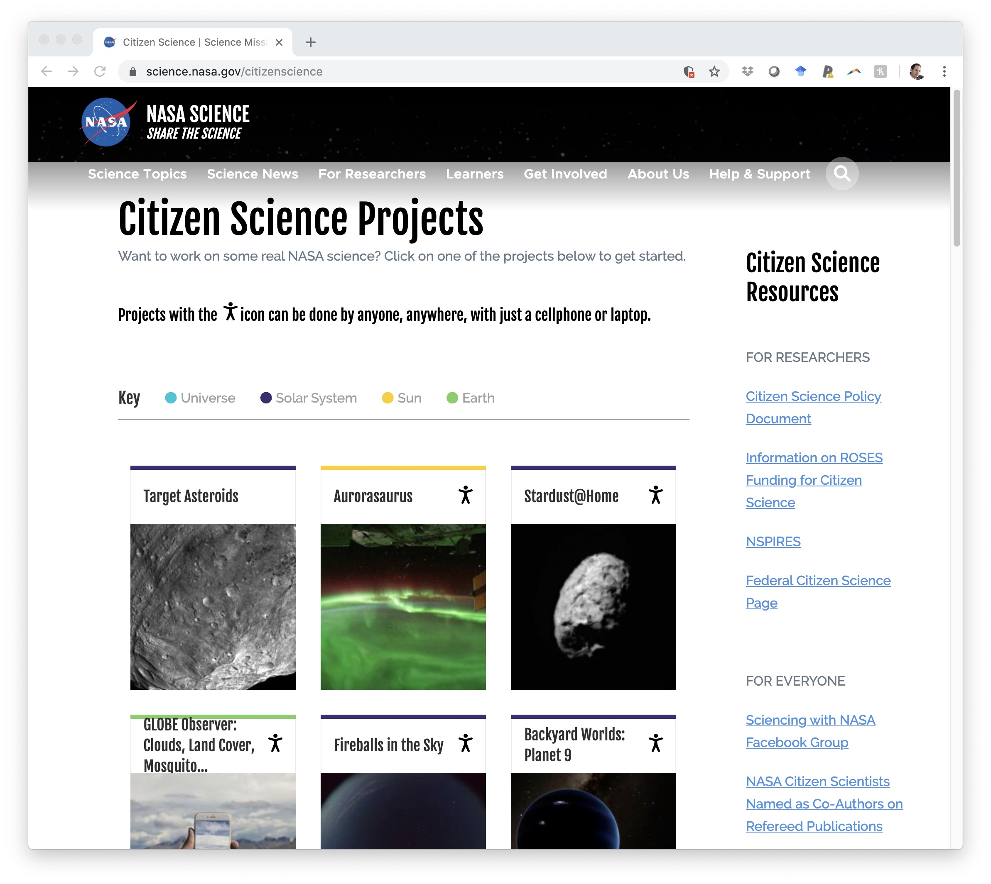
science.nasa.gov/citizenscience

Slide 18
116 NASA Citizen Scientists Have Become
Named Co-Authors on Scientific Papers
Those 36 papers are listed at
science.nasa.gov/citizenscience
We’re building a library of profiles
of those 116 citizen scientists
to feature on the site.

Slide 19
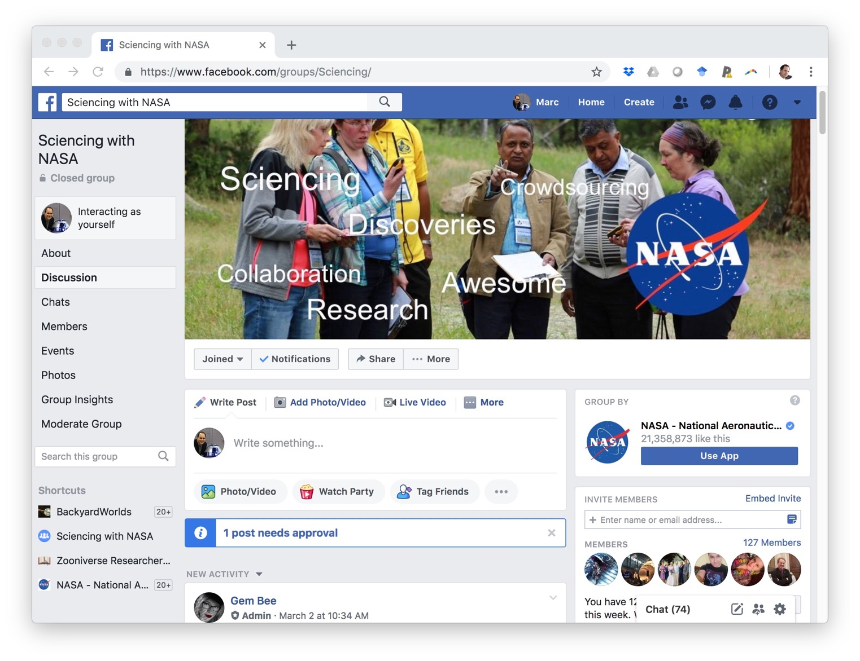
Sciencing with NASA Facebook Group
>12,000 members
And you can post too!

Slide 20
Maria Santos
Citizen Science Communications Lead

Slide 21
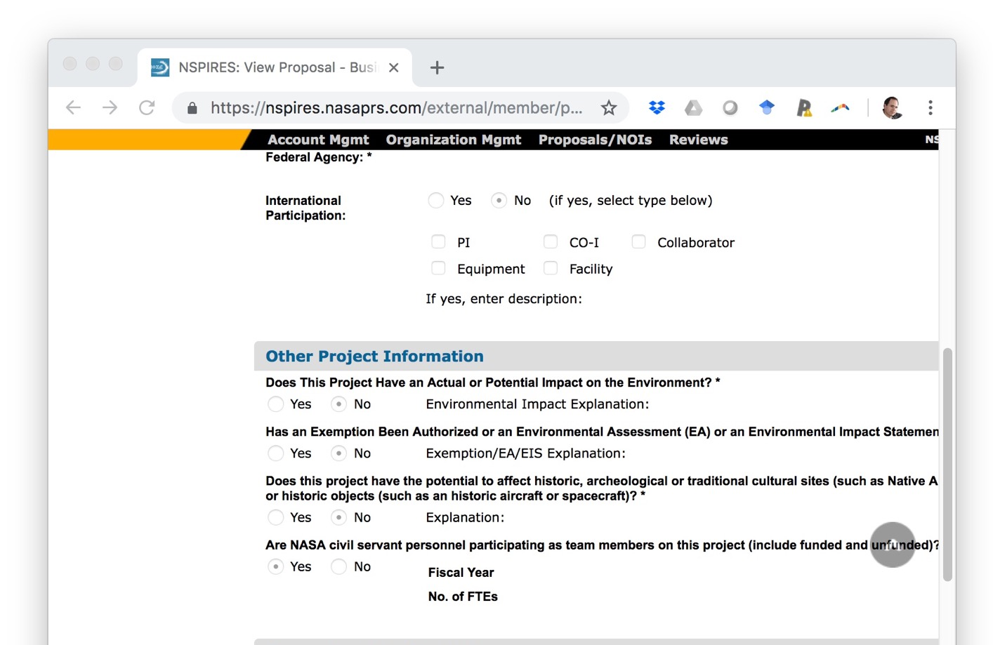
Citizen Science ROSES Opportunities through SE&P
…click “Y” on the new Y/N question in NSPIRES to indicate
your proposal uses citizen science!

Slide 22
Citizen Science in ROSES
Frequently Asked Questions
Online at science.nasa.gov/citizenscience

Slide 23
Q: Is citizen science outreach?
A: No. Projects that have outreach as their primary goal are not generally considered “citizen science” by SMD.

Slide 24
Science Policy Document 33
“SMD citizen science projects shall be held to the same rigorous standards as any SMD science program. Documented project goals must include advances in science, the merit of which shall be determined by peer review.”
More than merely “publishable”!

Slide 25
Q: When is the ROSES citizen science proposal deadline?
A: There is no single deadline; there are many deadlines. You may propose citizen science projects to any existing ROSES 2019 or 2020 call. The deadlines are given in Tables 2 and 3 of ROSES.
Also, keep an eye out for future citizen science-specific calls! E.g. the 2016 Citizen Science for Earth Systems Call.

Slide 26
Q: Our elementary/high school/college students are doing real NASA science! Is this eligible for ROSES citizen science funding?
A: If they are volunteering to do it then yes! If the students are required to do it for a class or paid to do it then no, not right now.
But if you think it’s competitive NASA science, apply for that ROSES funding anyway!

Slide 27
science.nasa.gov/citizenscience

Slide 28
Some of the elements of a competitive science project:
Addresses a currently unsolved problem and seems likely to solve a decent sized chunk of that problem.
Science team composed of experts in relevant fields.
Uses the best methodologies (citizen science or not).
Citizen science must be the best way to solve the problem!

Slide 29
Q: May I start my own citizen science community/platform? Or am I required to work with a particular existing community/platform?
You are not required to work with any existing citizen science community or platform. But if you plan to develop a new platform or community, you should explain why, given the many platforms/communities that already exist (e.g. Zooniverse, GLOBE, iNaturalist etc.).

Slide 30
Q: May I add a citizen science component onto an existing project or a project that’s mainly professional scientists?
A: Yes. You may combine citizen science with any existing project. Citizen science methods should be chosen whenever they are the best tool to accomplish a scientific goal.

Slide 31
Q: May I apply for funding to support a project that has already been active since before the new Citizen Science Policy (SPD-33)?
A: Yes. But first contact a) the technical officer on the award and b) the SMD citizen science officer (Marc.Kuchner@nasa.gov). And if you get the award, then SPD-33 will apply to your project.

Slide 32
SMD Citizen Science Leads
Division Plans Are Due Jan 31
Contact your division rep if you want to provide input!
Allison Leidner
Earth Science
Liz MacDonald
Heliophysics
Becky Rench
Planetary Science
Marc Kuchner
Astrophysics

Slide 33
Building the NASA Citizen Science Community II
July 22-24, 2020
Sarah Kirn, Leigh Peake, Christine Voyer
Gulf of Maine Research Institute
Jennifer Shirk
Citizen Science Association
Portland, Maine

Slide 34

Building the NASA Citizen Science Community III
May, 2021
At the Biennial Citizen Science
Association Meeting!
Phoenix, Arizona

Slide 35
Contact me: Marc.Kuchner@nasa.gov
And go to science.nasa.gov/citizenscience

Slide 38
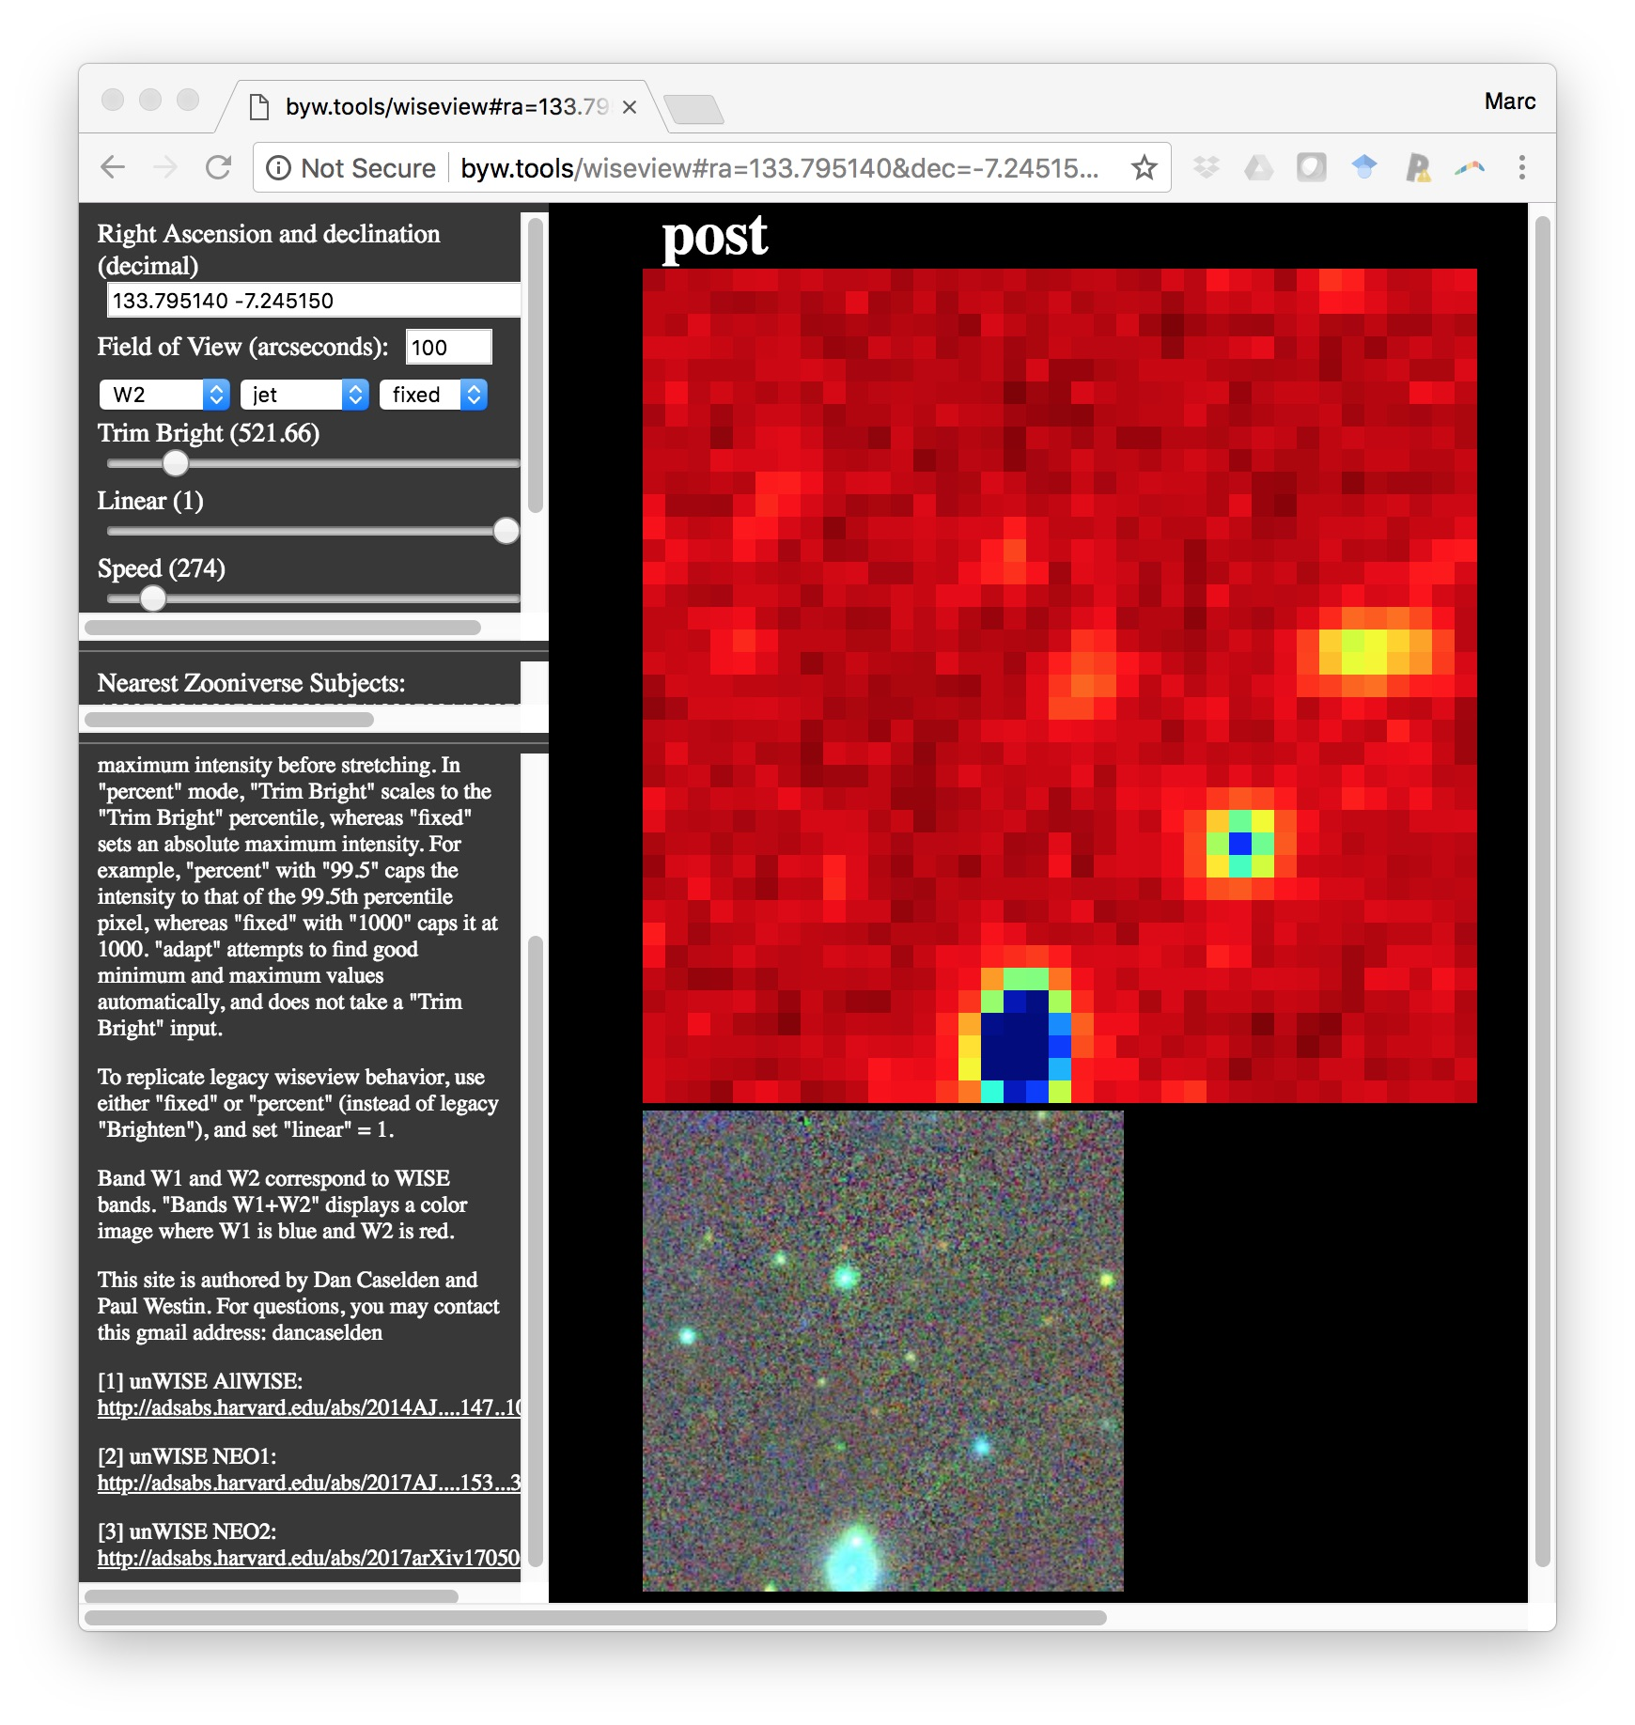
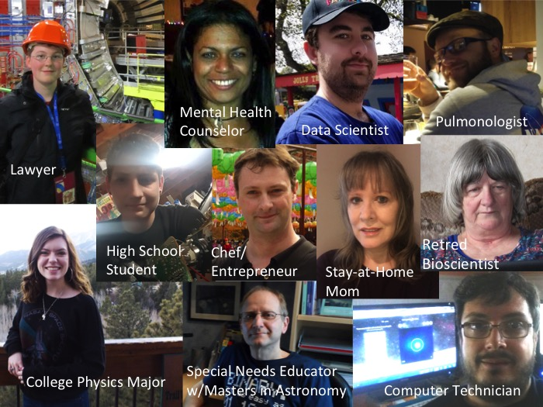
WISEView
Web-Based Tool
for viewing
WISE+NEOWISE
Images.
Written by
Citizen Scientists
Dan Caselden
and Paul Westin

Slide 39
Who Are NASA’s Citizen Scientists?

Slide 40
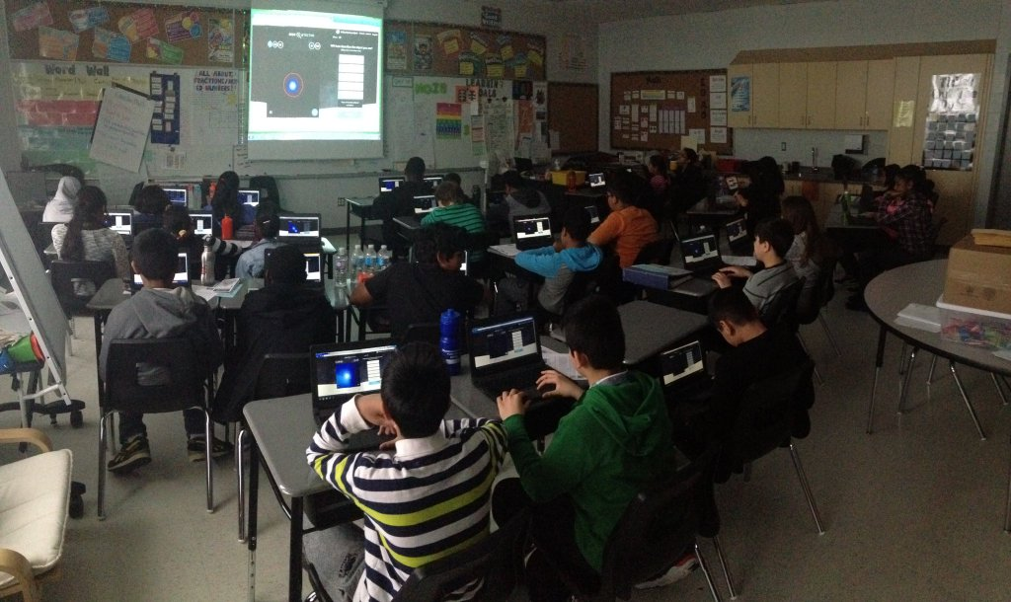
Michael Blake’s 6th grade class, Aylesbury, Canada

Slide 41
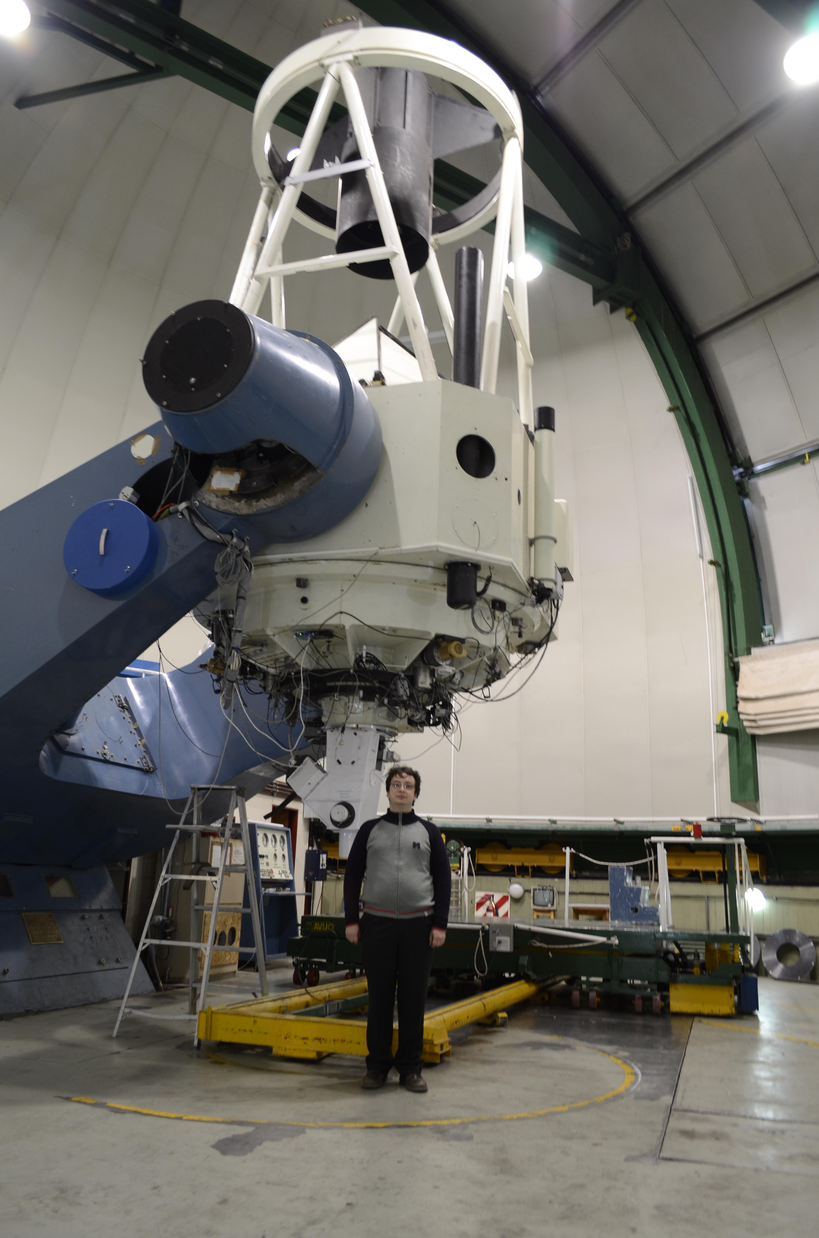
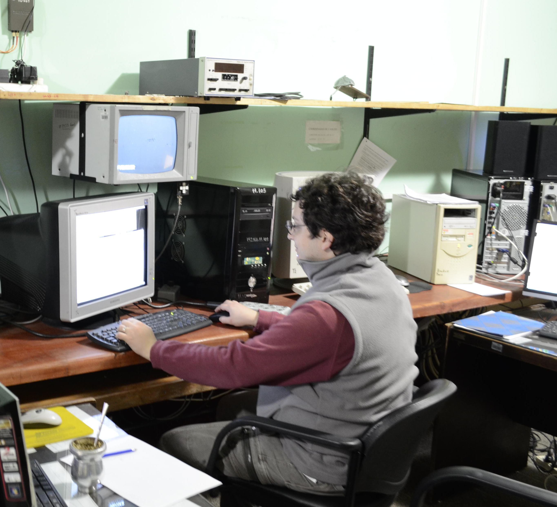
Citizen Scientist Hugo Durantini Luca drove 12 hours across South America to help out with an observing run!!

Slide 42
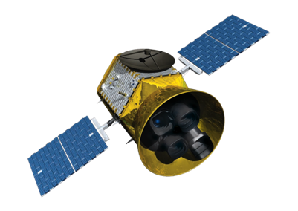


Present and Future of NASA Science
1 million
Most
interesting
Images
Correctly
interprets 99%
of them
Analysis, Problem Solving,
Data Collecting by
Citizen Scientists
100 million
Images, Spectra,
Time Series, etc.
Machine Learning
& Data Mining

