Slide 1
Stella Splendida
Jonathan Arenberg and John O’Meara
@JonArenberg and @Astronomera
jon.arenberg@ngc.com and jomeara@keck.hawaii.edu

Slide 2
Developing the Scientific and Engineering Workforce of the 21st Century
Jonathan Arenberg and John O’Meara
@JonArenberg and @Astronomera
jon.arenberg@ngc.com and jomeara@keck.hawaii.edu

Slide 3
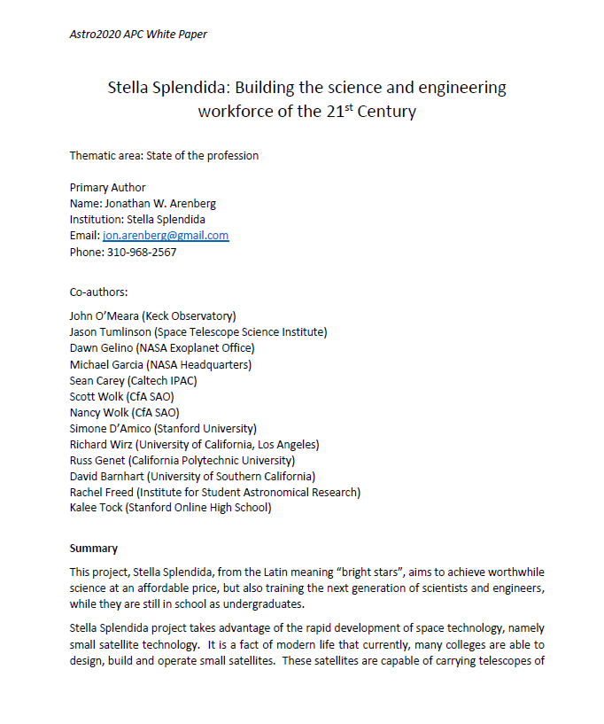
Presenting Stella Splendida
Who are we?
Need
Concept
Where are we in development of the concept?
What is next
Want to help
Summary
Astro 2020 Whitepaper

Slide 4
Who are we?
Jonathan Arenberg
Chandra
Starshade
JWST
Astro 2020 Decadal Missions
LUVOIR
Origins
Lynx
Other missions and technologies
John O’Meara
Chief Scientist Keck Observatory
LUVOIR STDT
Synergy Science Team

Slide 5
Who are we?
Jonathan Arenberg
Chandra
Starshade
JWST
Astro 2020 Decadal Missions
LUVOIR
Origins
Lynx
Other missions and technologies
John O’Meara
Chief Scientist Keck Observatory
LUVOIR STDT
Synergy Science Team
Scientist

Slide 6
Who are we?
Jonathan Arenberg
Chandra
Starshade
JWST
Astro 2020 Decadal Missions
LUVOIR
Origins
Lynx
Other missions and technologies
John O’Meara
Chief Scientist Keck Observatory
LUVOIR STDT
Synergy Science Team
Engineer
Scientist

Slide 7
White Paper Co-authors
Jason Tumlinson (Space Telescope Science Institute)
Dawn Gelino (NASA Exoplanet Office)
Michael Garcia (NASA Headquarters)
Sean Carey (Caltech IPAC)
Scott Wolk (CfA SAO)
Nancy Wolk (CfA SAO)
Simone D’Amico (Stanford University)
Richard Wirz (University of California, Los Angeles)
Russ Genet (California Polytechnic University)
David Barnhart (University of Southern California)
Rachel Freed (Institute for Student Astronomical Research)
Kalee Tock (Stanford Online High School)
Krystal Puga (Northrop Grumman Space Systems)

Slide 8
Need for the future workforce
Science (Astrophysics, Earth Science etc) from space driven by technology
Telescope aperture
High performing systems
Very large
Very stable
Time domain
Cost and schedule efficiency
Engineering
Support to science
Need to be able to “speak customer”

Slide 9
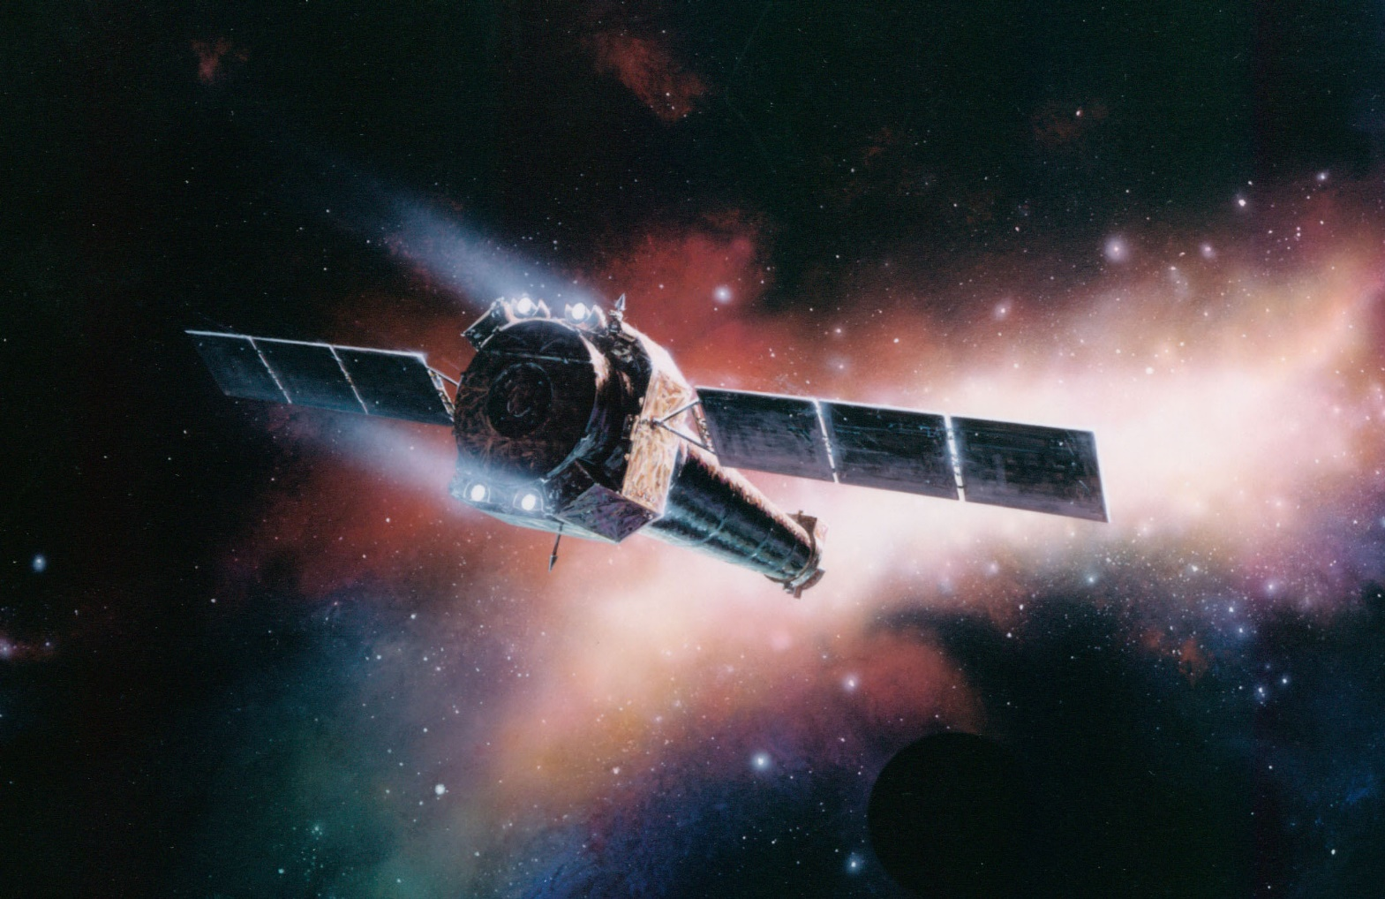

Slide 10
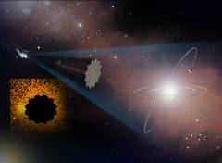
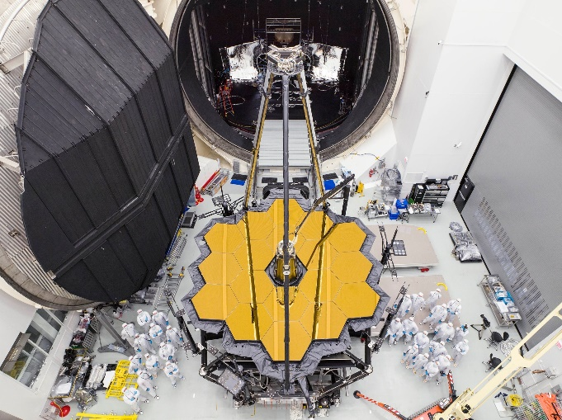

Slide 11
Need for the future workforce
Secret Sauce!!
Need scientists that speak engineering &
Engineers that speak science

Slide 12
The BIG Idea

Slide 13
The BIG Idea: Give Students the Experience
Do real science from cubesats
Data archive to be open like a flight mission
Mission is designed and built by undergraduates
Science driven
Calibration
Data sets from different satellites
Partner science and engineering departments (at same university)
Ultimately all astronomy degree granting institutions (~500 in USA)
Integrate with course work (science and engineering)

Slide 14
Where are we?
For Stella Splendida to be a viable program we must establish both a mature concept (what and how) and technology

Slide 15
Where are we?
For Stella Splendida to be a viable program we must establish both a mature concept (what and how) and technology
Concept Maturity
Viability
Technological Maturity

Slide 16
Where are we?
For Stella Splendida to be a viable program we must establish both a mature concept (what and how) and technology
Concept Maturity
Viability
Science Mission
Integration into course work
Review
Build, test, calibration
Funding
Archive
Launch
Ground stations
Current State
Technological Maturity

Slide 17
Open Questions
Science Mission
Time domain measurement of brightest stars
Archive
Scope of work
How much of the satellite is unique (university by university designs)
Calibration
Design reviews
Ground stations and archives
Launch
Pilot phase (program development pathfinding)
Limited funding and universities
Contracts
Money

Slide 18
Open Questions
Science Mission
Time domain measurement of brightest stars
Archive
Scope of work
How much of the satellite is unique (university by university designs)
Calibration
Design reviews
Ground stations and archives
Launch
Pilot phase (program development pathfinding)
Limited funding and universities
Contracts
Money
Science Team
Engineering Team
Program Team

Slide 19
Immediate Steps
Form 501(c)3 – Non-profit organization
By-laws
Board
Articles
Website, email all that…
Hold initial (WebEx) meetings of science, engineering and program teams later in Q1-20

Slide 20
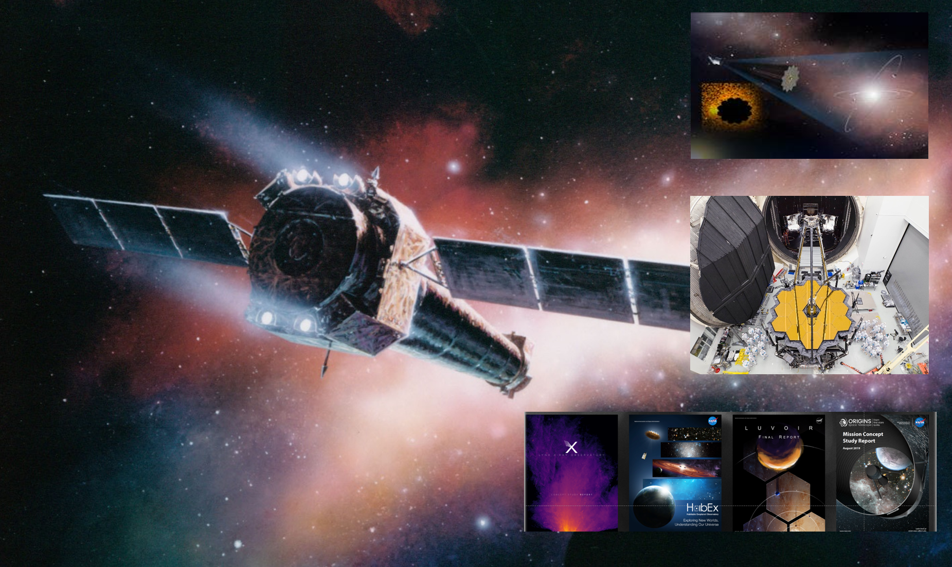
Stella Splendida is a concept for the development of the science and engineering workforce of the 21st Century
Unique opportunity to inject valuable mission experience
Partnership among academics, industry, scientists
Engineers speaking science
Scientists speaking engineering
We are in the process of organizing
Want to help create the workforce for tomorrow’s missions and for the tomorrow after that
Contact us
jon.arenberg@ngc.com or jomeara@keck.hawaii.edu

