Slide 1

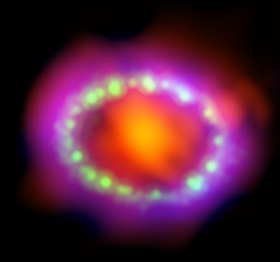
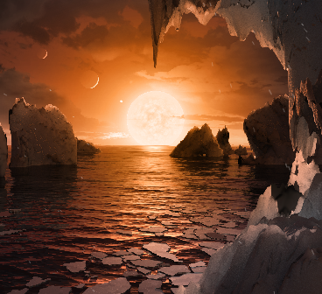
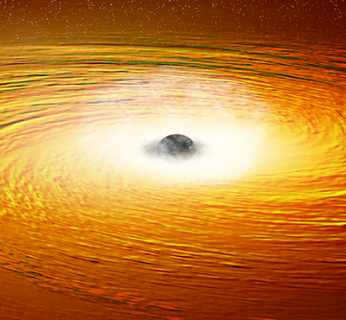
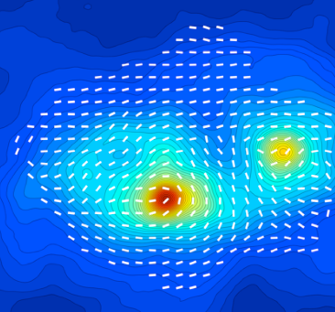
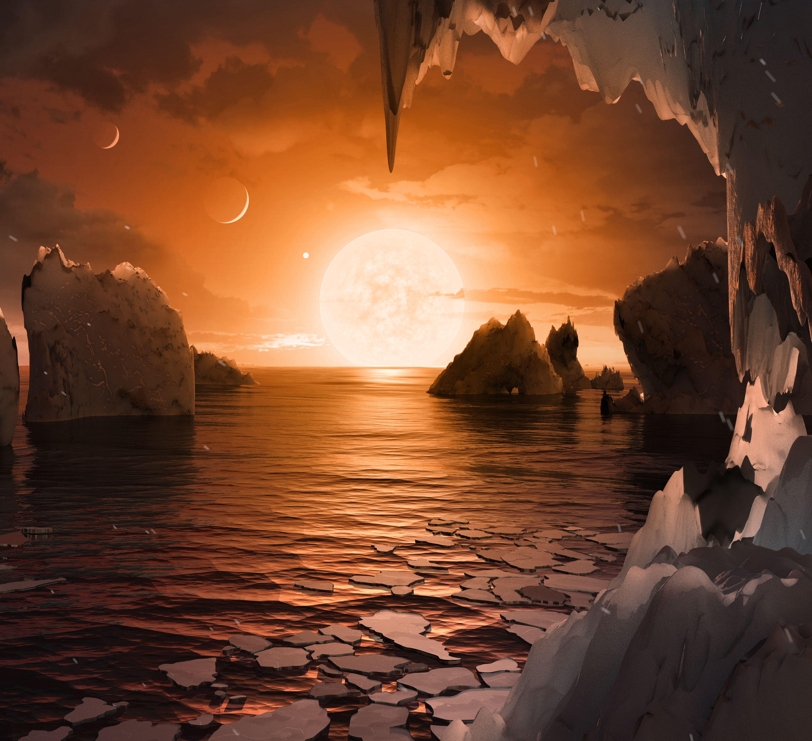
NASA Astrophysics CubeSats and SmallSats: Current and Future Prospects
Jan 4, 2020 AAS Workshop
Hawaii
Michael Garcia
NASA HQ
HST Program Scientist
Athena Deputy Program Scientist
APRA, LUVOIR Deputy PS
UV/Vis/ExoPlanets Program Scientist
Astrophysics CubeSats and SmallSats POC
Michael Garcia

Slide 2
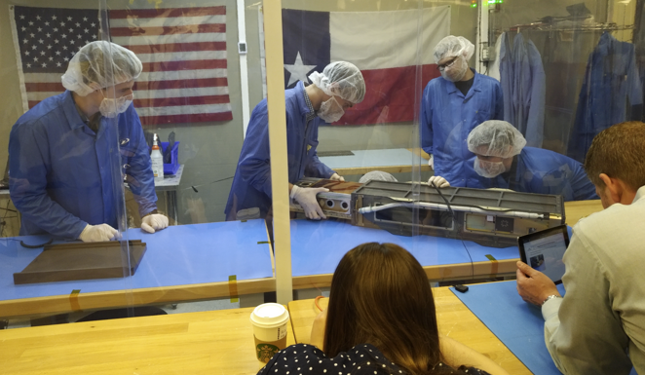
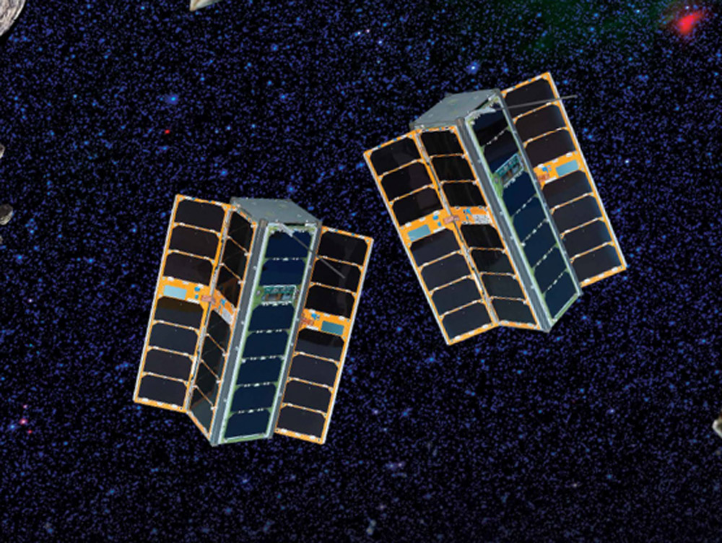
Astrophysics CubeSats
Astrophysics CubeSats are solicited annually via ROSES/APRA (D.3).
CubeSats are reviewed along with other sub-orbital proposals; they compete with balloons and sounding rockets (and potentially ISS attached payloads).
The largest CubeSats that are eligible via APRA are 12U.
Astrophysics CubeSats are funded via a $5M annual budget line that was originally appropriated by Congress, and is now part of Astrophysics planning.
Over 2012-2018 we have received <6> CubeSat proposals/year; 6 have been selected, 14% selection rate (~1 per year). APRA average selection rate is ~30% for suborbital proposals.
Are CubeSats of limited use for flux-starved Astrophysics? (Sun, Earth, bright!)

Slide 3
Astrophysics CubeSats
Over 2012-2018 we have received <6> CubeSat proposals/year; 6 have been selected, 14% selection rate. APRA average is ~30% for suborbital proposals
Is the reason really that Astrophysics is flux starved?
Learning Curve? Increased capabilities of CubeSat spacecraft/platforms?
Year | E | E/VG | VG | VG/G | G | F
2012 |  |  |  | 4 | 4 | 1
2013 |  |  | 1 | 3 | 2 | 1
2014 |  |  | 2 | 2 | 2 | 1
2015 |  |  | 3 |  | 1
2016 | 1 |  | 1 | 1 | 1
2017 | 1 | 2 |  | 1 | 1

Slide 4
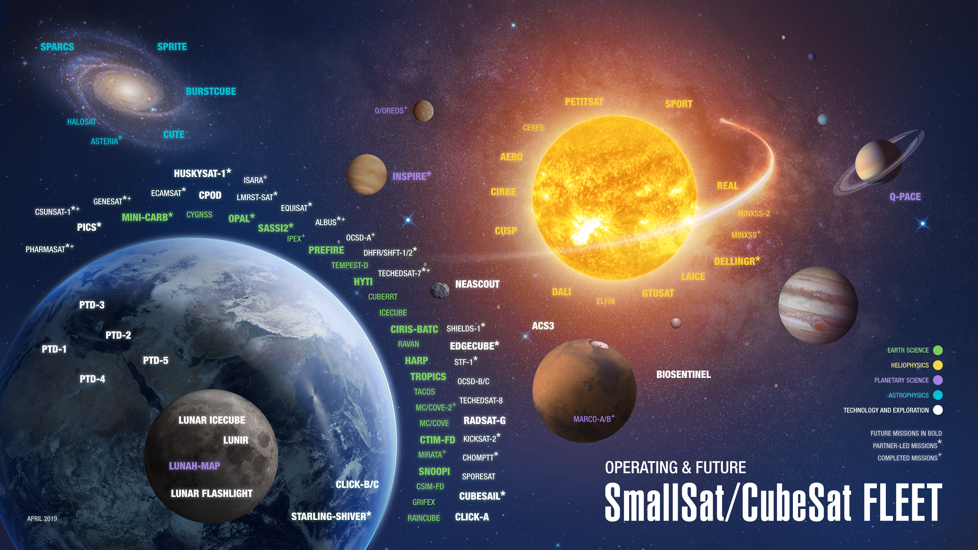
Lots of SMD CubeSats
BLACKCAT
Notes:
Words From ROSES? Grad students can be a strength or weakness for sub-orbital, lack of them is not necessarily a weakness for other categories.
Cubesats and ISS because they are expected to be sub-orbital class, in scope and cost.

Slide 5
How Can Small Astrophysics CubeSats Compete with Big, Expensive Satellites already in Orbit?
The figure of merit for observing diffuse emission, survey grasp, is the product of effective area and solid angle of the field of view, AΩ. HaloSat has a small effective area, but a large field of view, giving it a grasp competitive with major missions.
Instrument | Grasp (cm² deg²)
HaloSat | 26
Chandra | 1.2
XMM-Newton | 324
By Finding Unexploited Niches

Slide 6
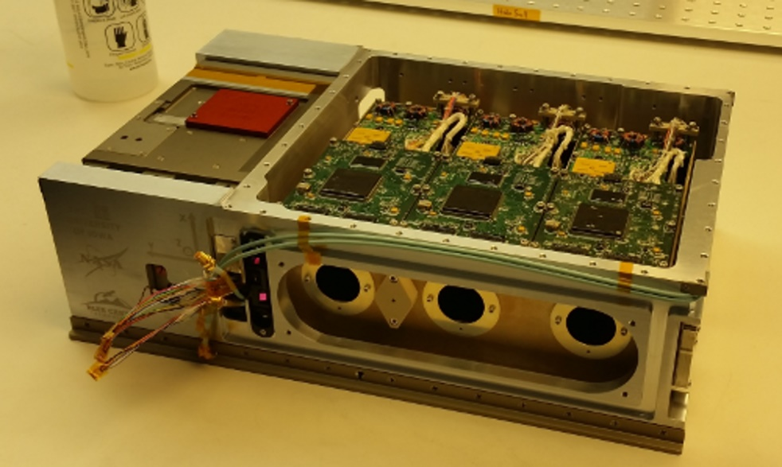
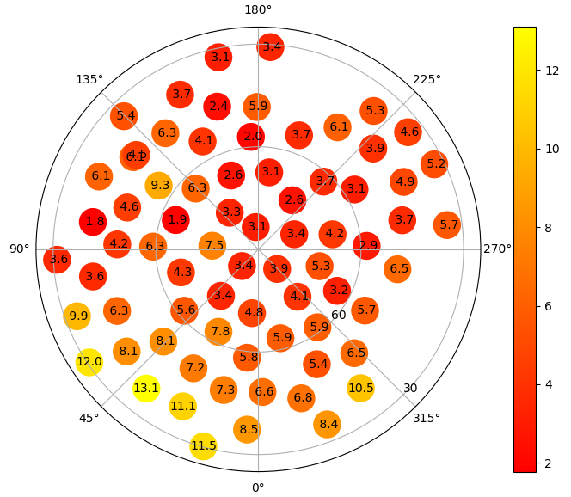
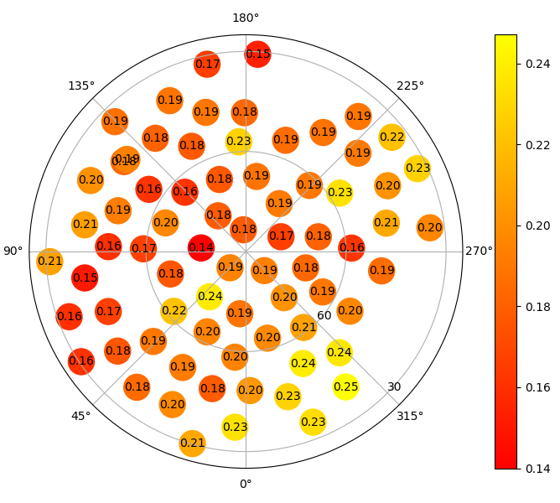
Science from APDs First CubeSat: HaloSat Results on Southern Galactic Halo
Emission Measure (10⁻³ cm⁻⁶ pc)
Temperature
(kT in keV)
Large variation in EM – factors of 10x
New Finding: Halo is concentrated towards core, lumpy
Daniel LaRocca, 11:30

Slide 7
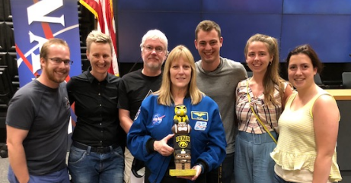
HaloSat, APDs First CubeSat
The day before the launch, the Iowa HaloSat team met Astronaut Kay Hire.

Slide 8
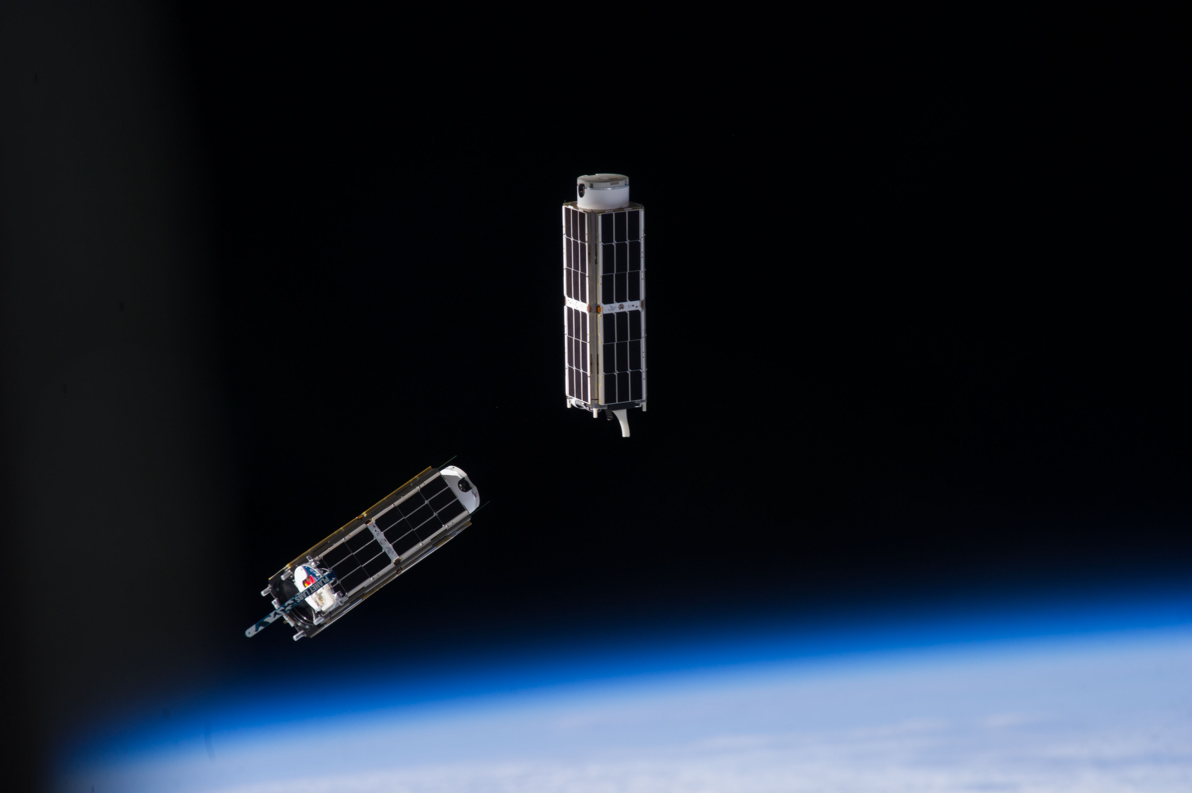
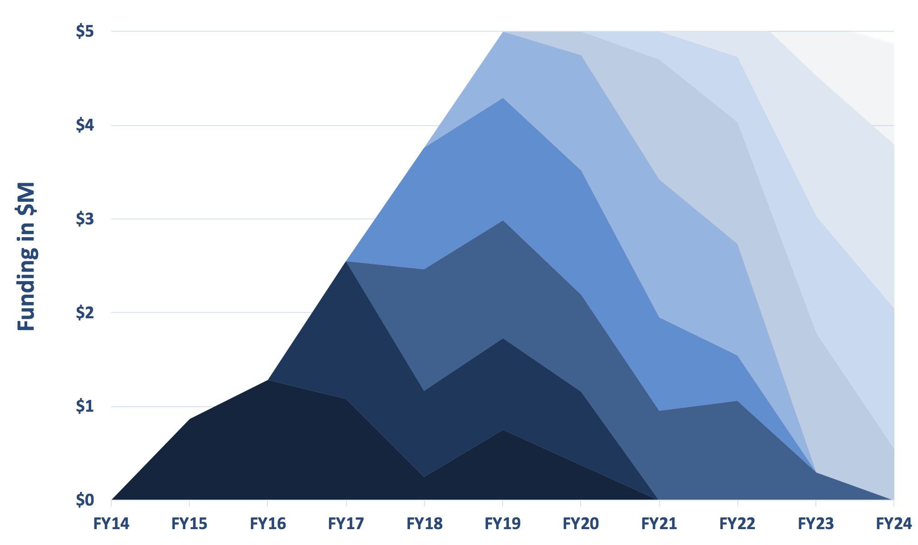
ASTROPHYSICS CUBESAT FUNDING
APRA-20
APRA-22
APRA-17:
SPRITE
APRA-18:
BlackCat
APRA-21
APRA-16:
BurstCube
APRA-15:
SPARCS
APRA-14:
CUTE
Manifested Landsat-9,
March 2020
APRA-12:
HaloSat
Deployed from ISS July 2018
Launch:
Notes:
EJD 10/24/19: Replaced “The” with “NASA’s”, replaced “per year” with “annually”; for consideration – not sure if the launch triangles are lining up with table and perhaps not enough of them, and in slideshow on my computer the chart and arrows running off right side of slide – no change made, for APD decision

Slide 9
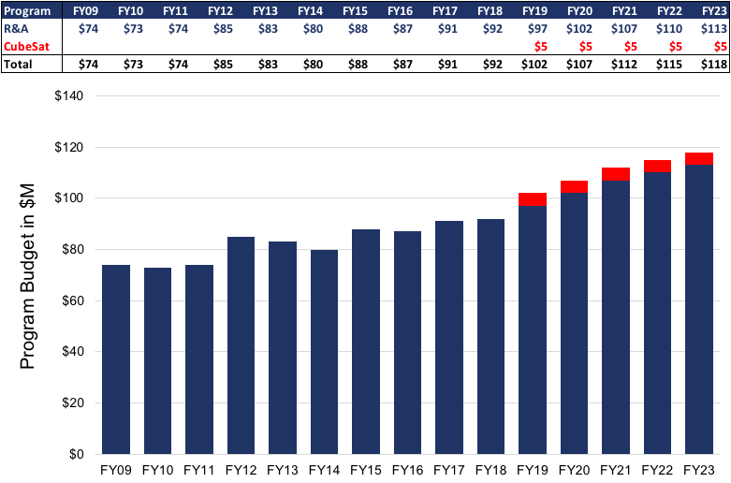
Astrophysics R&A and CubeSats Funding
APD CubeSat initiative

Slide 10
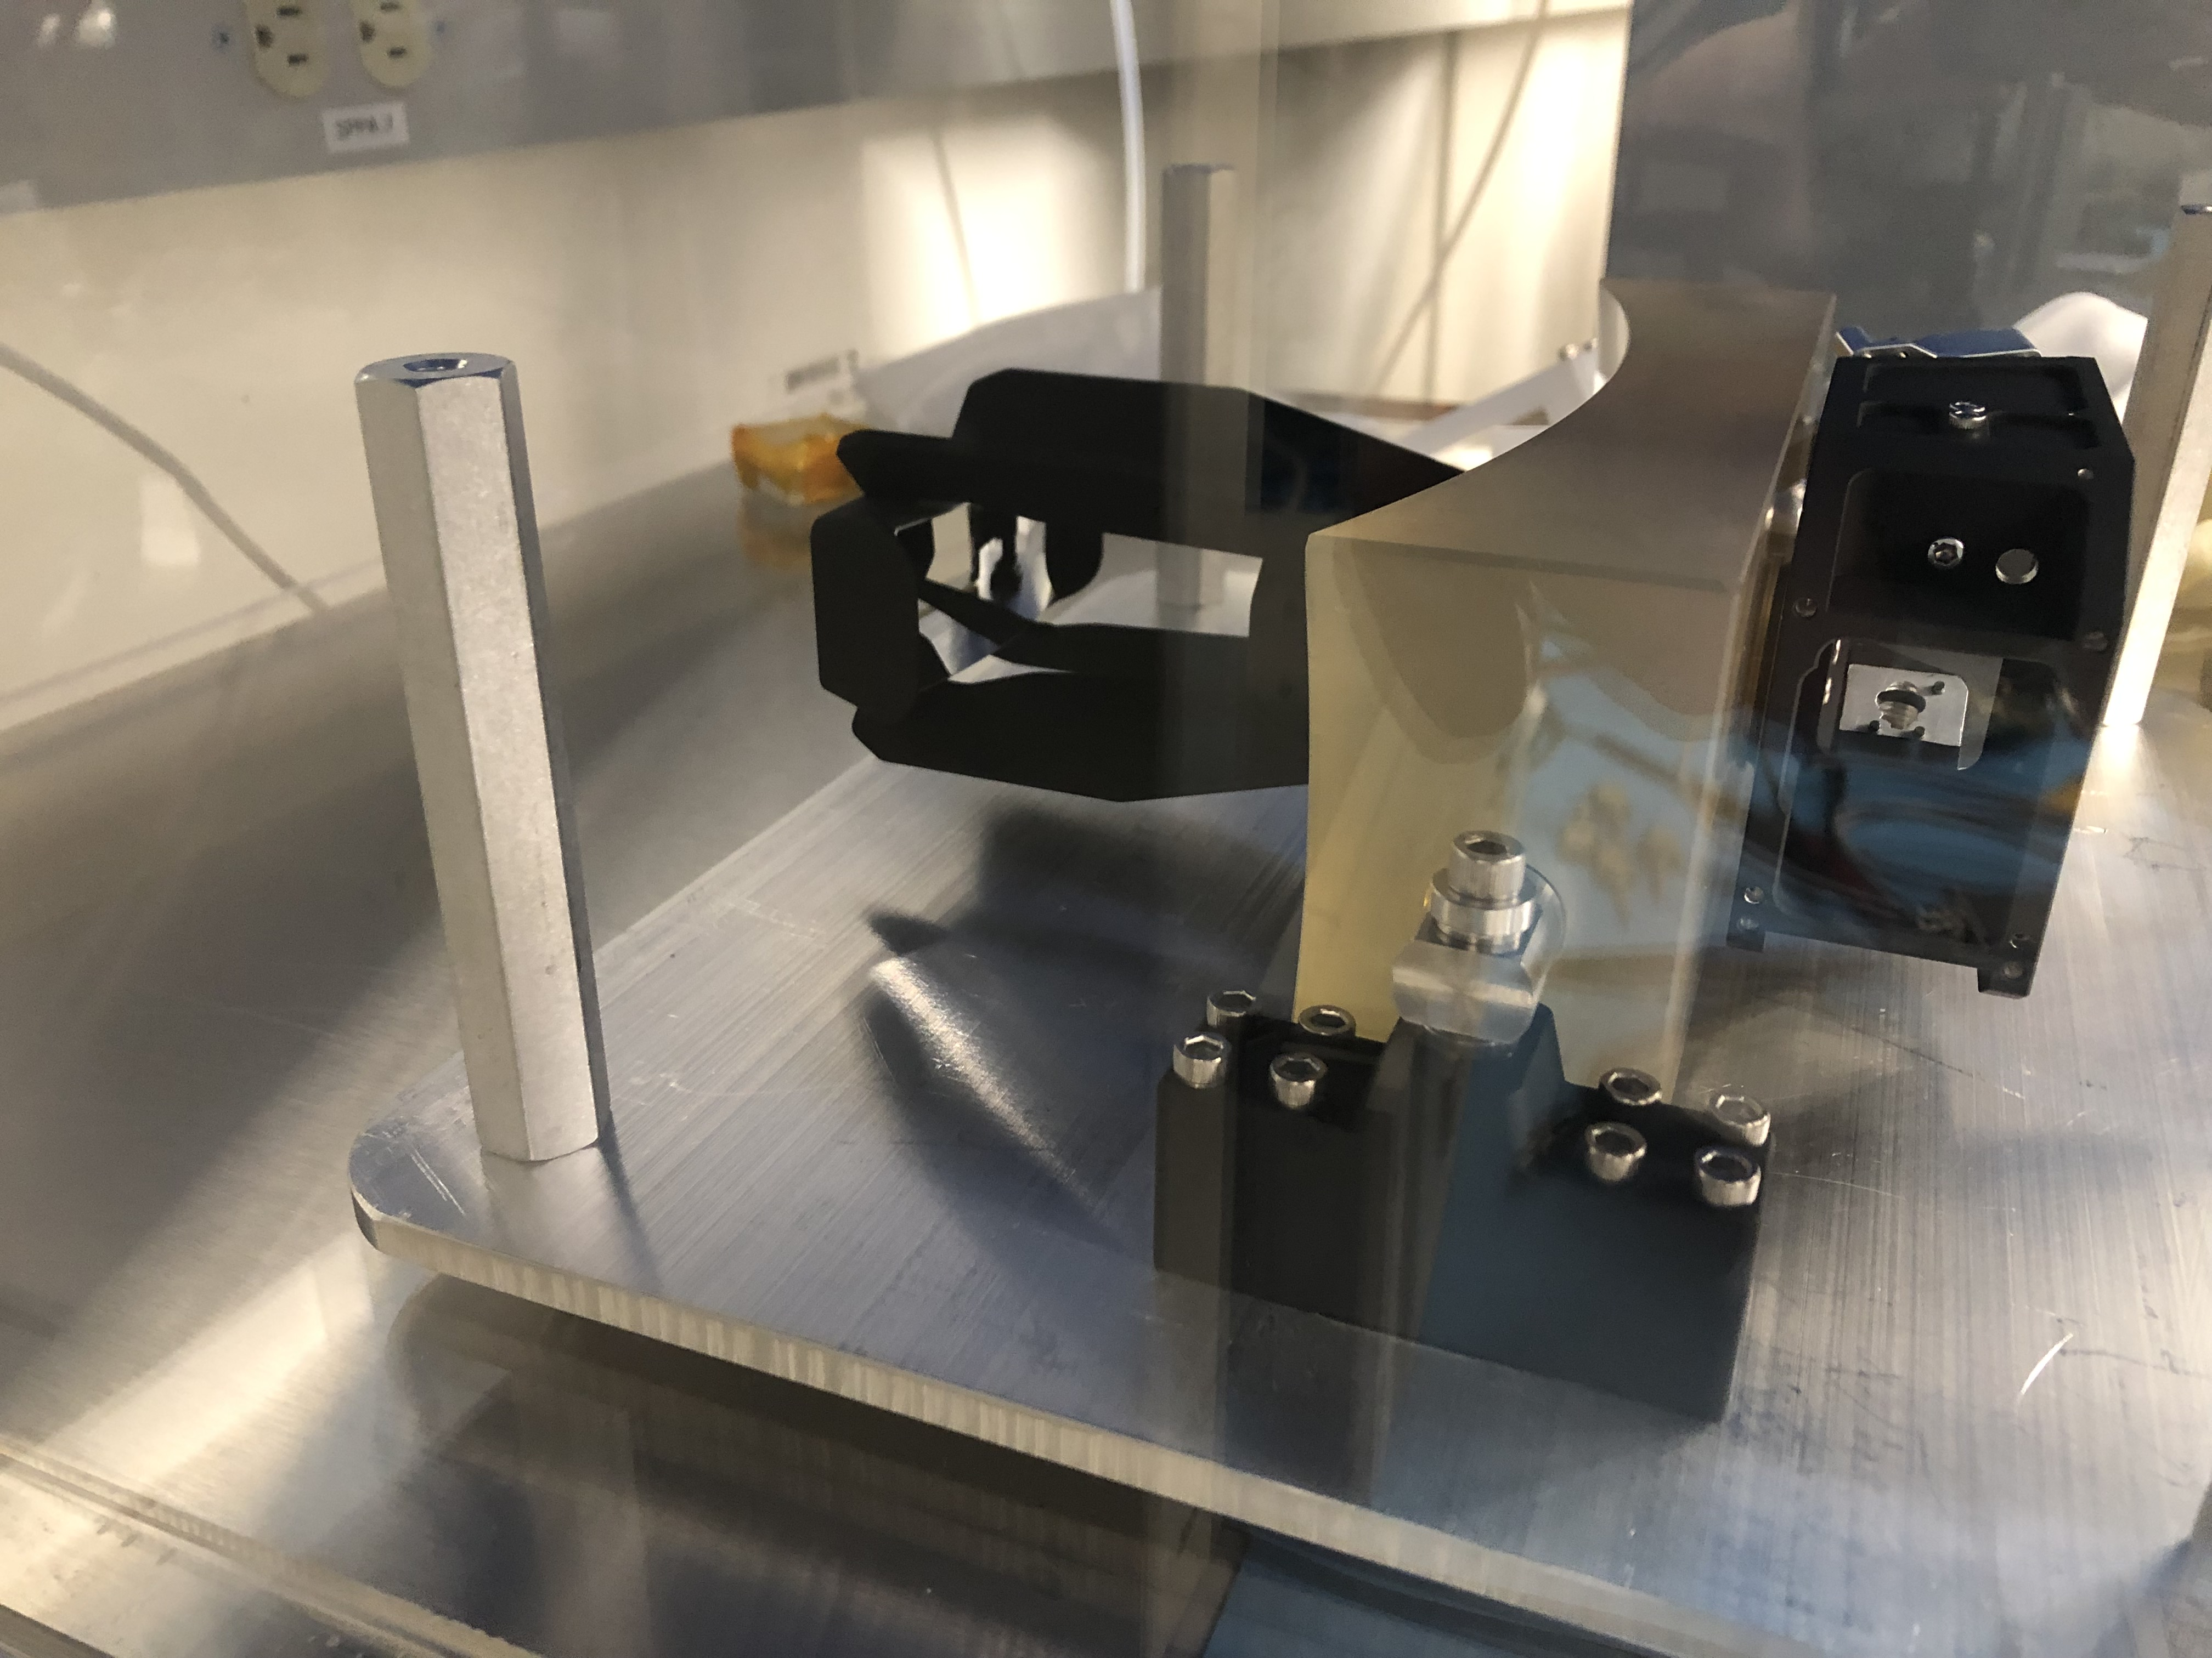
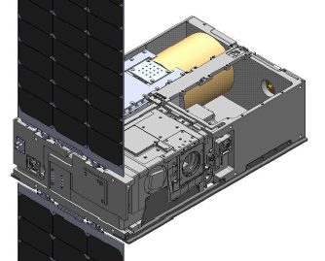
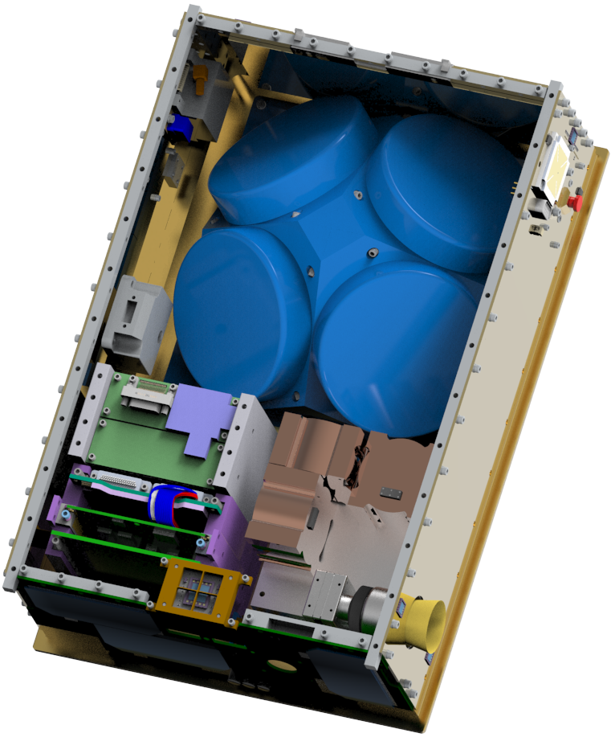

Five Astrophysics CubeSats in Development
  CUTE, PI: Kevin France, CU,
  Science Objectives: The Colorado Ultraviolet Transit Experiment (CUTE) will take medium resolution UV spectra of 14 hot Jupiters during transit, in order to measure atmosphere being ablated away. Technologies: BCT S/C, COTS telescope and camera.
  Launch: March 21 on LS-9
  SPARCS, PI: Eygenya Shkolnik, ASU
  Science Objectives: Determine rate, strength and 2-band color of bright UV flares from 25 M dwarfs, effect on habitability?
  Technologies: BCT S/C, d-doped CCD, UV dichroic.
  Launch: Fall 2021
  SPRITE, PI: Brian Fleming, CU
  Science Objectives: Determine ionization rate of IGM from galaxies and AGN, trace feedback within galaxies driven by star-forming regions, using low-resolution imaging UV spectrograph.
  Technologies: in house S/C, UV coatings, next-gen MCP.
  Launch: Fall 2022
  BlackCat, PI: Abe Falcone, Penn St.
  Science Objectives: GRB/Transient detection in 0.2-20keV with coded mask.
  Technologies: CMOS x-ray CCD
  Launch: FY2024
  BurstCube, PI: Jeremy Perkins (GSFC)
  Science Objectives: Rapid localizations for LIGO/Virgo detections with short GRBs; Search of g-ray transients.
  Technologies: Dillingr derived bus, Fermi-GBM like detectors.
  Launch: Fall 2021
Notes:
ling

Slide 11
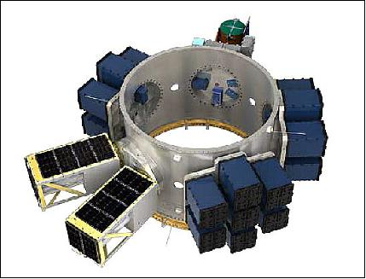
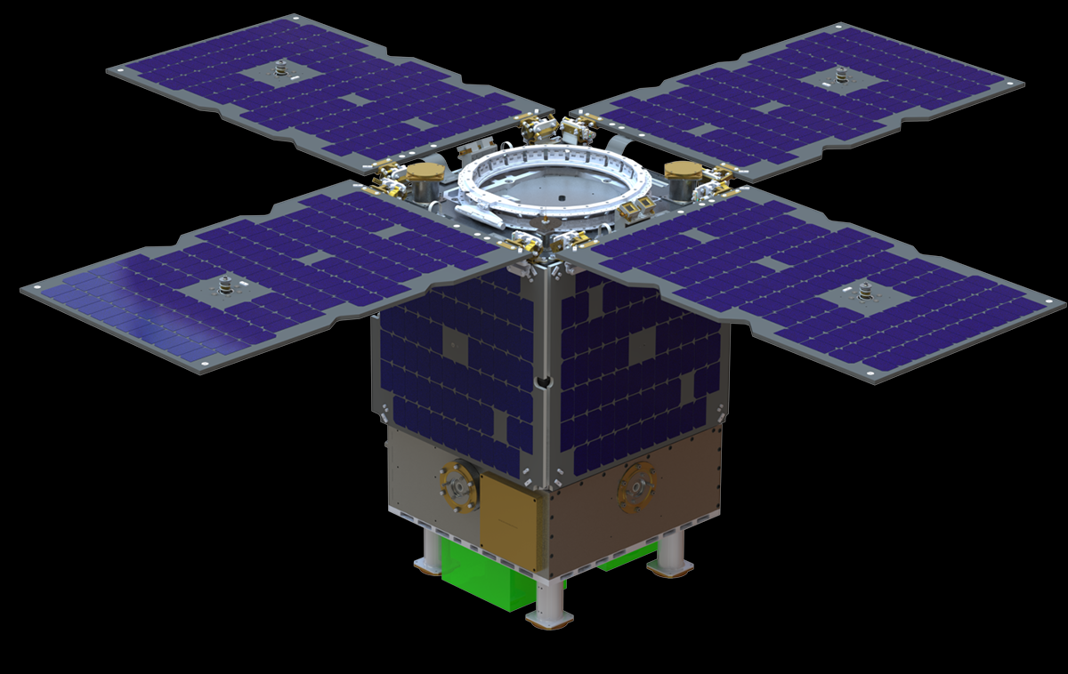
2018, Nine Astrophysics Science SmallSat Studies
Waveband:
X-ray: 4, (XQSat, SEEJ, VTXO, HREXI)
UV: 2 (GUCI++, mDOT)
Vis: 1 (aMASS)
IR: 1 (ISCEA)
Radio: 1 (DAPPER)
Science Topics:
Cosmology/Clusters: 2 (DAPPER, ISCEA)
ExoPlanets: 3 (mDOT, MASS, SEEJ)
Transients/GW: 2 (GUCI++, HREXI)
X-treme Universe: 2 (XQSat, VTXO)
Technologies:
Formation Flying: 2 (VTXO, mDOT)
Results:
Lots of good concepts, 2019 AS³, SmallSats in all future Explorer MO
Two Page Public Fact Sheets:
https://www.nasa.gov/feature/nasa-astrophysics-eyes-big-science-with-small-satellites
Notes:
Words From ROSES? Grad students can be a strength or weakness for sub-orbital, lack of them is not necessarily a weakness for other categories.
Cubesats and ISS because they are expected to be sub-orbital class, in scope and cost.

Slide 12
SmallSats Costing
One Result from 2018 Astrophysics Science SmallSat Studies (AS³)
Grass Root Costs < Design Center Model costs.
Why?
One Example: BCT S5 bus quote $2.7M, Design Center Model $14M. Add 30% reserves and your $25M program is >$35M total. Have the vendors broken the cost curve, or are they overly optimistic?

Slide 13
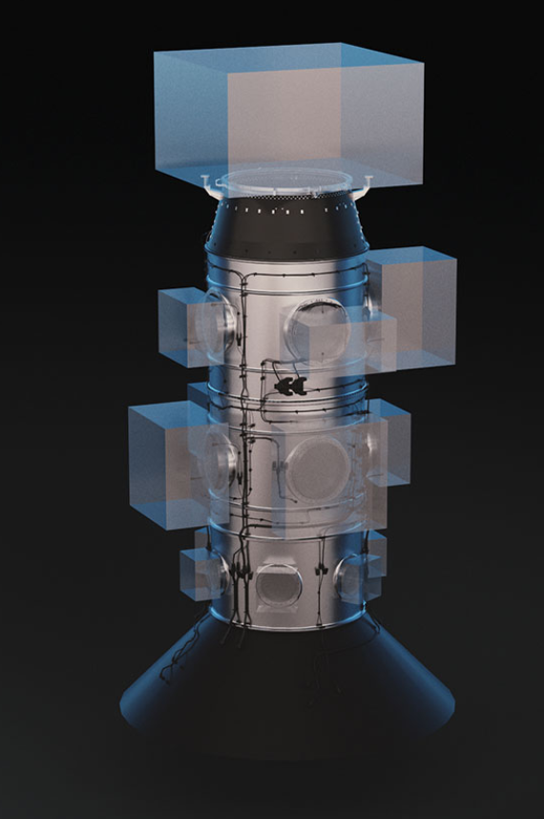
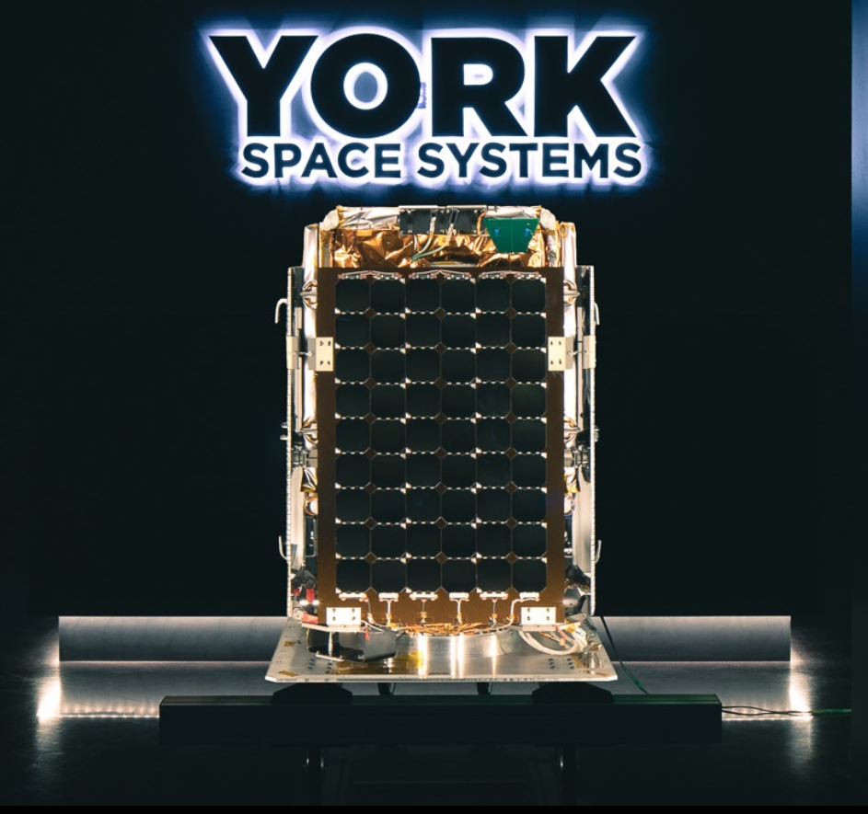
Can we go bigger in R&A/APRA?
APRA/CSLI does allow up to 12U, but do date all Astrophyiscs CubeSats have been 6U and costs up to $5M total
Commercial Launchers and Buses?
SpaceX’s SmallSat Rideshare Program
Monthly rideshare missions starting 3/2020
ESPA class payloads, 200 kg for “as low as $1M”, to both LEO and SSO
CSLI $0.9M for 12U CubeSat in last APRA
APRA does allow ‘bring your own ride’
https://www.spacex.com/smallsat
York Space Systems S-class bus
85kg payload
3-axis stabilized (10”, 1.5°/s)
100W orbit average power
22.5” × 22.5” × ≥18.9”
$1.2M, comparable to CubeSat buses
12/year, growing to ~200/year
https://www.yorkspacesystems.com/s-class/

Slide 14
BACK UP

Slide 15

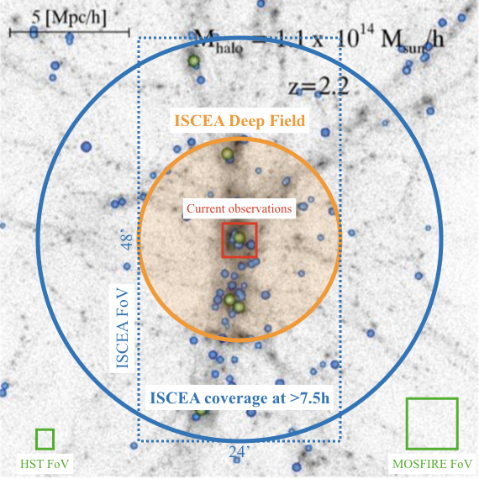
ISCEA: Infrared SmallSat for
Cluster Evolution Astrophysics
PI: Yun Wang (Caltech/IPAC)
ISCEA pushes the envelope for “Big Science” at an extraordinary value from a SmallSat.
Game-changing science of cosmic evolution at the peak of galaxy formation
25 cm aperture telescope with 0.32 deg² FoV, multi-object spectroscopy
Demonstrating key innovative instrument technology that will be available to future satellite missions
Valuable Guest Observatory beyond its prime mission
ISCEA FoV (large blue box) compared to current observations (small red square), for a simulated protocluster at z = 2.2. Background grayscale shows dark matter filaments. The blue and green filled circles highlight star-forming and passive galaxies in the protocluster, respectively.

Slide 16
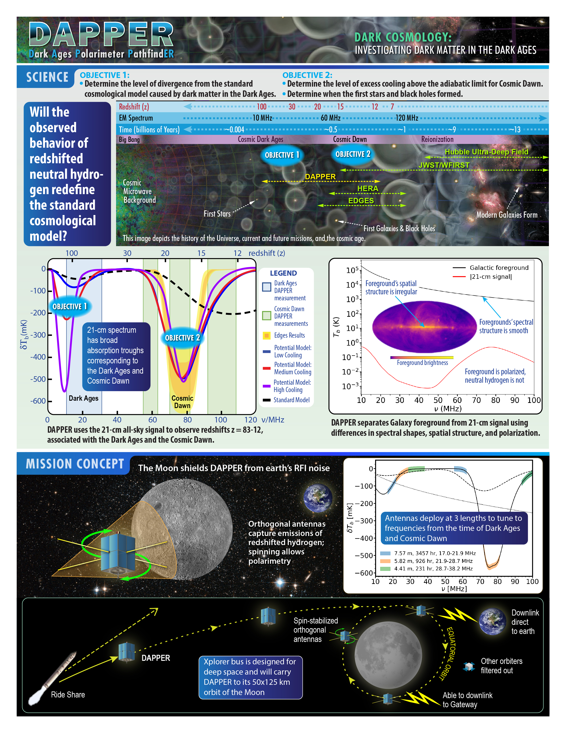
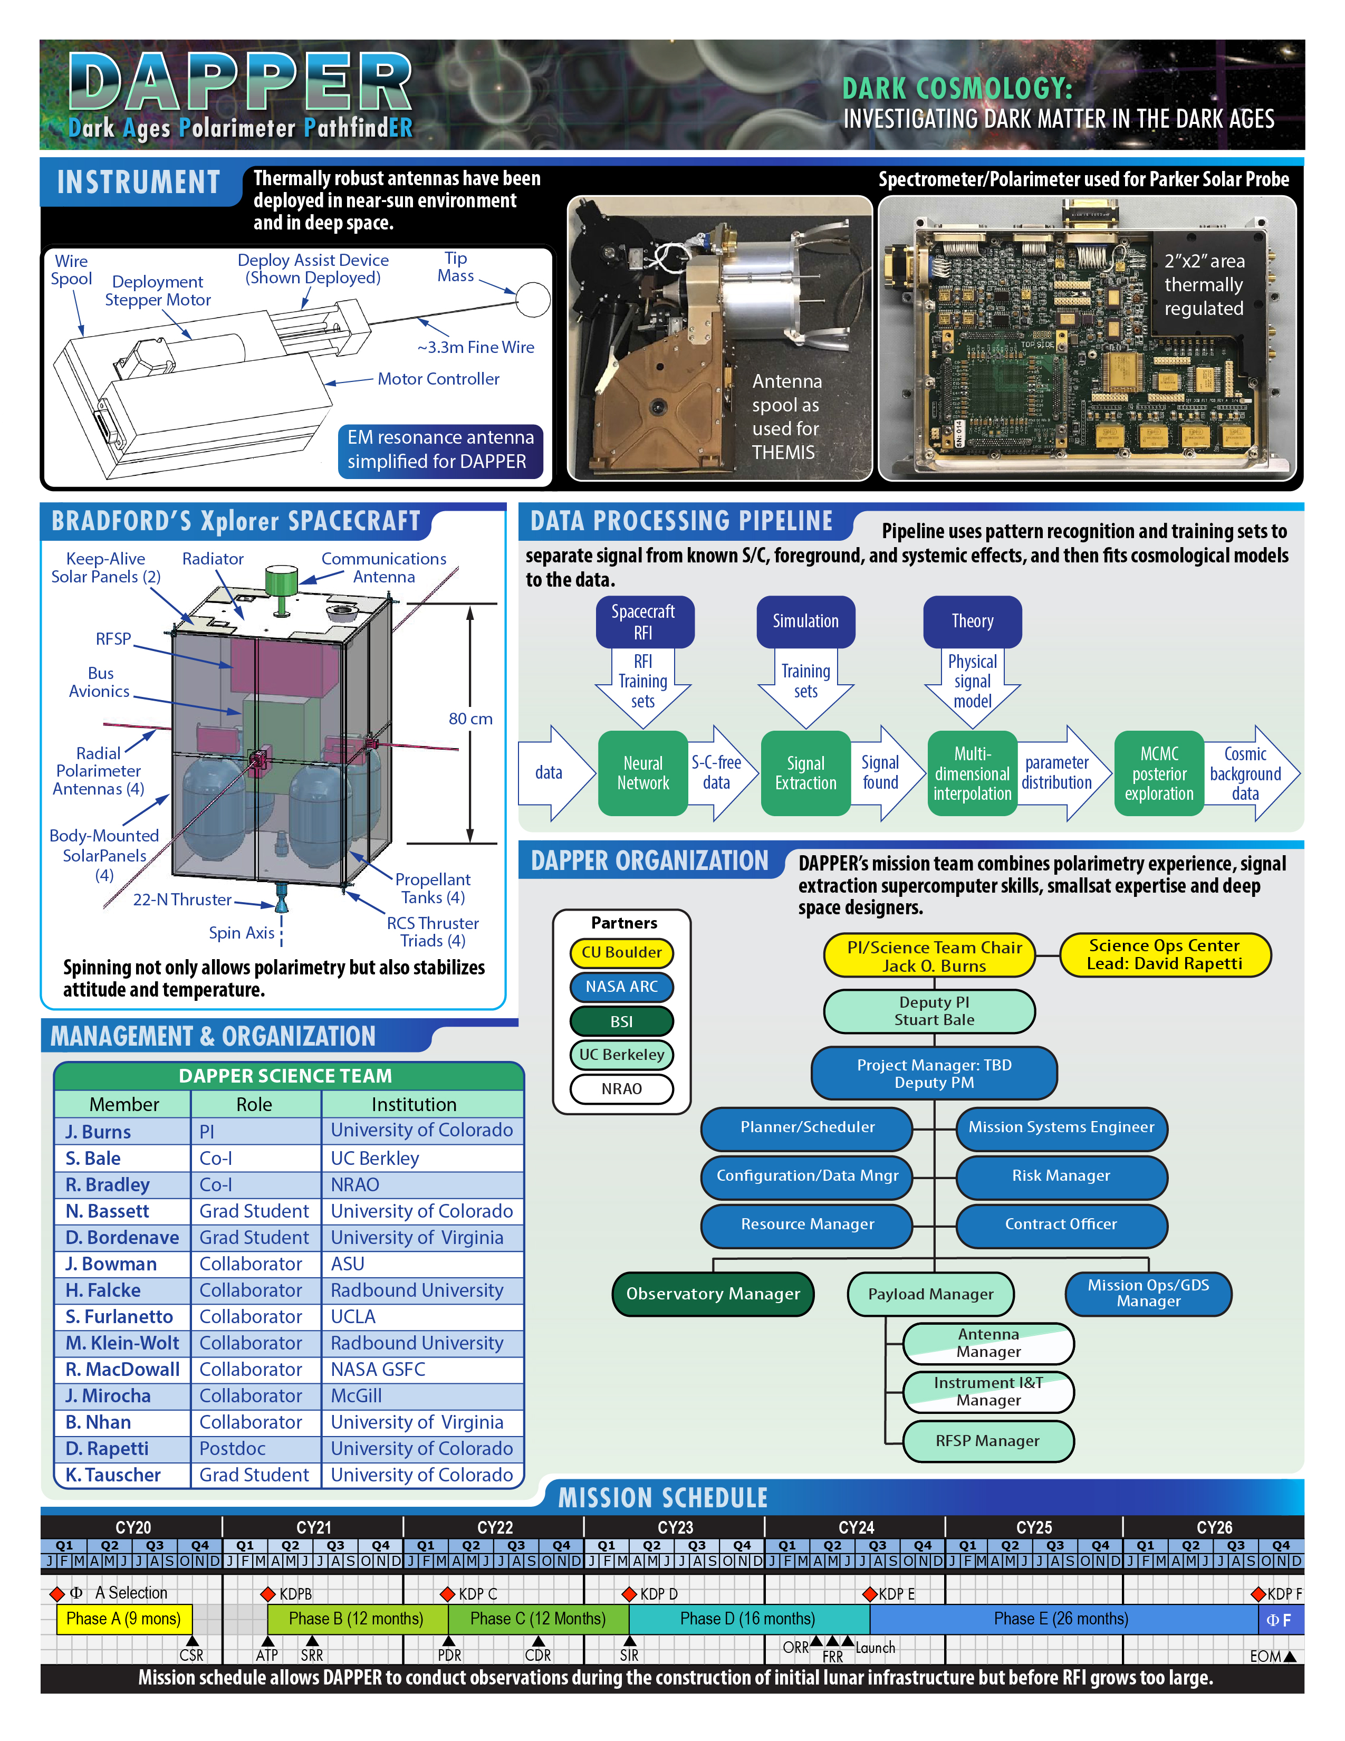
DAPPER, Dark Ages Polarimeter PathfinER
PI: Jack Burns, UC Boulder
Notes:
Words From ROSES? Grad students can be a strength or weakness for sub-orbital, lack of them is not necessarily a weakness for other categories.
Cubesats and ISS because they are expected to be sub-orbital class, in scope and cost.

Slide 17
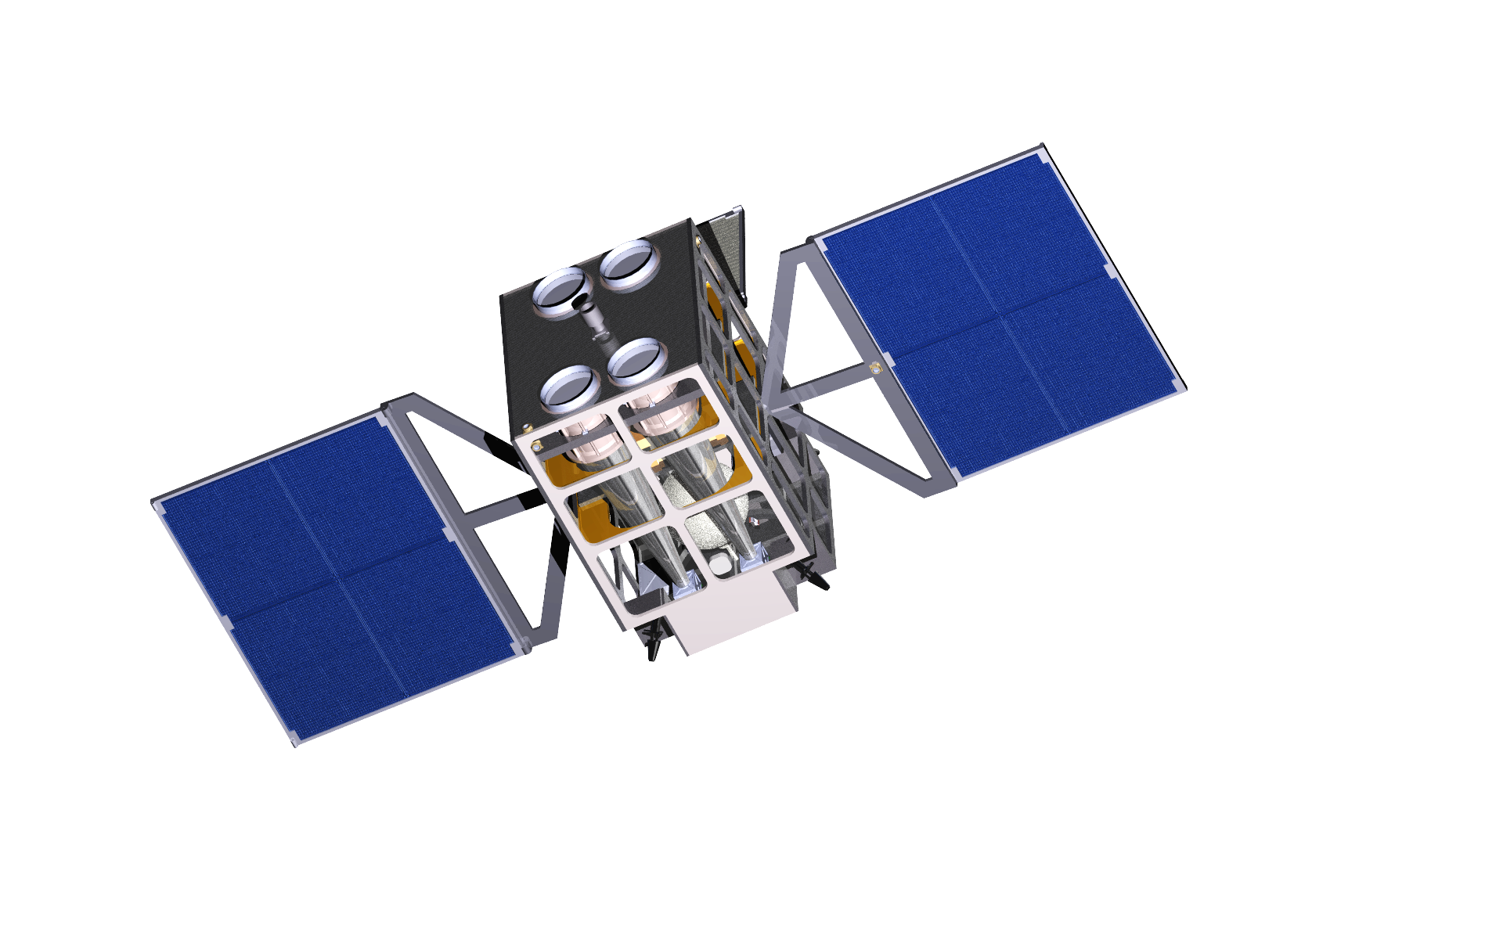
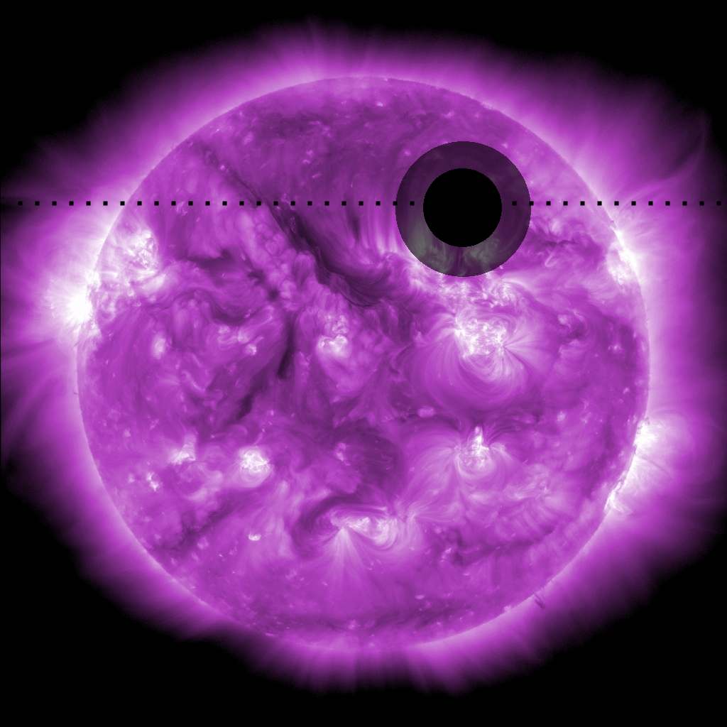
SEEJ: Smallsat Exploration of the Exospheres of Nearby Hot Jupiters Orbiting X-ray Bright Stars
PI Scott Wolk, Smithsonian/CfA
The primary objective of SEEJ (pronounced “siege”) is to measure the depth of planetary transits of at least 10 Hot Jupiters from 0.5-2.0 keV to 2% percent accuracy.
This allows the measurement of the exosphere and mass loss of the planet which is often due to XUV flux.
Using high cadence monitoring SEEJ will observe scores of transits of each TESS X-ray bright system detected.
With a total of ~ 150 cm² EA SEEJ will achieve signal to noise similar to the published results of Chandra and XMM.
Could launch by 2025

Slide 18
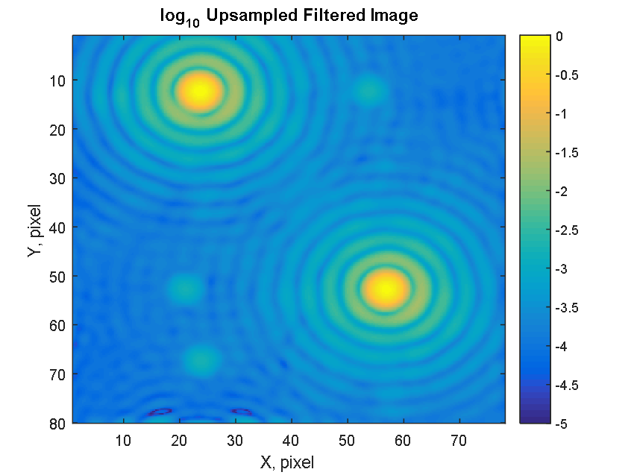
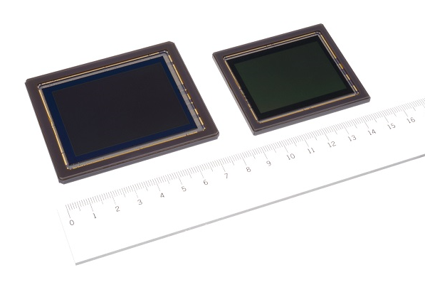
MASS (MicroArcsec Small Satellite) (M. Shao, JPL)
1st Exo-Earth in HZ around a G star.
Determine planetary masses via orbital astrometric wobble, for Earth mass planets around nearby stars
Centroid to 10⁻⁴ pix
4~5 μas astrometry (1hr)
1 Mearth HZ (~6 nearby stars. & 2 Mearth ~14 stars in 3yr)
10⁻⁴ pix centroiding with laser sub-pixel characterization of detector (lab demo)
New 100Mpix backside CMOS detectors now available (~1e read noise)
Ultra-low cost ESPA S/C based on cubesat subsystems. $4M vs $35M for S/C bus. 2 in orbit.
ARFL S5 Mission
ESPA S/C
~35cm telescope
2/28/2019 launch
~$4M s/c bus
150&100Mpix CMOS backside
sensor (1e read noise 3hz frame)
Notes:
The image shows 2 bright airy spots. The smaller spots are “ghost” images caused by on-chip electronics Xtalk. (that can be subtracted)
The 100 and 150Mpix sensors are available today. Space Micro corp will build a flight camera around them for $850K (and $350 for unit #2) Includes a FPGA with ~trillion arith ops/sec for image processing. (programming the FPGA not included) We need to ID target star and ~100 ref stars and only send down “postage” stamps not the whole 100 Mpix. (I think they built the flight focal planes for TESS.)
The Asteria cubesat demonstrated high thermal stability (0.01C) of the focal plane and sub-arcsec pointing stability. We will adopt similar techniques for MASS.
SiC 35cm telescope ROM quote of ~ $2M is from a company that built the 8 SiC 35cm telescopes for Skybox/Google/Planet Labs now in orbit at a lower price. But this price is 3X lower than the NASA/JPL NICM flight instrument cost model.
The S/C bus ROM cost from Blue Canyon was almost an order of magnitude lower than similar ESPA class S/C bus from Ball and Gen Atomics(Surrey) from 3-4 yrs ago.

Slide 19
mDOT, minature Distributed Occulter Telescope
PI: Bruce MacIntosh (Stanford)
mDOT is a minuature starshade, occultor formation flying demonstrator
Pair of cubesats (telescope = 6u, starshade = 180 kg) formation flying in LEO
NUV bandpass, 10x more sensitive than LBTI HOST, exo-zodi light detection around 6-8 nearby bright stars
3m starshade, 10cm telescope
Pathfinder for future larger star shades

Slide 20
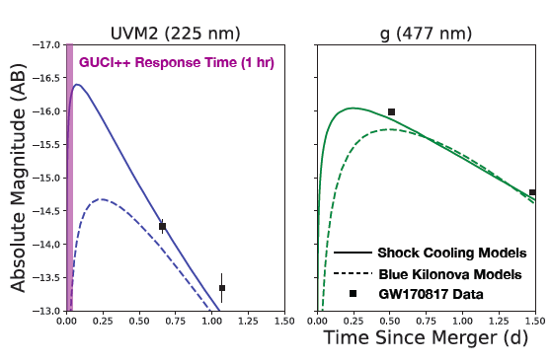
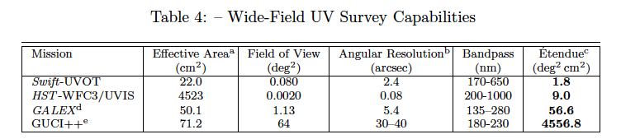
GUCI++ Gravitational wave Ultraviolet Counterpart Imager,
PI: Brad Cenko (NASA/GSFC)
GUCI++ is a network of 3-5 12U smallsats designed to characterize emission from NS-NS mergers
Triggered by ground-based GW detectors
64 sq-degree, rapid UV multi-bandpass followup
First All-sky UV synoptic survey when not doing GW followup
Increased UV throughput of delta-doped detectors
Expected rate 6/year
UV lightcurve is strong discriminator of models

Slide 21
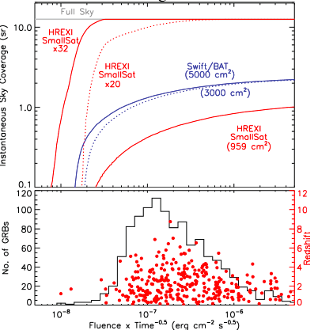
HREXI, High Resolution Energetic X-ray Imager
PI: Josh Grindlay (Harvard/CfA)
HREXI is network of 20-30 smallsats offering continuous all-sky 3-200 keV monitoring
Synoptic all-sky x-ray survey allows multiple science targets including GW followup, transients, and deep survey
Coded aperature telescope, NuStar-like CZT detectors
BCT uSat-S5 bus
A network of 32 would be more capable than current SoA (Swift/BAT), and would detect large numbers of high redshift GRBs

Slide 22
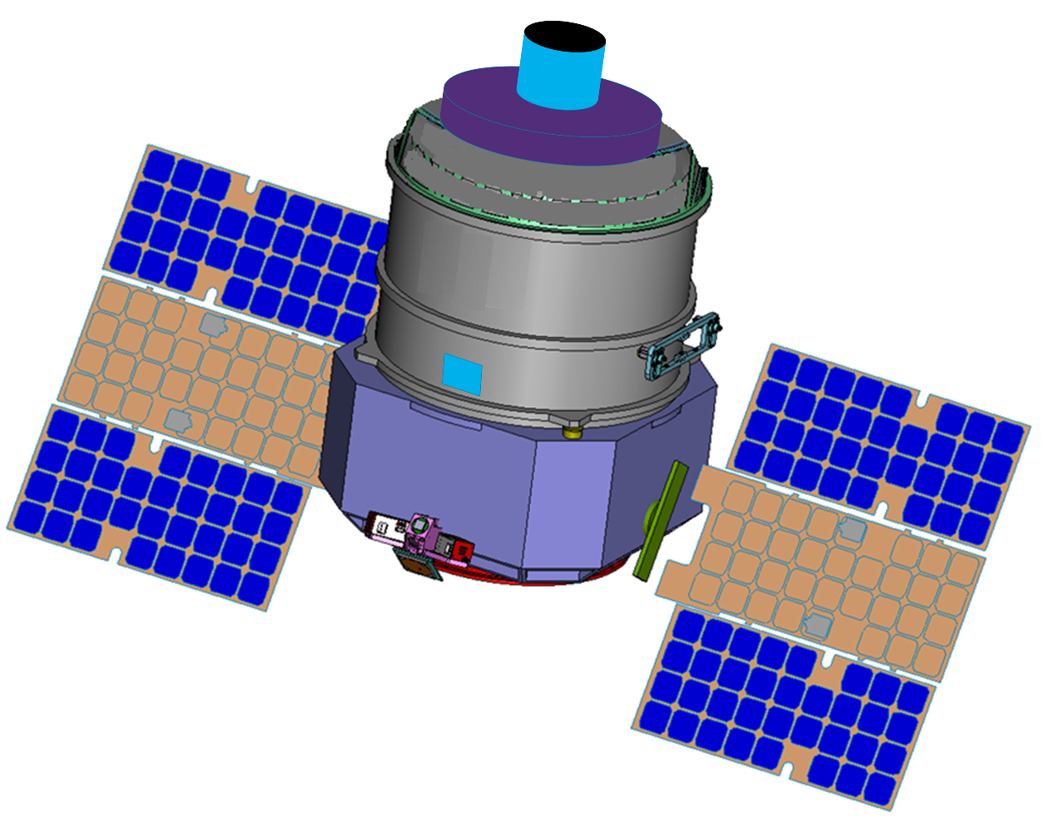
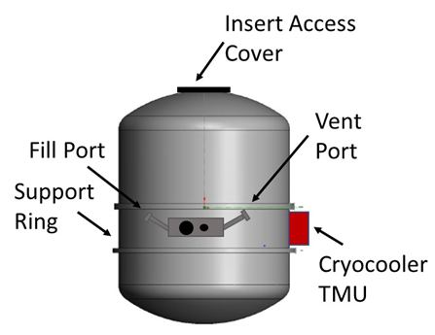
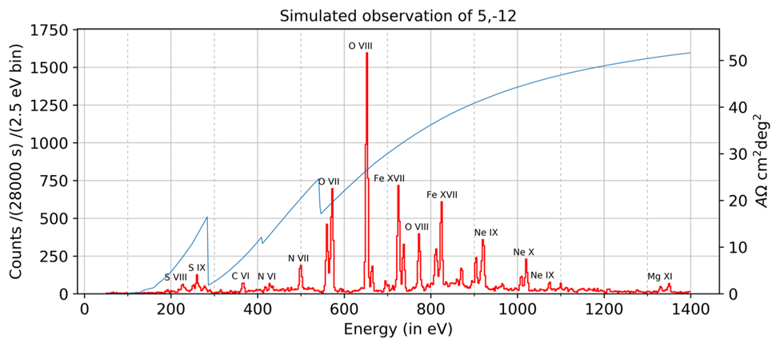
XQCSat, X-ray Quantum Calorimeter Satellite
PI: Philip Kaaret,U. Iowa
Feedback is an essential process in galaxy evolution. The Milky Way is a nearby laboratory to study feedback.
X-ray microcalorimeter with large field of view enables high resolution spectra of diffuse emission with 100× grasp of XRISM in ESPA-Grande envelope.
Based on technology demonstrated in Wisconsin rocket flights.
Challenge is to build a liquid helium-filled cryostat that will stay cold for mission duration of at least 30 days. We use technology developed for NASA/GSFC Superfluid Helium On Orbit Transfer (SHOOT) project.
Simulated 28 ks spectrum has lines from all astrophysically important elements.

Slide 23
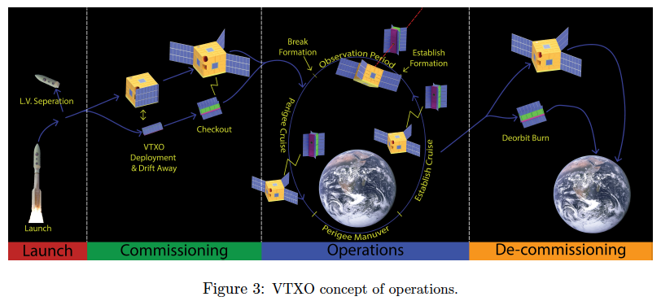
VTXO, Virtual Telescope for X-ray Observations
PI: John Krizmanic (NASA/GSFC)
VTXO is a long focal length soft x-ray telescope that achieves 10mas spatial resolution, 50x beyond current capabilities
6U Phase Fresnel Lenses operating in soft x-ray band, 27U detector sat
0.5 to 10 km focal length via formation flying
Elliptical ~GTO like orbits allows hours long integration times with modest delta-V
Probe closer to central engines in bright x-ray sources

