Slide 1
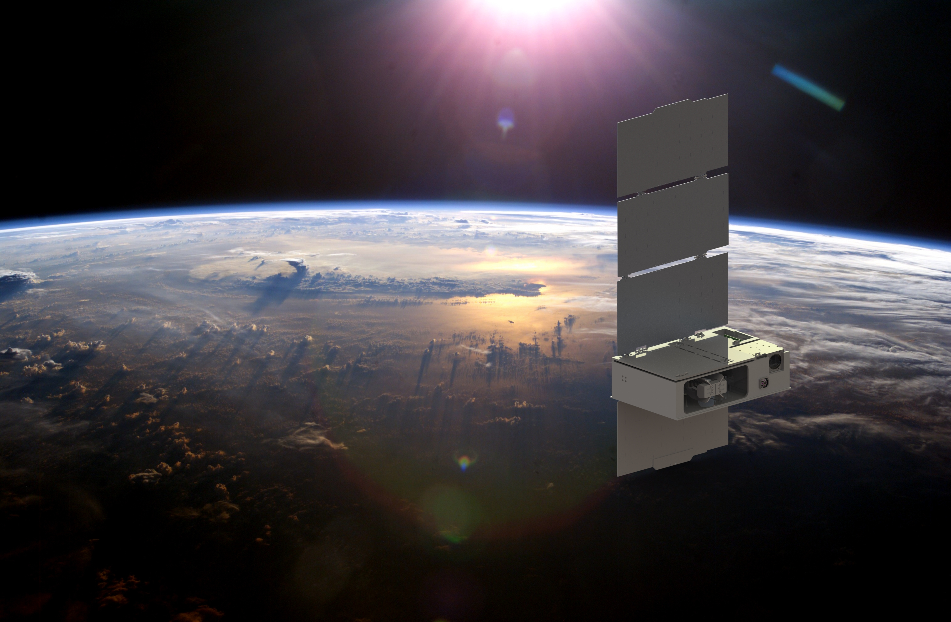
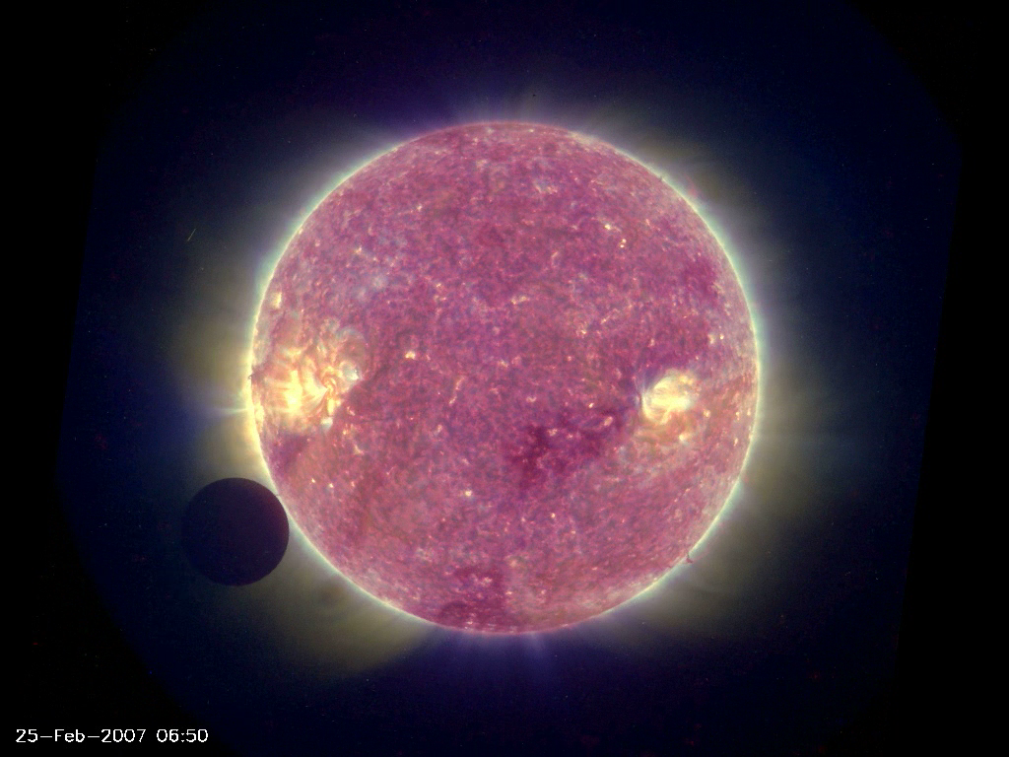
Exoplanet Transit Spectroscopy with Small Satellites
Kevin France – Colorado
Cubesat Workshop
AAS: 04 January 2020
@CuteCubeSat
Notes:
CUTE is a 6U cubesat mission funded by NASA and led at the University of Colorado, with strong European involvement.

Slide 2
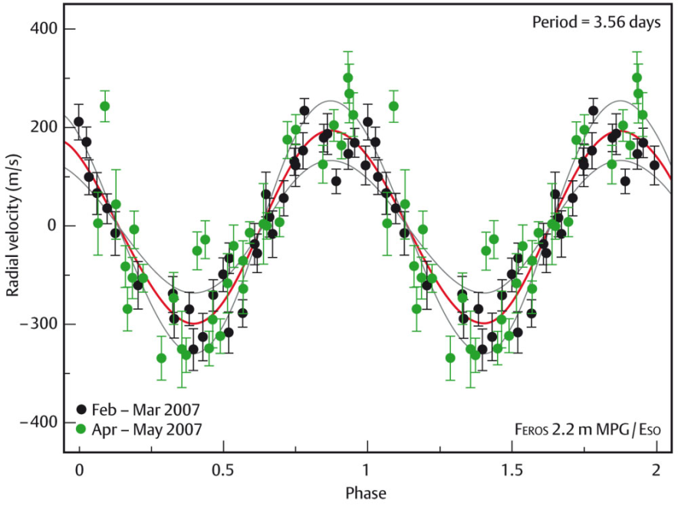
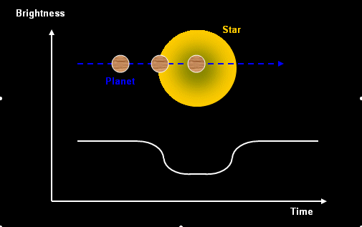
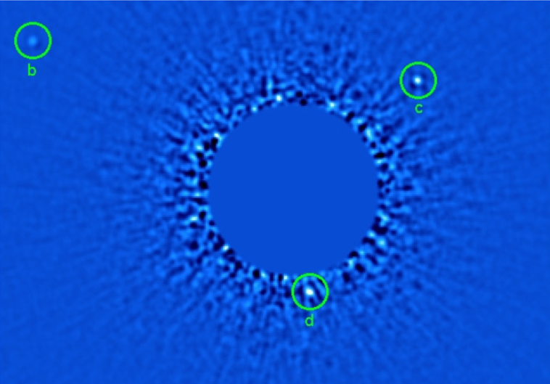
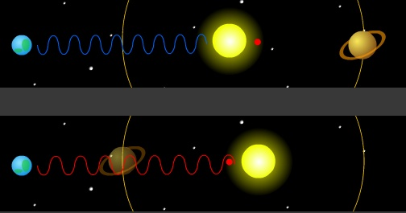
Extrasolar Planets:
N_{plan}(2020)
~4000 Confirmed
~200 × N_{plan}(1999)
Replace w/ Venus transit
Radial Velocity
Transits
Direct Imaging
Notes:
The discovery of a huge number of extrasolar planets over the past 20 years has fundamentally changed our view of Earth’s place in the Universe
It is a topic that EVERYONE is interested in. When you talk to someone on a plane or give a public lecture, everyone is interested in the idea of discovering “other solar systems”.
In addition, most undergrad or grad students that are interested in working with me are attracted by the opportunity to work on data or build instruments related to exoplanets
Primary detection techniques: RV, transits (Kepler), direct imaging w/ AO, microlensing (not discussed)

Slide 3
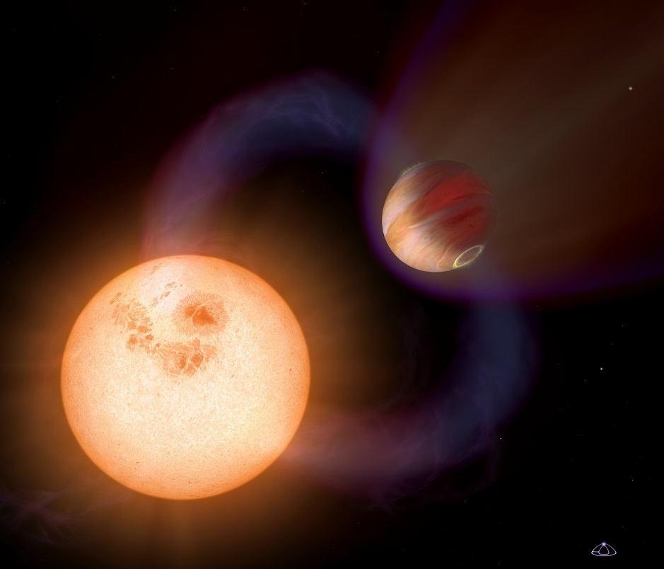
Extreme exoplanetary systems: new regimes of planetary physics and star-planet interactions
Overview:
Classes of planets not found in the solar system
Planetary atmospheres undergoing exaggerated physical and chemical
processing
Statistics and systematics,
the need for a dedicated
UV transit experiment:
CUTE
Notes:
LEAD-IN TO HOW WE DETECT and STUDY INDIVIDUAL ATMOSPHERES

Slide 4
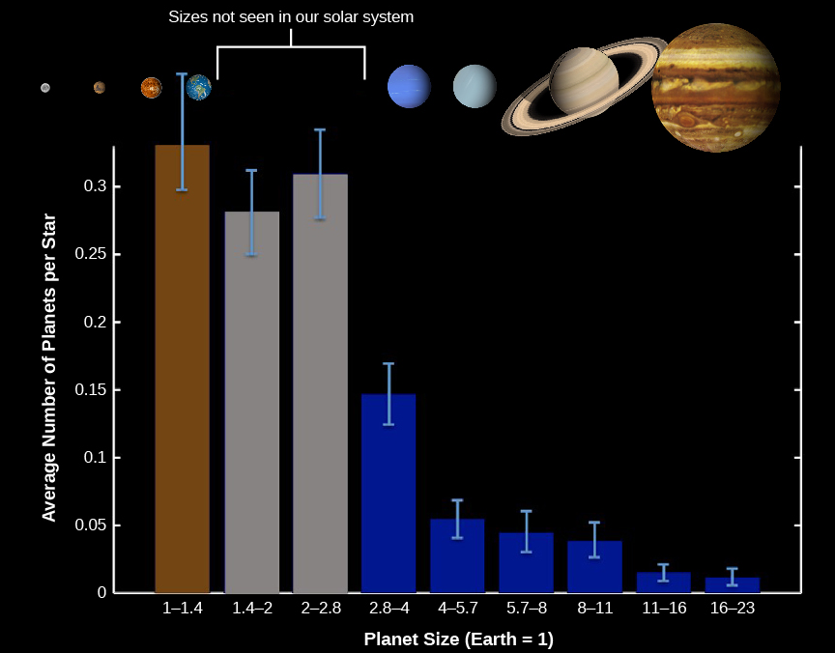
The Extrasolar Planet Zoo
Notes:
as early 2018. This plot has 2213 (and as of May 7 2018, there were 2327 confirmed planets.
the first thing you may notice is that the most common varieties of planets are super-Earths and sub-Neptunes, two types of planets that we do not have in the solar system!
Prevalence: Now that we have so many planets, statistical demographic studies have carried out, finding that between 10-50% of low-mass stars like our sun and red dwarfs likely host rocky planets at the right temperature to support liquid water on their surfaces, or, in the Habitable Zone.

Slide 5
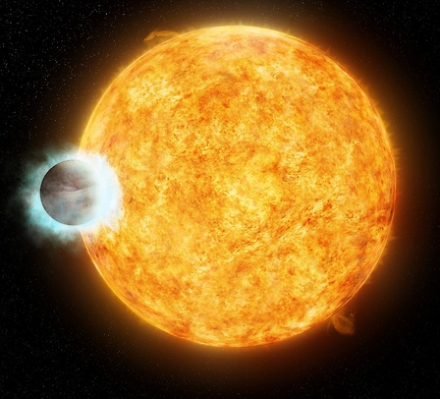
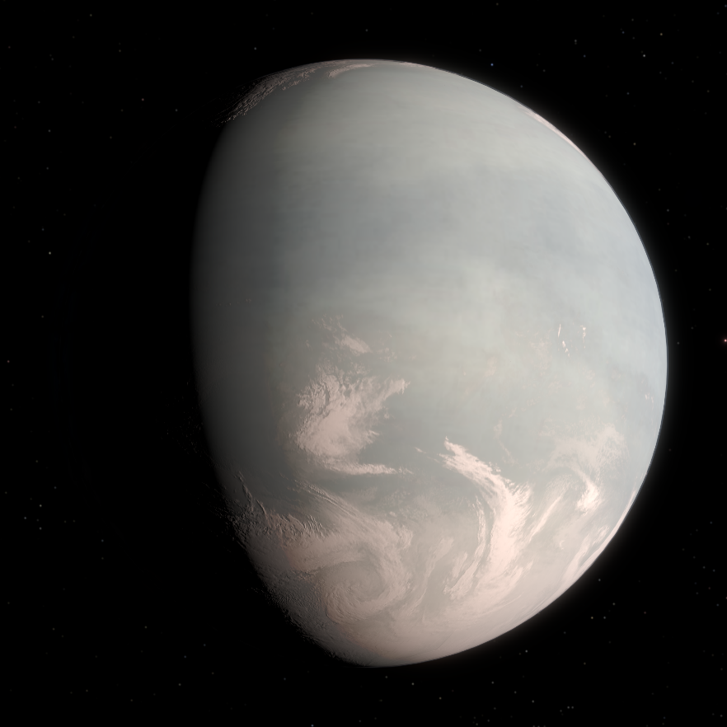
The Extrasolar Planet Zoo
Hot Jupiter
Super-Earth
WASP-18b, solar-type host
M ~ 10 M_{J}, R ~ 1.1 R_{J}
a ~ 0.02 AU
T_{eff} ~ 2400 - 3100 K
GJ 832c, red dwarf host
M sin(i) ~ 5.2 M_{E}, R ~ 1.7 R_{E}
a ~ 0.16 AU
T_{eff} ~ 230 - 280 K
(Hellier et al. 2009)
(Wittenmyer et al. 2014)
Notes:
Two examples of extrasolar planetary classes that we do not have in the solar system. 10 M_J orbiting at 0.02 AU!
Planet with relatively climate temps, but 5 x Earth’s mass.
So, the diversity of planetary systems is one of things that is opening up the field of comparative planetology.

Slide 6
Extreme exoplanetary systems: new regimes of planetary physics and star-planet interactions
Overview:
Classes of planets not found in the solar system
Planetary atmospheres undergoing exaggerated physical and chemical
processing
Statistics and systematics,
the need for a dedicated
UV transit experiment:
CUTE
Notes:
LEAD-IN TO HOW WE DETECT and STUDY INDIVIDUAL ATMOSPHERES

Slide 7
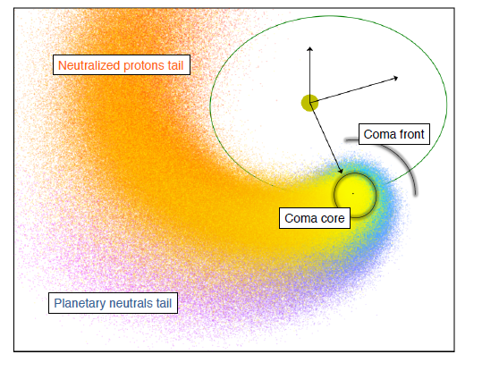
HOT JUPITER Atmospheres
EUV heating driving mass-loss from short-period planets
Most spectacular example has been on the short-period Neptune-mass planet GJ 436b
Notes:
So you might ask how we know this!?!

Slide 8
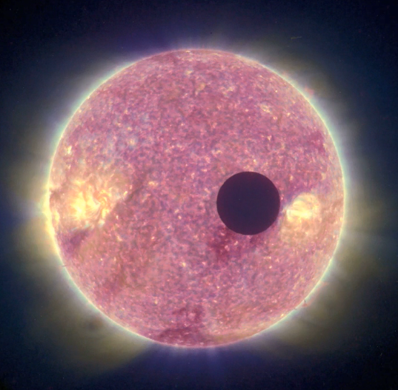
Exoplanet Atmospheres
Narrow-band/spectroscopic transit analysis can probe absorption by specific atmospheric constituents
Occultation Depth =
(R_{P} / R*)²
Notes:
So, for large planets or small stars, this gets easier to detect.

Slide 9
Exoplanet Atmospheres
Narrow-band/spectroscopic transit analysis can probe absorption by specific atmospheric constituents
Occultation Depth = (R_{P}(λ) / R*)²
Atmosphere
Transit Spectroscopy:
in-transit vs. out-of-transit
Composition
Temperature structure
Velocity flows
Mass-loss rates
Notes:
So, for large planets or small stars, this gets easier to detect.
And when we can study the occultation depth as a function of wavelength, we are doing spectral characterization of these atmospheres.

Slide 10
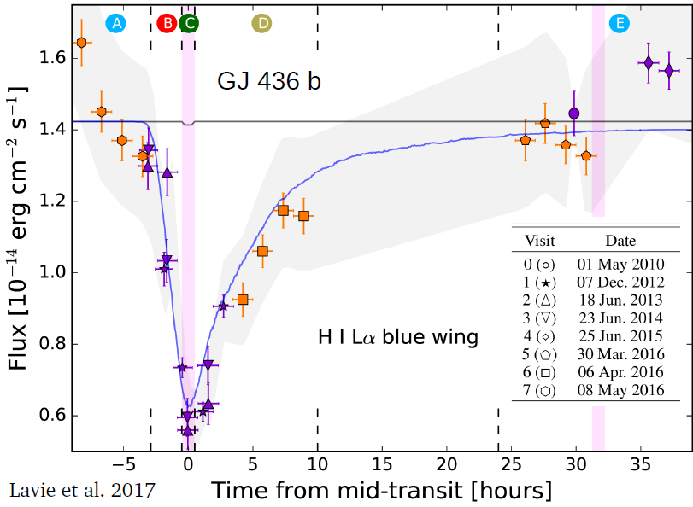
Transit Spectroscopy of Short-period Planets
EUV heating driving mass-loss from short-period planets
Most spectacular example has been on the short-period Neptune-mass planet GJ 436b
Hydrogen detected in the upper atmosphere of GJ436b (Kulow et al. 2014; Ehrenreich et al. 2015; Bourrier et al. 2016; Lavie et al. 2017)
Transit depth ~ 50% (!)
Notes:
Note that the 50% may be a geometric effect. It may be that the star’s light (AT Lyman-alpha!!) would be entirely blocked if they were perfectly aligned. BUT: (there are many more models for how this process happens than examples of it happening! )
DESCRIBE in words the controversies surrounding most transit observations besides this one. No need to show examples as it might be perceived as criticizing existing works -- we have between 3 and 6 examples of escaping atmospheres, and I would say there are disputes about all but 2 of them. So, we are in a place where the data volume, quality, and interpretation are limiting the development of the field.

Slide 11
Extreme Exoplanet Atmospheres: challenges
For most Hot Jupiters measured with Hubble, we rarely get the same transit result twice!
More modeling than observational studies.
: time-variability in the star(?), planetary mass-loss rate (?), or apples-vs-oranges observations and data reduction algorithms
Notes:
HERE ARE THE CHALLENGES AND SOLUTIONS THAT WERE THE DRIVING FORCES BEHIND CUTE:

Slide 12
Extreme Exoplanet Atmospheres: challenges
Rarely get the same transit result twice: time-variability in the star(?), planetary mass-loss rate (?), or apples-vs-oranges observations and data reduction algorithms
Sample size of mass-loss measurements ~6, early-ingress ~1, late-egress ~2
Stellar baseline for transit
measurements
Self-consistent modeling framework
Notes:
HERE ARE THE CHALLENGES AND SOLUTIONS THAT WERE THE DRIVING FORCES BEHIND CUTE:

Slide 13
Extreme Exoplanet Atmospheres: challenges
Rarely get the same transit result twice: time-variability in the star(?), planetary mass-loss rate (?), or apples-vs-oranges observations and data reduction algorithms
Sample size of mass-loss measurements ~6, early-ingress ~1, late-egress ~2
Stellar baseline for transit
measurements
Self-consistent modeling framework
→ multiple, consecutive transits, single data pipeline
Notes:
So, for large planets or small stars, this gets easier to detect.

Slide 14
Extreme Exoplanet Atmospheres: challenges
Rarely get the same transit result twice: time-variability in the star(?), planetary mass-loss rate (?), or apples-vs-oranges observations and data reduction algorithms
Sample size of mass-loss measurements ~6, early-ingress ~1, late-egress ~2
Stellar baseline for transit
measurements
Self-consistent modeling framework
→ multiple, consecutive transits, single data pipeline
→ dedicated platform = more data
Notes:
So, for large planets or small stars, this gets easier to detect.

Slide 15
Extreme Exoplanet Atmospheres: challenges
Rarely get the same transit result twice: time-variability in the star(?), planetary mass-loss rate (?), or apples-vs-oranges observations and data reduction algorithms
Sample size of mass-loss measurements ~6, early-ingress ~1, late-egress ~2
Stellar baseline for transit
measurements
Self-consistent modeling framework
→ multiple, consecutive transits, single data pipeline
→ dedicated platform = more data
→ ± 0.25 phase coverage
Notes:
So, for large planets or small stars, this gets easier to detect.

Slide 16
Extreme Exoplanet Atmospheres: challenges
Rarely get the same transit result twice: time-variability in the star(?), planetary mass-loss rate (?), or apples-vs-oranges observations and data reduction algorithms
Sample size of mass-loss measurements ~6, early-ingress ~1, late-egress ~2
Stellar baseline for transit
measurements
Self-consistent modeling framework
→ multiple, consecutive transits, single data pipeline
→ dedicated platform = more data
→ ± 0.25 phase coverage
→ state-of-the-art, physically self-consistent models
Notes:
So, for large planets or small stars, this gets easier to detect.

Slide 17
Extreme exoplanetary systems: new regimes of planetary physics and star-planet interactions
Overview:
Classes of planets not found in the solar system
Planetary atmospheres undergoing exaggerated physical and chemical
processing
Statistics and systematics,
a dedicated UV
transit experiment:
CUTE
Notes:
LEAD-IN TO HOW WE DETECT and STUDY INDIVIDUAL ATMOSPHERES

Slide 18
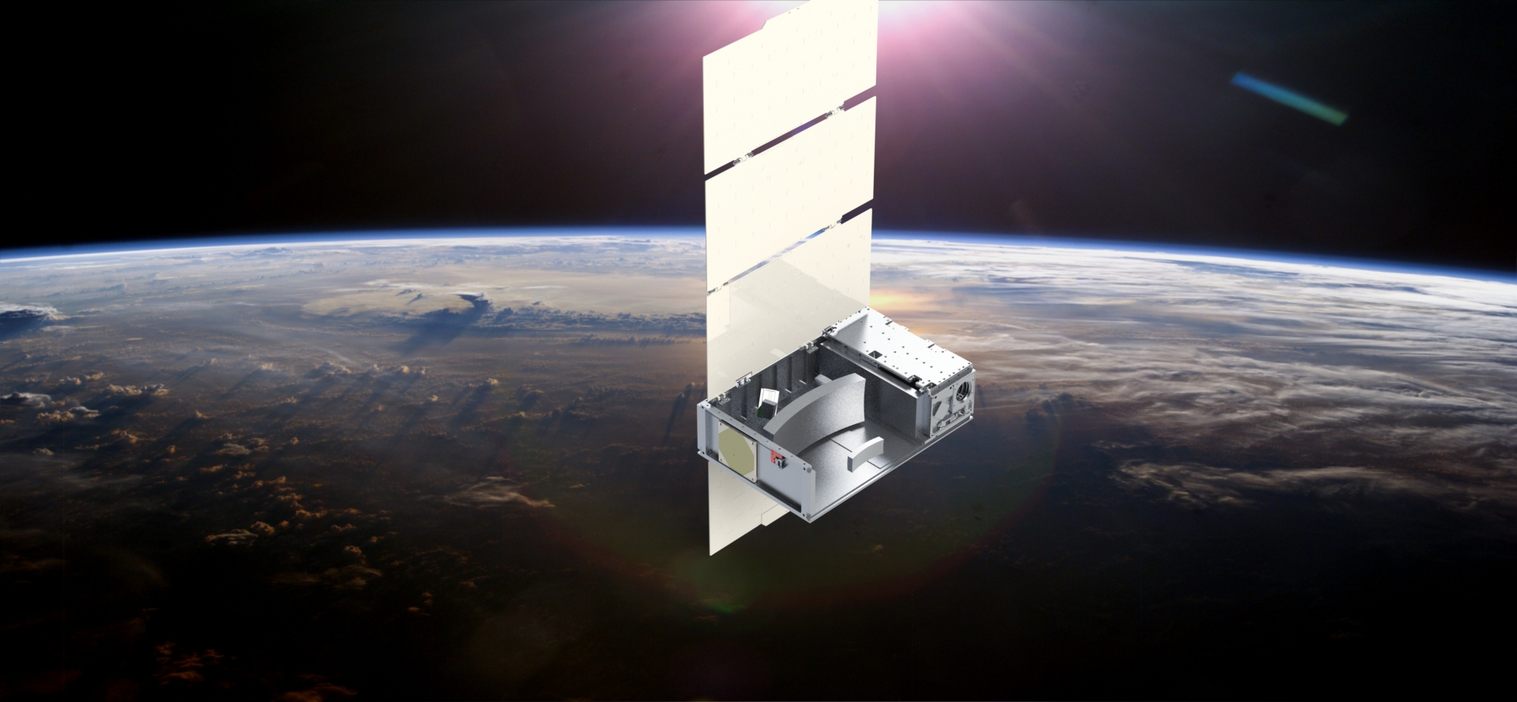
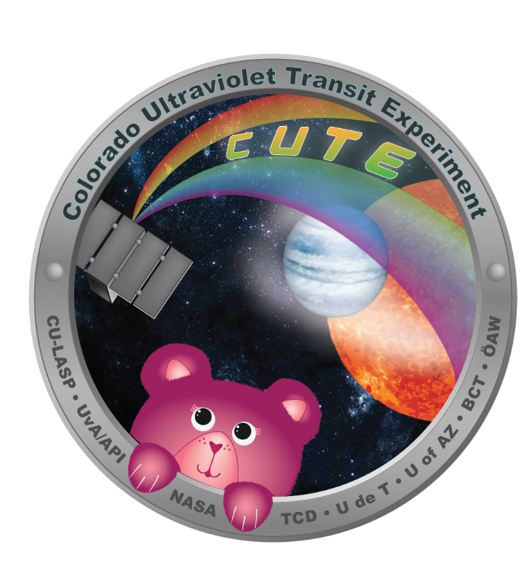

Colorado Ultraviolet transit Experiment (CUTE)
University of Colorado:
Kevin France (PI), Brian Fleming (PS), Rick Kohnert (PM), Nicholas Nell, Arika Egan, Stefan Ulrich, Nick DeCicco, Ambily Suresh, Wilson Cauley
United States:
Tommi Koskinen (UofA), Matthew Beasley (SwRI), Keri Hoadley (Caltech)
Europe:
Jean-Michel Desert (Amsterdam), Luca Fossati (ÖAW), Pascal Petit (UdeT), Aline Vidotto (TCD)
Notes:
CUTE is a 6U cubesat mission funded by NASA and led at the University of Colorado, with strong European involvement.

Slide 19

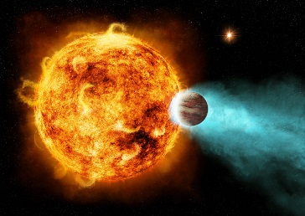
CUTE: A new approach to atmospheric mass-loss measurements
Survey of ~12-30 short-period transiting planets around nearby stars:
Atmospheric mass-loss
Exoplanet magnetic fields?
Notes:
Tommi’s Sci Team talk: 10/2/17:
--NUV/CUTE probes higher than 1mbar, likely 3 – 50 mbar or higher.
--Some metals form into clouds, so we will not see all of them (only for planets hotter than condensation temp of clouds w/ relevant molecules).
--Molecules (OH in NUV), H2O and CO in FUV.
--High altitude haze deck on 189733b b/c Rp/R* higher than water feature in NIR (formed around 1 mbar). High altitude hazes may be soot particles.
--

Slide 20
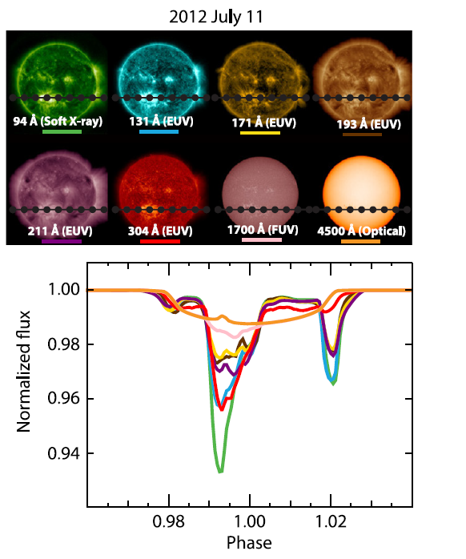
CUTE: A new approach to atmospheric mass-loss measurements
Most detections of atmospheric mass loss have been carried out in the FUV, Lyα (e.g. Vigal-Madjar+ 2004, 2013, Linsky+ 2010, Ben-Jaffel+ 2007, 2013, Kulow+ 2014, Ehrenreich+ 2015, Bourrier et al. 2018)
Controversial interpretation due to low-S/N and uncertain chromospheric intensity distribution (e.g., Llama & Shkolnik 2015).
The NUV has both a more uniform, mainly photospheric, intensity distribution AND an overall brighter background for transit observations, ~50-1000x brighter.
Llama & Shkolnik 2015, 2016

Slide 21
CUTE: A new approach to atmospheric mass-loss measurements
Most detections of atmospheric mass loss have been carried out in the FUV (e.g. Vigal-Madjar+ 2004, 2013, Linsky+ 2010, Ben-Jaffel+ 2007, 2013, Kulow+ 2014, Ehrenreich+ 2015, Bourrier et al. 2018)
Controversial interpretation due to low-S/N and uncertain chromospheric intensity distribution (e.g., Llama & Shkolnik 2015).
The NUV has both a more uniform, mainly photospheric, intensity distribution AND an overall brighter background for transit observations, ~50-1000x brighter.
Source: SDO
CUTE:
NUV Transit
Spectrophotometry
Krivova et al. 2006

Slide 22
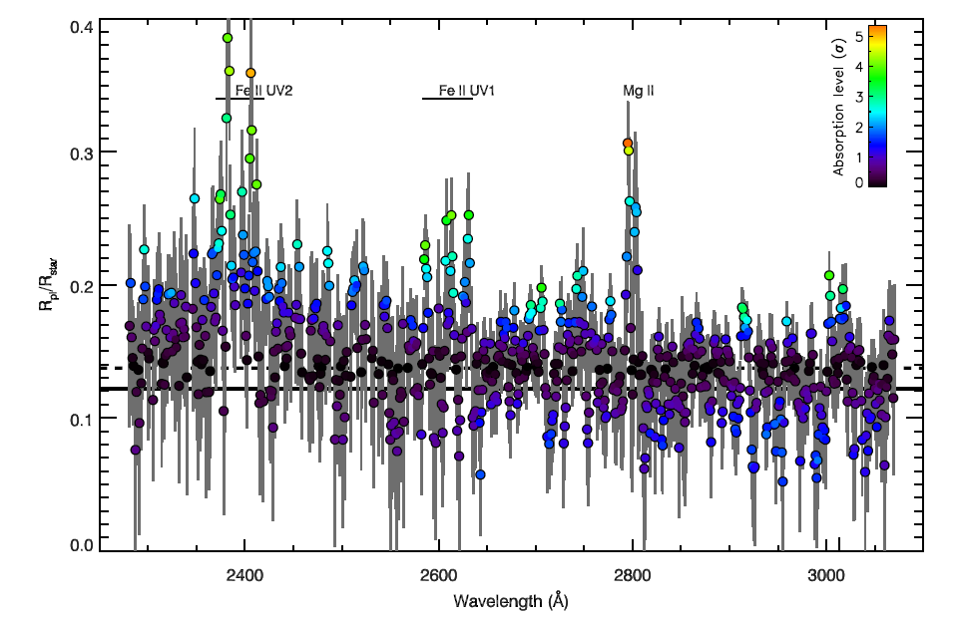
CUTE: A new approach to atmospheric mass-loss measurements
Brighter stellar flux enables spectroscopy in a correspondingly smaller platform
Spectroscopy required to isolate escaping gas species
Sing et al. 2019
Notes:
Maybe show the Bourrier et al. or the Sing et al. total light curve vs the depth in individual lines!

Slide 23

CUTE: A new approach to atmospheric mass-loss measurements
Brighter stellar flux enables spectroscopy in a correspondingly smaller platform
Spectroscopy required to isolate escaping gas species
Sing et al. 2019
Music credits, James Mason & MinXSS team
Notes:
A standard mp3 spans about 20000 Hz in range and has a resolution of about 76 Hz, so that comes to 263 resolution elements per stereo channel (so 526 bins total) in the uncrushed song – James Mason, 12/30/19

Slide 24
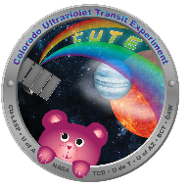
Astronomy with Cubesats: Dedicated
Mission Architecture
30 cm
CUTE: First NASA grant funded UV/O/IR astronomy cubesat
  Halosat X-ray cubesat (P. Kaaret, Univ. Iowa)
  More widely used in Earth observing, education,
  and solar physics (e.g. CSSWE, MinXSS – Mason et al. 2017)
20 cm
6U
6U
10 cm
Source: Radius Space Systems
ASTERIA - JPL
Notes:
So, that was WHAT we are planning to do, now HOW are we going to do that?
NOTE: ASTERIA deployed from the ISS in mid-Dec.

Slide 25
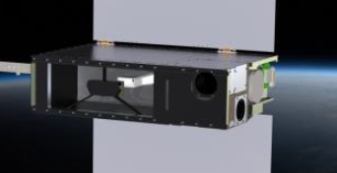
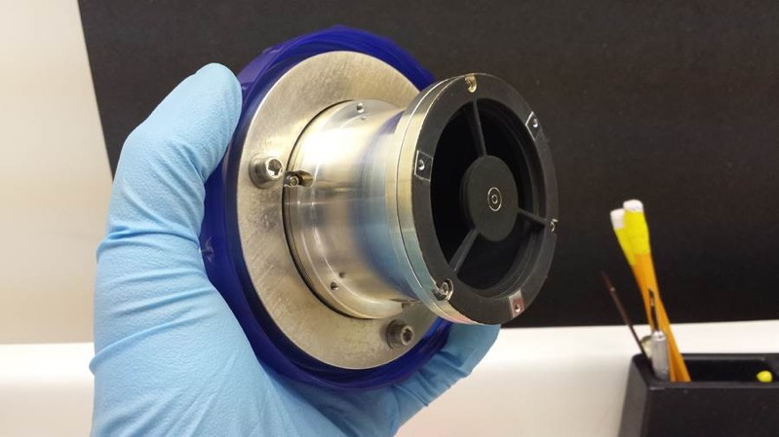
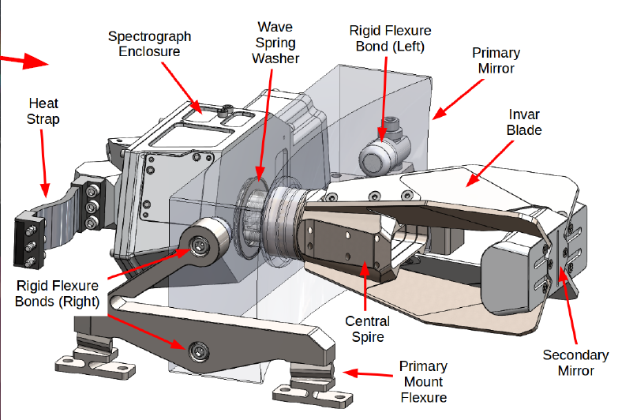
CUTE Telescope
See CUTE design overview in Fleming et al. (2018)
Source: Nu-Tek Precision Optics
Geometric clear area for a 9cm Cassegrain: A_{T} ~ 47 cm²
Geometric clear area for a 20 x 8 cm Cassegrain: A_{CUTE} ~ 140 cm²
A_{T,r}/A_{CUTE} = 3 x more collecting area
(requires robust scattered light control, reducing usable gain to factor of 3)
Notes:
a 20 x 8 cm, F/0.65 parabolic primary mirror feeding an F/2.6 classical cassegrain telescope.

Slide 26
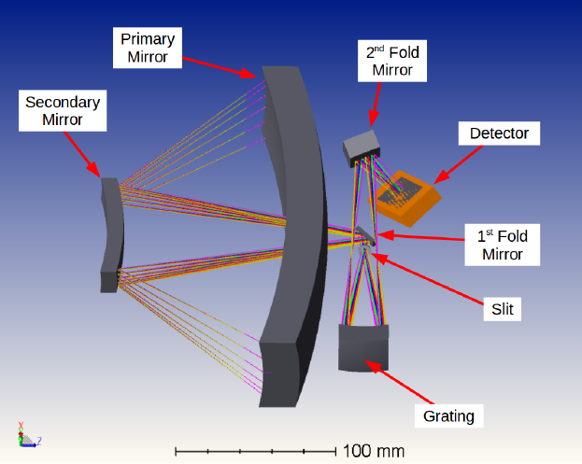
CUTE Science Instrument
See CUTE design overview in Fleming et al. (2018), Egan et al. (2018)
Notes:
The rectangular telescope feeds light into a compact medium-resolution spectrometer…..You can see the 10cm, ~4 inches, shown for reference.
GRATING: The beam is diffracted, magnified, and focused by a spherical R=86.1 mm, 1714 gr/mm aberration correcting ion-etched holographic grating of the type used in HST-COS and ruled by Horiba J-Y.

Slide 27
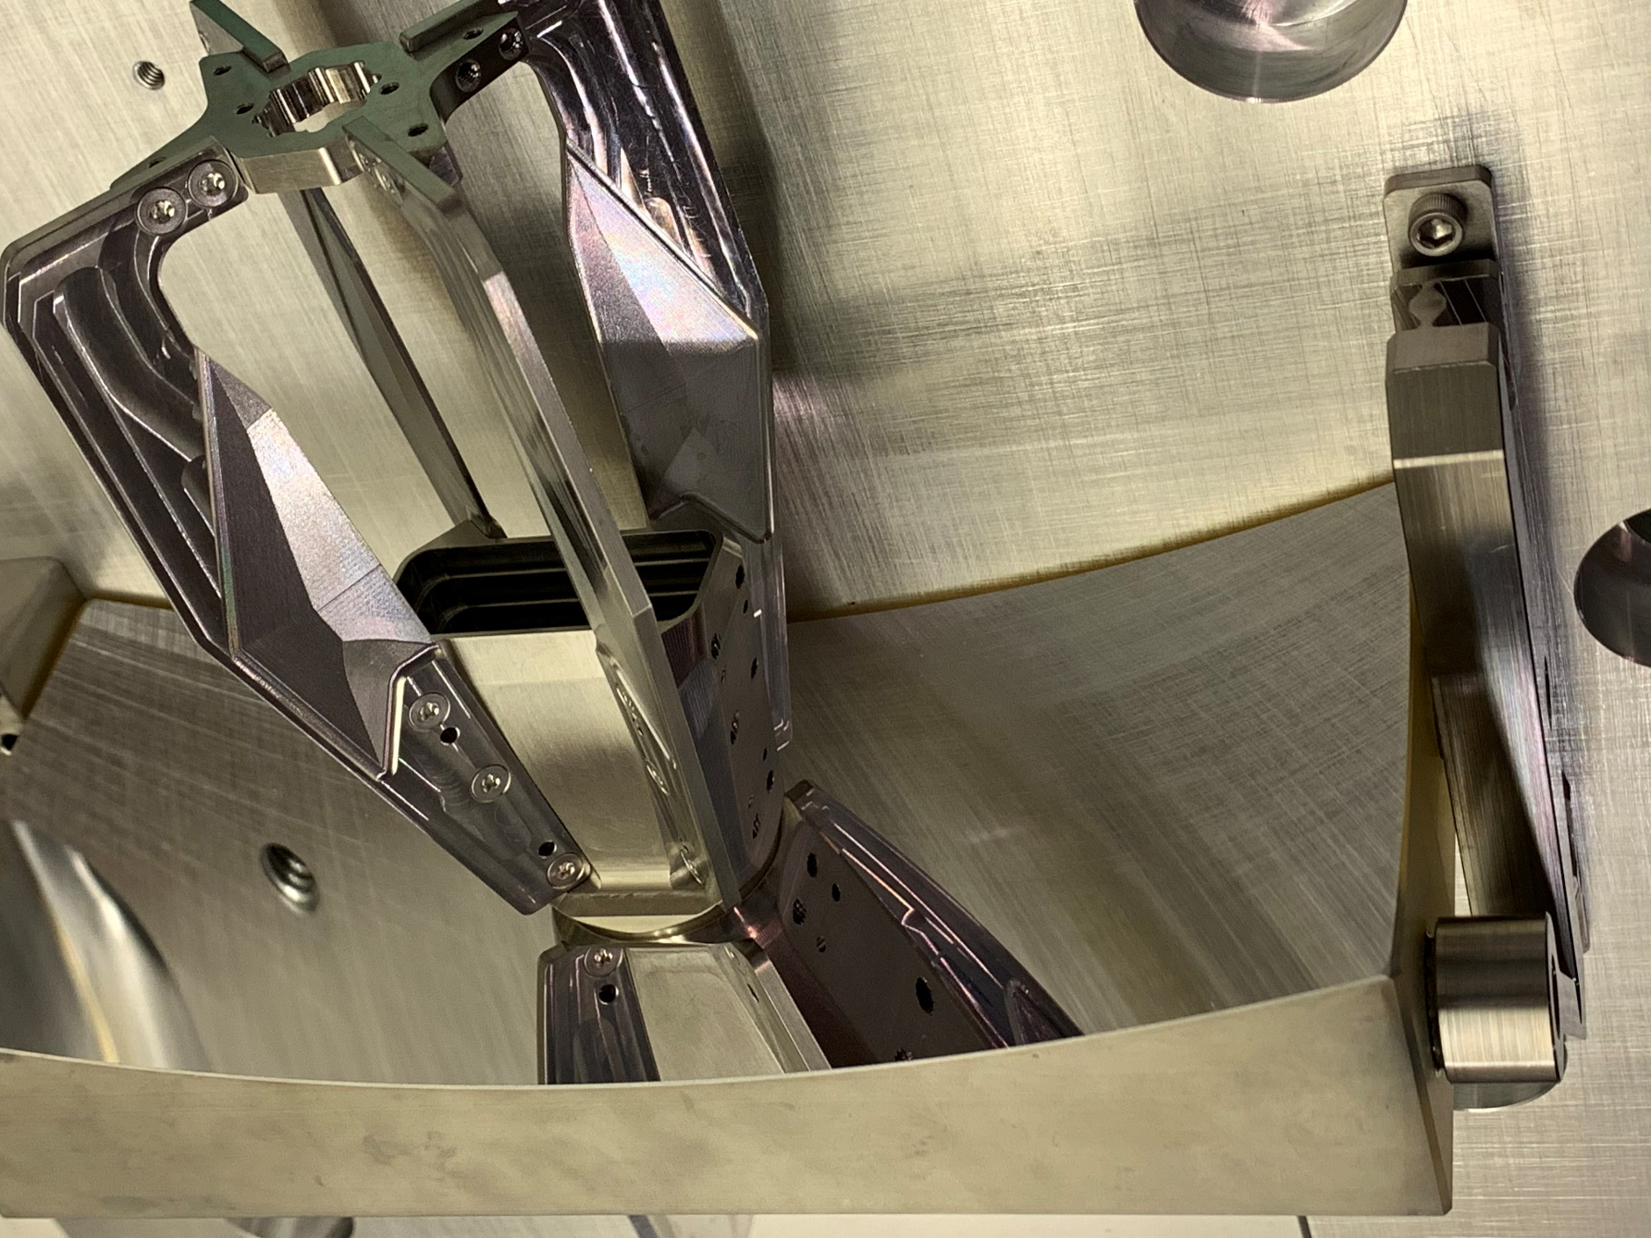
CUTE Telescope (Spare)
See CUTE design overview in Fleming et al. (2018); Egan et al. (2018)
Notes:
DETECTOR: e2v CCD42-10 back-illuminated, UV-enhanced CCD detector. The CCD42-10 has an active area of 27.6 6.9 mm with 2048 x 515 pixels, each 13.5 micron square. The CCD42-10 has flight heritage from the Mars Science Laboratory ChemCham LIBS spectrometer

Slide 28
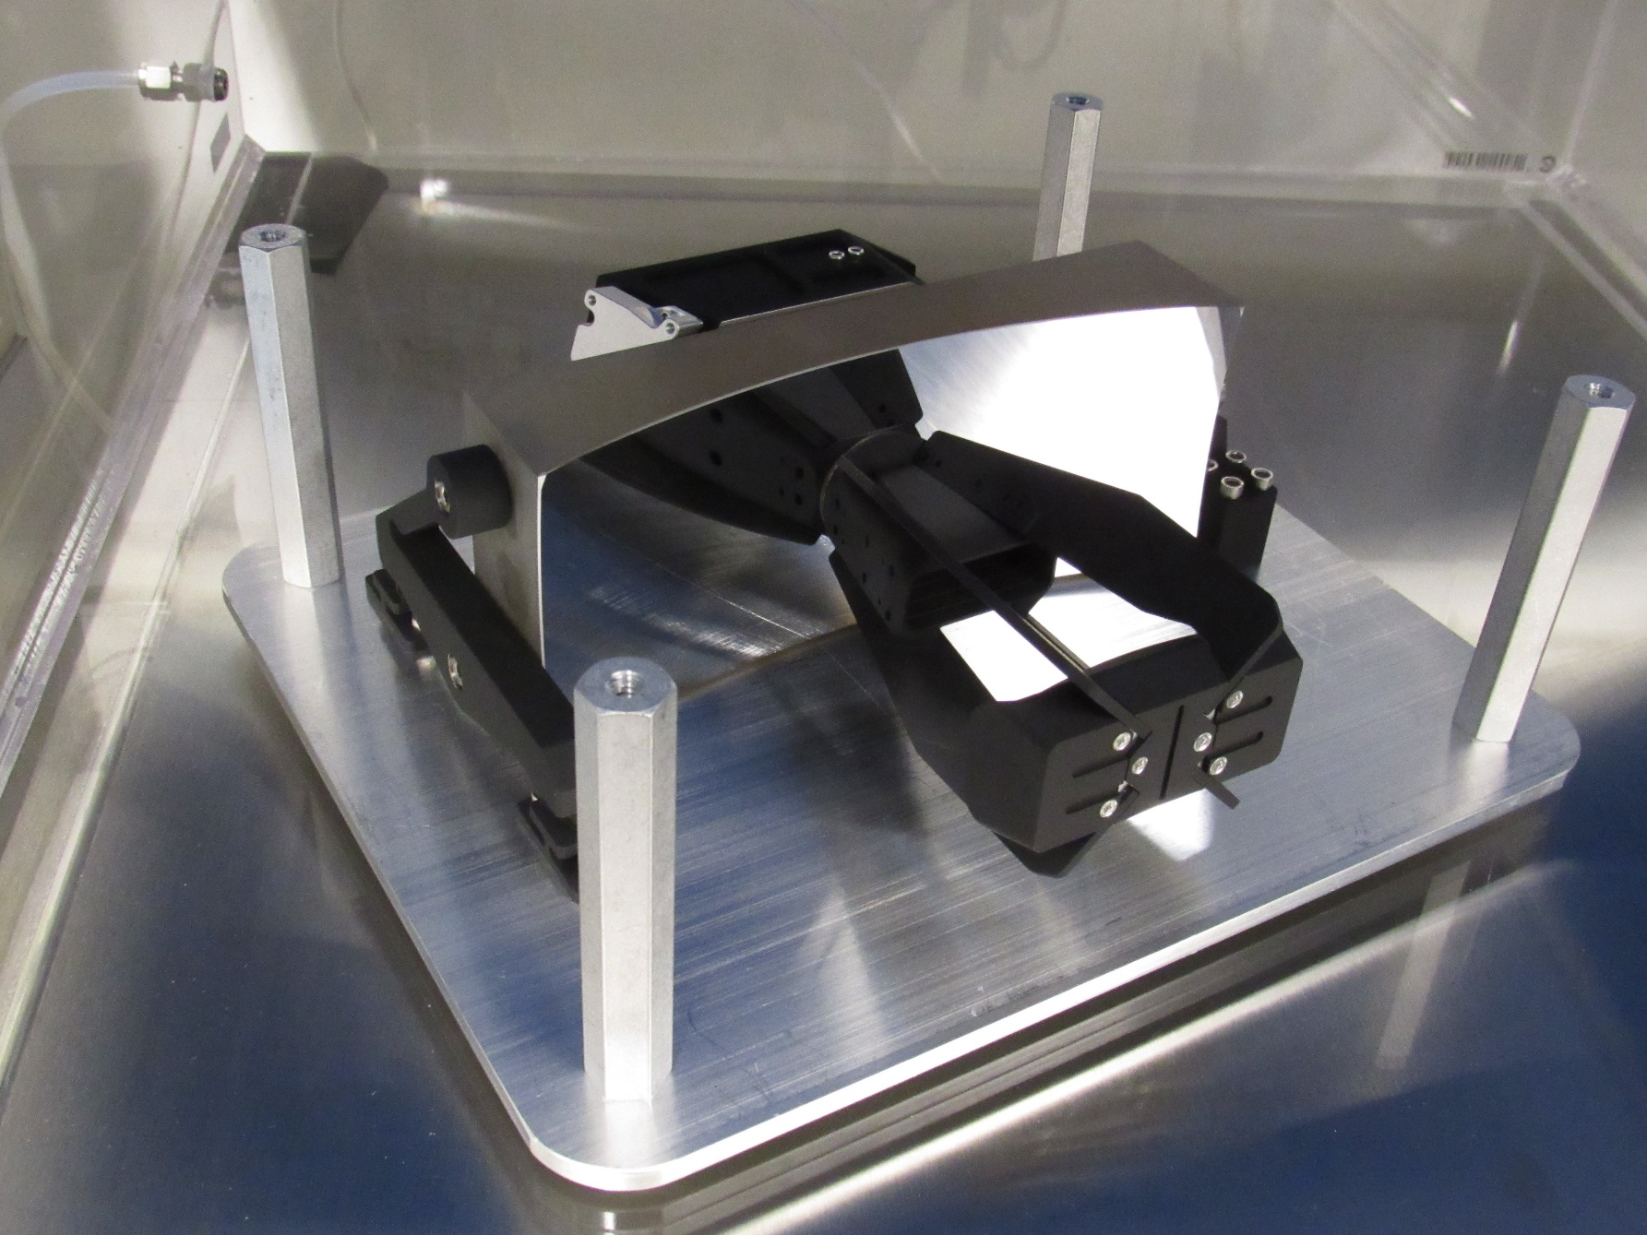
CUTE Telescope (Flight)
See CUTE design overview in Fleming et al. (2018); Egan et al. (2018)
Notes:
DETECTOR: e2v CCD42-10 back-illuminated, UV-enhanced CCD detector. The CCD42-10 has an active area of 27.6 6.9 mm with 2048 x 515 pixels, each 13.5 micron square. The CCD42-10 has flight heritage from the Mars Science Laboratory ChemCham LIBS spectrometer

Slide 29
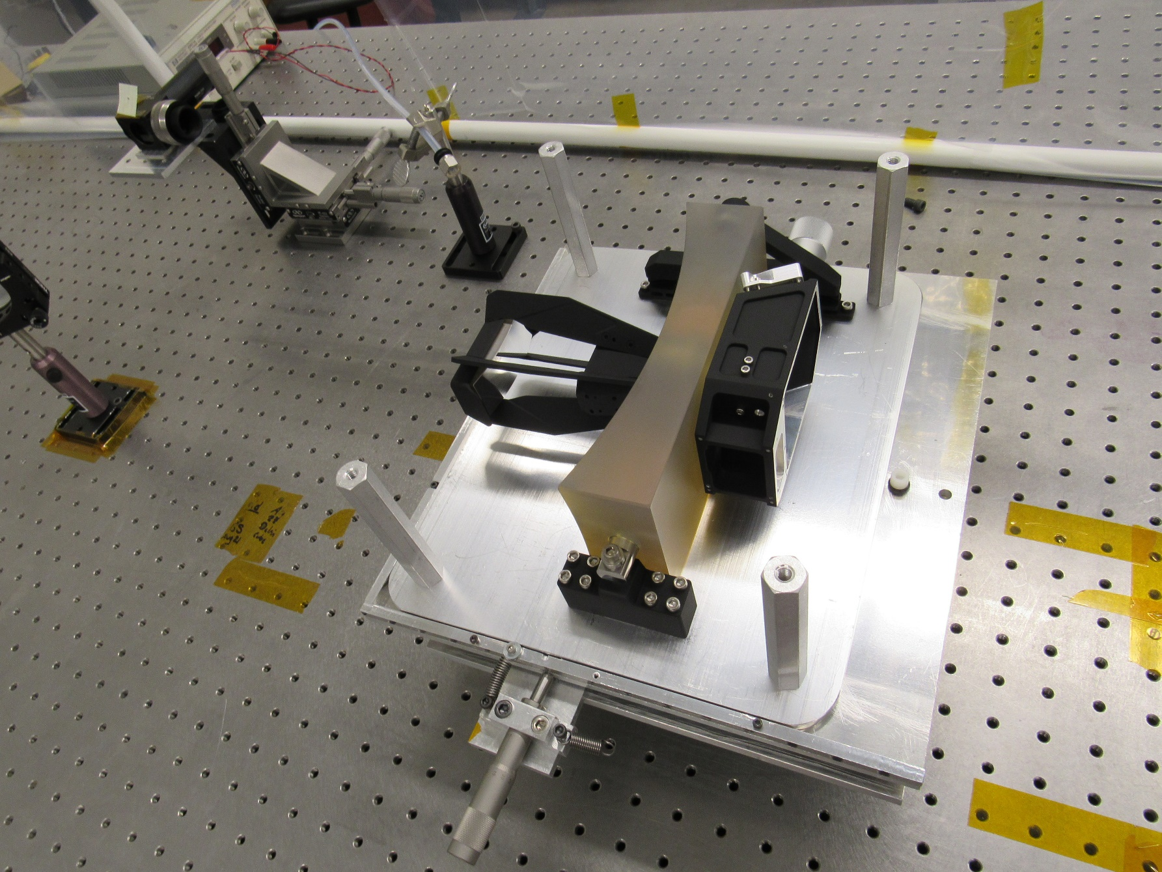
CUTE Telescope (Flight)
See CUTE design overview in Fleming et al. (2018); Egan et al. (2018)
Notes:
DETECTOR: e2v CCD42-10 back-illuminated, UV-enhanced CCD detector. The CCD42-10 has an active area of 27.6 6.9 mm with 2048 x 515 pixels, each 13.5 micron square. The CCD42-10 has flight heritage from the Mars Science Laboratory ChemCham LIBS spectrometer

Slide 30
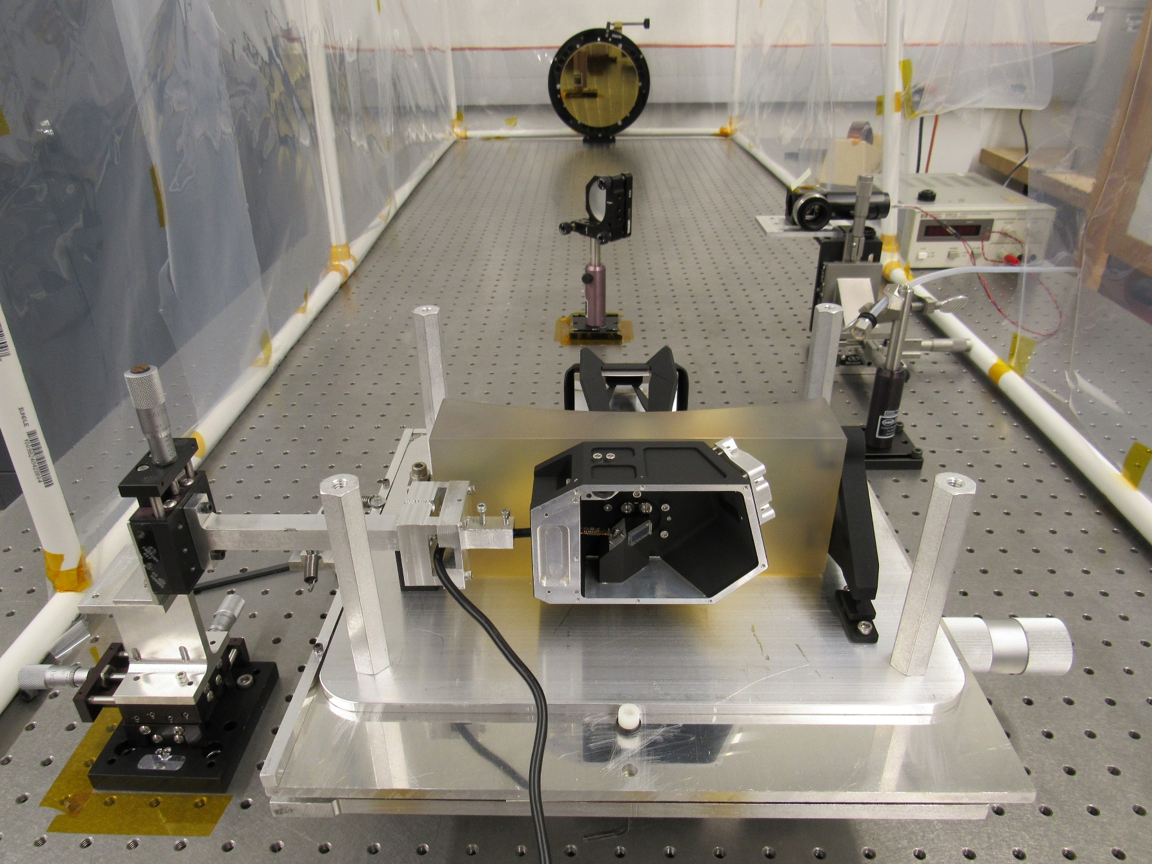
CUTE Telescope (Flight)
See CUTE design overview in Fleming et al. (2018); Egan et al. (2018)
Notes:
DETECTOR: e2v CCD42-10 back-illuminated, UV-enhanced CCD detector. The CCD42-10 has an active area of 27.6 6.9 mm with 2048 x 515 pixels, each 13.5 micron square. The CCD42-10 has flight heritage from the Mars Science Laboratory ChemCham LIBS spectrometer

Slide 31
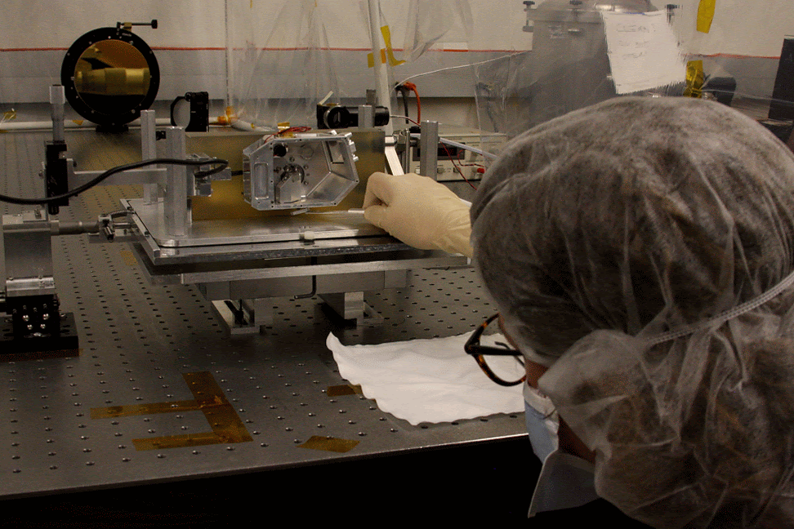
CUTE Telescope (Flight)
See CUTE design overview in Fleming et al. (2018); Egan et al. (2018)
Notes:
DETECTOR: e2v CCD42-10 back-illuminated, UV-enhanced CCD detector. The CCD42-10 has an active area of 27.6 6.9 mm with 2048 x 515 pixels, each 13.5 micron square. The CCD42-10 has flight heritage from the Mars Science Laboratory ChemCham LIBS spectrometer

Slide 32
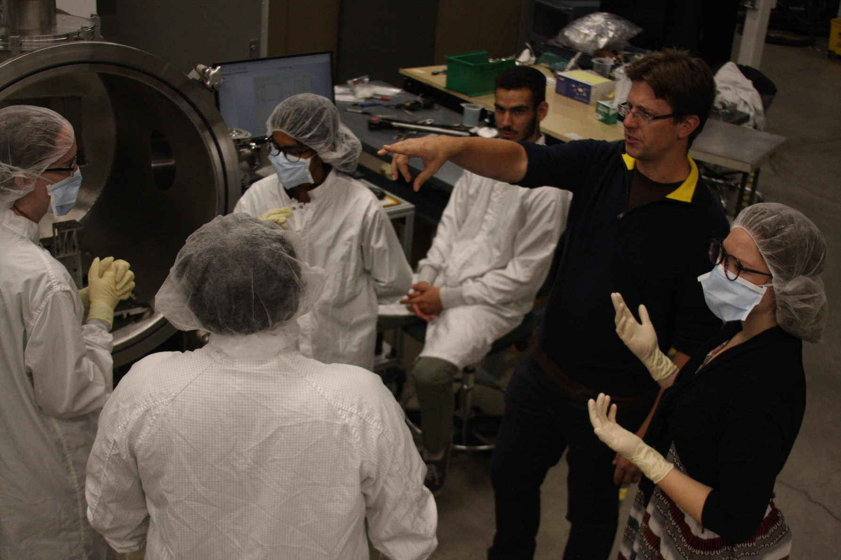
CUTE Team and Testing
Notes:
DETECTOR: e2v CCD42-10 back-illuminated, UV-enhanced CCD detector. The CCD42-10 has an active area of 27.6 6.9 mm with 2048 x 515 pixels, each 13.5 micron square. The CCD42-10 has flight heritage from the Mars Science Laboratory ChemCham LIBS spectrometer

Slide 33
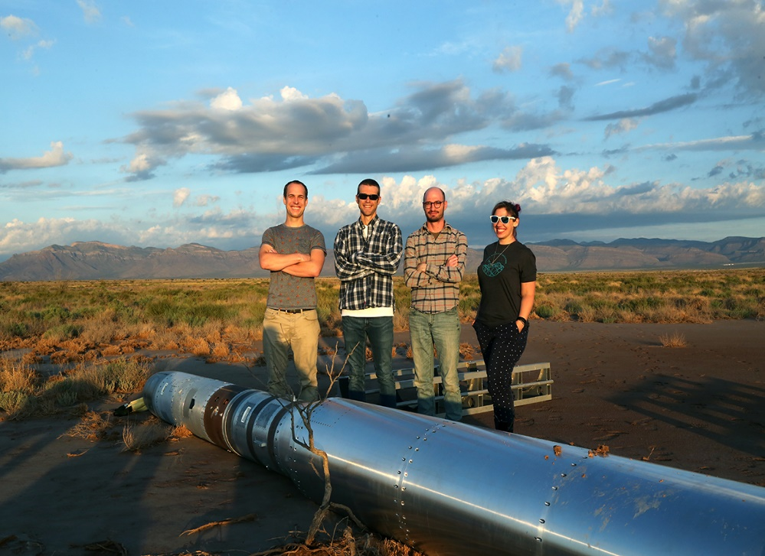
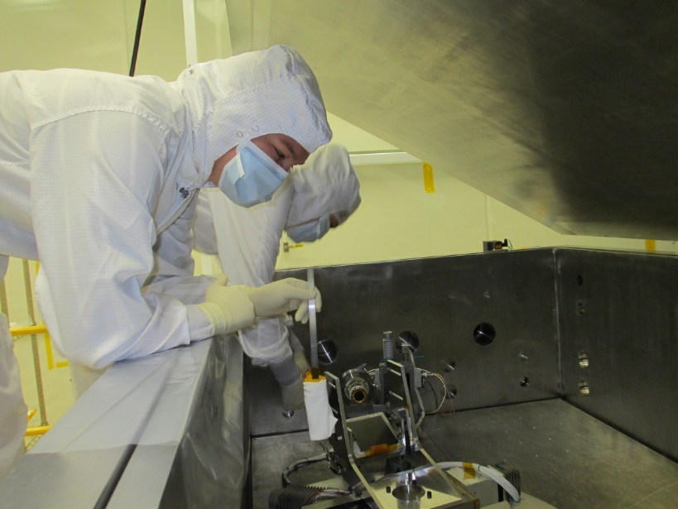
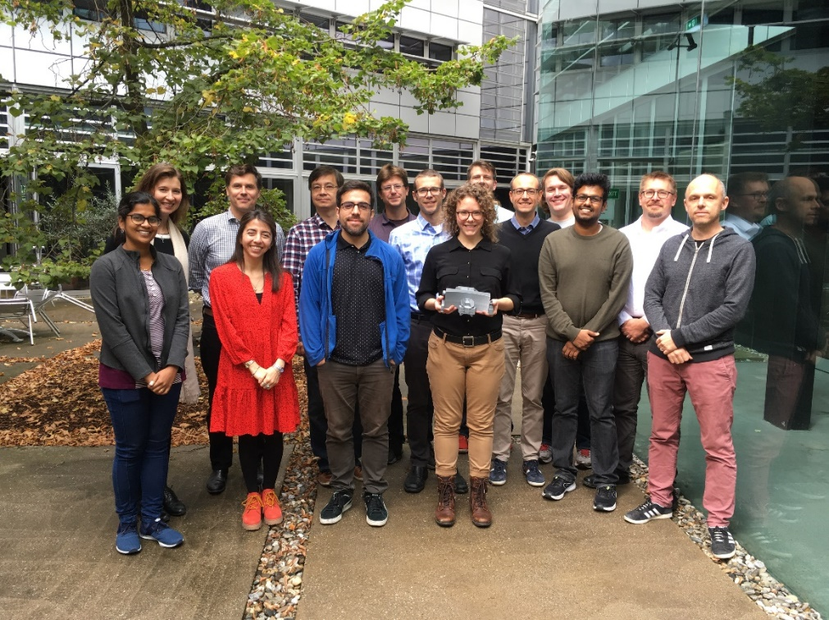
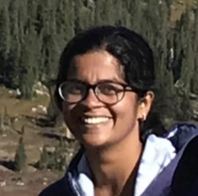
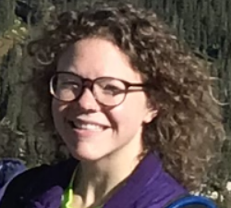



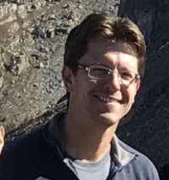
Student & PI Training Opportunities
Suborbital Research Programs: end-to-end mission experience
Hands-on training in space hardware
Dr. Ambily Suresh
Arika Egan
Prof. Kevin France
Stefan Ulrich Nick DeCicco
Prof. Brian Fleming
CUTE Science Team,Oct 2019
Notes:
Both the component-level and end-to-end testing will be performed in the vacuum facilities at the University of Colorado.
In addition, we have a fully capable uplink/downlink command center (UHF to command the spacecraft, S-band for data downlink) at LASP.

Slide 34
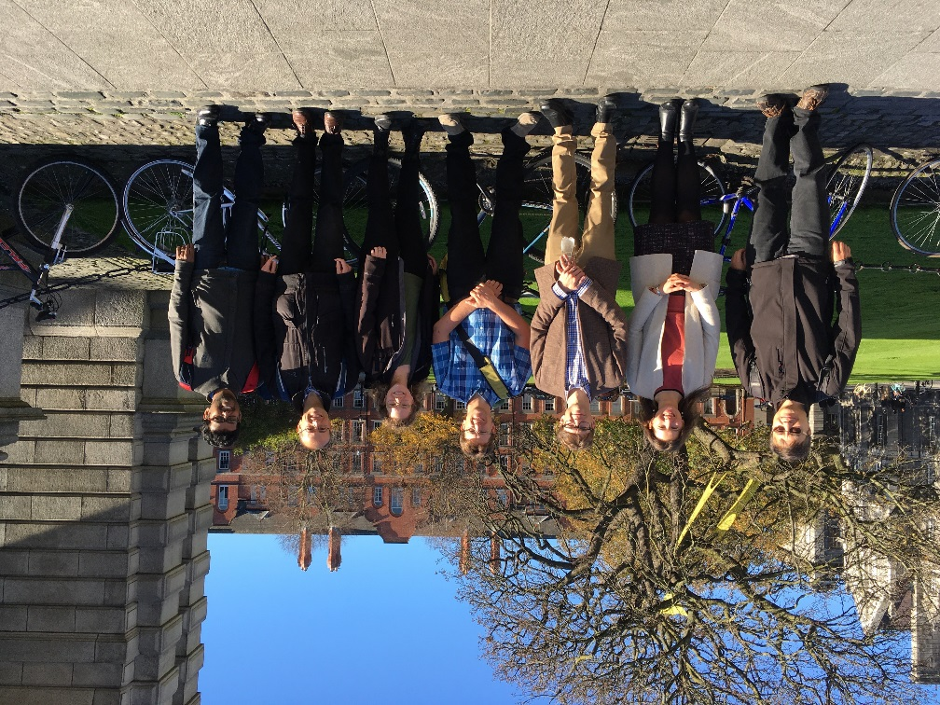
Student Training at the University of Colorado
Suborbital Research Programs: end-to-end mission experience
Hands-on training in space hardware
Dr. Ambily Suresh
Arika Egan
Prof. Kevin France
Stefan Ulrich Nick DeCicco
Prof. Brian Fleming
CUTE Science Team, Oct 2017
Notes:
Both the component-level and end-to-end testing will be performed in the vacuum facilities at the University of Colorado.
In addition, we have a fully capable uplink/downlink command center (UHF to command the spacecraft, S-band for data downlink) at LASP.

Slide 35
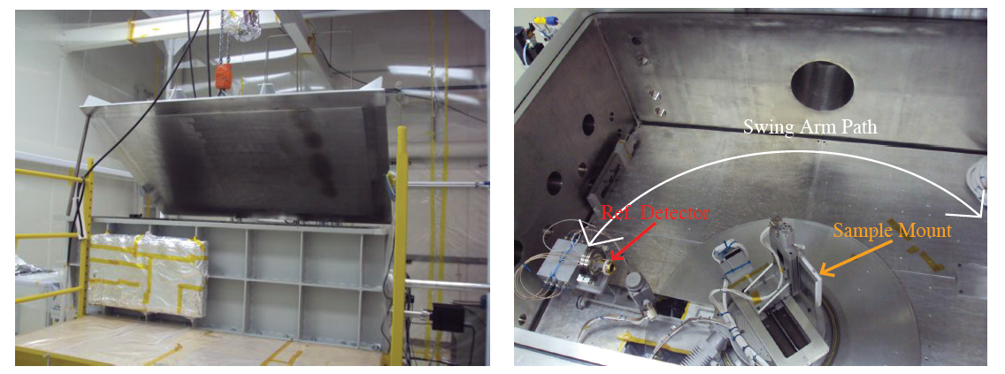
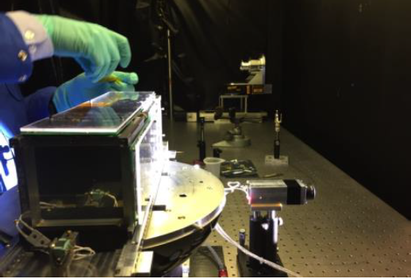
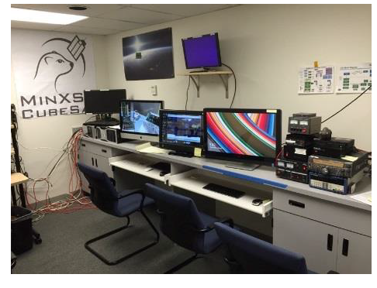
Student Training at the University of Colorado
Notes:
Both the component-level and end-to-end testing will be performed in the vacuum facilities at the University of Colorado.
In addition, we have a fully capable uplink/downlink command center (UHF to command the spacecraft, S-band for data downlink) at LASP.

Slide 36
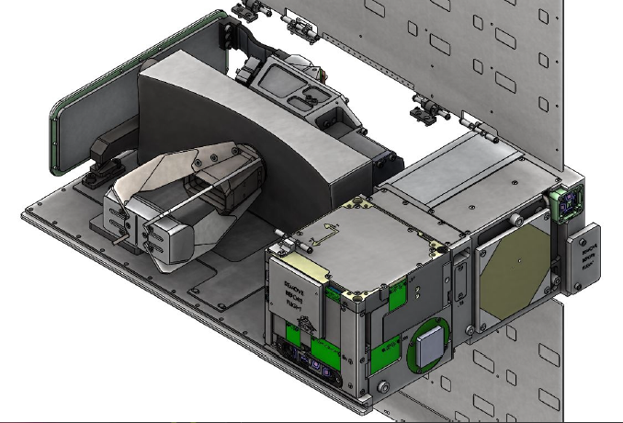
Integrated CUTE Science Instrument
See CUTE design overview in Fleming et al. (2018); Egan et al. (2018)
Notes:
DETECTOR: e2v CCD42-10 back-illuminated, UV-enhanced CCD detector. The CCD42-10 has an active area of 27.6 6.9 mm with 2048 x 515 pixels, each 13.5 micron square. The CCD42-10 has flight heritage from the Mars Science Laboratory ChemCham LIBS spectrometer

Slide 37
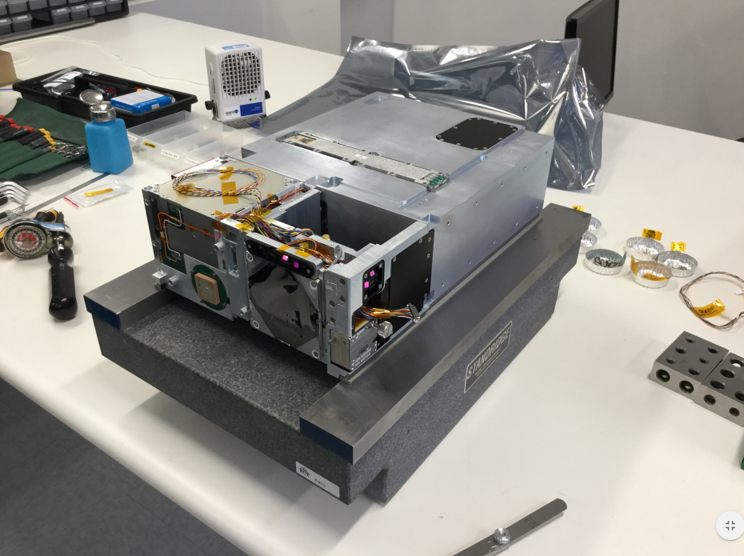
CUTE Spacecraft: Blue Canyon Technology
See CUTE design overview in Fleming et al. (2018); Egan et al. (2018)
Notes:
DETECTOR: e2v CCD42-10 back-illuminated, UV-enhanced CCD detector. The CCD42-10 has an active area of 27.6 6.9 mm with 2048 x 515 pixels, each 13.5 micron square. The CCD42-10 has flight heritage from the Mars Science Laboratory ChemCham LIBS spectrometer

Slide 38
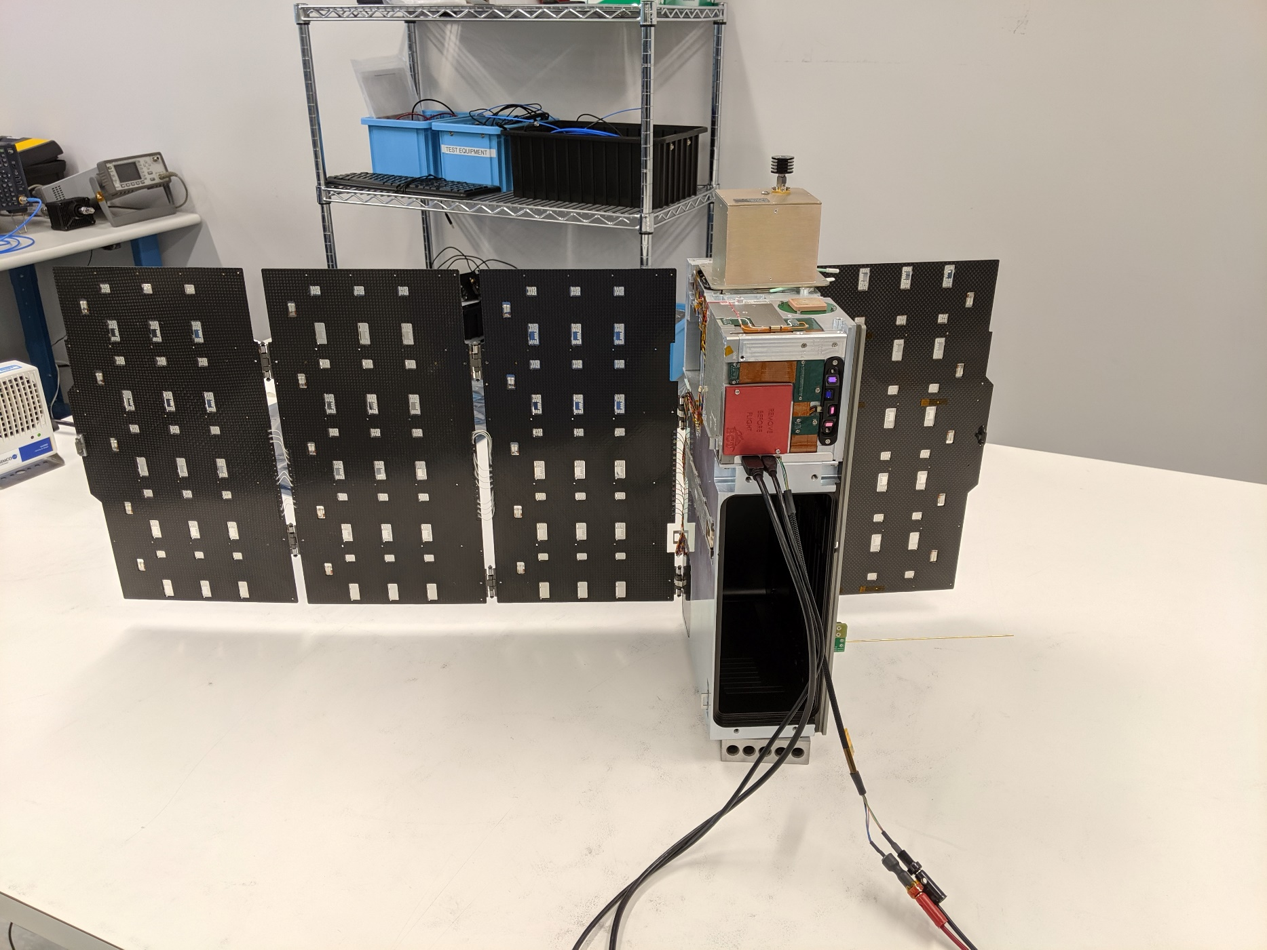
CUTE Spacecraft: Blue Canyon Technology
See CUTE design overview in Fleming et al. (2018); Egan et al. (2018)
Notes:
DETECTOR: e2v CCD42-10 back-illuminated, UV-enhanced CCD detector. The CCD42-10 has an active area of 27.6 6.9 mm with 2048 x 515 pixels, each 13.5 micron square. The CCD42-10 has flight heritage from the Mars Science Laboratory ChemCham LIBS spectrometer

Slide 39
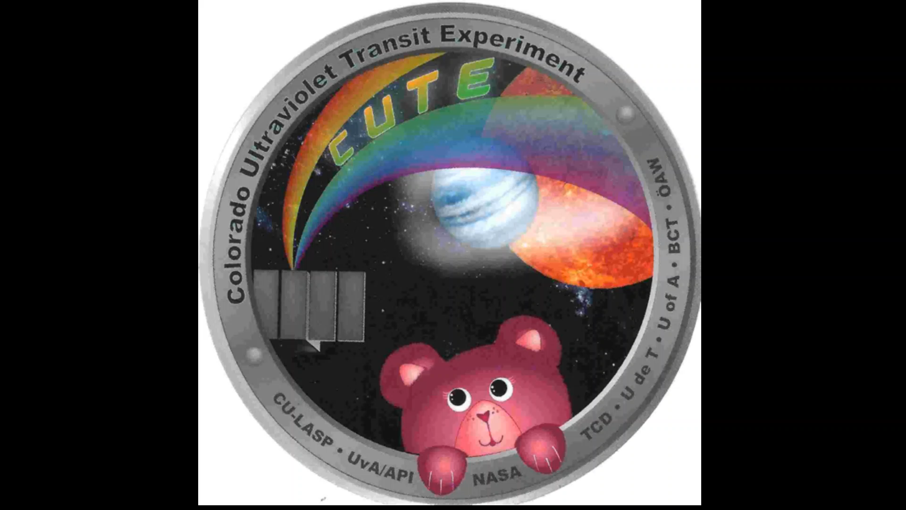
CUTE Spacecraft Testing
See CUTE design overview in Fleming et al. (2018); Egan et al. (2018)
Notes:
DETECTOR: e2v CCD42-10 back-illuminated, UV-enhanced CCD detector. The CCD42-10 has an active area of 27.6 6.9 mm with 2048 x 515 pixels, each 13.5 micron square. The CCD42-10 has flight heritage from the Mars Science Laboratory ChemCham LIBS spectrometer

Slide 40
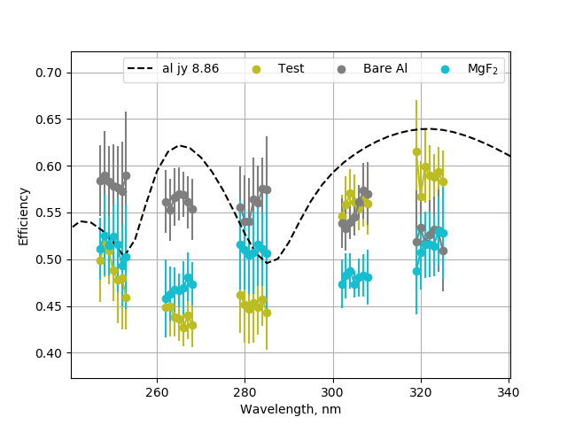
CUTE Flight Grating(s)
See CUTE design overview in Fleming et al. (2018), Egan et al. (2018)
Notes:
The rectangular telescope feeds light into a compact medium-resolution spectrometer…..You can see the 10cm, ~4 inches, shown for reference.
GRATING: The beam is diffracted, magnified, and focused by a spherical R=86.1 mm, 1714 gr/mm aberration correcting ion-etched holographic grating of the type used in HST-COS and ruled by Horiba J-Y.

Slide 41
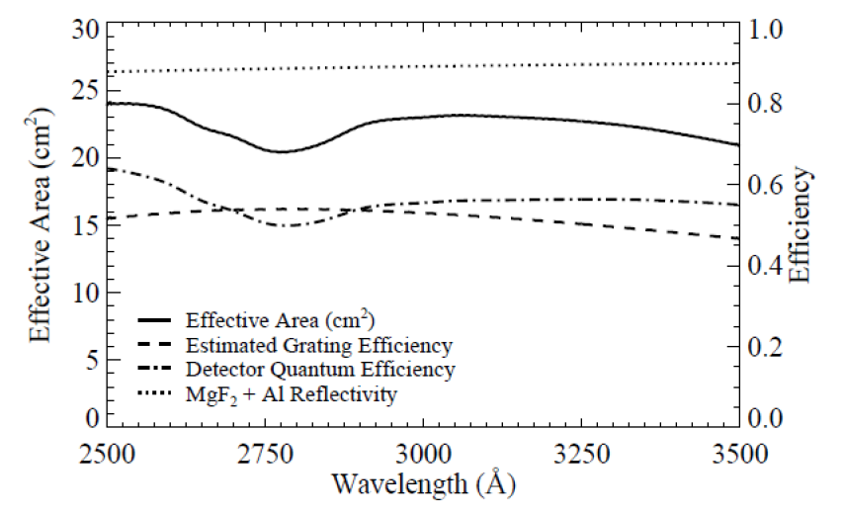
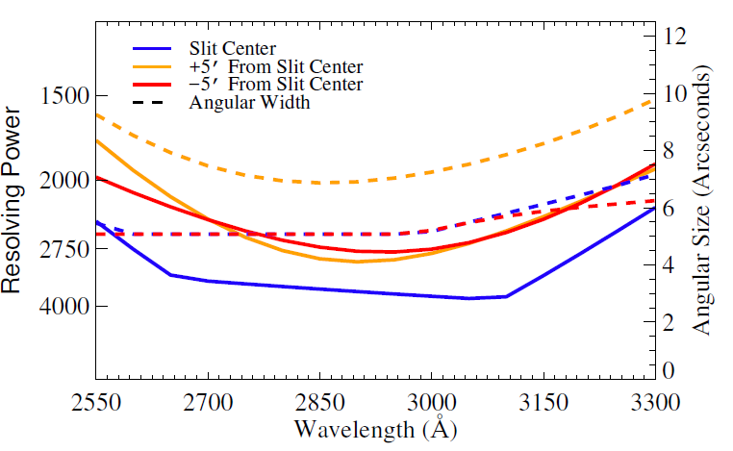
CUTE Predicted Performance
Proposal
20 x 8 cm Telescope:
A_{eff} = A_{T} R⁵ ε_{grat} QE_{D} = 20-25 cm²
Compact Spectrograph:
<R> = 2000 - 3000
Performance relative to GALEX NUV Grism:
A_{eff,CUTE}/A_{eff,GALEX} = ~50%
R_{CUTE}/R_{GALEX,NUV} = 40x
Angular Resolution: Similar
Notes:
COS G230L: 440 cm^2 at 2800 Ang.
STIS E230M: 200-300cm2 at 2800 Ang (so CUTE is actually about 10% of STIS E230M sensitivity)
Sensitivity for 1WASP 14b transit: ~ 1.2%

Slide 42
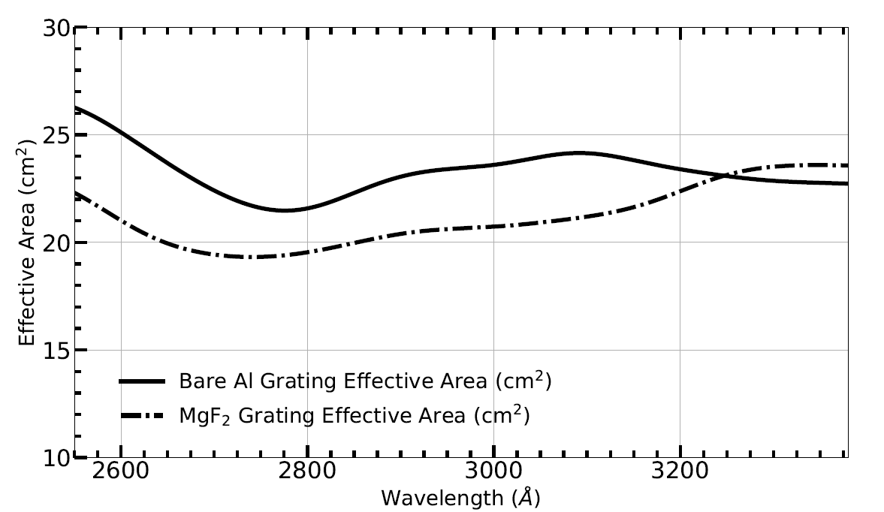
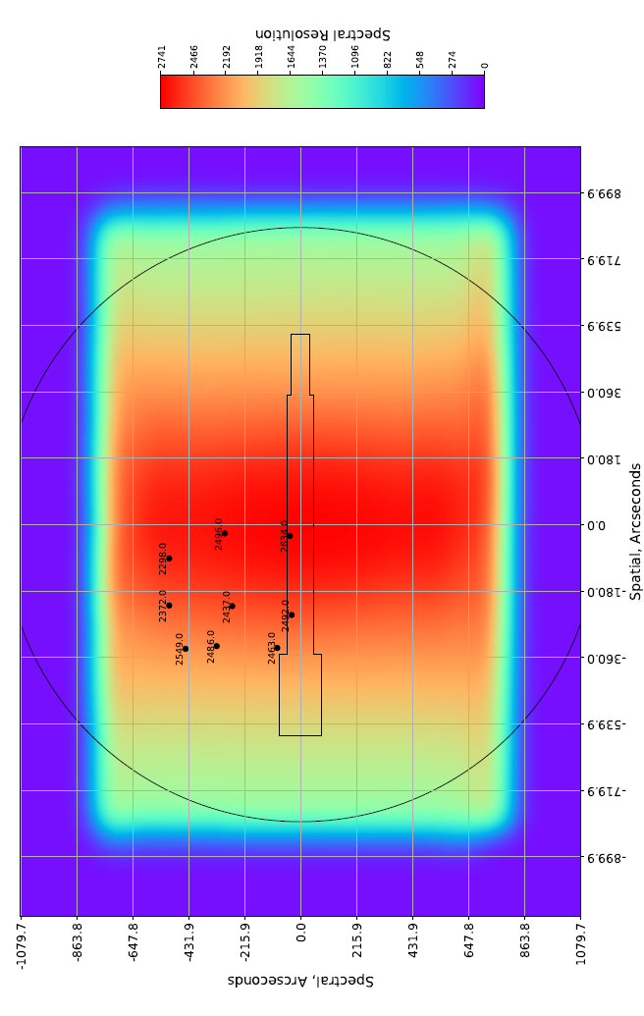
CUTE Measured Performance
Flight
Components
Instrument Sensitivity:
A_{eff} = A_{T} R⁵ ε_{grat} QE_{D} = 20-25 cm²
Flight Telescope Spots:
<R> = 2400-2600
Notes:
COS G230L: 440 cm^2 at 2800 Ang.
STIS E230M: 200-300cm2 at 2800 Ang (so CUTE is actually about 10% of STIS E230M sensitivity)
Sensitivity for 1WASP 14b transit: ~ 1.2%

Slide 43
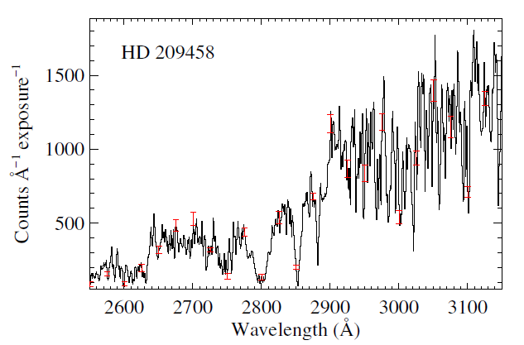
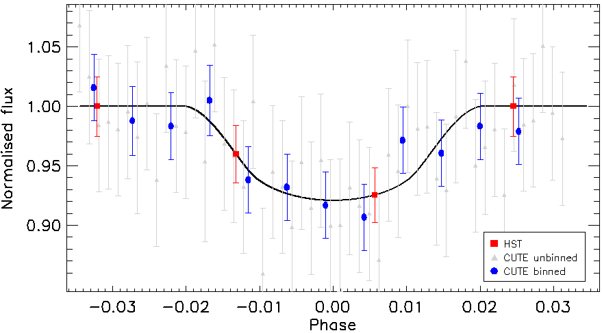
CUTE Predicted Performance
CUTE will achieve >3σ detections of transits as low as 0.1% depth for the brightest targets, and < 1% for all baseline targets with 5+ lightcurves per target:
  Continuum transit sensitivity to 0.7% depth for median target over 1 transit
  = Capable of detecting geometric transit and atmospheric transit
Notes:
note 0.1% is less than the geometric size of most planets, so that will provide a baseline reference point.
< 1% is sufficient for geometric size of most Jovian-sized planets

Slide 44

CUTE Status

Slide 45

CUTE
Jan 2021

Slide 46
CUTE Status
Proposed ROSES D.3 APRA - March 2016
Selected February 2017, funded July 2017
Science Team face-to-face meetings:
Oct 2017, Nov 2018, Oct 2019
Long lead items arrive: 2018 - now
Assembly, test, calibration: ongoing
Launch Q1-2021
  8 Month Baseline mission:
  12 exoplanetary systems, 6-10 transits each
  12 – 20 additional systems in 12 month extended mission
@CuteCubeSat

Slide 47
END
Notes:
DETECTOR: e2v CCD42-10 back-illuminated, UV-enhanced CCD detector. The CCD42-10 has an active area of 27.6 6.9 mm with 2048 x 515 pixels, each 13.5 micron square. The CCD42-10 has flight heritage from the Mars Science Laboratory ChemCham LIBS spectrometer

Slide 48

CUTE Example Target Visibility List
PI – France
Notes:
Sample target availability plot for the first quarter of 2020: every time you see one of the planet’s colorbar filled in, that planet is available for a transit observation.
As you can see, there are ample targets at all times, enabling high-efficiency observing.

Slide 49

CUTE Mission Summary
See CUTE design overview in Fleming et al. (2018), Egan et al. (2018)
Notes:
DETECTOR: e2v CCD42-10 back-illuminated, UV-enhanced CCD detector. The CCD42-10 has an active area of 27.6 6.9 mm with 2048 x 515 pixels, each 13.5 micron square. The CCD42-10 has flight heritage from the Mars Science Laboratory ChemCham LIBS spectrometer

Slide 50


Exoplanet Atmospheres
Spectroscopic transit analysis can probe absorption by specific atmospheric constituents
Atmospheric Water
Absorption
Optical, NIR Transit of the HD 209458b
(Deming et al. 2013, see also Burrows et al. 2014, Sing et al. 2016)
Occultation Depth = (R_{P}(λ) / R*)²
Notes:
Note also that this was how the first exoplanetary atmosphere was discovered (sodium in 209458b atmosphere from HST by Charbonneau et al. 2002).

Slide 51

Transit animation
NUV Transit Spectra of WASP-12b: Early Ingress
Slide credits Joe Llama – Lowell Obs
Fossati et al. (2010); Vidotto et al. (2010)

Slide 52


Transit animation
NUV Transit Spectra of WASP-12b: Early Ingress
Slide credits Joe Llama – Lowell Obs
Fossati et al. (2010); Vidotto et al. (2010)
Llama et al. (2011); Haswell et al. (2012)
Nichols et al. (2015)

Slide 53

Slide credits Joe Llama – Lowell Obs
Interaction between stellar wind and planetary magnetic field may cause compression.
(Vidotto et al. 2010, 2011)
Interaction strength depends on relative velocity and coronal/wind density and temperature
Notes:
DO EXOPLANETS HAVE MAGNETIC FIELDS?

Slide 54

WASP-12b in the Near-UV
NUV Transit Spectra of WASP-12b: Early Ingress
Slide credits Joe Llama – Lowell Obs
Llama et al. (2011), Vidotto et al. (2010):
  Potential detection of a magnetic field around WASP-12b.
  Magnetosphere protects the atmosphere to ~5 Rp.
  Bp ~ 24 Gauss
1.000
Flux
0.985
0.970
-0.1
0.0
-0.1
Phase
Notes:
Results have been very unconvincing, but the low quality of the data (for the ~3 of this stars this can be done on) is the limiting factor at this point (in my mind)

Slide 55
Not the only interpretation:
Hydrodynamic mass-loss may support an upstream shock (Lai et al. 2010)
Accretion stream onto the star ahead of the motion (Bisikalo et al. 2013)
Plasma torus from satellites (Ben-Jaffel & Ballester 2014; Kislyakova et al. 2016)
CLOUDY modeling finds compressed stellar winds produce insufficient optical depth, arguing for the planetary mass-loss explanation (Turner et al. 2016)
Notes:
DO EXOPLANETS HAVE MAGNETIC FIELDS?

