Slide 1









Probing the UV Environment of Exoplanets
around M dwarfs with SPARCS
(Star-Planet Activity Research CubeSat)
Paul Scowen, for Evgenya Shkolnik
and the SPARCS Mission Team

Slide 2
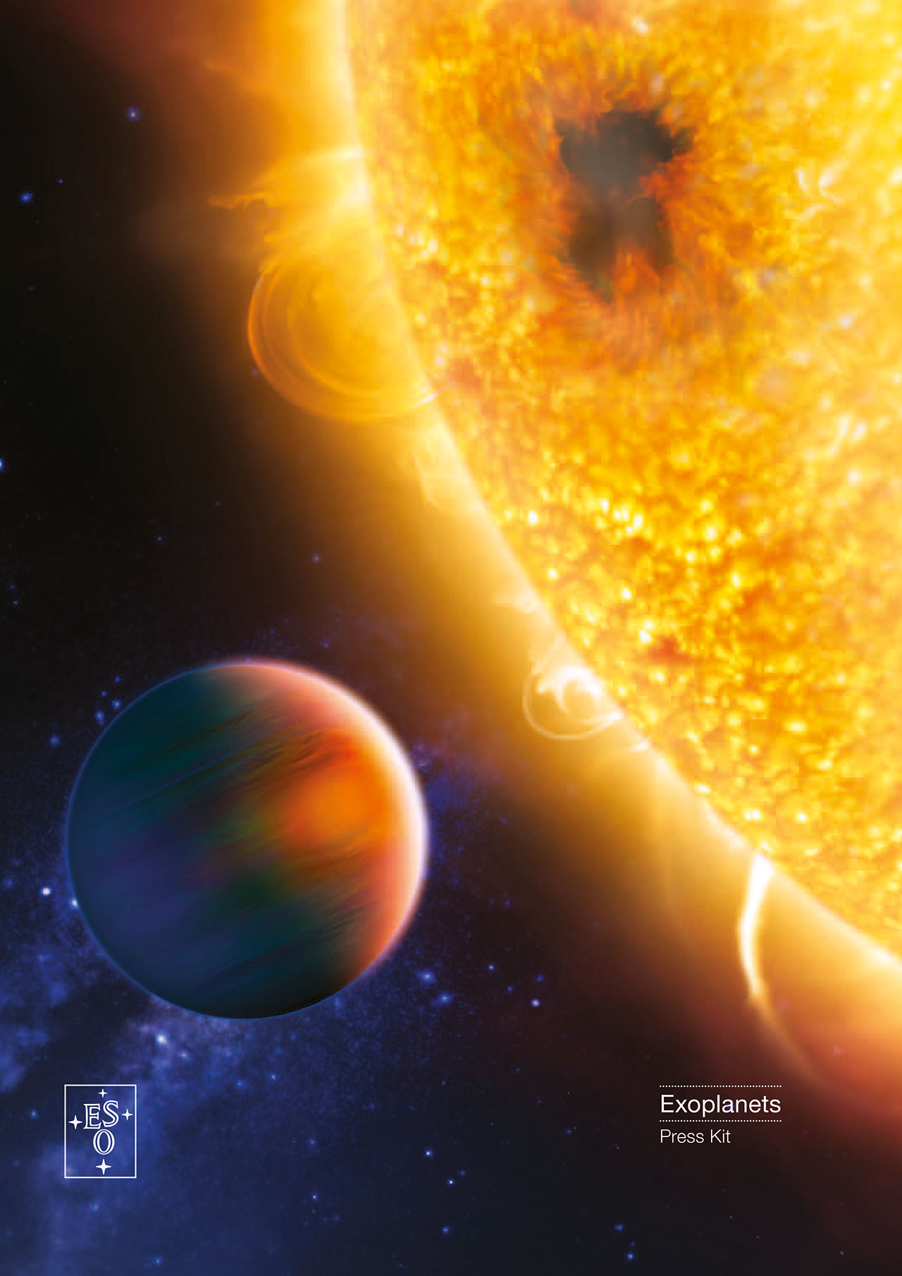
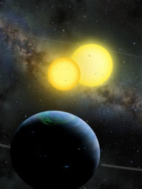
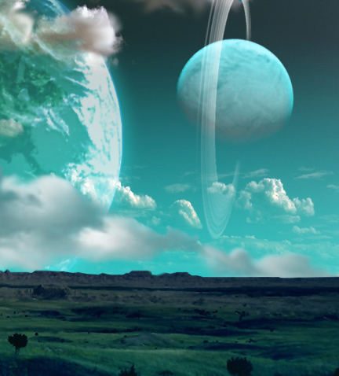
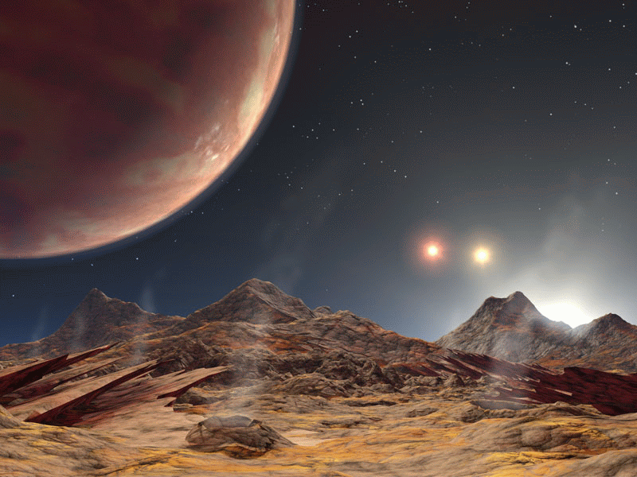
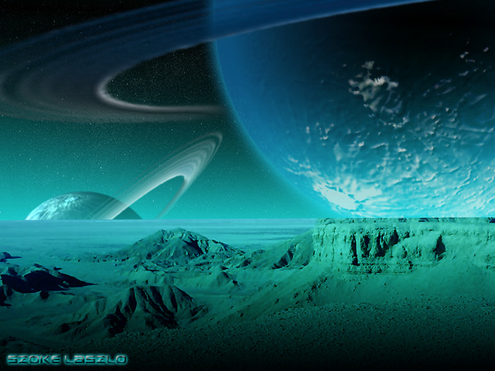
Four facts from three decades of planet hunting:
Exoplanets are everywhere.
They are extremely diverse.
~12 HZ planets...
and counting, mostly around low-mass stars
~25% of planets around low-mass stars lie in the HZ. → ~40 billion HZ planets in the Milky Way!
Why? Because one of my, and perhaps your, life’s goals is to understand the distribution of planetary (incl. habitable) environments in our galaxy.
Exoplanets are everywhere.
Characterization of HZ planets is happening.

Slide 3
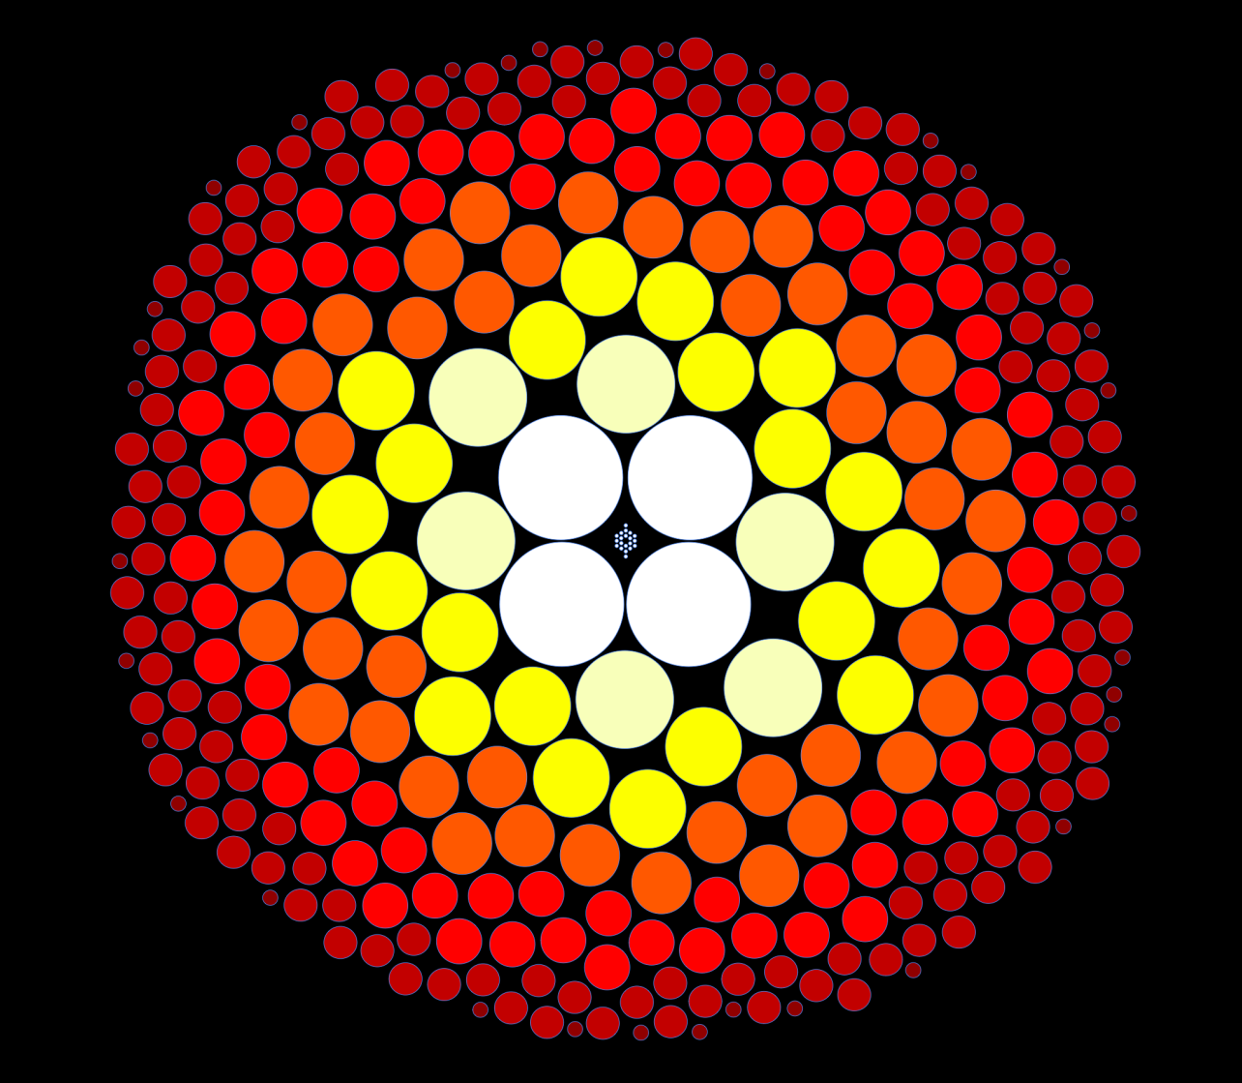
Nearest stars within
30 light years
Sun
Early-Ms
Luminosity (Sun=1)
Mid-Ms
Late-Ms
Mass (Sun=1)
Credit: T. Henry, RECONS group

Slide 4
Nearest stars within
30 light years
Sun
Luminosity (Sun=1)
e.g. Proxima Centauri 0.2% of Sun’s luminosity
Mass (Sun=1)
Credit: T. Henry, RECONS group

Slide 5
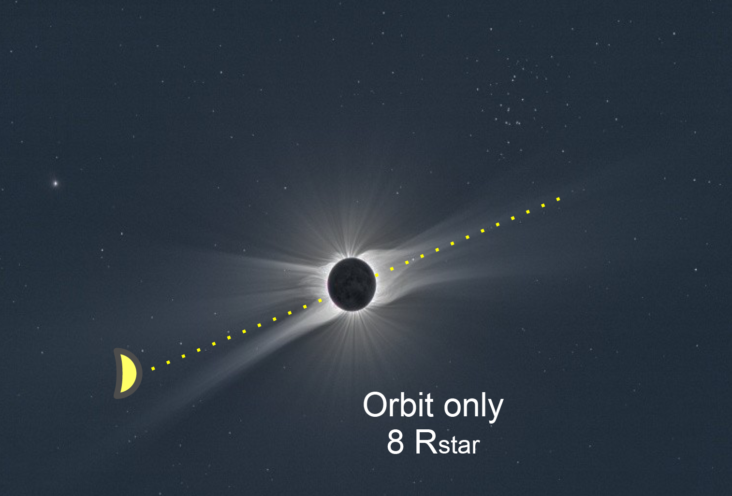

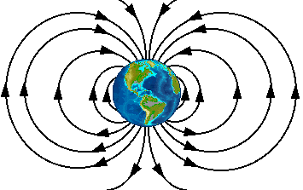
M dwarf HZs are close!
Planetary consequences of high-energy radiation at close distances.
Atmospheric heating/escape by extreme-UV (EUV) photons
Atmospheric photochemistry (e.g. photodissociation of key molecules) by far-UV (FUV) and near-UV (NUV)
Surface habitability
Detection of an habitable and inhabited planet (UV can create false positives and false negatives)

Slide 6
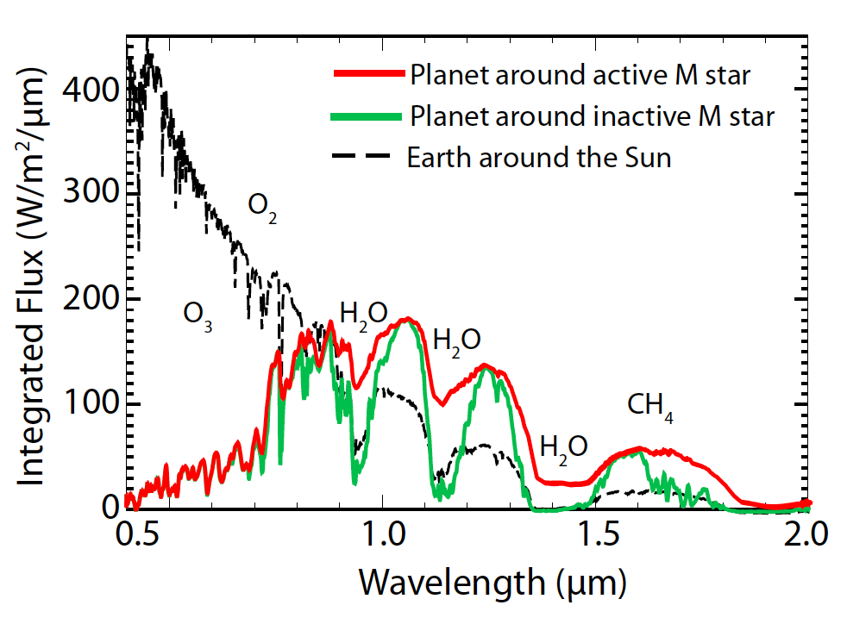
Detecting molecules in a planetary atmosphere requires the UV context.
Dissociate O₂ to form O₃
+
O
O₂
O₃
Photodissociate H₂O, CH₄, and CO₂
+
H₂O
2H
O
Adapted from Rugheimer et al. 2015

Slide 7
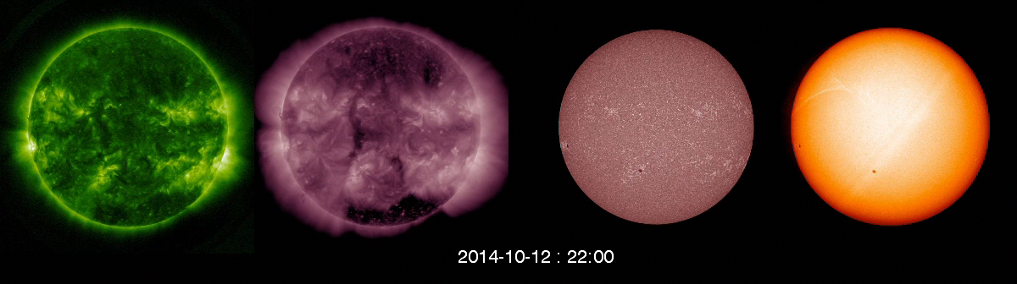
The Sun’s High Energy Radiation
Extreme
ultraviolet
Far
ultraviolet
Soft X-ray
Optical
Flaring & quiet corona
Active corona
Chromosphere & transition region
Photosphere
NASA/SDO/J. Llama

Slide 8
We known M dwarfs are more active than the Sun.
We want to know how active they are in the UV,
across planet formation and evolution timescales.
Notes:
Here is an image of a solar eclipse

Slide 9

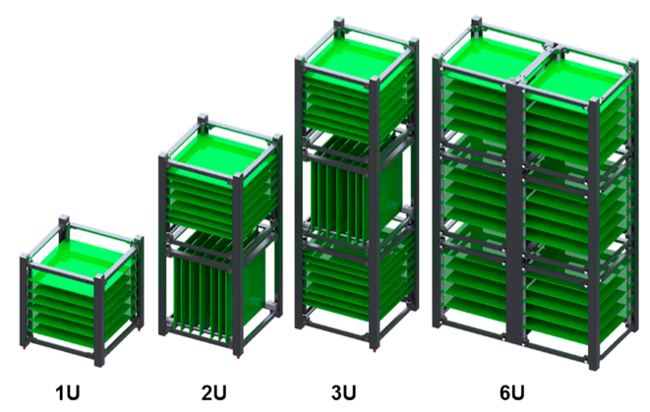
SPARCS will be a 6U CubeSat.
  Standardization of size, and off the shelf components reduces time and costs.
Source: Radius Space
Notes:
CubeSats are small satellites built in units of cubes of 10x10x10 cm. SPARCS will be w 6U cubesat, which is about the size of a family-sized cheerios box. The family-size is important because, as many of you, every mm counts when building a space craft.

Slide 10
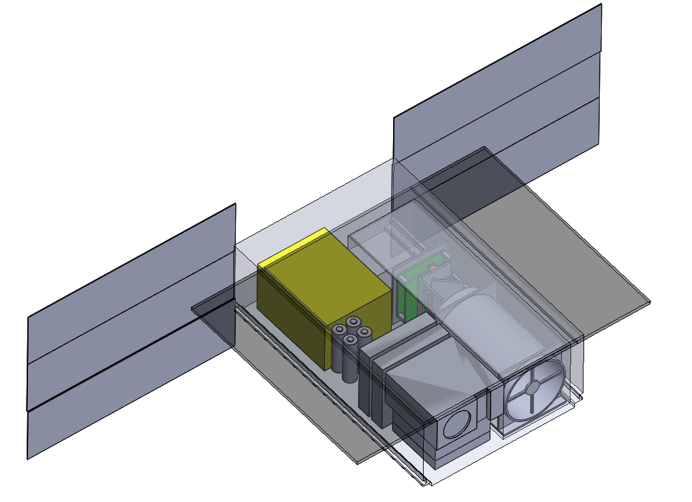
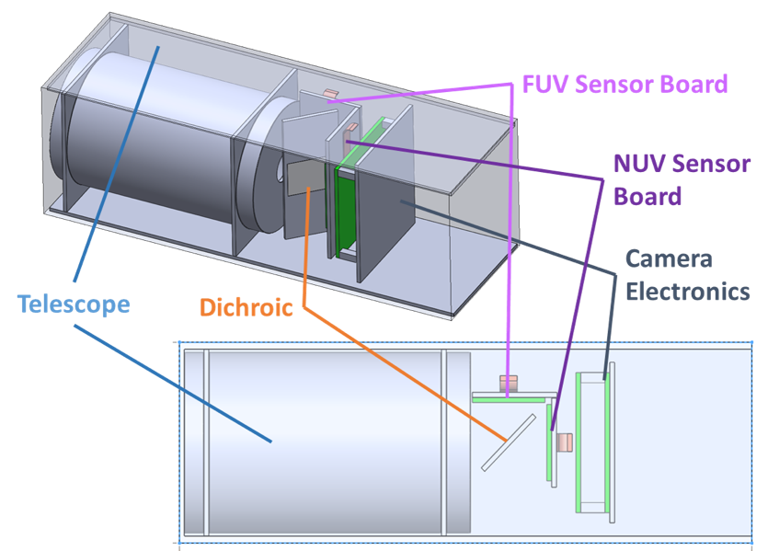
Overview of SPARCS
6U CubeSat, 9 cm telescope
with a 0.7° FOV
Active pointing with reaction
wheels and star tracker
UV camera with two
detectors: S-FUV [153-171 nm]
& S-NUV [258-308 nm]
Photometric precision:
1% - 10%
>1 year of dedicated monitoring of M stars from a sun-synchronous orbit

Slide 11
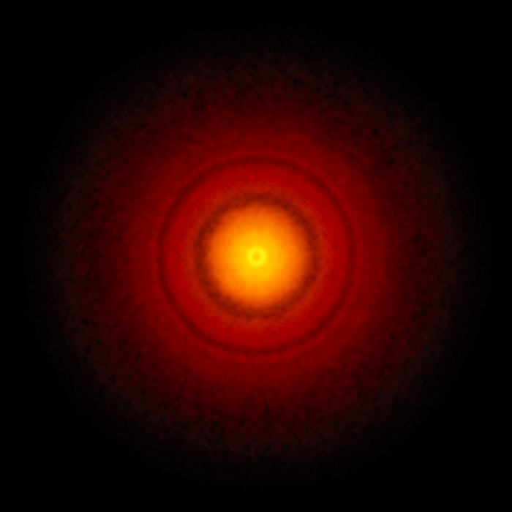
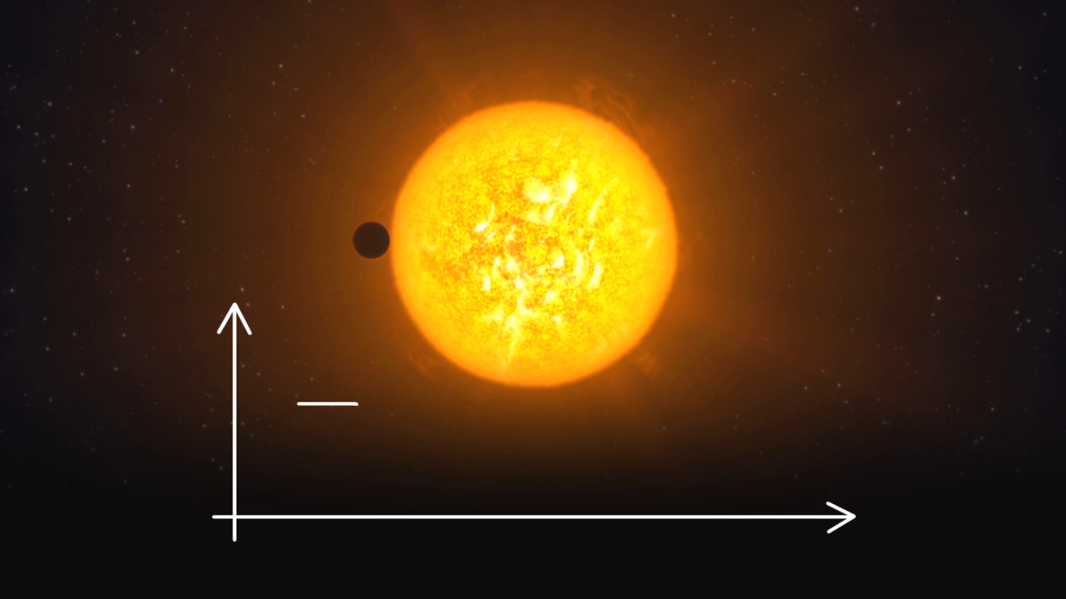
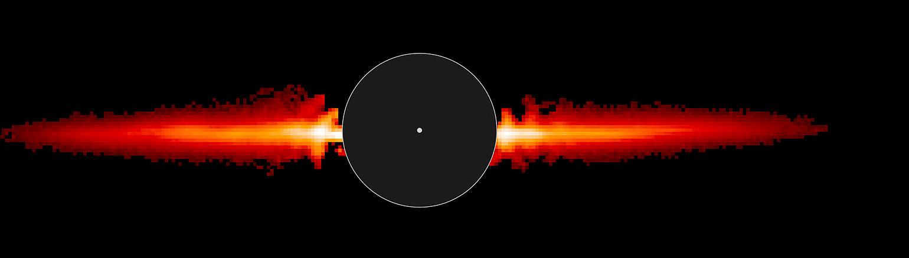
SPARCS Targets
Young M stars possibly forming planets
Old M dwarfs with transiting planets
TWA and AU Mic with debris disks – signpost of planets (Boccaletti et al. 2015)

Slide 12
Adding the time-domain:
SPARCS Monitoring Plan
Recording timescales from minutes to weeks to measure short-term flaring and long-term rotational modulation.
Notes:
Fig. 2.—: SPARCS will provide three orders of magnitude increase in M dwarf UV measurements covering timescales from minutes to weeks recording short-term flaring and long-term rotational modulation. These data will guide new upper-atmosphere stellar models and photochemical planet atmosphere models to better understand the evolution and habitability of a planet. We aim to monitor each of these 22 targets for 15-40 days during a 2-year mission.

Slide 13
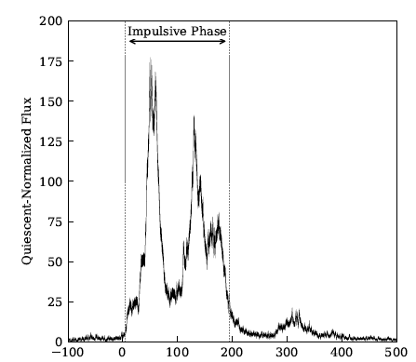
First results: The HazFlare SuperFlare
→ 1 superflare per day on a 45 Myr M star
Time (s)
HAZMAT IV; Loyd et al., 2018b

Slide 14
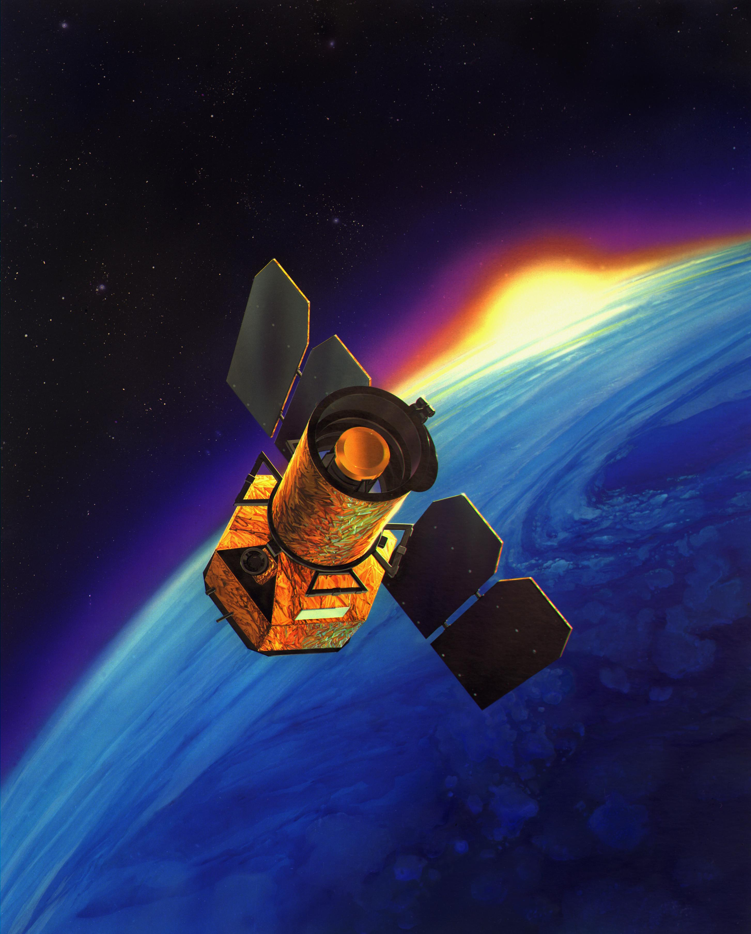
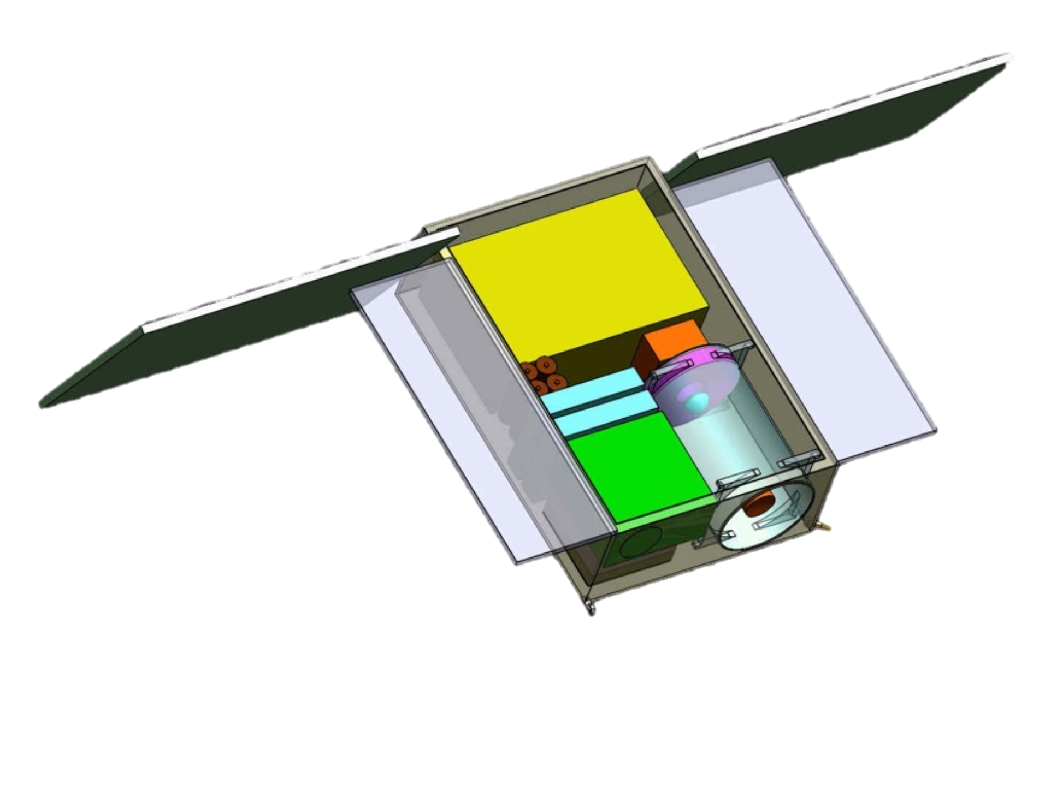
GALEX
SPARCS
^{~To scale}

Slide 15
So what makes us think we can do useful UV science with SPARCS?
(For more details, see poster papers)

Slide 16
An interdisciplinary, creative team that can work together for years.
Principal Investigator
Evgenya Shkolnik (ASU)
Science
Travis Barman (UA)
Varoujan Gorjian (JPL)
Joe Llama (Lowell)
Victoria Meadows (UW)
Mark Swain (JPL)
Robert Zellem (JPL)
Systems Engineer
Peter Vedder (Qualek)
Daniel Jacobs (ASU)
Payload Scientist
David Ardila (JPL)
Camera/Detector
Shouleh Nikzad (JPL)
April Jewell (JPL)
CubeSat Telescope
and I&T
Paul Scowen (ASU)
Matt Beasley (SWRI)
Mary Knapp (MIT)
Operations/Software
Judd Bowman (ASU)
Tahina Ramiaramanantsoa (ASU)

Slide 17
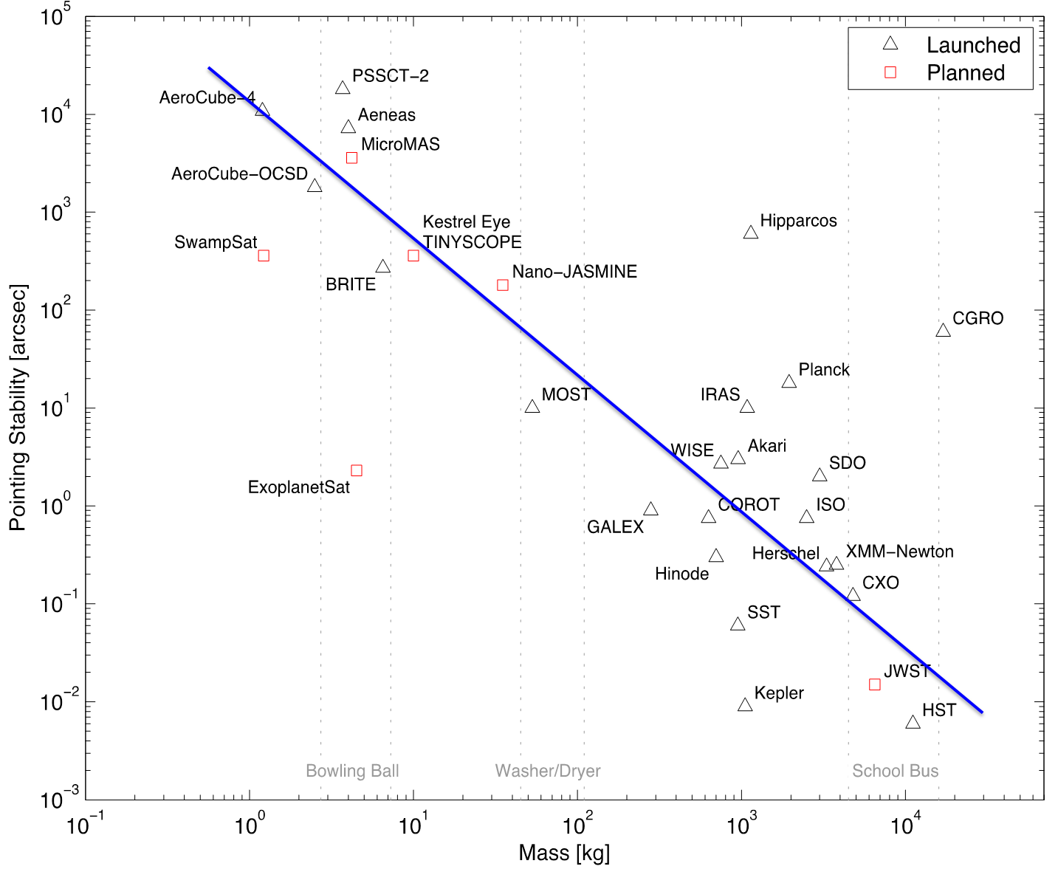
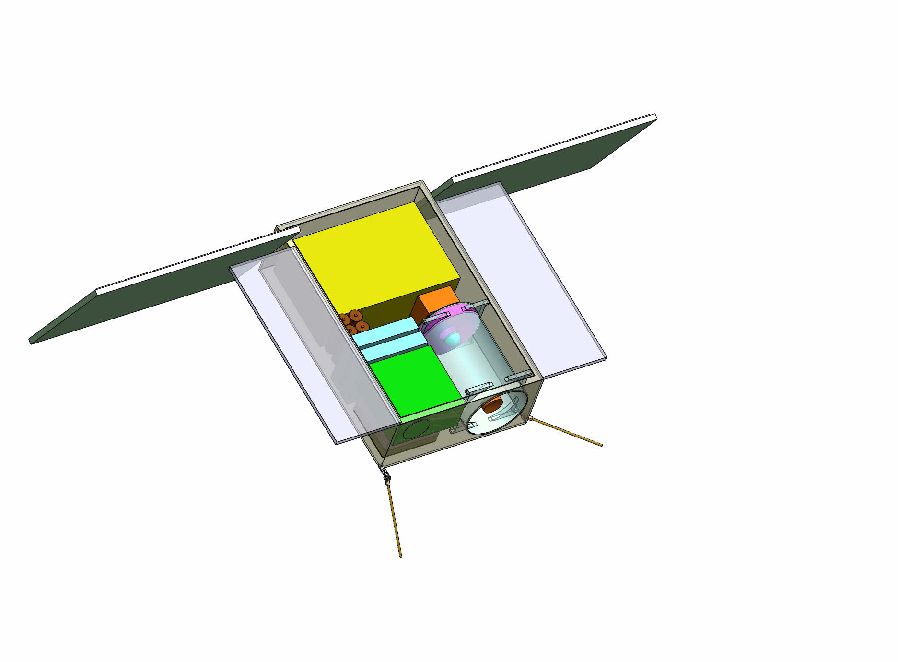
Pointing stability is getting better.
ASTERIA
SPARCS
ACS with a star tracker, accelerometers, a Sun-sensor, and a GPS to precisely drive three-axis reaction wheels.
Credit: C. Pong (MIT/JPL)

Slide 18

SPARCS’ technology mission:
Fly high-QE, delta-doped detectors (SPARCam)
Fully-processed thinned CCDs are modified for UV enhancement by growing
2.5 nm of boron-doped silicon on the back surface.
CCD47-20
NUV detector QE
See Nikzad et al. 2012
Notes:
But the technological SECRET SAUCE - is what we call SPARCam
The delta-doped, AR-coated CCD47-20 will set a record for sensitivity and has the potential to revolutionize UV astronomy. SPARCS is enabled by these high QE detectors (>75% in the NUV; >5⇥ higher than GALEX) and visible-blind filters.
Delta-doping paired with custom antireflection (AR) coatings has been shown to consistently increase QE at UV wavelengths to >40% in backside-illuminated (BSI) silicon detectors (Nikzad et al. 2012). This success is the culmi- nation of a focused funding e↵ort by NASA through the COR Strategic Astrophysics Technology (SAT) program and highlighted in the 2014 Cosmic Origins Program An- nual Technology Report (COR-PATR 2014). Delta-doped CCDs such as those planned for SPARCS have already flown on five sounding rockets (Nikzad et al. 2000; Lupu et al. 2008; Feldman et al. 2009; Fernandes et al. 2013), with yet another to be delivered to Caltech for FIREBall- 2, a stratospheric balloon payload for a Fall 2016 flight (Hamden et al. 2014). SPARCS is the logical mission to bring this advanced technology to space.
To control the red leak (Sec. 1.6.4), out-ofband
filter transmission needs to be at least three
orders of magnitude (i.e., %OD3) lower than inband
transmission. Commercial solutions exist
for the S-NUV band, but none can o↵er the high
throughput and large out-of-band rejection required
for the S-FUV band.
To implement the S-FUV band, we will use
JPL’s innovative metal-dielectric filter (MDF).
In MDFs, layers of parallel reflecting plates
separated by a transparent layer are deposited
on delta-doped imagers (Hennessy et al. 2015;
Nikzad et al. 2016). These layers constructively
phase-match the transmission at particular wavelengths
and not at others. Out-of-band light is
not subjected to the same interference and is
rejected by the high natural reflectance of the
stack.

Slide 19
SPARCS’ technology mission:
Fly high-QE, delta-doped detectors (SPARCam)
Fully-processed thinned CCDs are modified for UV enhancement by growing
2.5 nm of boron-doped silicon on the back surface.
CCD47-20
NUV detector QE
S-FUV
S-NUV
See Nikzad et al. 2012
Notes:
But the technological SECRET SAUCE - is what we call SPARCam
The delta-doped, AR-coated CCD47-20 will set a record for sensitivity and has the potential to revolutionize UV astronomy. SPARCS is enabled by these high QE detectors (>75% in the NUV; >5⇥ higher than GALEX) and visible-blind filters.
Delta-doping paired with custom antireflection (AR) coatings has been shown to consistently increase QE at UV wavelengths to >40% in backside-illuminated (BSI) silicon detectors (Nikzad et al. 2012). This success is the culmi- nation of a focused funding e↵ort by NASA through the COR Strategic Astrophysics Technology (SAT) program and highlighted in the 2014 Cosmic Origins Program An- nual Technology Report (COR-PATR 2014). Delta-doped CCDs such as those planned for SPARCS have already flown on five sounding rockets (Nikzad et al. 2000; Lupu et al. 2008; Feldman et al. 2009; Fernandes et al. 2013), with yet another to be delivered to Caltech for FIREBall- 2, a stratospheric balloon payload for a Fall 2016 flight (Hamden et al. 2014). SPARCS is the logical mission to bring this advanced technology to space.
To control the red leak (Sec. 1.6.4), out-ofband
filter transmission needs to be at least three
orders of magnitude (i.e., %OD3) lower than inband
transmission. Commercial solutions exist
for the S-NUV band, but none can o↵er the high
throughput and large out-of-band rejection required
for the S-FUV band.
To implement the S-FUV band, we will use
JPL’s innovative metal-dielectric filter (MDF).
In MDFs, layers of parallel reflecting plates
separated by a transparent layer are deposited
on delta-doped imagers (Hennessy et al. 2015;
Nikzad et al. 2016). These layers constructively
phase-match the transmission at particular wavelengths
and not at others. Out-of-band light is
not subjected to the same interference and is
rejected by the high natural reflectance of the
stack.

Slide 20
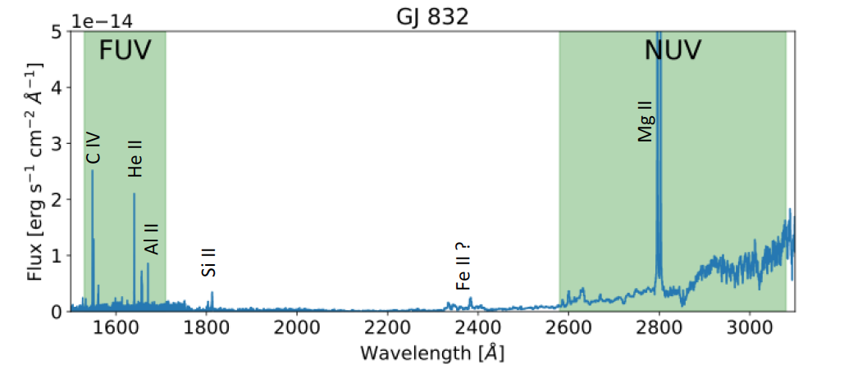
The S-FUV and S-NUV bands contain transition region and chromosphere emission lines.
And together, will track flare colors.
Credit: P. Loyd

Slide 21
Conquering the Red Leak with Custom Filters
σ/μ
Notes:
DELETE?

Slide 22
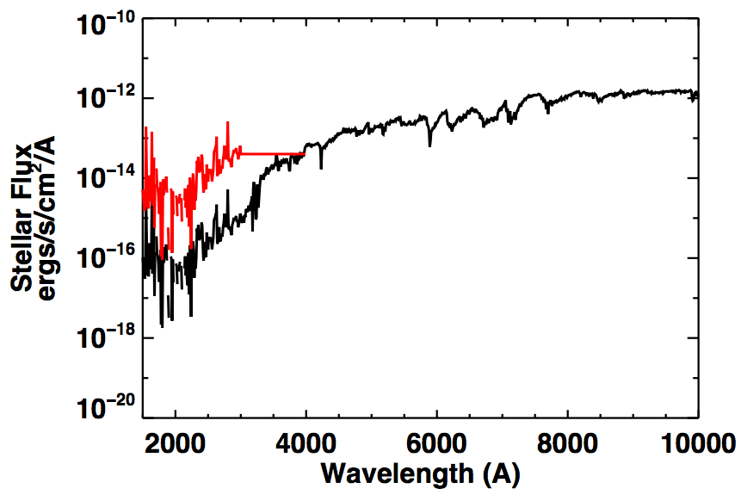
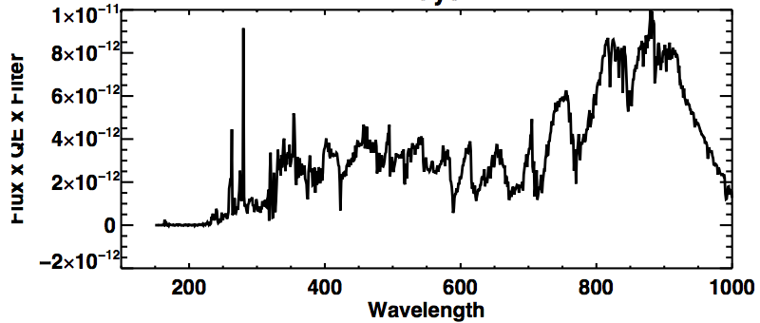
Conquering the Red Leak with
Custom Filters
COTS filters allow stellar red photons to flood the detector.
Stellar Spectrum
s/m

Slide 23
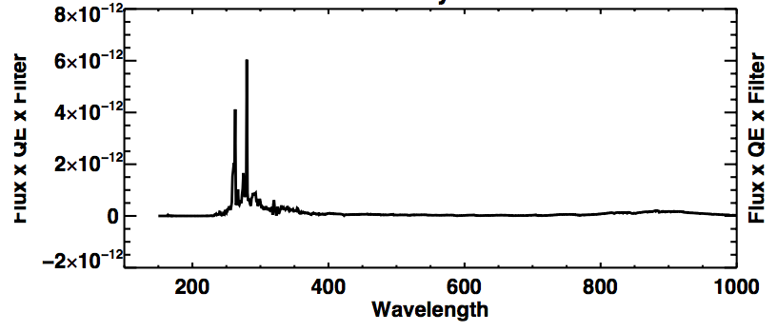
Conquering the Red Leak with
Custom Filters
With SPARCS filters, over 90% of the detected flux is from UV wavelengths for both the active and inactive stars.
Stellar Spectrum
σ/μ

Slide 24
So what makes us think we can do useful UV science with SPARCS?
Great team
COTS parts
More stable pointing
High quantum efficiency detectors
Filters with good red-light suppression
(For more details, see poster papers)

Slide 25
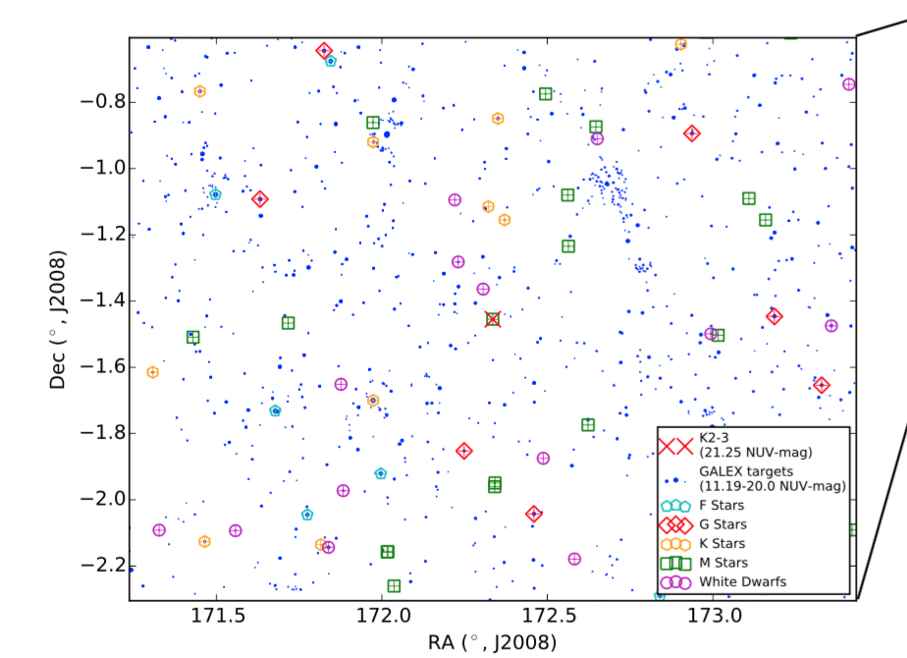
Field of View w/ Ancillary Science

Slide 26
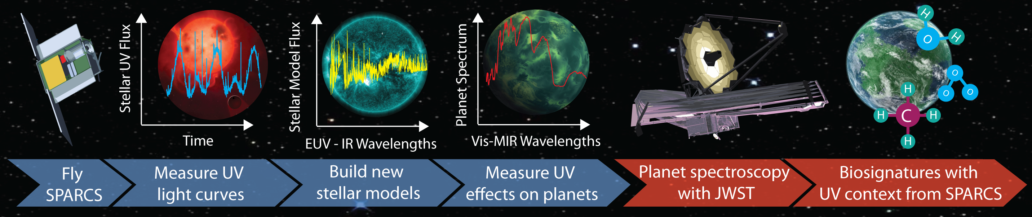
SPARCS Science Plan

Slide 27
SPARCS Science Plan

Slide 28
SPARCS Timeline
Adapted from David Oh (JPL)
Pre-Phase A | Concept Studies | Brainstorming, Trade Studies, Feasibility Study | For SPARCS: 5 months
Phase A | Concept Development
Phase B | Preliminary Design Completion | Detailed Trade Studies, Develop System Designs and Plans | 9 months
Phase C | Final Design and Fabrication | Finish Design, Build Hardware & Software, Test Subsystems | 20 months
Phase D | System Integration, Test & Launch | Bring Everything Together and Test, Test, Test! | 6 months
Phase E | Operations | Fly the Spacecraft, Do the Mission | ≥ 12 months
So, in the end of 2021,
SPARCS will fly....

Slide 29
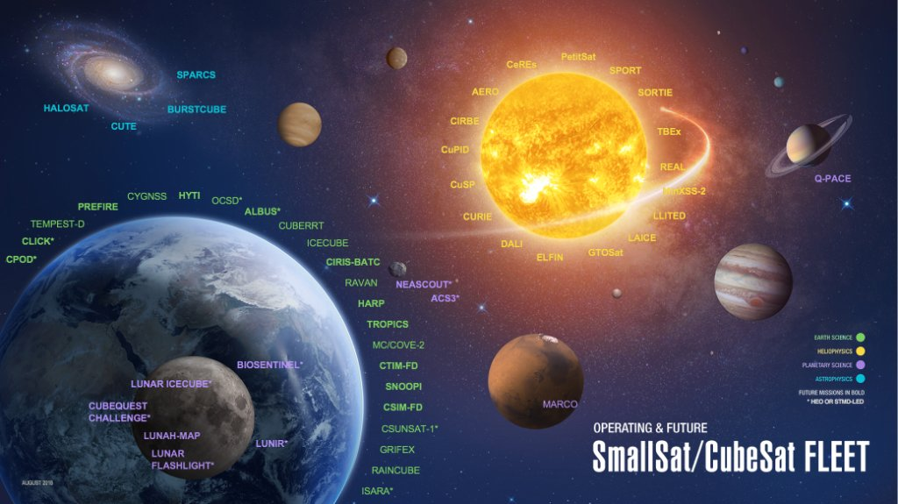
SPARCS in broader CubeSat context

Slide 30
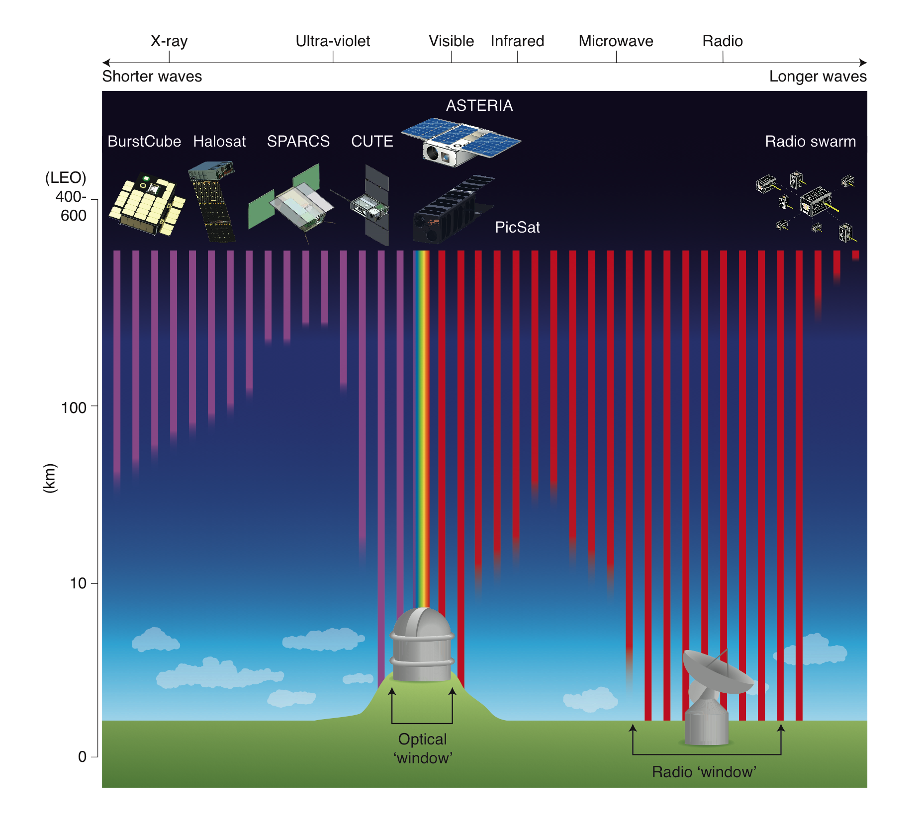

SPARCS in broader CubeSat context
Shkolnik 2018, “On the Verge of an Astronomy CubeSat Revolution”, Nature Astronomy

Slide 31
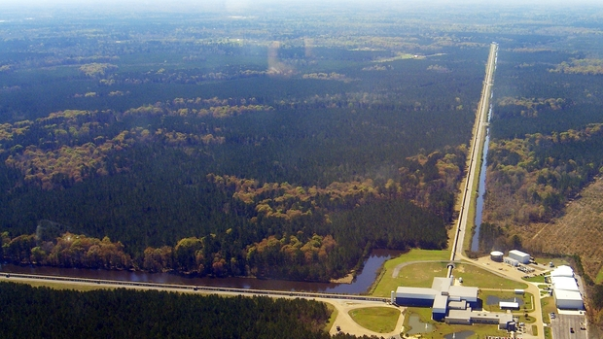
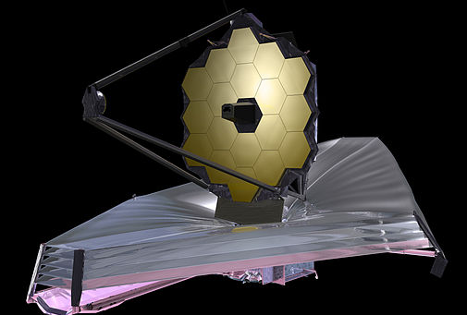
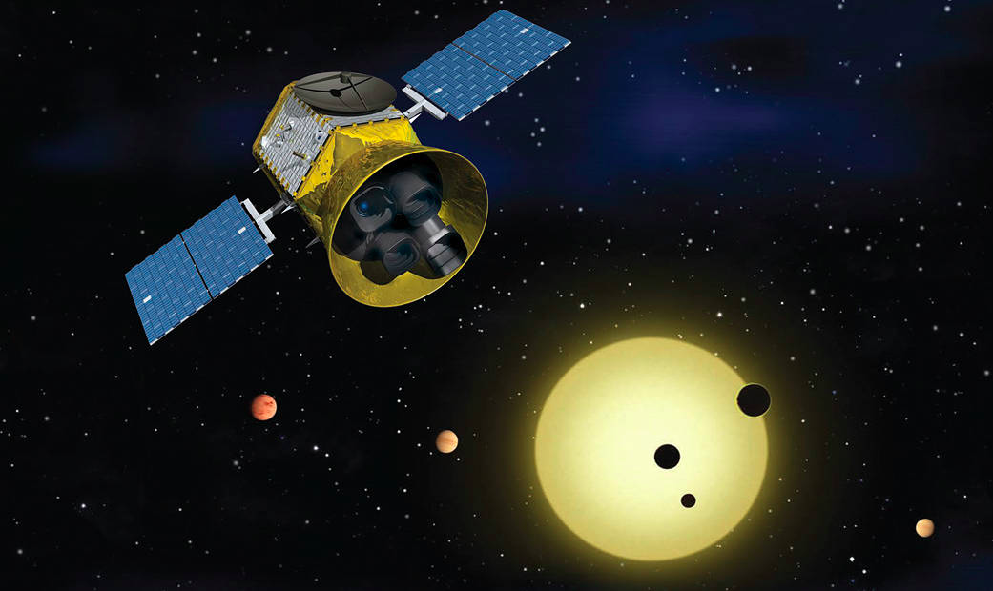
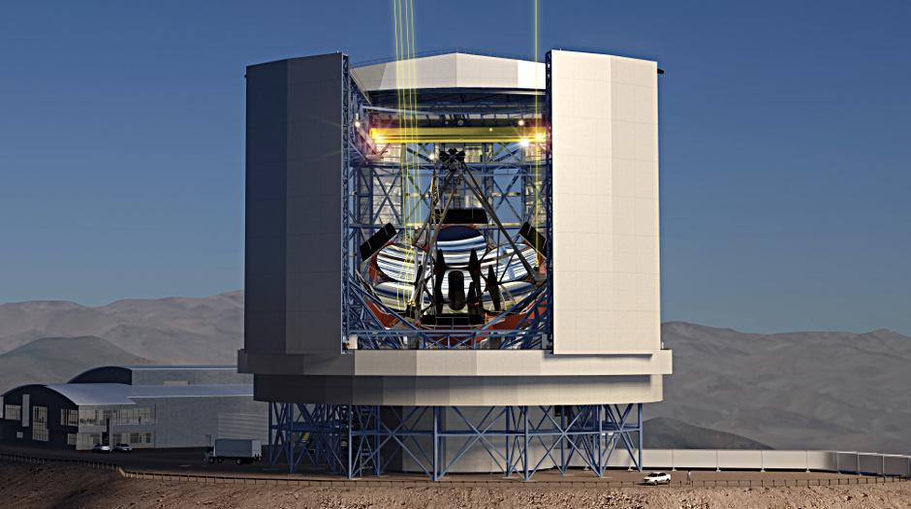
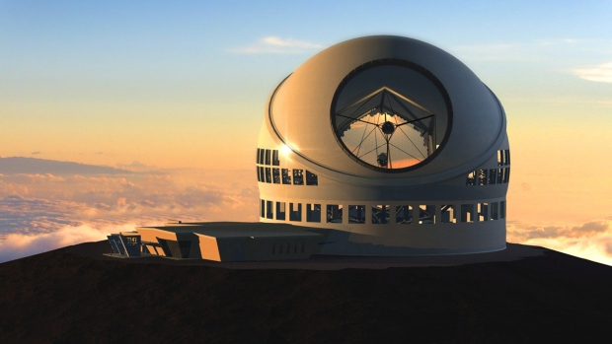
Further possibilities:
Pairing CubeSats with large space- and ground-based telescopes

Slide 32
BACKUP

Slide 33
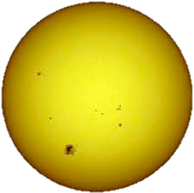
Fixed solar
arrays face sun
Telescope faces target star
Discrete flip about telescope boresight axis (every half orbit)
Communication antenna faces Earth
Radiator faces deep space
Notes:
SPARCS will be in a sun-synchronous 6 pm orbit

Slide 34
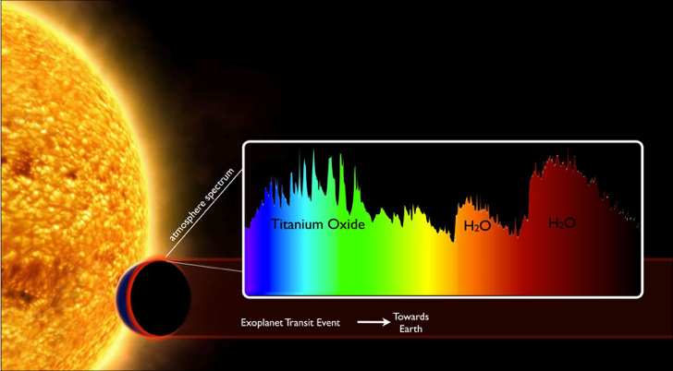
Detecting planet atmospheres
ESA/David Sing

Slide 35
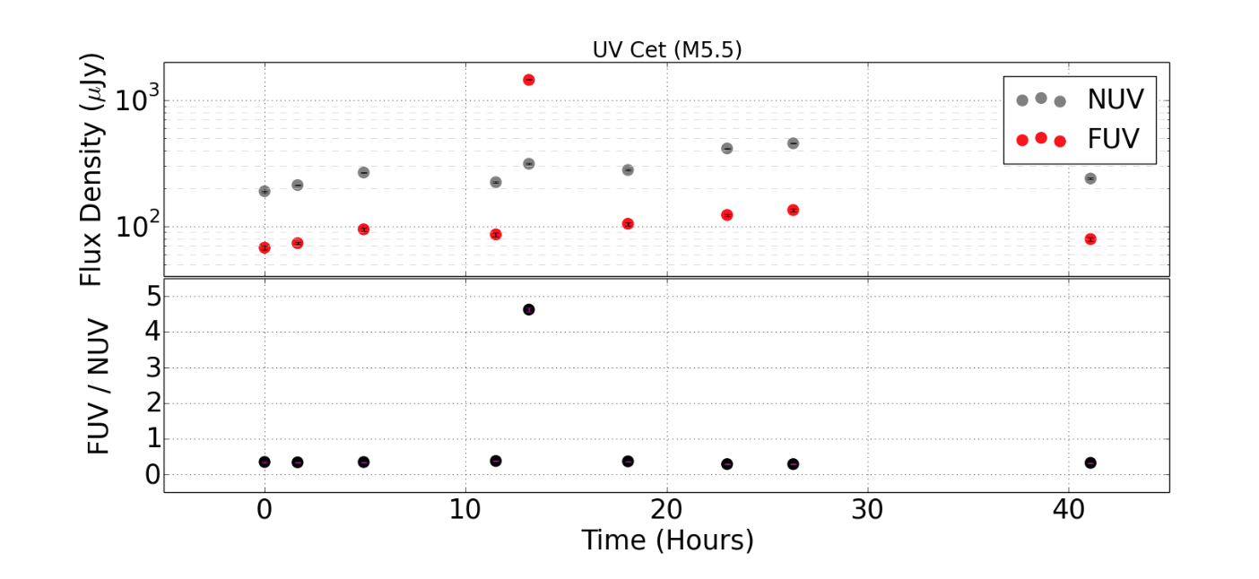
We will track flare colors (ratios) with a dichroic to monitor the FUV and NUV simultaneously.
GALEX observations of active M dwarfs, UV Cet.
FUV-to-NUV ratio can >1 during large flares.
HAZMAT II; Miles & Shkolnik 2017

Slide 36
Knowing the Full UV Spectrum
Photosphere
Chromosphere
Transition Region
& Corona
Data of ET Cha from Woitke et al. 2011

Slide 37
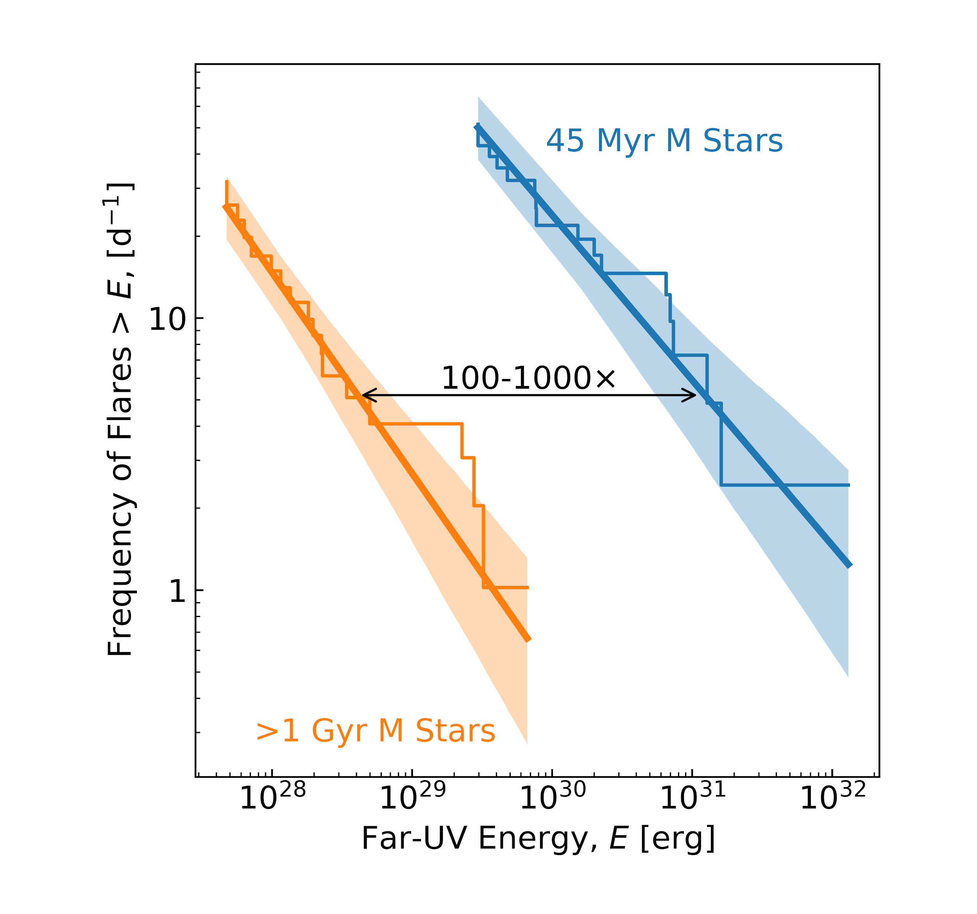
M dwarfs do indeed flare more frequently and with more vigor.
Loyd et al., 2018b
?
HAZMAT IV; Loyd, Shkolnik et al., 2018a
MUSCLES; Loyd et al. 2018b

Slide 38
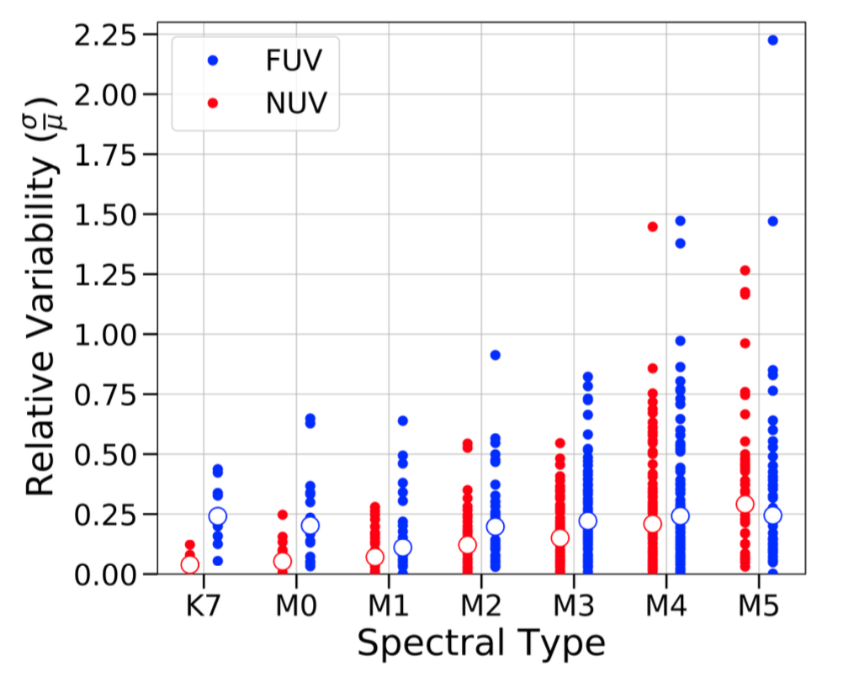
UV variability increases with later spectral type, but most M dwarfs have only 3 - 5 GALEX observations.
σ/μ
HAZMAT II; Miles & Shkolnik (2017)
Notes:
But we don’t know how much of this variability is due stellar rotation and due to flaring or other forms of activity.

Slide 39
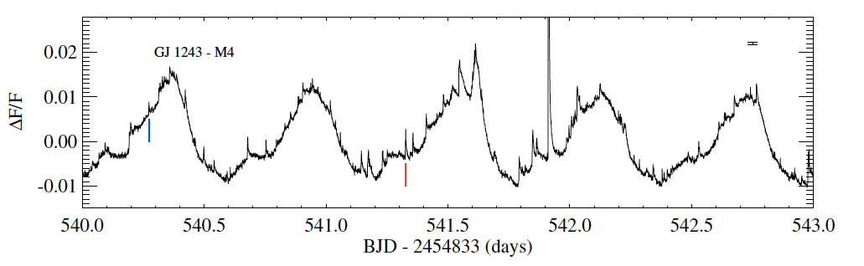
Want: Rotation and flaring of a M stars in the UV
Like this: Kepler (optical) monitoring of active M
Hawley et al. 2014
Notes:
We know M dwarfs are more active than the Sun.
We want to know how variable they are in the UV due to rotation and flaring
across planet formation and evolution timescales,
and for those with transiting planets whose atmosphere we want to understand.

Slide 40
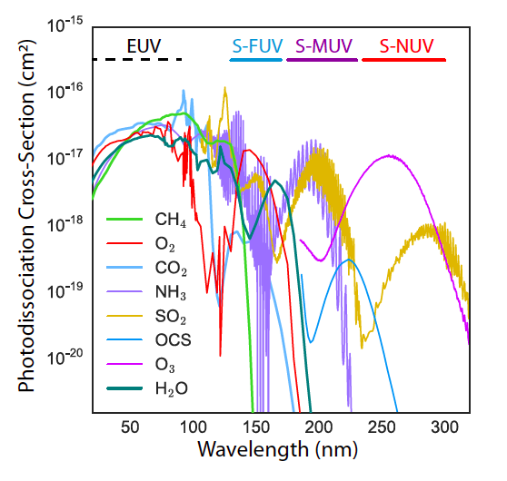
UV Dissociating Wavelengths Affecting Terrestrial Planet Atmosphere Photochemistry

Slide 41
FUV and NUV wavelengths are needed to build upper-atmosphere stellar models to predict the full wavelength range.
See upcoming paper: Peacock et al., submitted

Slide 42
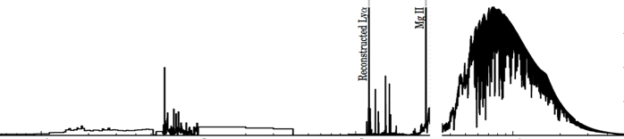
The UV and X-ray drive photochemistry and thermal escape
Flux Density x100
Flux Density
10
100
1000
10000
Wavelength [Å]
Figure courtesy of Parke Loyd
Notes:
development of life (e.g. H2O, H2, O2, CO2, H2S hydrogen sulfide, and OCS carbonyl sulfide) and signatures that would be indicative of life (e.g. CH4 methane, NH3 ammonia, and N2O nitrogen oxide)

Slide 43
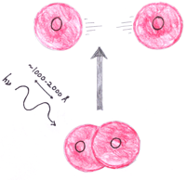
The UV and X-ray drive photochemistry and thermal escape
UV
Flux Density x100
Flux Density
10
100
1000
10000
Wavelength [Å]
Figure courtesy of Parke Loyd
Notes:
development of life (e.g. H2O, H2, O2, CO2, H2S hydrogen sulfide, and OCS carbonyl sulfide) and signatures that would be indicative of life (e.g. CH4 methane, NH3 ammonia, and N2O nitrogen oxide)

Slide 44
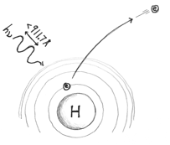
The UV and X-ray drive photochemistry and thermal escape
X-ray + Extreme UV
UV
Flux Density x100
Flux Density
10
100
1000
10000
Wavelength [Å]
Figure courtesy of Parke Loyd
Notes:
development of life (e.g. H2O, H2, O2, CO2, H2S hydrogen sulfide, and OCS carbonyl sulfide) and signatures that would be indicative of life (e.g. CH4 methane, NH3 ammonia, and N2O nitrogen oxide)

Slide 45
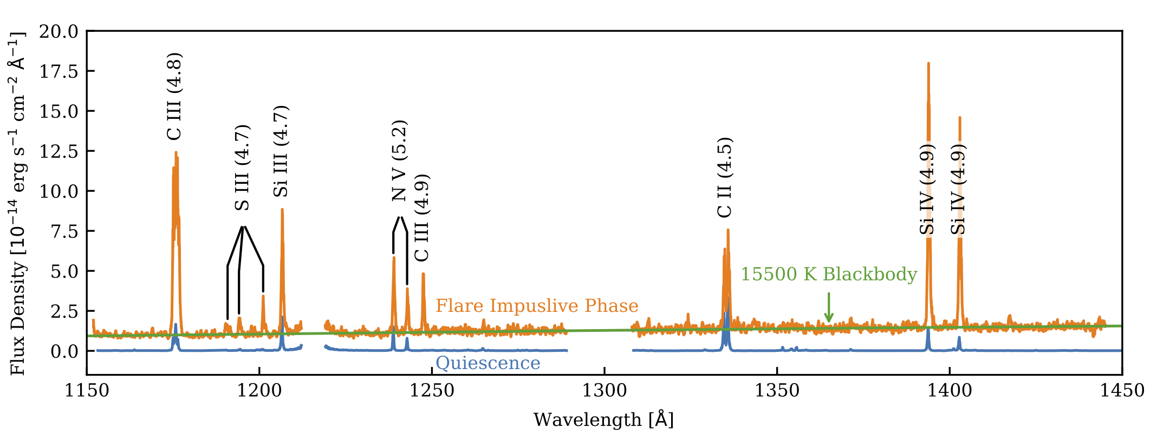
First results: The HazFlare SuperFlare
→ 1 superflare per day on a 40 Myr M star
HAZMAT IV; Loyd et al., 2018b

Slide 46
Detecting molecules in a planetary atmosphere requires the UV context.
Dissociate O₂ to form O₃
+
O
O₂
O₃
Photodissociate H₂O, CH₄, and CO₂
+
H₂O
2H
O
Adapted from Rugheimer et al. 2015

Slide 47
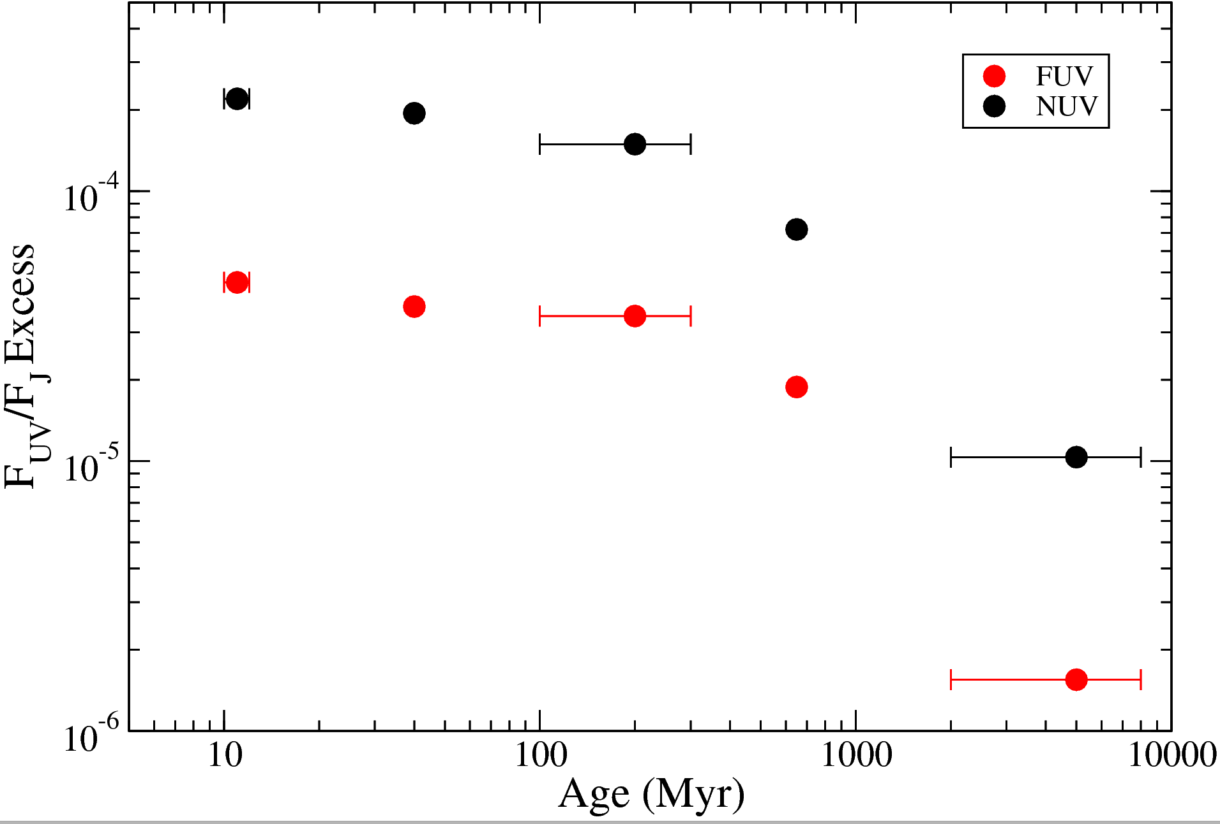
UV evolution over planet formation & evolution timescales for early M stars.
UV Emission
Disk dispersal and giant planet formation
Terrestrial planet formation and primordial atmosphere
Earth’s second atmosphere was generated plus turn-on of dynamo action for magnetic field.
If the secondary atmosphere survives, then life may evolve.
See Shkolnik & Barman 2014 for early Ms and Schneider & Shkolnik 2018 for mid-to-late Ms
Notes:
So here are the results: We plot the fractional excess NUV and FUV flux as a function of stellar age. We have removed the contribution of the photosphere in order to just measure the excess flux is just the emission measured from the upper stellar atmosphere, namely the chromosphere, the transition region, and the corona.
The stars that we used in order to make this figure were all published M dwarf members on known YMGs, confirmed as such by their common 3-D space motion as well as spectroscopic age indicators, such as Lithium, H_alpha and surface gravity.
The data points are the median values for the set of M dwarfs at each age with the error bars representing the full span of the points. Even in the old M dwarf sample, there are clearly some very active stars.
There appears to be a relatively slow decline in the UV excess flux, as well as an the X-ray, until at least300 Myr with a sharper drop in the old M dwarfs. Without confirmed M dwarfs in nearby star clusters with ages of 1-2 Gyr, mapping the precise evolution at these older ages is not currently possible.
As you might of expected, there is clearly a drop in flux from young to old stars. Stelzer et al had a really nice paper last year showing a similar drop using just 10 Myr stars and old field Ms. However, critical planet formation and evolutionary stages occur at these intermediate ages so knowing what is actually happening at these ages, is important. So, roughly speaking, between 0 and 10 Myr is when circumstellar disk dispersal and giant planet formation occur. Between about 10 and 50 Myr, is when we expect terrestrial planet formation to happen along with the primordial atmosphere. And at least for the early Earth, there are reports about a secondary atmosphere forming between 50 and 500 Myr along with the beginnings of the dynamo action with generates the Earth’s protective magnetic field. And lastly, should the atmosphere survive, and other conditions for life be met, then life may start forming and bacteria-induced chemical evolution of the planet’s atmosphere may occur. : For Earth, this happened after 1.7 Gyr.
In most cases, the photospheric flux is negligible, except for the oldest and most massive M dwarfs, peaking at 70% of the total flux in the NUV and at only 0.005% in the FUV.
So, here, stars are again like humans, where they start out young and energetic and with time start to slow down and become less active. The comparison of course fails at mass loss, as stars shed mass as they age, and well, people, that’s not usually the case. ☺

Slide 48
UV evolution over planet formation & evolution timescales for early M stars.
UV Emission
See Shkolnik & Barman 2014 for early Ms and Schneider & Shkolnik 2018 for mid-to-late Ms
Notes:
So here are the results: We plot the fractional excess NUV and FUV flux as a function of stellar age. We have removed the contribution of the photosphere in order to just measure the excess flux is just the emission measured from the upper stellar atmosphere, namely the chromosphere, the transition region, and the corona.
The stars that we used in order to make this figure were all published M dwarf members on known YMGs, confirmed as such by their common 3-D space motion as well as spectroscopic age indicators, such as Lithium, H_alpha and surface gravity.
The data points are the median values for the set of M dwarfs at each age with the error bars representing the full span of the points. Even in the old M dwarf sample, there are clearly some very active stars.
There appears to be a relatively slow decline in the UV excess flux, as well as an the X-ray, until at least300 Myr with a sharper drop in the old M dwarfs. Without confirmed M dwarfs in nearby star clusters with ages of 1-2 Gyr, mapping the precise evolution at these older ages is not currently possible.
As you might of expected, there is clearly a drop in flux from young to old stars. Stelzer et al had a really nice paper last year showing a similar drop using just 10 Myr stars and old field Ms. However, critical planet formation and evolutionary stages occur at these intermediate ages so knowing what is actually happening at these ages, is important. So, roughly speaking, between 0 and 10 Myr is when circumstellar disk dispersal and giant planet formation occur. Between about 10 and 50 Myr, is when we expect terrestrial planet formation to happen along with the primordial atmosphere. And at least for the early Earth, there are reports about a secondary atmosphere forming between 50 and 500 Myr along with the beginnings of the dynamo action with generates the Earth’s protective magnetic field. And lastly, should the atmosphere survive, and other conditions for life be met, then life may start forming and bacteria-induced chemical evolution of the planet’s atmosphere may occur. : For Earth, this happened after 1.7 Gyr.
In most cases, the photospheric flux is negligible, except for the oldest and most massive M dwarfs, peaking at 70% of the total flux in the NUV and at only 0.005% in the FUV.
So, here, stars are again like humans, where they start out young and energetic and with time start to slow down and become less active. The comparison of course fails at mass loss, as stars shed mass as they age, and well, people, that’s not usually the case. ☺

