Slide 1

Making CubeSats Autonomous - the Easy Way!
Rashied Amini
AAS 235
Honolulu, Hawaii
January 4, 2020
© 2020. California Institute of Technology. Government sponsorship acknowledged.

Slide 2
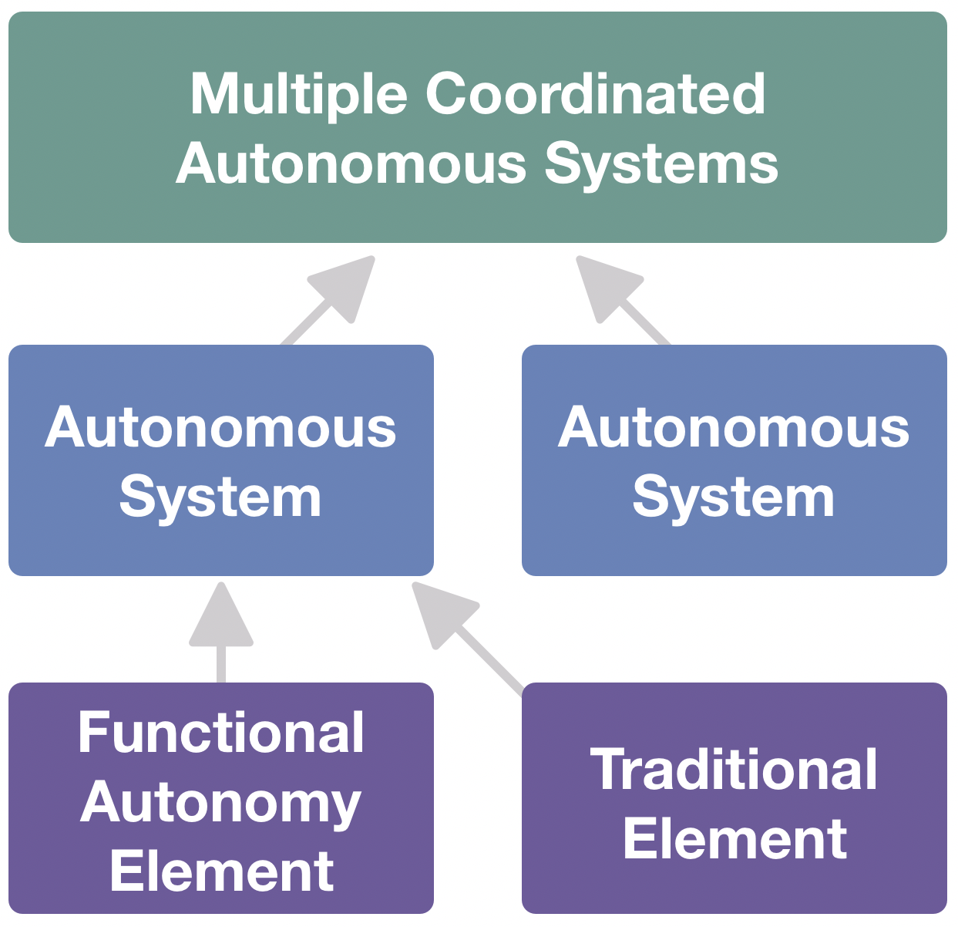
…but what is autonomy?
“Autonomy is the ability of a system to achieve goals while operating independently of external control”
So what do observatory or spacecraft software have to do so they can behave autonomously?
  Planning/Scheduling
  Data processing
  Fault Protection
  Less profoundly terrifying than implementing self-driving vehicles!
Self-driving cars? Drones? Machine Learning?
Isn’t this hard?
Reference herein to any specific commercial product, process, or service by trade name, trademark, manufacturer, or otherwise, does not constitute or imply its endorsement by the United States Government or the Jet Propulsion Laboratory, California Institute of Technology.

Slide 3
why develop an autonomous system?
Open-source software packages available
Trains students on new technology, adding a marketable skill
Improve competitive position
Reduces operations complexity
On-board data processing improves observing efficiency.
More reliable observatories will result in ~5%* more observing time
Transient event observatories, interferometry, multi-messenger science
Developing autonomous systems forces good engineering practices, improving:
  Design, build, & test processes
  Predictability of system behavior
  Likelihood of mission success

Slide 4
how systems make decisions/commanding
traditional command
goal-based command
Sequence Start
Time 0630.00: FillWater
Time 0630.30: ReplaceFilter
Time 0631.30: AddNewCoffee
Time 0633.00: StartBrew
Sequence End
Sequences express operator intention for the spacecraft and need to be uploaded frequently.
Time-driven commanding.
Command execution not contingent on success of past commands, though some mission managers can use conditional sequence blocks
Operator intention expressed as state goals
Flexible and reliable execution accounts for run-time anomalies
Permits hierarchical decision-making

Slide 5
how systems make decisions/architecture
traditionally commanded
autonomous

Slide 6
where to start?
Flight software: Your observatory needs an OS!
  F Prime: JPL flight software for smallsats: https://github.com/nasa/fprime
  Robotic Operating System (ROS): https://www.ros.org/
Planner/Executive: The brain of system-level autonomy.
  Flight
    MEXEC: JPL software. License can be requested.
    EUROPA-2: ARC Software. https://github.com/nasa/europa
  Ground
    TREX Executive: Planner/executive based on EUROPA: http://wiki.ros.org/trex_executive
    ROS Planner: Path planner. Useful depending on application: http://wiki.ros.org/global_planner
Process: How to get started
  Currently compiling internal documentation, journal paper some time this year?
  See me!

