Slide 1
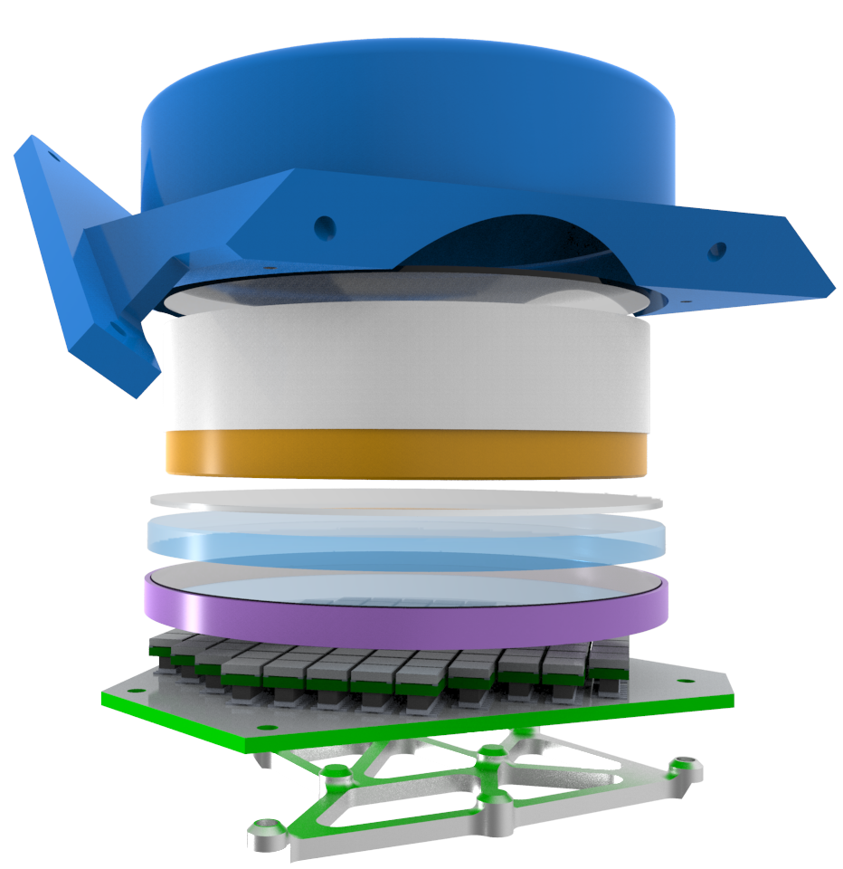
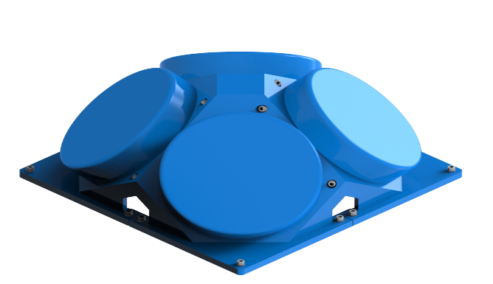
BurstCube: A CubeSat for Gravitational Wave Counterparts
Jeremy S. Perkins (PI)
for the BurstCube Team

Slide 2
BurstCube Team
PI: Jeremy Perkins (NASA/GSFC) Website: https://asd.gsfc.nasa.gov/burstcube/
Clemson
Dieter Hartmann
NRL
Lee Mitchell
GWU
Alyson Joens
NASA/GSFC
Alessandro Bruno
Eric Burns
Regina Caputo
Brad Cenko
Georgia de Nolfo
Julie McEnery
Judith Racusin
NASA/MSFC
Michelle Hui
Daniel Kocevski
Colleen Wilson-Hodge
UAH
Michael Briggs
UCD
Lorraine Hanlon
Sheila McBreen
David Murphy
Alexey Uliyanov
Sarah Walsh
UMBC/CRESST/GSFC
Sean Griffin
John Krizmanic
Amy Y. Lien
Jacob R. Smith
UMD
Isabella Brewer
Peter Shawhan
USRA
Carolyn Kierens
UVI
Antonino Cucchiara
David Morris

Slide 3
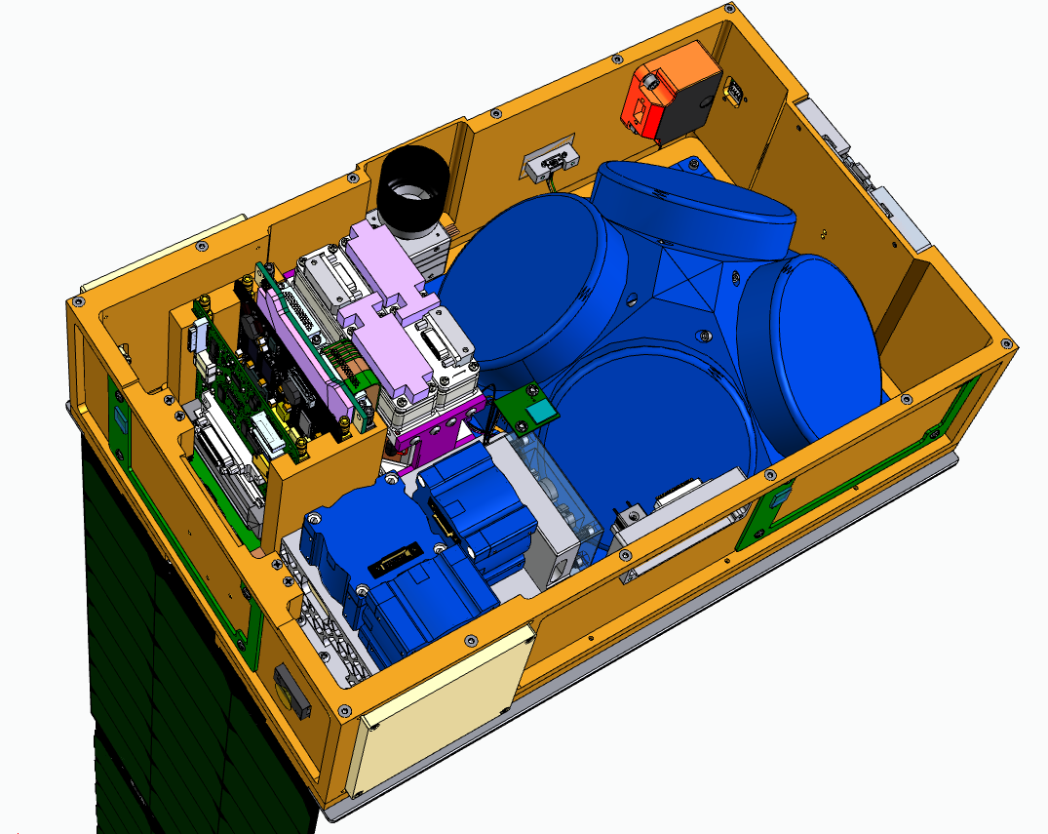
Scope of the BurstCube Project
BurstCube is a 6U CubeSat (10 x 20 x 30 cm³) with a 4U instrument package.
Objective: Detect and Characterize Short Gamma-ray Bursts (sGRBs) that are Counterparts of Gravitational Wave Sources.
The instrument consists of four CsI scintillators read out by arrays of Silicon Photomultipliers.
Detects photons from 50keV to 1 MeV
Roughly localizes GRBs on the sky
Rapidly (<1 hr) downlinks alert notifications.
Project began in Fall 2017, requirements review in Fall 2018, and instrument CDR November 2019.
MEMs IMU
Batteries
Star Tracker
EPS
Solar Panels Rel Mech
C&DH
SSC w/GPS
Torquer X3
Instrument Assembly
FSS
Radio
Reaction Wheels X3
S-Band Antenna X2

Slide 4
BurstCube Science Objective
Primary Science Objective: Detect and Characterize Short Gamma-ray Bursts (sGRBs) that are Counterparts of Gravitational Wave Sources
Gravitational Wave Counterparts Provide Insight into:
Fundamental Physics
Cosmology
Jet Physics
Gamma-ray Burst Emission Mechanisms
Element Formation
Neutron Star Equation of State
Black Hole Formation
Neutron Star Mergers produce short duration gamma-ray bursts and gravitational waves

Slide 5
BurstCube Science Overview
Monitoring the variable gamma-ray sky complementing existing facilities to provide additional sky coverage for rare and unusual transients in the era of Multi-Messenger Astronomy
Provide autonomous detection, localization, and dissemination of new events to the world-wide community within minutes of detection
Characterize broad gamma-ray spectral and temporal evolution of transient events

Slide 6
BurstCube Secondary Science
Secondary Science: Monitor the Sky for Rare and Unusual Transients
With no additional hardware or requirements, BurstCube will also be sensitive to:
All GRBs – Long duration hypernovae, supernova associated, high redshift, nearby sub-luminous
Transient Galactic Sources – Magnetar flares, accreting binaries
Local Sources - Solar Flares, Terrestrial Gamma-ray Flashes

Slide 7
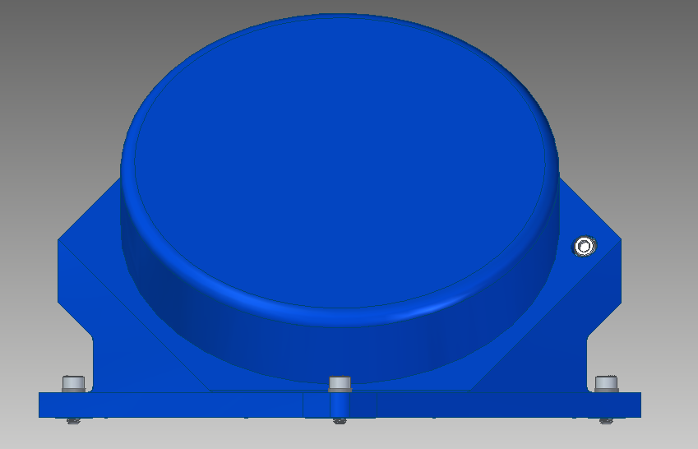
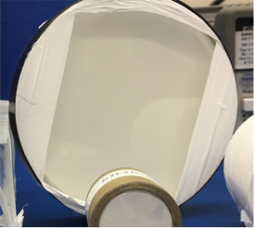
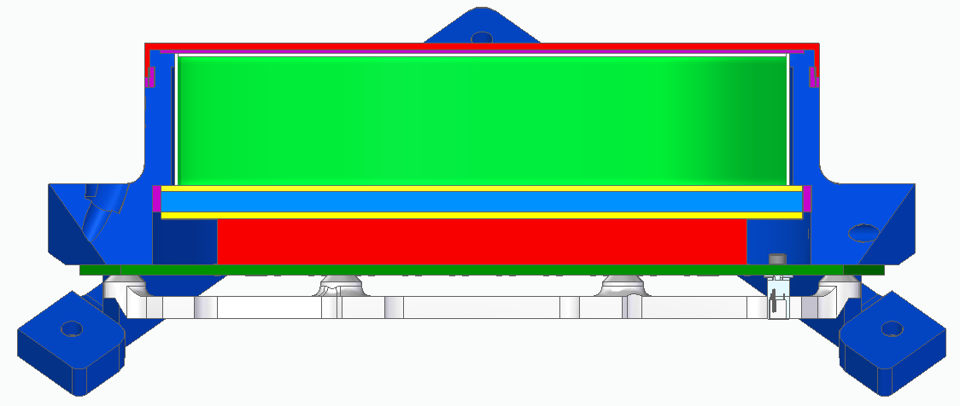
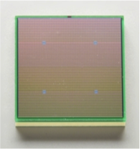
BurstCube Detector Overview
Front View (detector is cylindrical)
Thin Aluminum housing that is transparent to gamma-rays
CsI Crystal that converts gamma-rays into scintillation light (550nm).
Side Cross-Section
CsI Crystal
Quartz window allows scintillation light to escape (the inside of the can is covered in a diffusively reflective material)
SiPM arrays are mounted to the Instrument Detector Analog Board (IDAB) which sums the signals. A single analog signal (hit) comes out of a detector indicating a single photon interaction. The signal amplitude is proportional to the energy of the gamma-ray.
Silicon Photo-Multiplier (SiPM) Arrays convert light into electrical signals.
6mm Hamamatsu SiPM

Slide 8
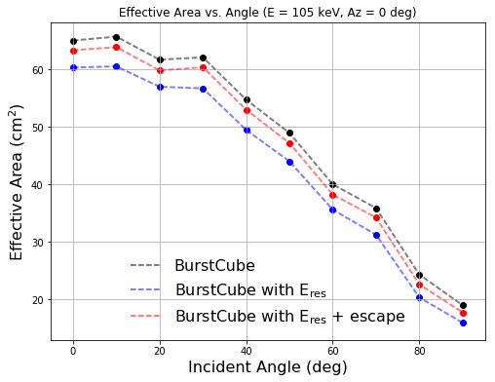
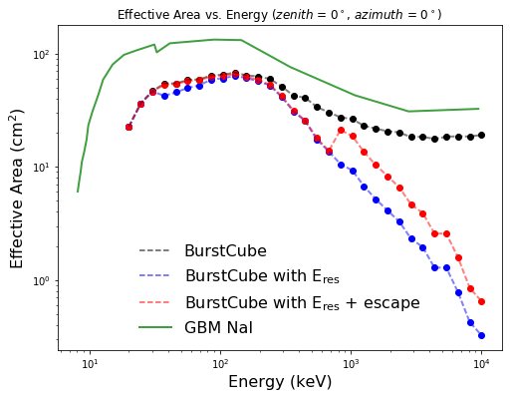
BurstCube Detector Overview
A detector has an effective area that changes with incidence direction.
A gamma-ray source that is on-axis produces more hits in a detector than one off-axis providing some directional capability.
A detector has an effective area that changes with energy.

Slide 9
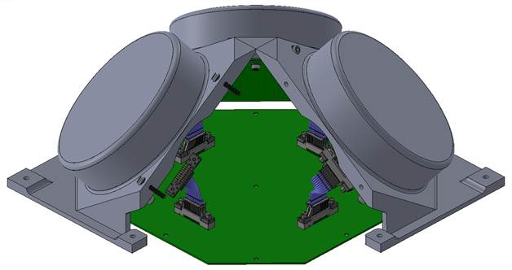
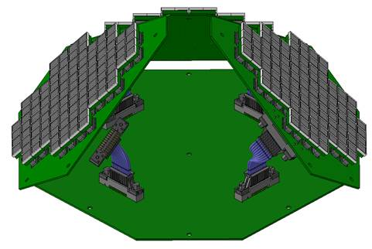
Detector Mechanical
The detailed mechanical design is based on the Fermi-GBM design.
CsI Crystals are 90.0 mm in diameter and 19.0 mm thick.
Each detector fits in a 1U (10 x 10 x 10 cm) space.
Optical pads are used to mechanically couple the crystal to the window and the window to the SiPMs providing optical coupling and mechanical buffering.
The mechanical housing holds each detector at a ~45 degree angle to zenith.
Four detectors are mounted together to form the instrument. Localizes gamma-ray sources by comparing the relative rates in each detector.
The four IDABs are connected to a single Instrument Data Processing Unit (IDPU). Details on this are in a following slide.

Slide 10
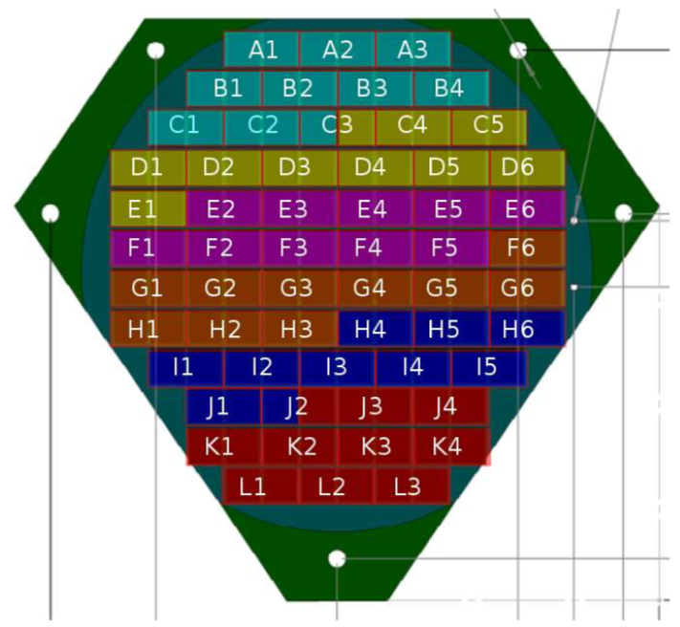
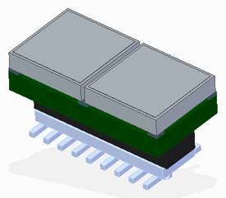
Instrument Front End Electronics (FEE)
19-20 SiPm signals are combined together (colors on left).
Each SiPm group’s signal is individually amplified and then these 6 signals are summed to provide a single analog output signal per detector.
The four analog signals are routed to the IDPU. The IDPU provides power to the individual IDABs (line and bias) and continuously digitizes the signals from the IDABs. The IDPU interfaces with C&DH.
SiPms are mounted to carrier boards (2 SiPMs per board, 116 total per detector)

Slide 11
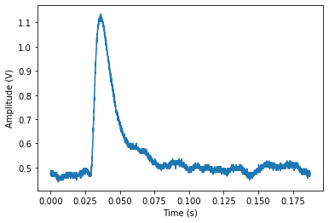
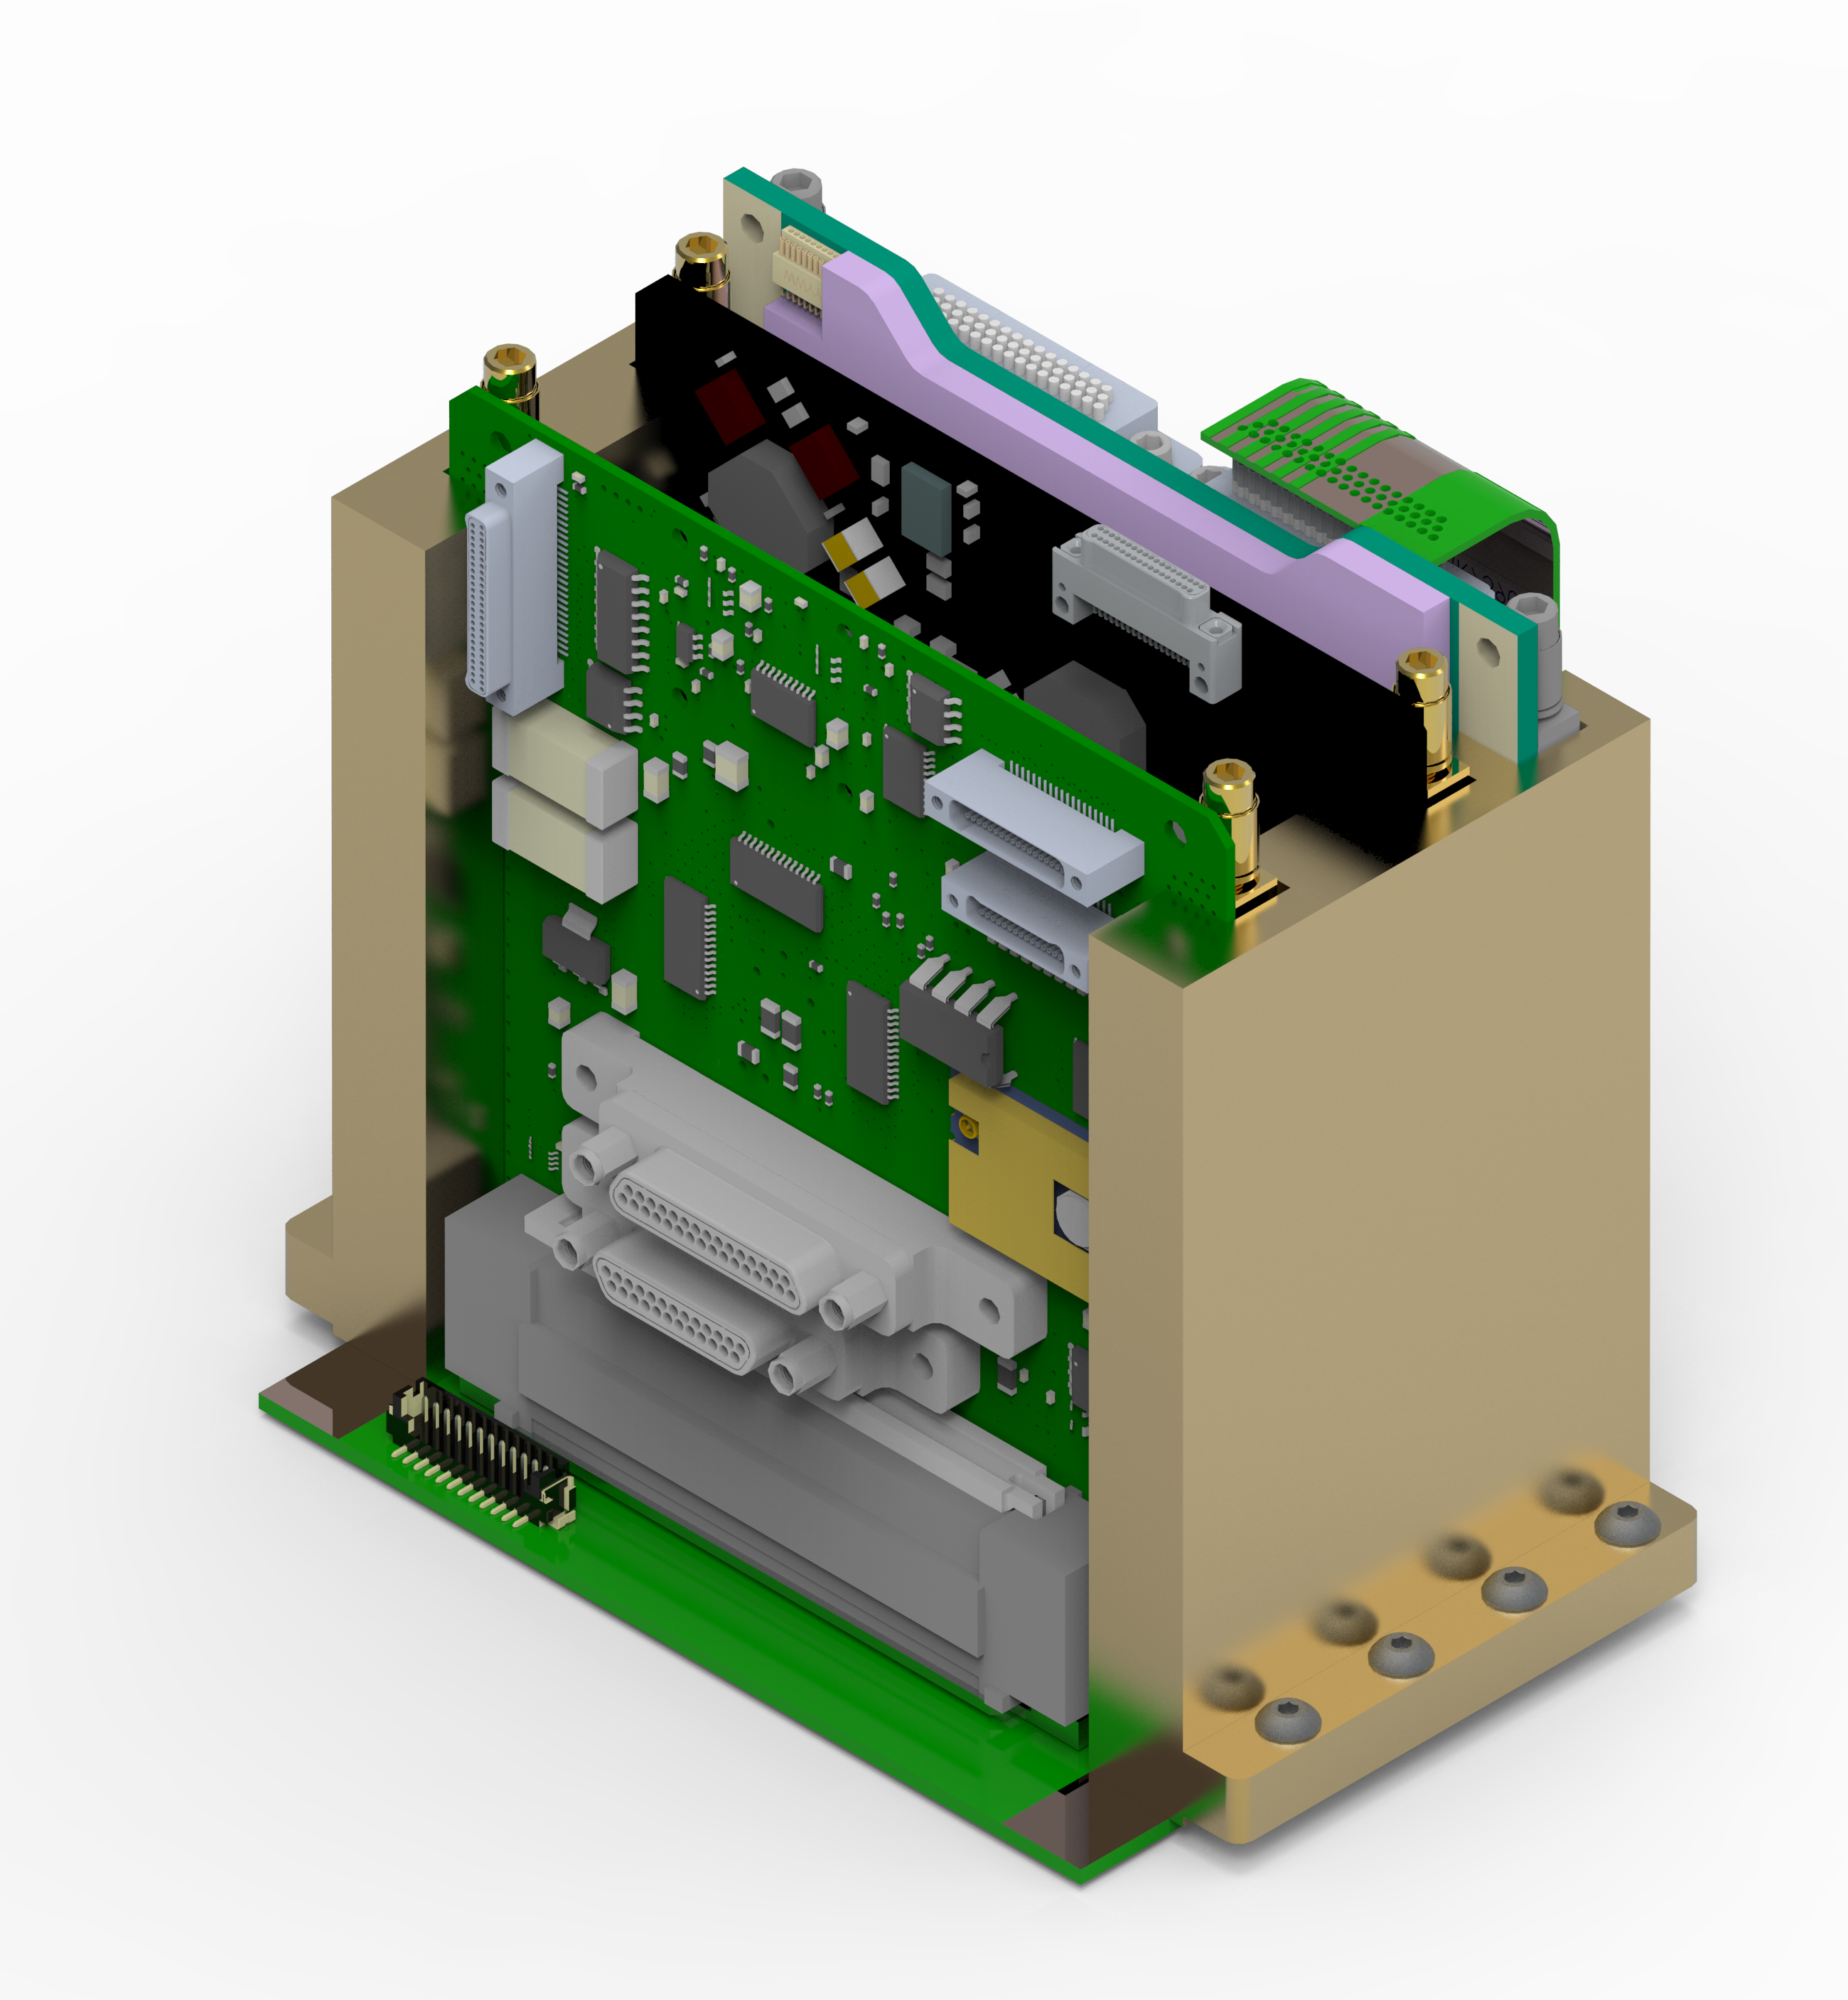
Day in the life of a photon
BurstCube_APRA_PI_Review_2019.pptx
Peak Finding & Time Tagging
Binning & Triggering
Amplitudes & Times
GRB: 100 kHz
Bkgnd: 1 kHz

Slide 12
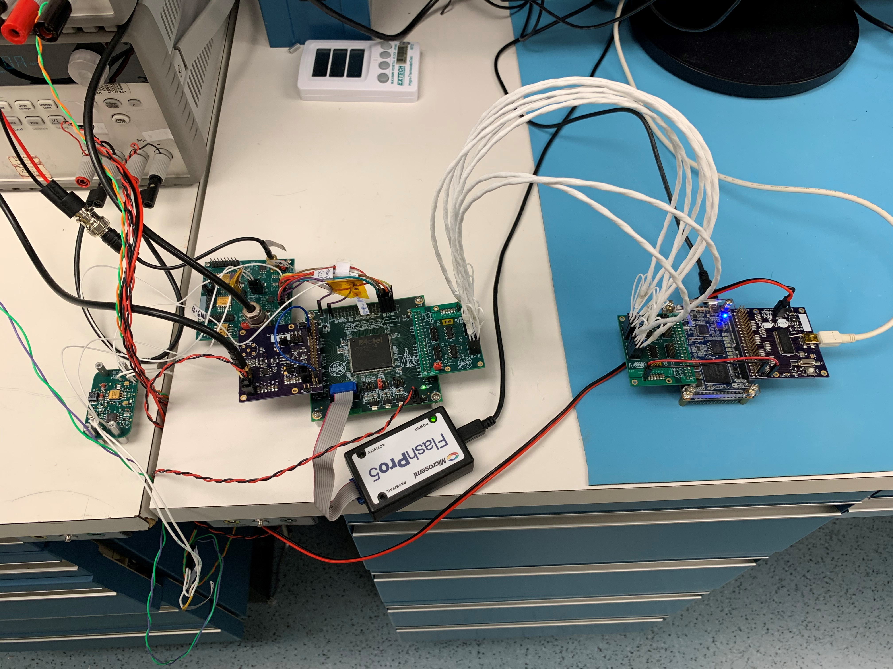
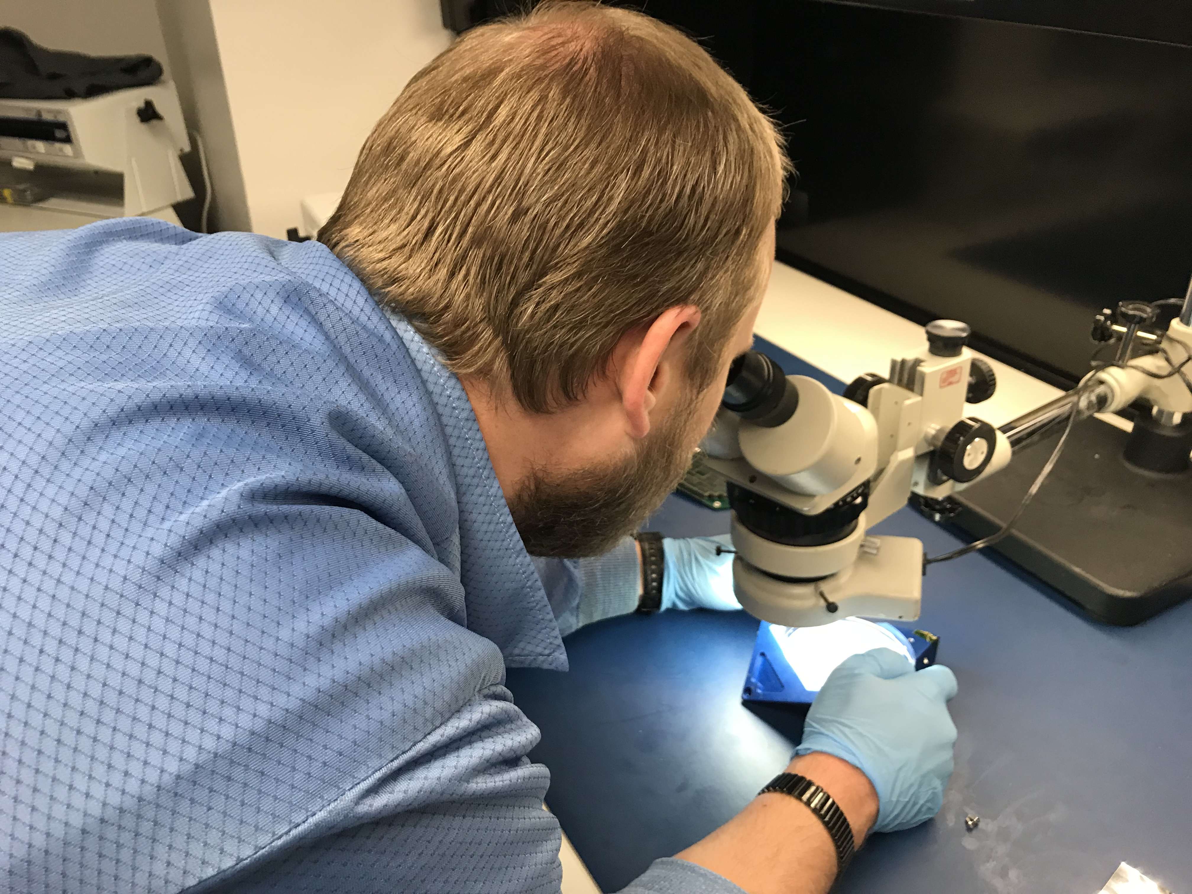
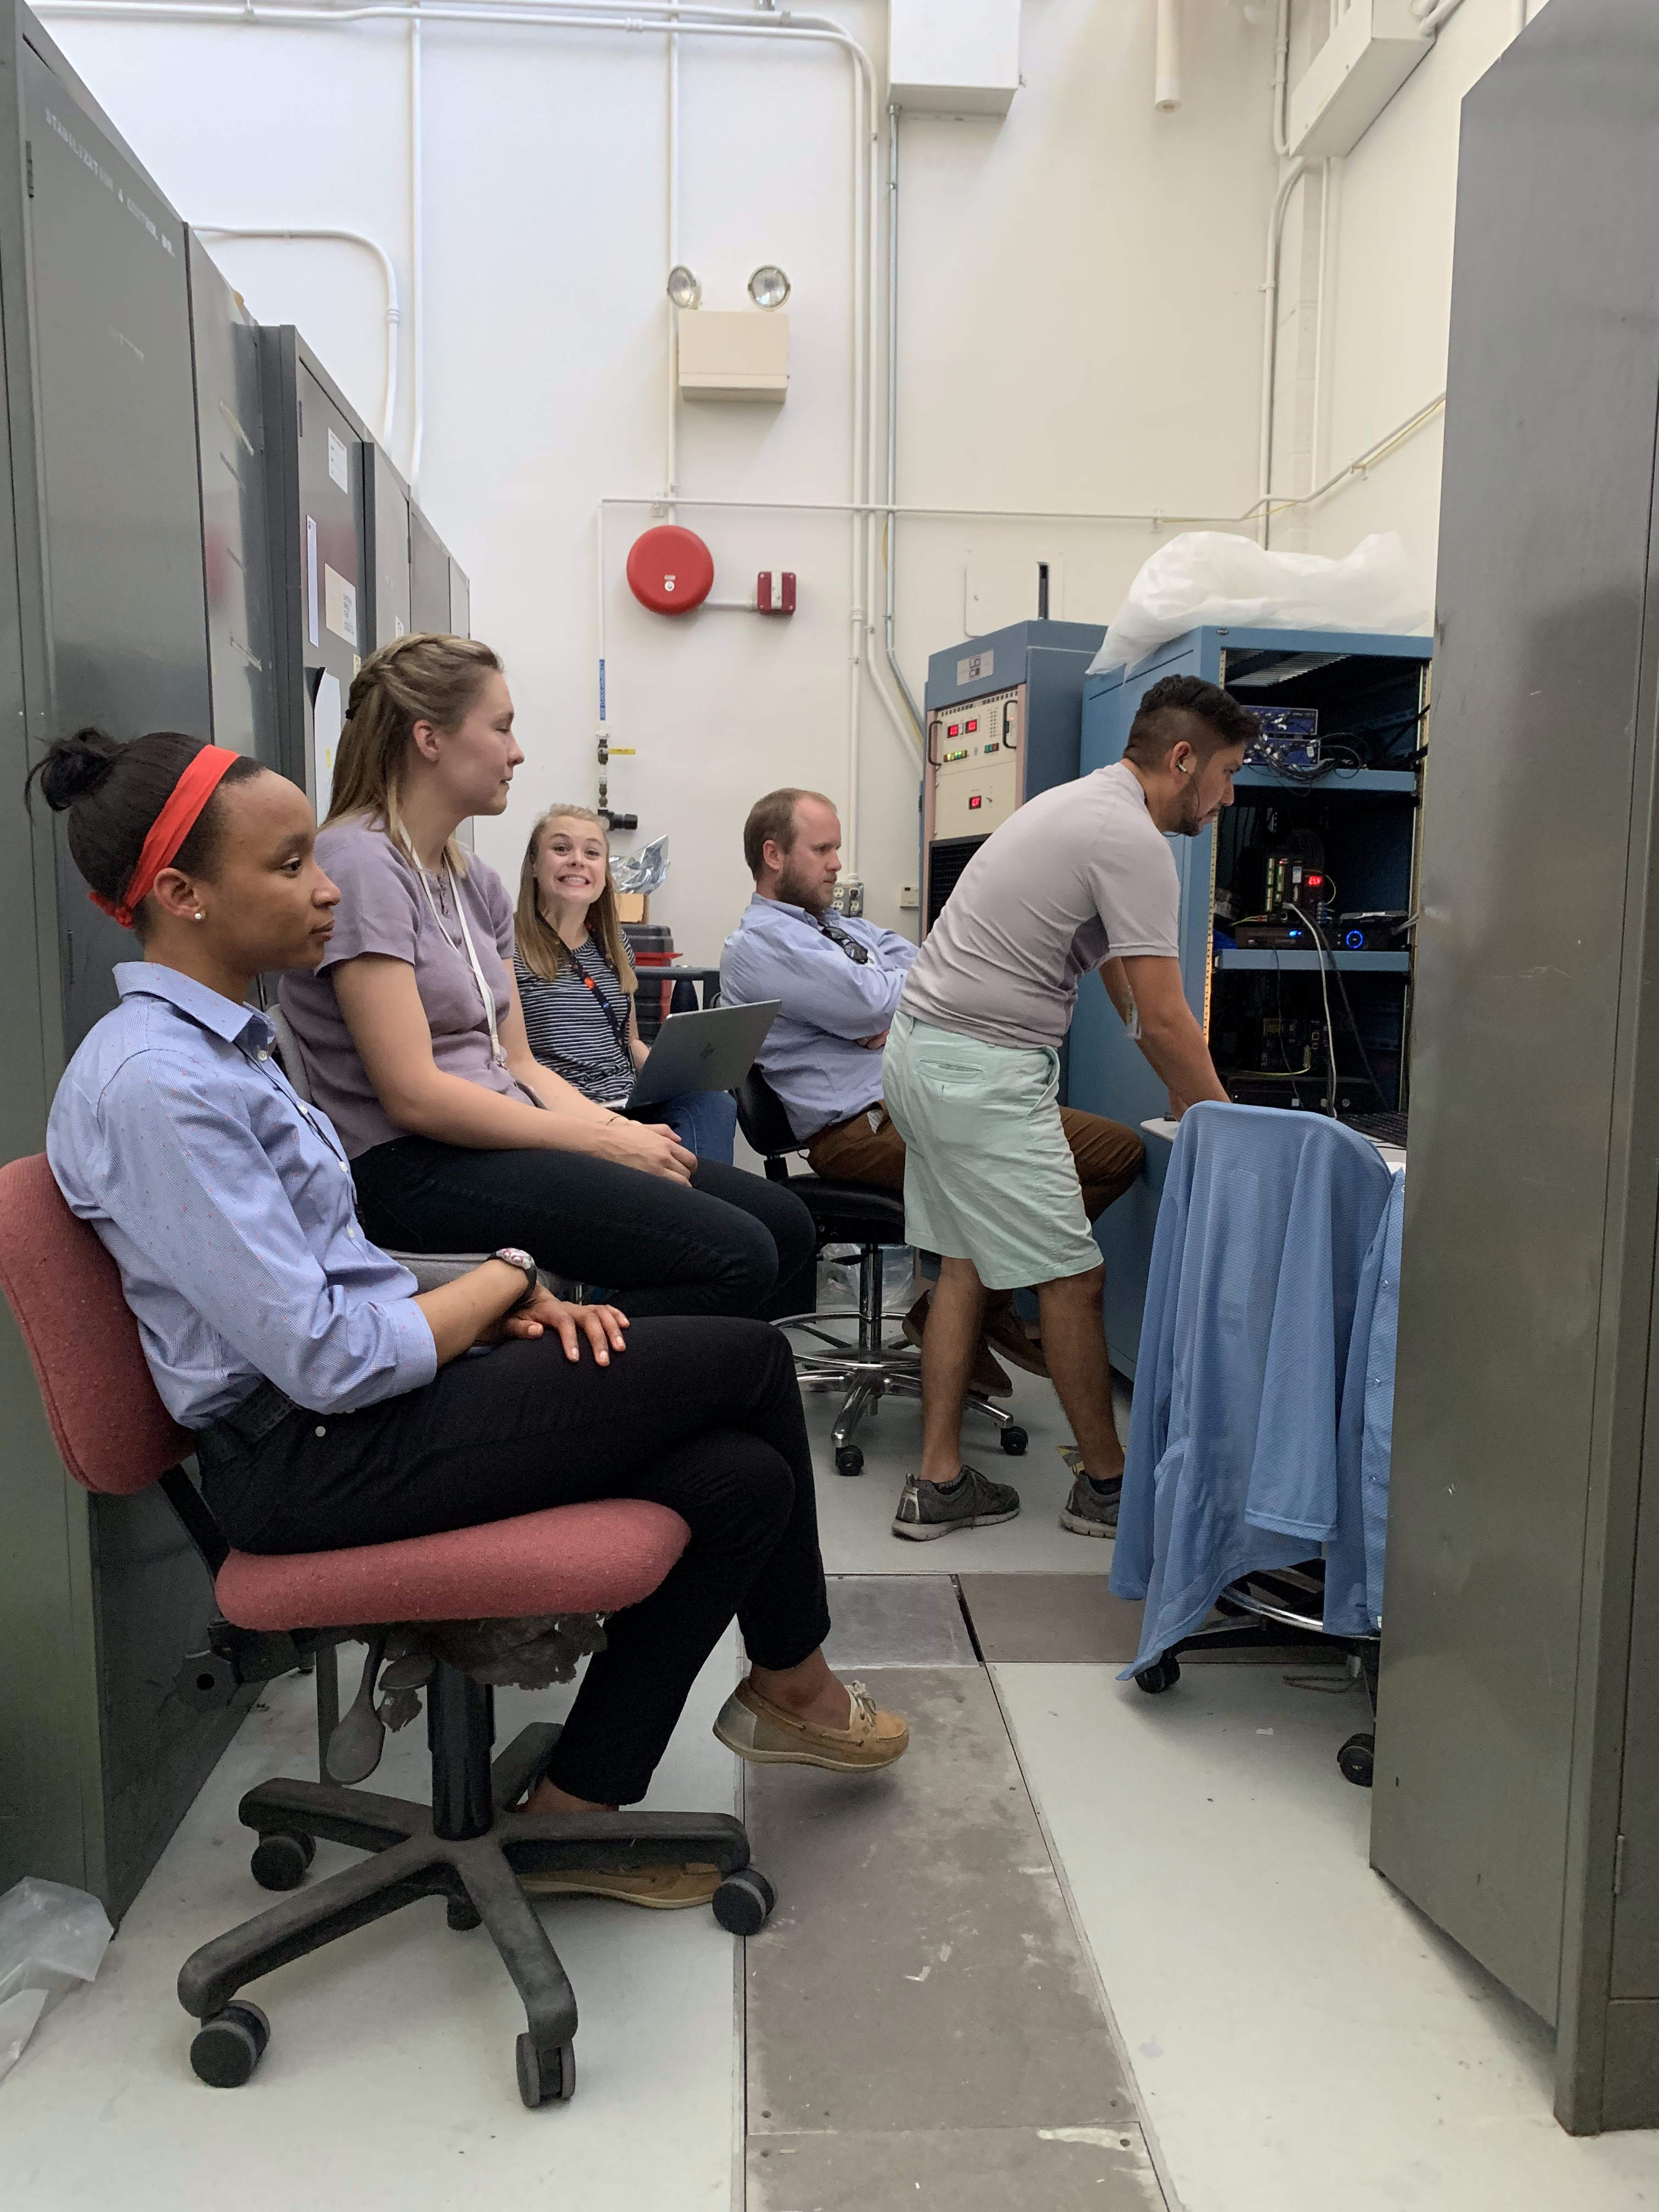
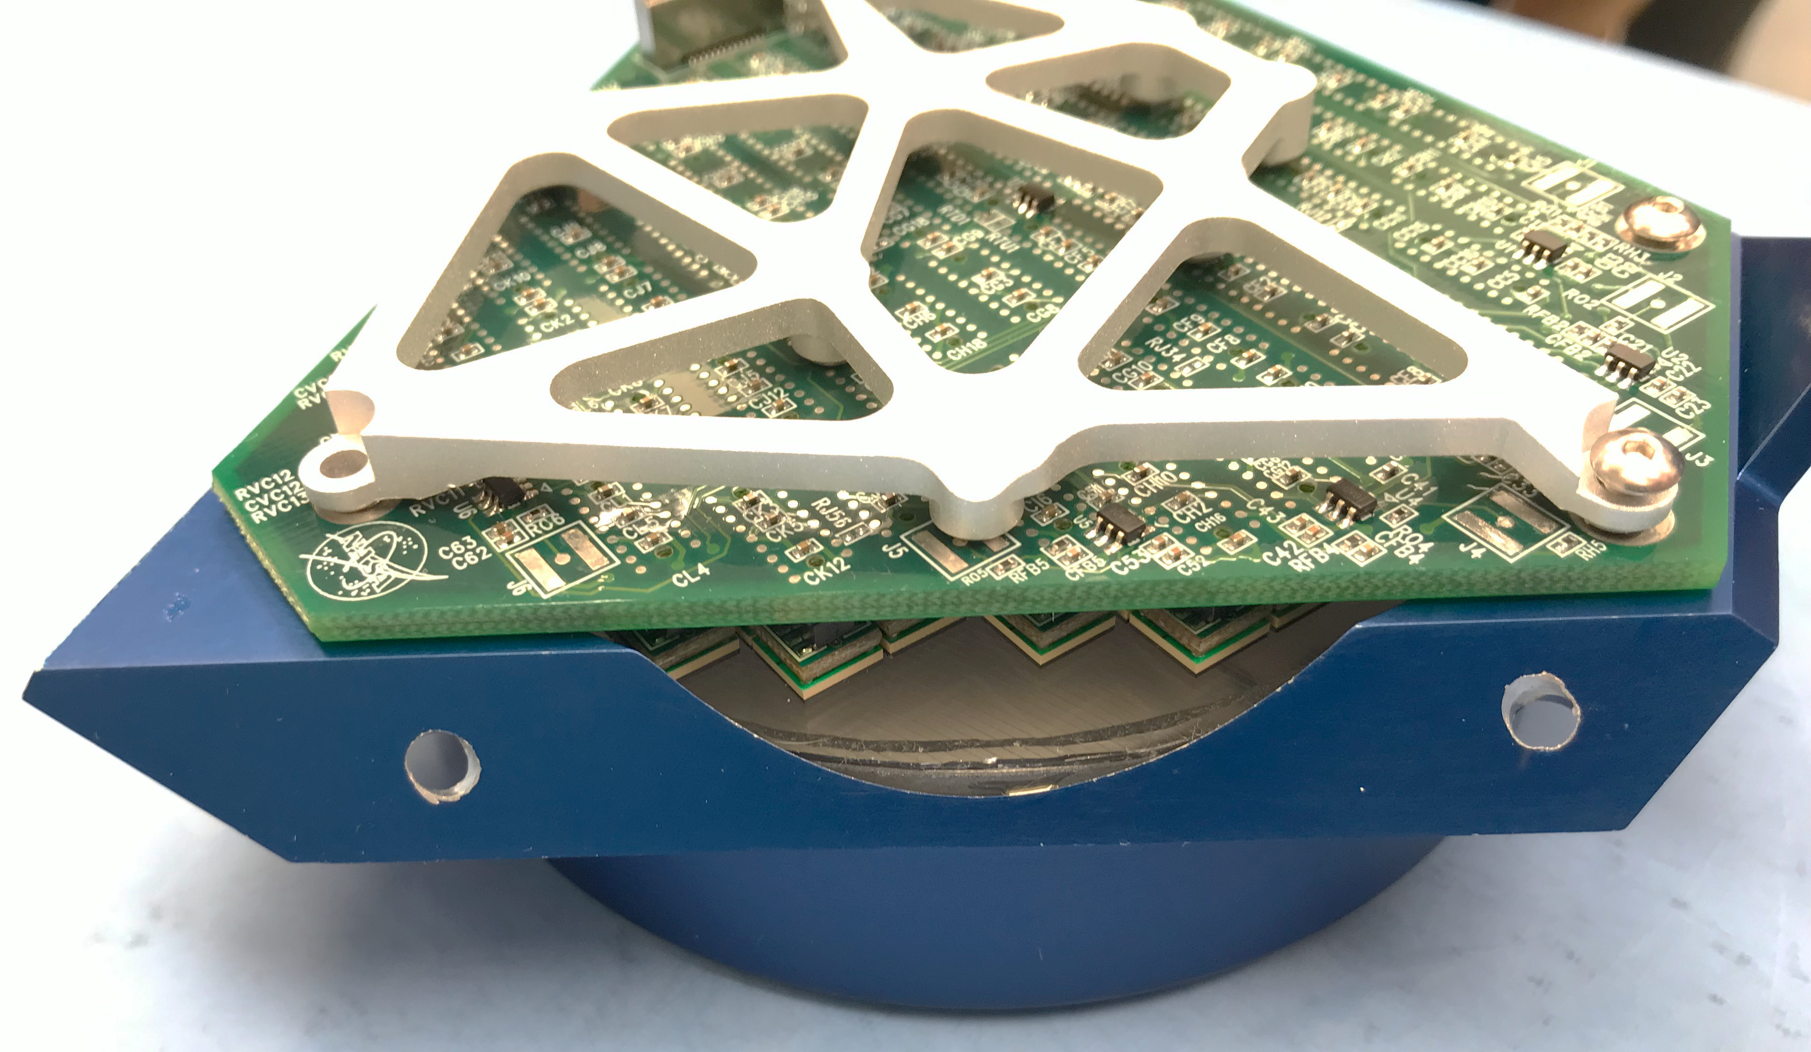
Prototype Instrument Pictures
Inspecting Detector post-Vibe
Electronics Flat-Sat (Digital Boards)
Watching Carlos (our ME) try to break our detector.
Single Quarter Detector

Slide 13
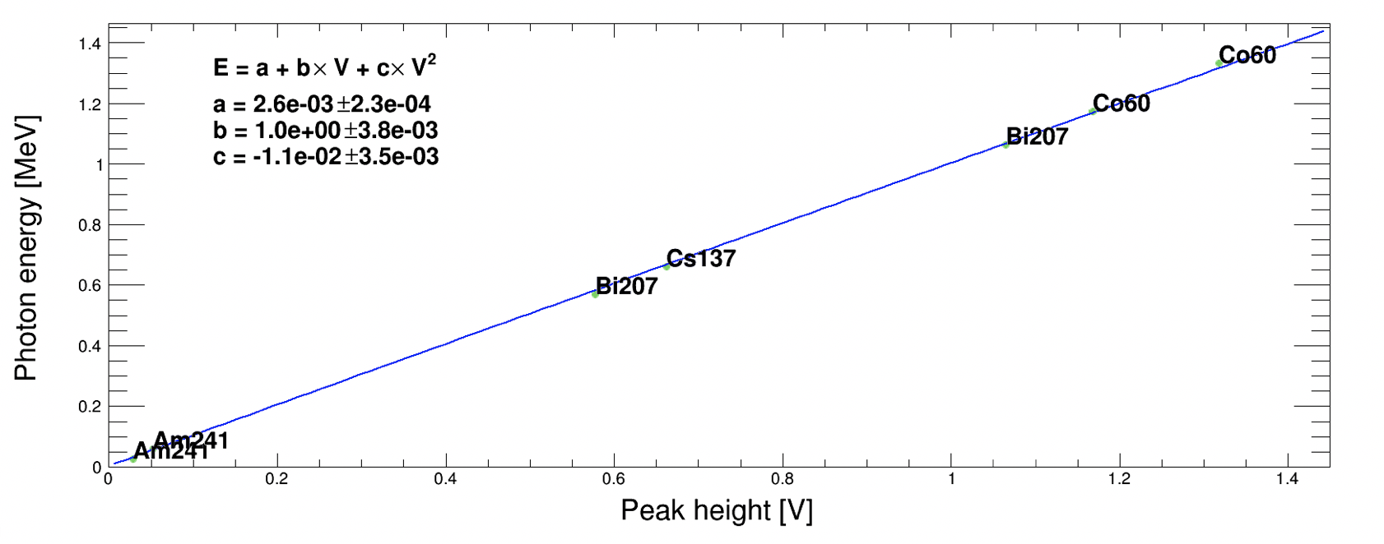
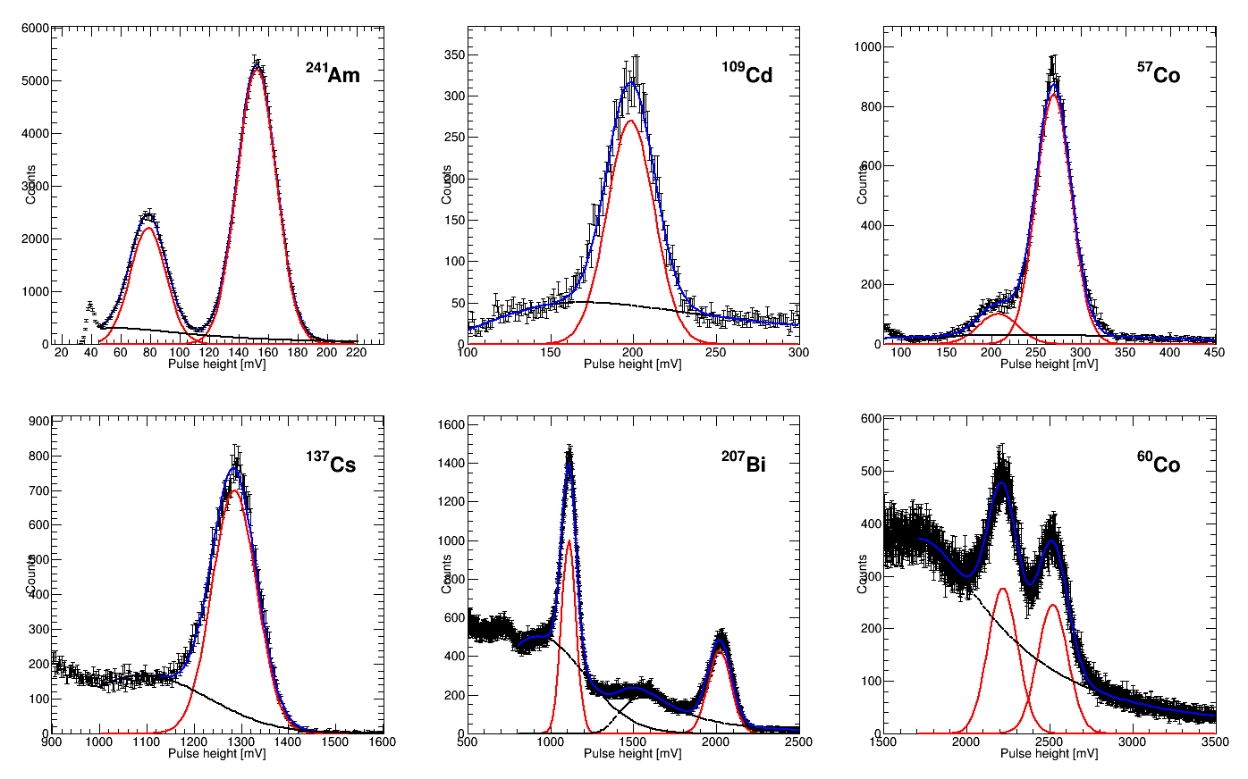
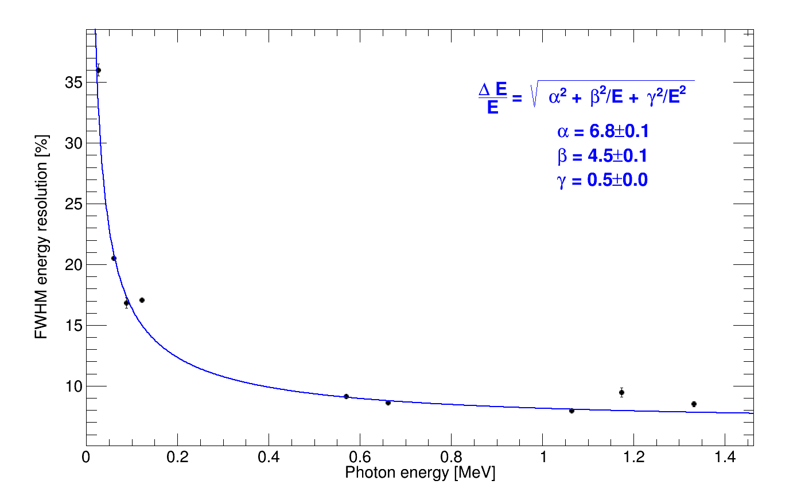
Energy Resolution
Prototype results (Bottom-line: within requirements)
Dynamic range: 26 keV to 1.33 MeV
Energy resolution: ~8.6% @ 660 keV
Am-241 (26 keV)
Am-241 (59 keV)
Cd-109, Co-57
Cs-137
Bi-207
Co-60
Bi-207

Slide 14
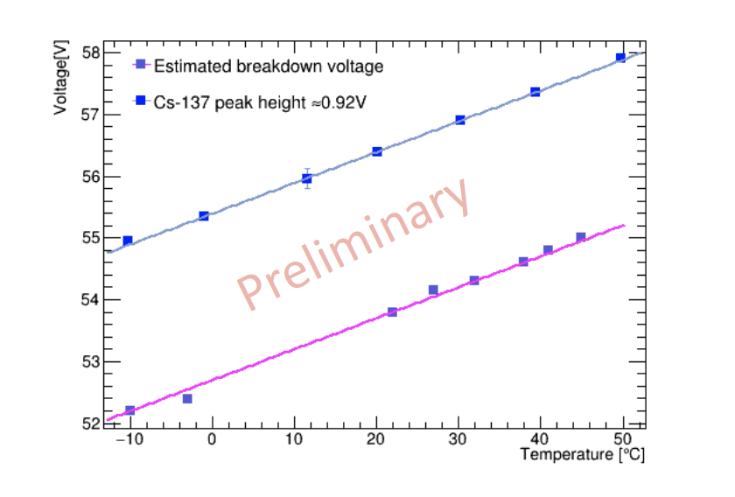
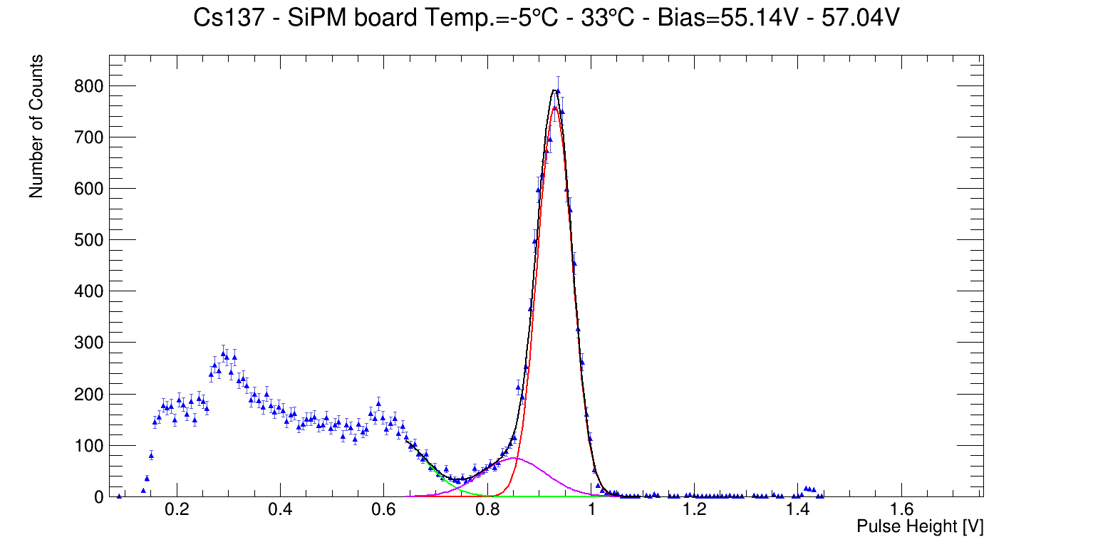
Temperature Compensation – Cs137
Resolution = 8.5±0.08 %
*Bias voltage is adjusted for each temperature (-5ºC to 33ºC) according to breakdown vs. temperature functional form
*Gain remains constant, thus bias voltage can compensate for temperature variations well within the expected temperature range of the mission

Slide 15
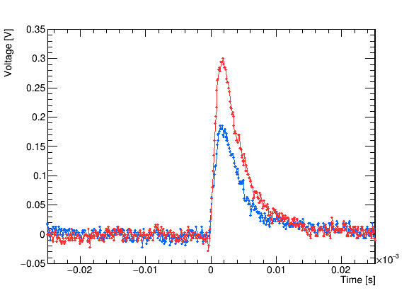
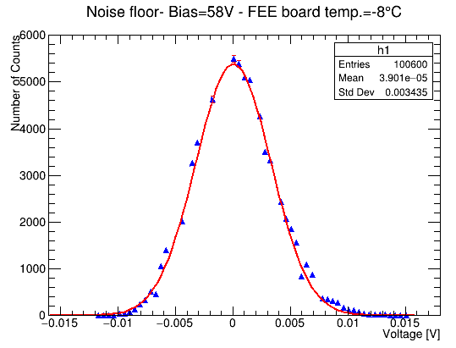
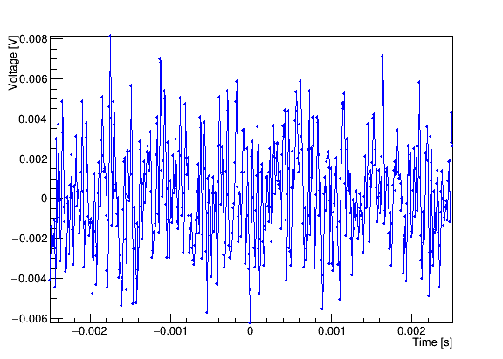
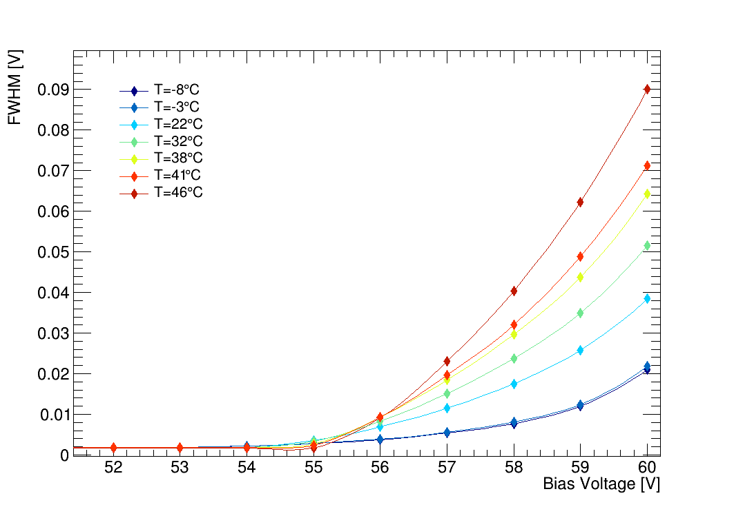
Instrument Detector Analog Board (IDAB) Noise
Am-241 typical waveforms - 5μs window
≈10mV
FEE board temp.: -8°C
Bias Voltage: 58V
baseline

Slide 16
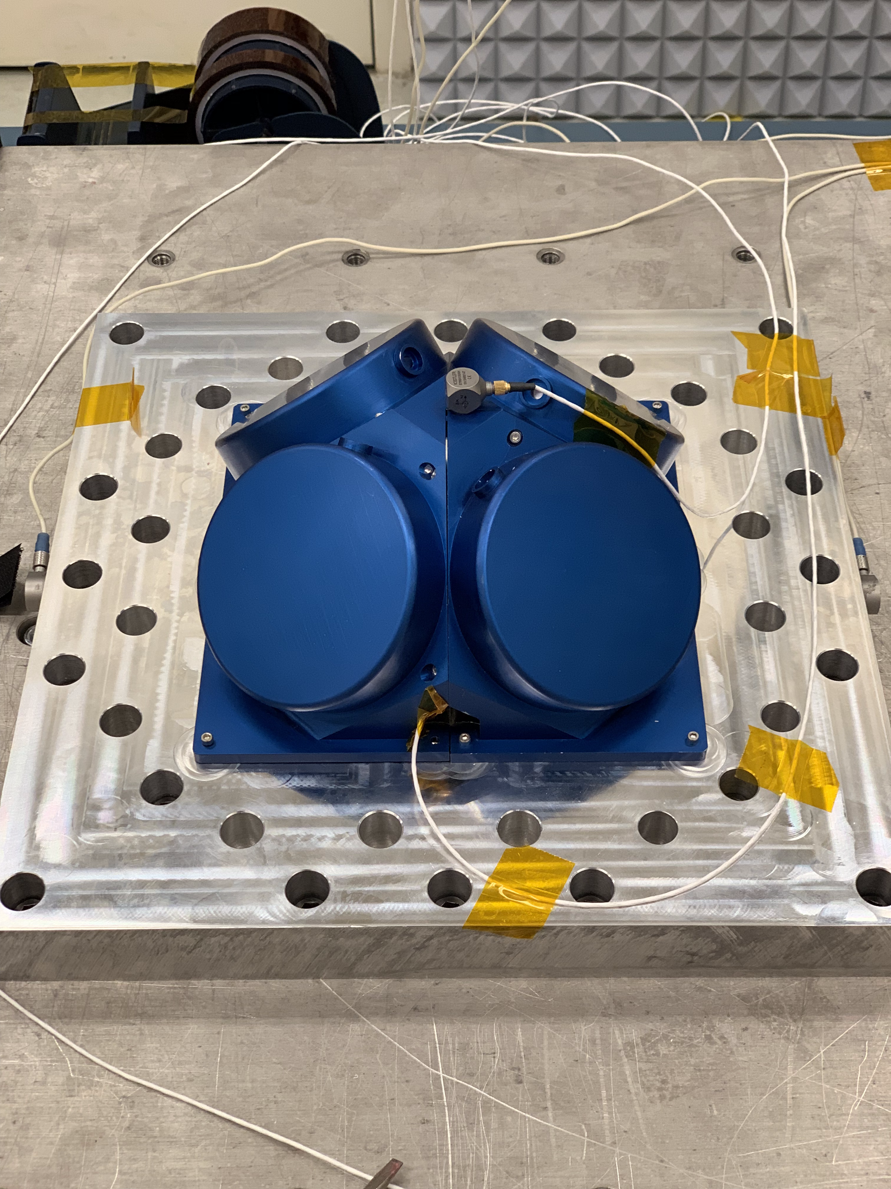
Environmental Testing
We took a ’protoflight’ unit through a Vibe and TVAC test to verify the design and reduce risk on the flight build.
This allows us to skip TVAC and Vibe on the full flight instrument and piggyback on the Vibe and TVAC once it’s integrated into the spacecraft.
We are investigating if we should go through another Vibe (as recommended at iCDR).
Also brings the instrument up to TRL 6.
Evaluating recent measurements (by NRL on SIRI) impact future missions.
Hardware:
Included a quarter detector including the full detector stack (crystal, housing, wrapping, and pads), a full SiPM array and a prototype IDAB.
Some anomalies were seen but determined these were due to handling and contamination (not design).
Developed procedures to prevent this on flight.
Inserted tests in the schedule to check for these types of issues.

Slide 17
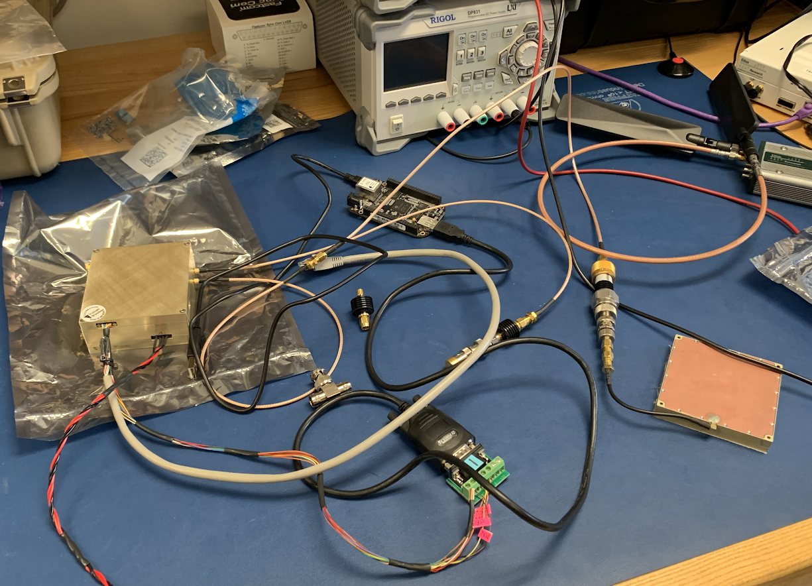
S/C Bus and Science: Vulcan Radio Status
S-Band NEN/TDRS Communications
Configurable up to 3-4 Mbps
Baselined 2 Mbps for Mission Operations
Vulcan Radio (Engineering Model)
Integrated into the Development Platform (Flatsat)
cFS Radio App development mature
NEN testing completed 09/2019
TDRS testing anticipated 01/2020
NIMO Link Analysis
Indicates that this radio will provide at least 1kbps to TDRS and 3-4 Mbps to NEN [TBD]

Slide 18
Status post-iCDR
Detailed plan exists for procurement, assembly, test, and calibration.
ICDs are mostly complete for the flight build (some are TBD pending further development).
Schedule for build is at a high fidelity.
Ground system and instrument flight software at PDR level. Will be at CDR level in March.
Mission CDR is in March.
Delivery to spacecraft is in September 2020.
Launch readiness is fall of 2021.
MEMs IMU
Batteries
Star Tracker
EPS
Solar Panels Rel Mech
C&DH
SSC w/GPS
Torquer X3
Instrument Assembly
FSS
Radio
Reaction Wheels X3
S-Band Antenna X2

