Slide 1
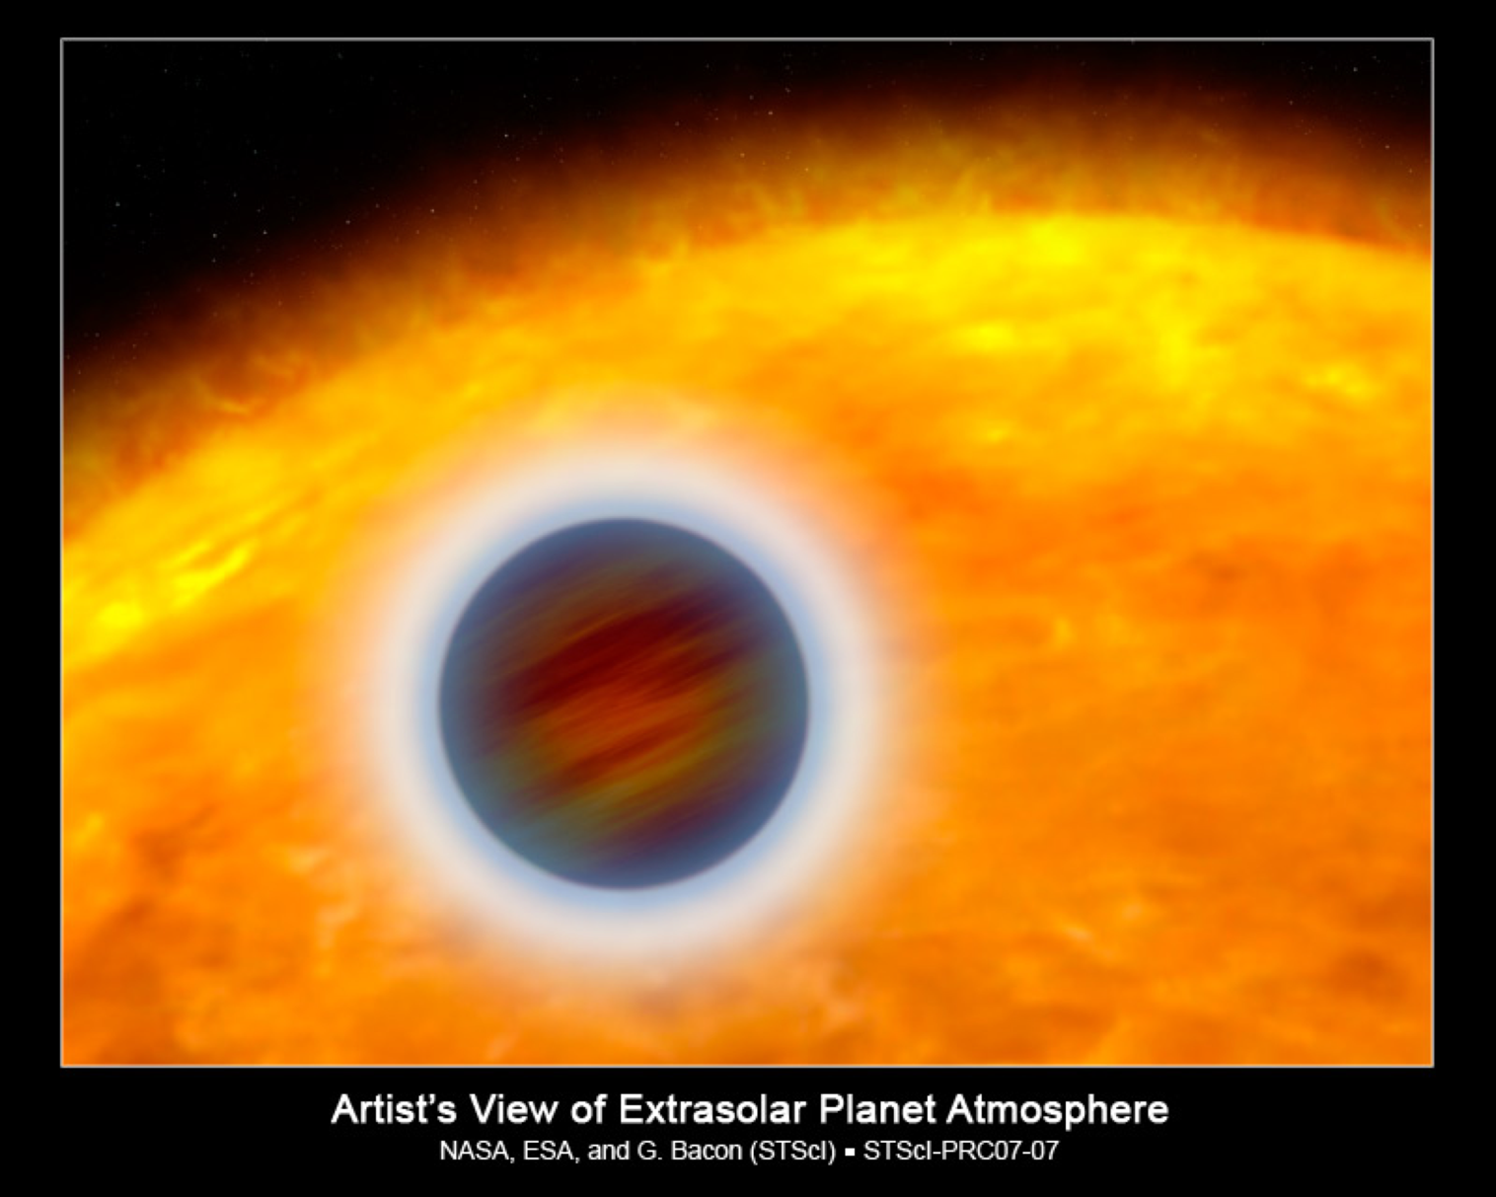

Exoplanet Watch:
Crowdsourcing Transiting Exoplanets
Sujay Nair¹, Quinn Perian¹,
Kalee Tock¹, Rob Zellem²
¹ Stanford Online High School
² Jet Propulsion Laboratory – California Institute of Technology
© 2020. California Institute of Technology.
Government sponsorship acknowledged.

Slide 2
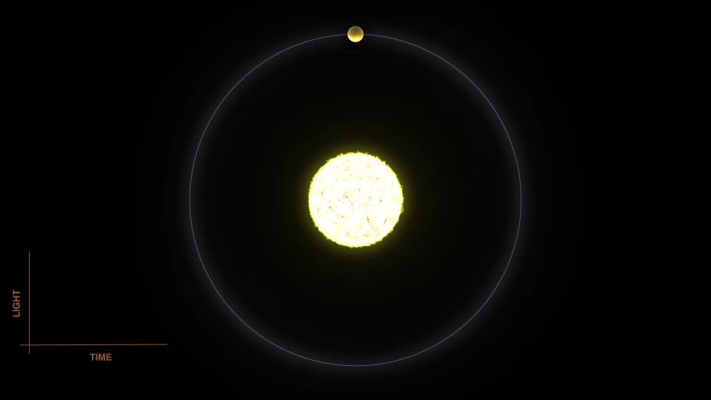
Transits
Measures the change in brightness as the planet passes in front of or behind its host star
  At best, the dip in brightness is 1%
Gives us the planet-to-star radius ratio
  Allows us to study planetary atmospheres
Method used to discover 3135 exoplanets of the 4104 currently-known
NASA

Slide 3
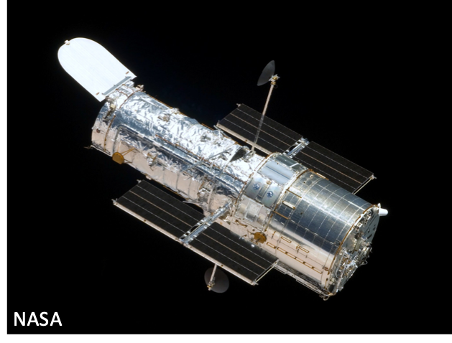
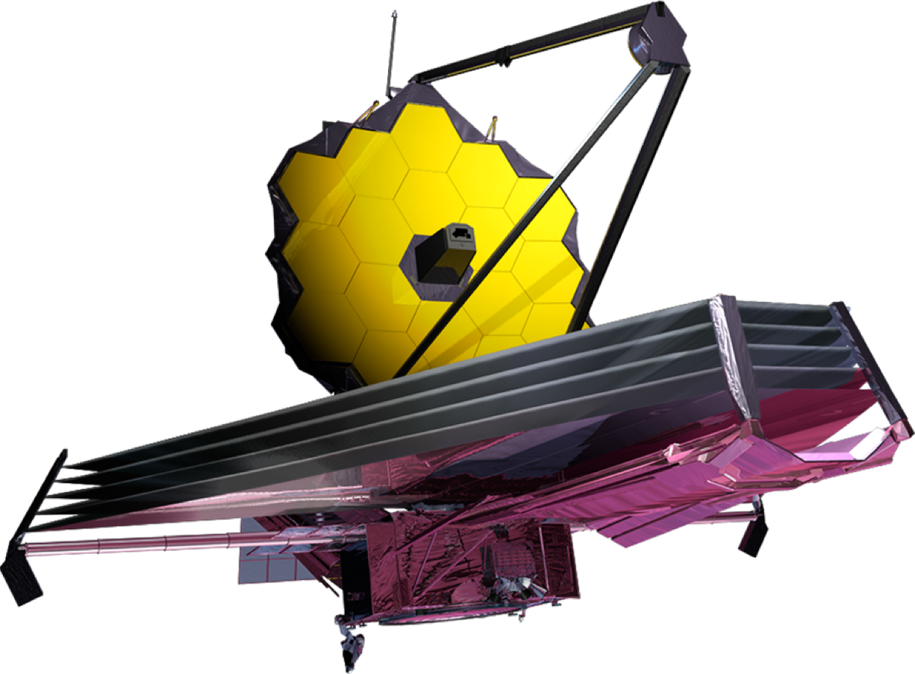
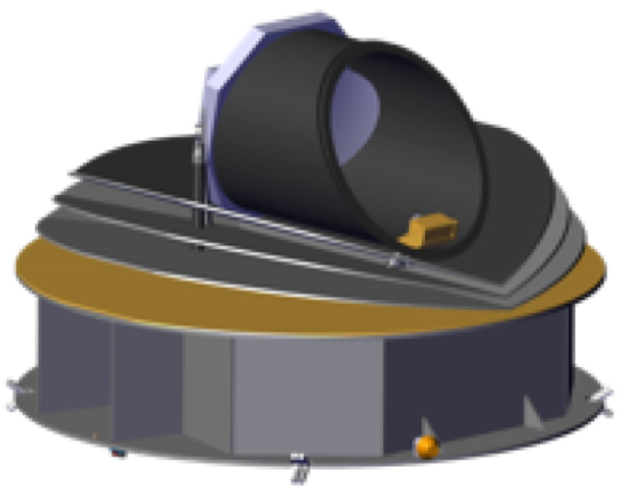
Transits
NASA’s Hubble – tens of planets
NASA’s JWST – tens to hundreds of planets
ESA’s ARIEL – hundreds to a thousand planets
NASA’s Astro2020 - ?
JWST - NASA/Goddard
ARIEL
(artist’s concept)

Slide 4
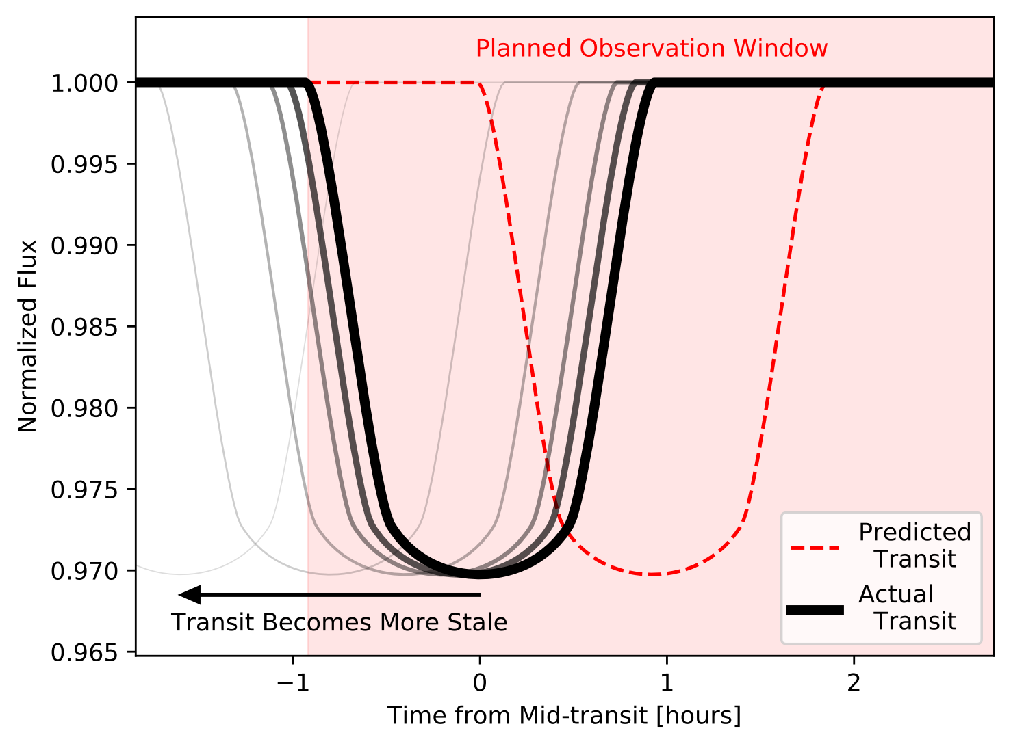
Need to keep things fresh
Zellem et al. (in review)

Slide 5
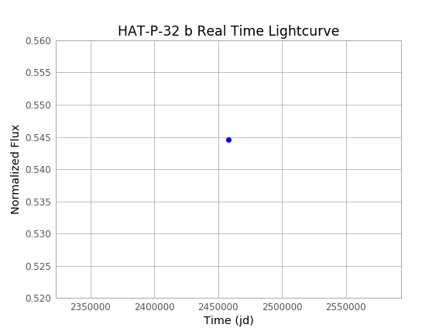
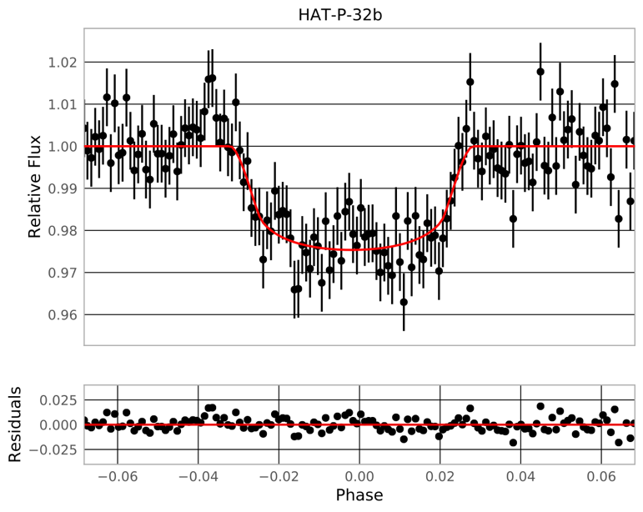
The Power of Small Telescopes
A single 6-inch (15.24-cm) telescope is capable of high-precision transit photometry
  MicroObservatory in Tucson, AZ
EXOplanet Transit Interpretation Code
Developed by Ethan Blaser (U. Virginia)
See my talk 337.07 on Tuesday at 11 AM in 321A
U. Virginia Undergrad Ethan Blaser
(Zellem et al. in review)

Slide 6
The Solution: Citizen Scientists
Periodically measure transiting exoplanets to keep their mid-transit times and orbital periods fresh so that large telescopes know when to observe them
  Would increase the efficiency of these telescopes’ observing time
    Strategic for NASA
  Follow-up is time sensitive
Monitor for stellar variability
Zellem et al. (in review)

Slide 7






Exoplanet Watch
A campaign aimed at amateur astronomers and smaller colleges/universities to routinely observe high-priority transiting exoplanets to keep their mid-transit times and orbital periods precise
  Complementary to existing surveys
Aims to increase learners’ understanding of the process of science and key topics in astronomy, and increase the role of NASA Astrophysics science experts as partners

Slide 8
Exoplanet Watch Deliverables
Data will be immediately public to entire community
Observers will be listed as co-authors on any published results
Enable science
  Keeping transit times fresh
  Discovery of new planets (transit timing variations)
  Monitoring for stellar variability
  Additional Future Goals
    Target confirmation (long period planets)
    Searching for blended pairs
Beta testing NOW
Contact me to get involved: rzellem@jpl.nasa.gov
Hiring 2 summer interns (undergrads or grads)

Slide 9
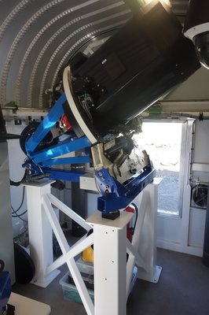
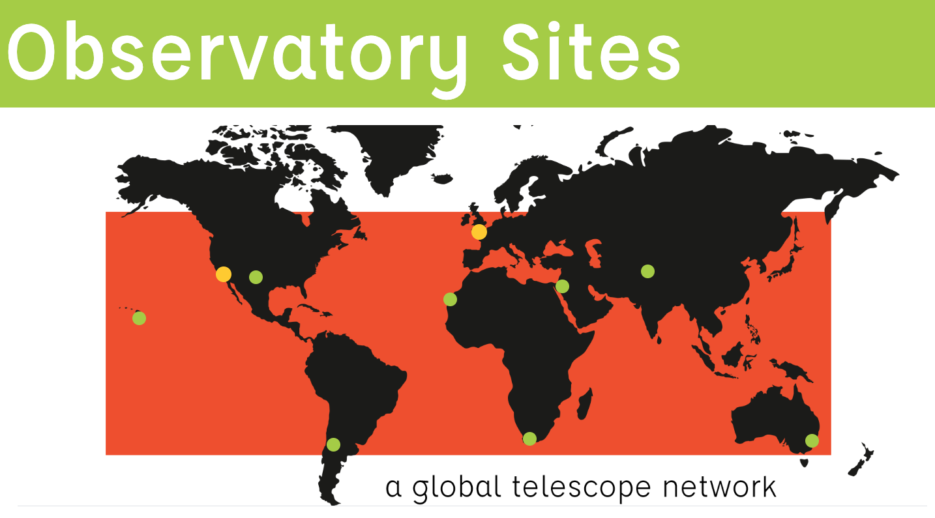
Time series observations on LCO
Selected bright targets with deep lightcurves.
0.4m telescopes
Exorequest
Notes:
Sujay

Slide 10
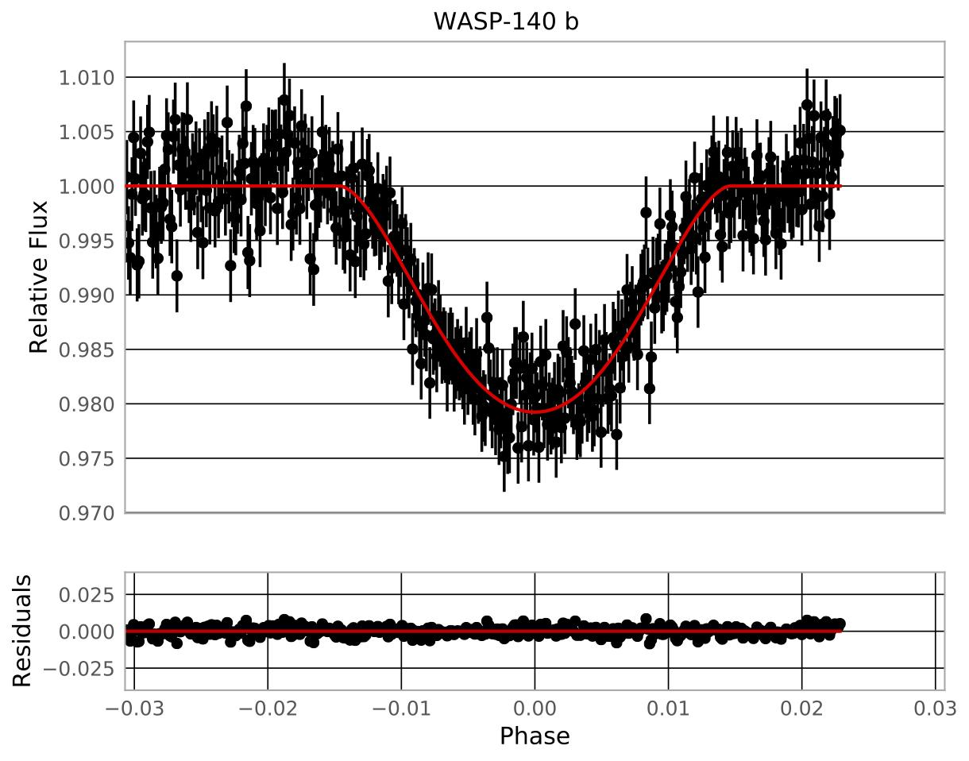
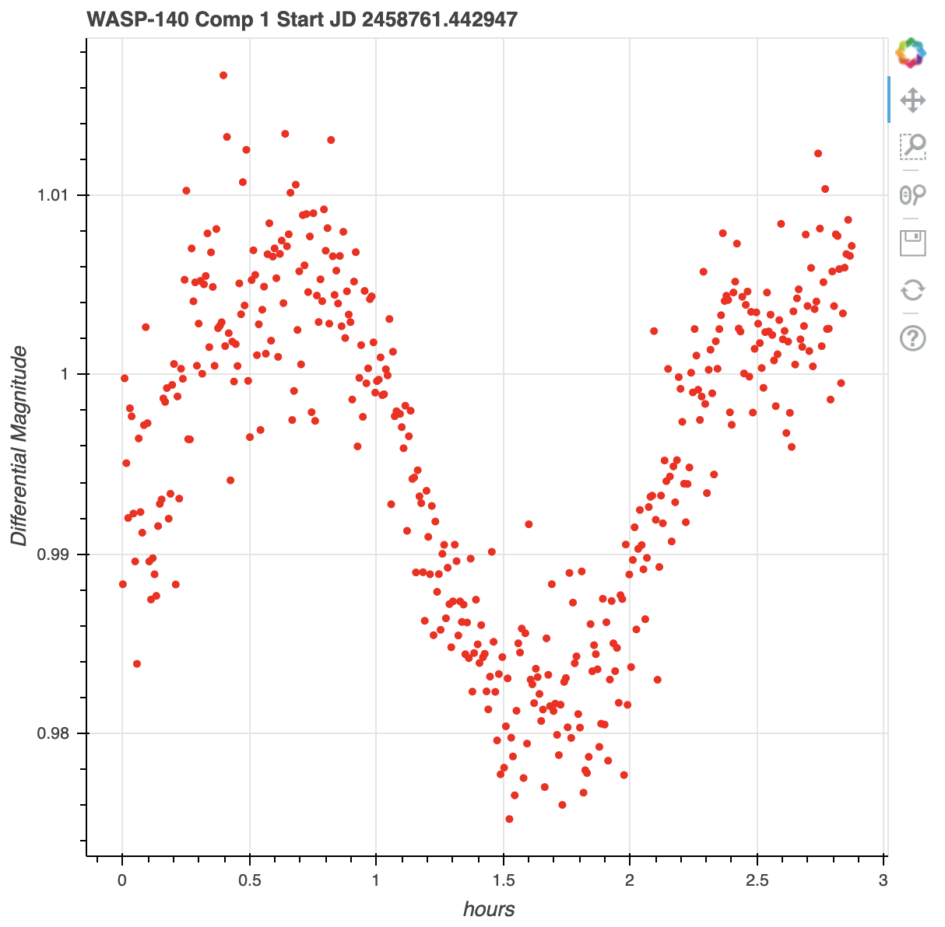
Fitting WASP-140b with EXOTIC
Differential magnitude
Time (hours)
Notes:
Sujay

Slide 11
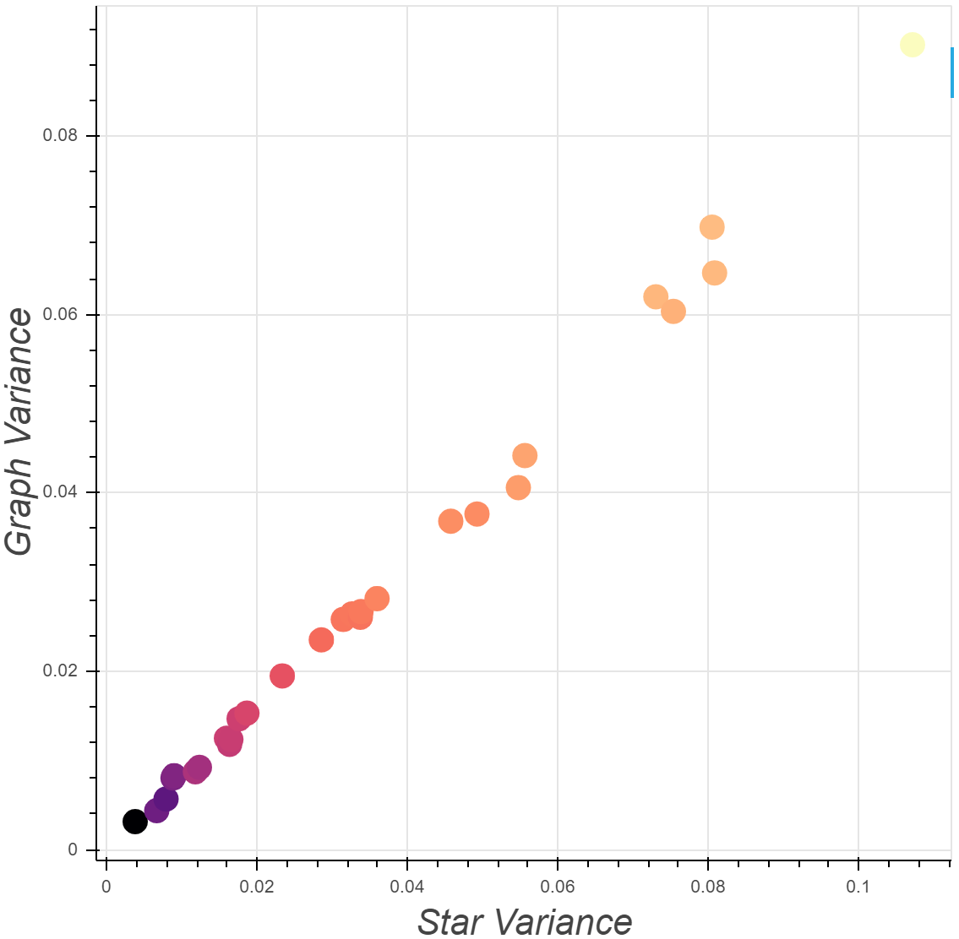
The Effect of Comparison Stars
Light Curve vs. Comp Star Variance
Lightcurve Spread
Total distance from average of nearby points
Lightcurve Spread
Comparison Star Variance
Scaled standard deviation
Comparison Star Variance
Notes:
Quinn
Color correlates to Comp Star Magnitude

Slide 12
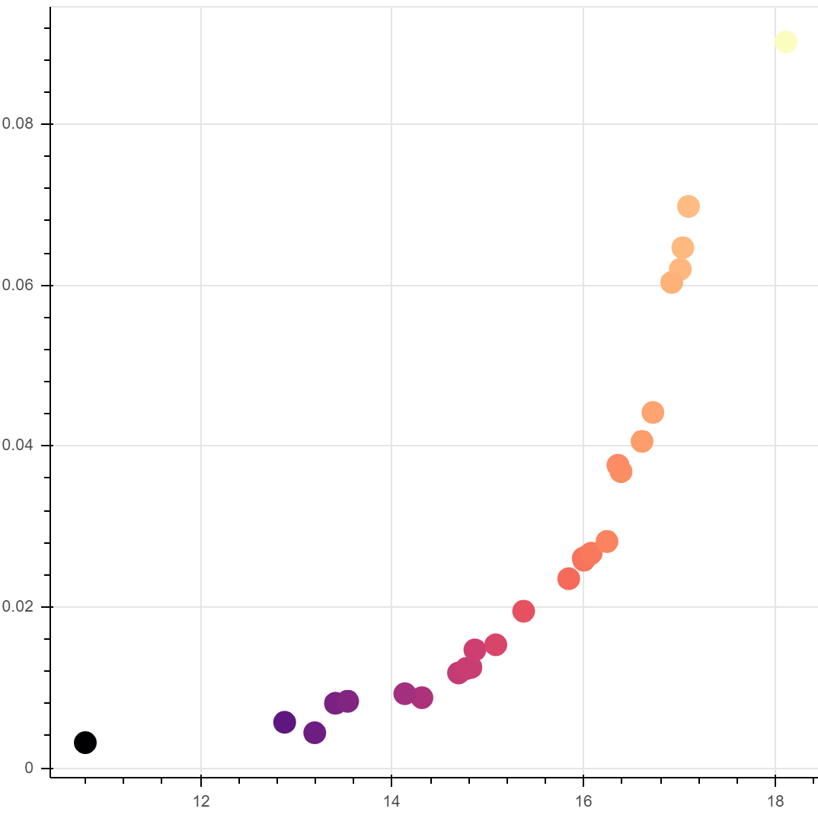
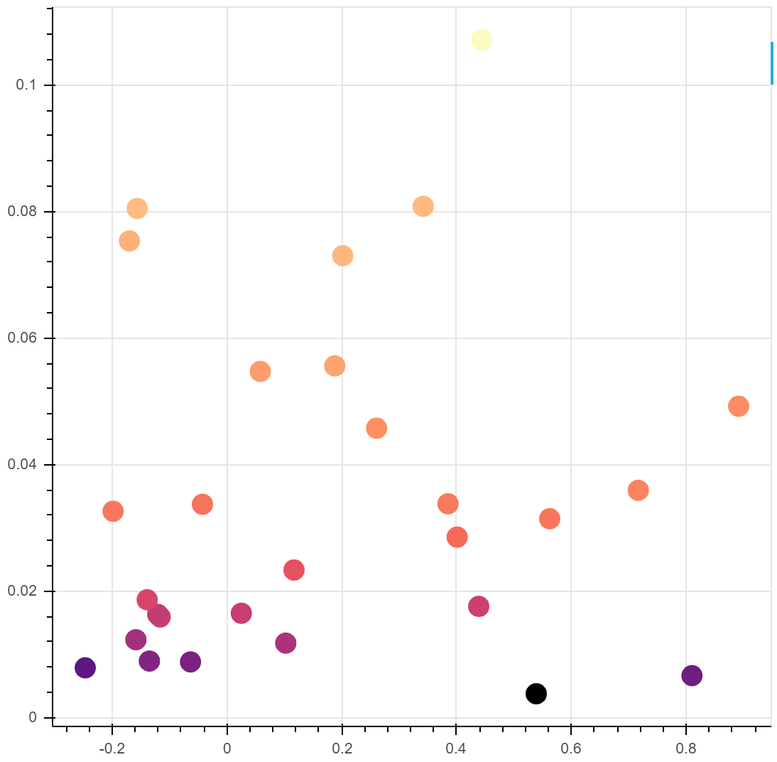

Factors affecting comp star variability for WASP-140b
Lightcurve Spread
Lightcurve Spread
WASP-140 b
12
14
16
18
-0.2 0 0.2 0.4 0.6 0.8
Comp Star Magnitude
Comp Star B-R Difference From Target
Notes:
Quinn

Slide 13
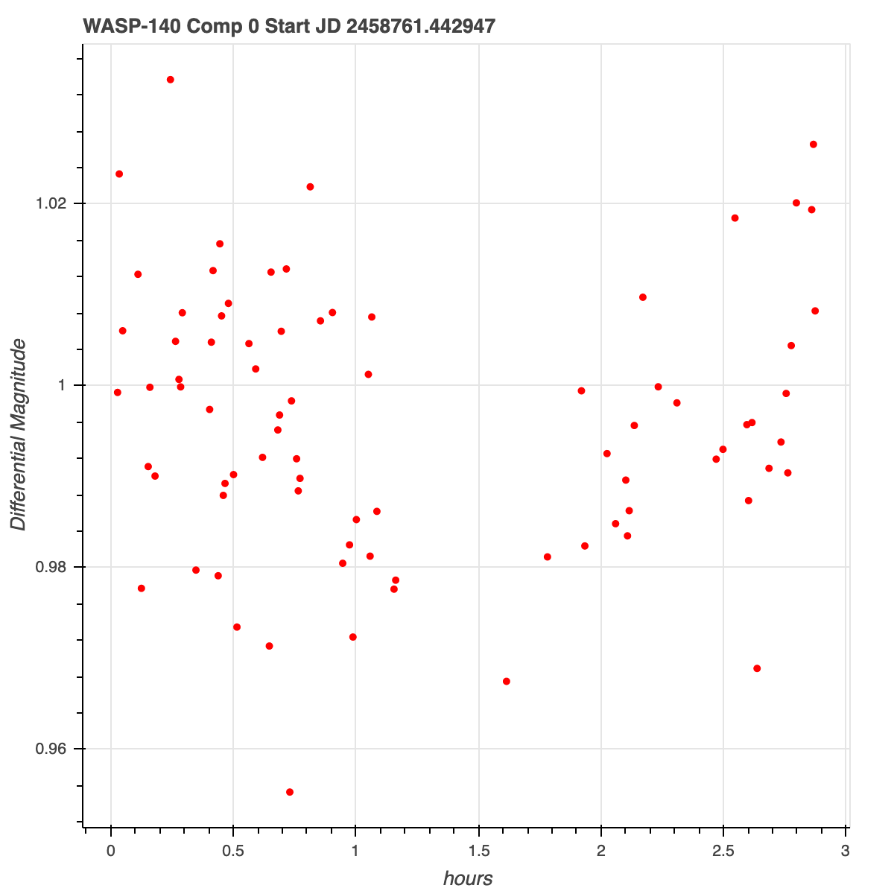
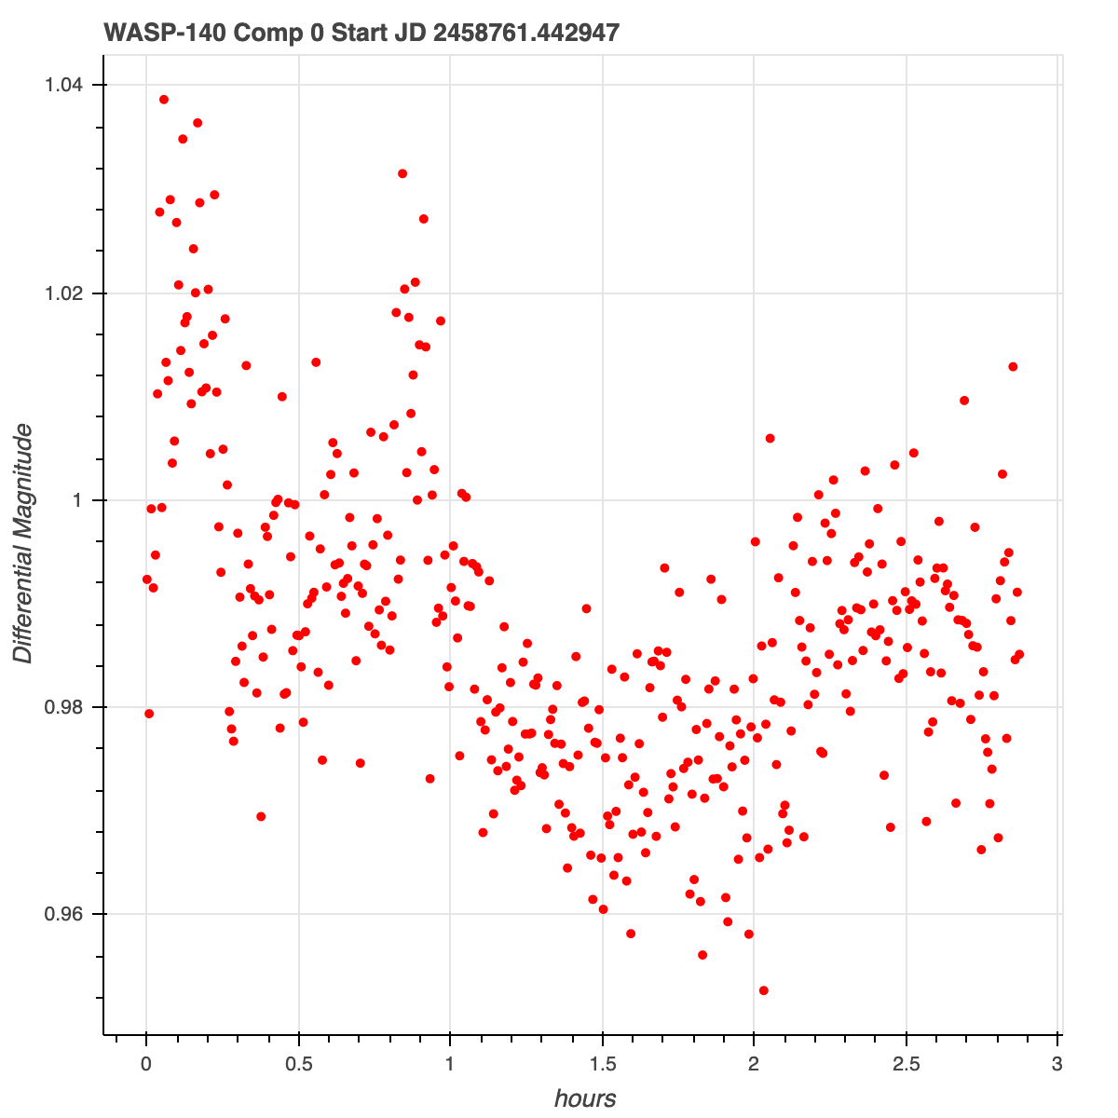
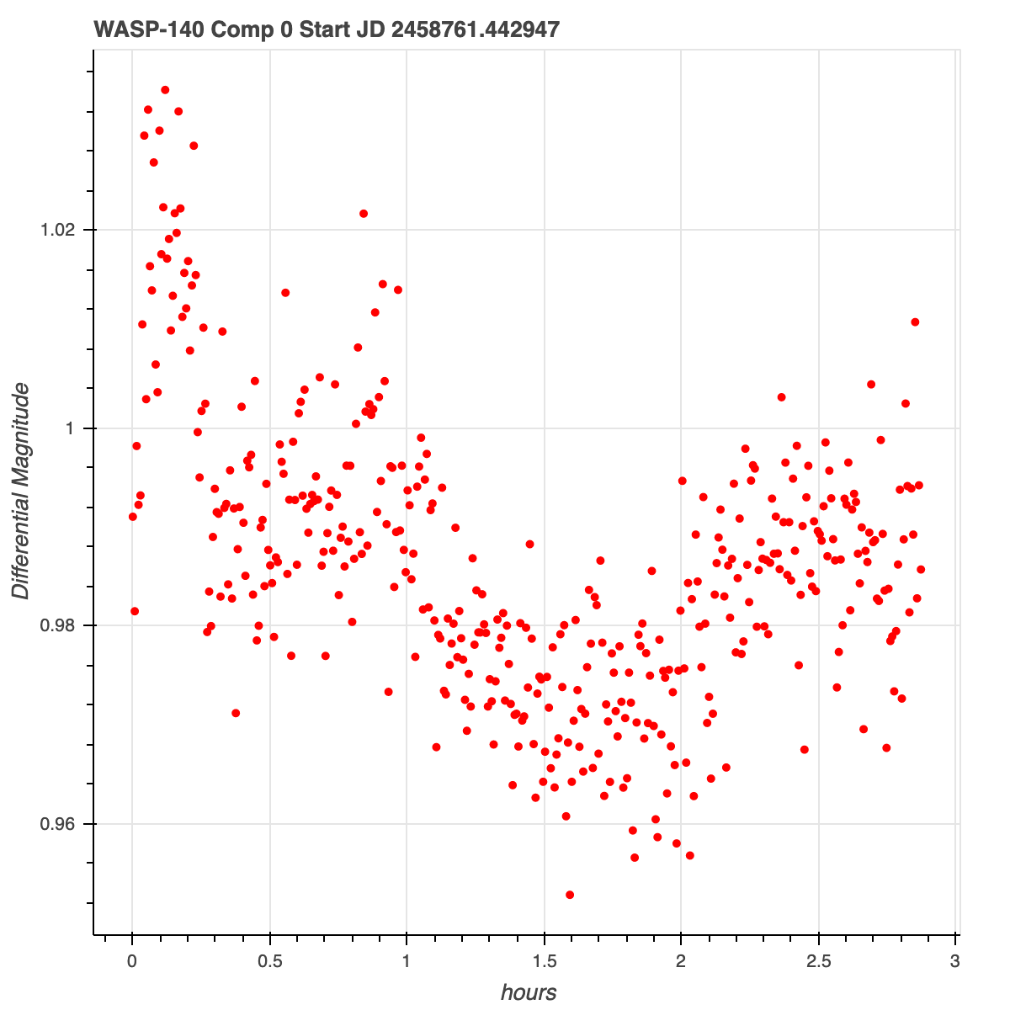
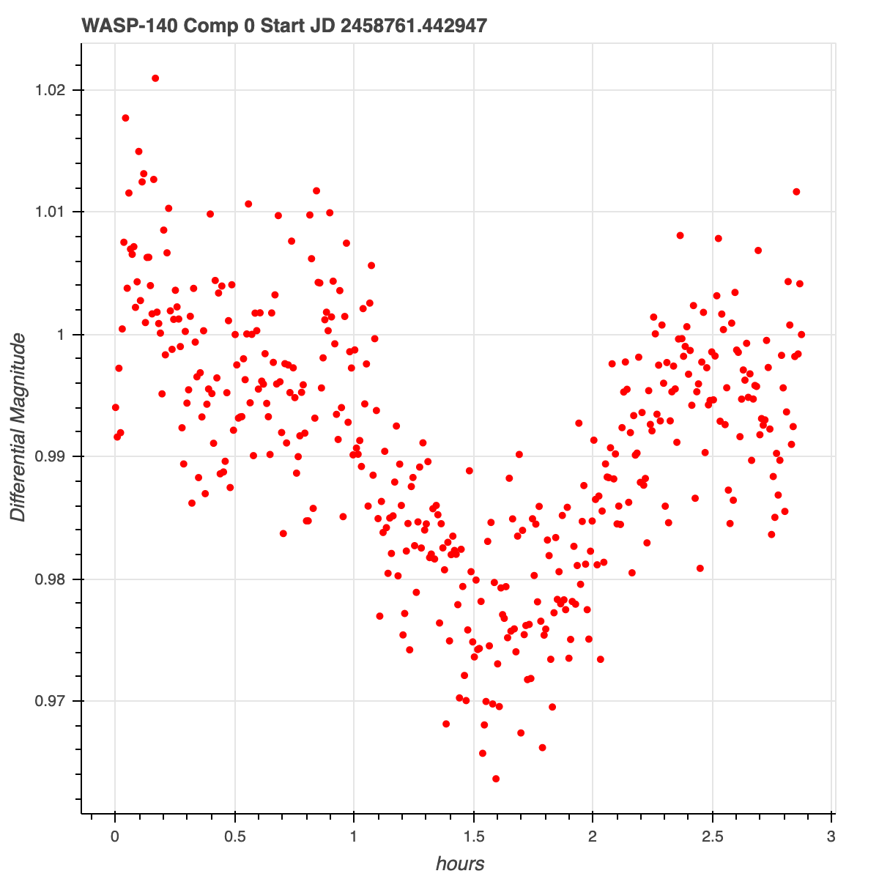
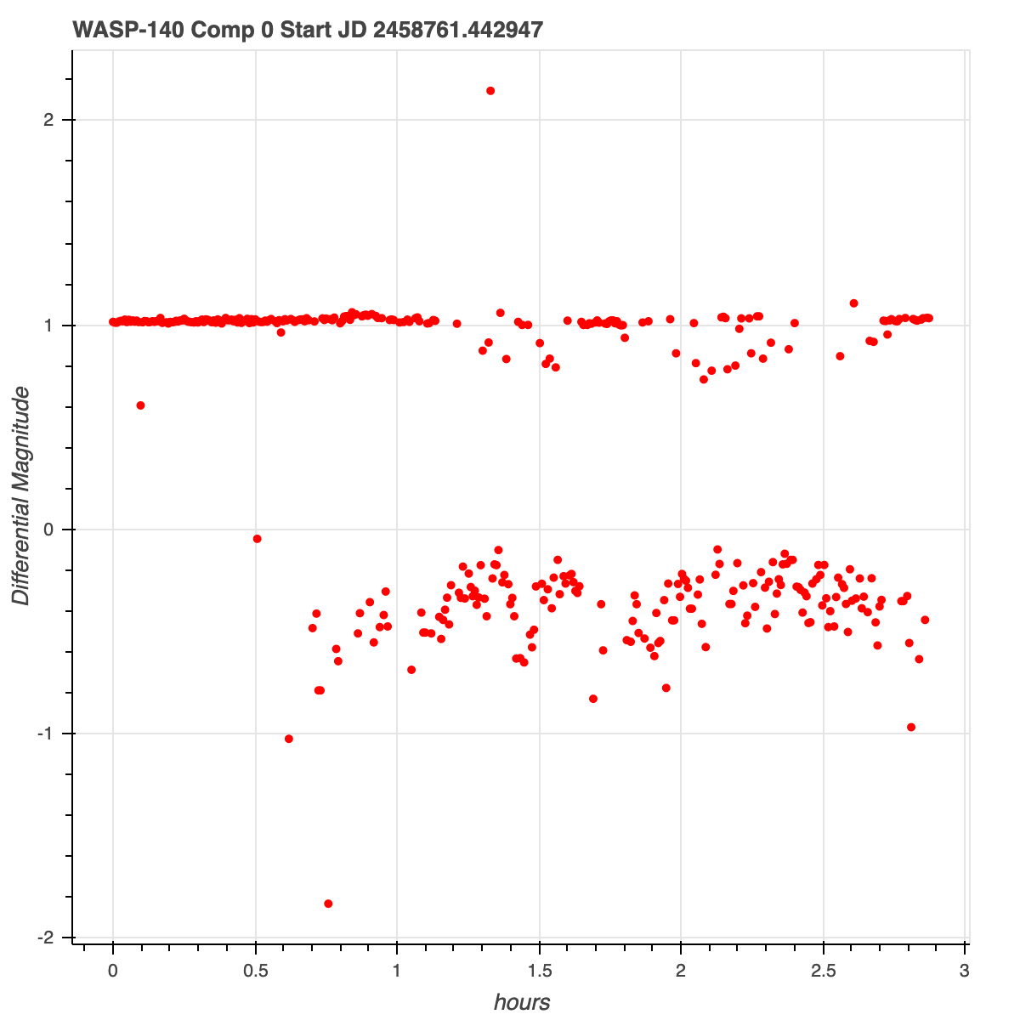
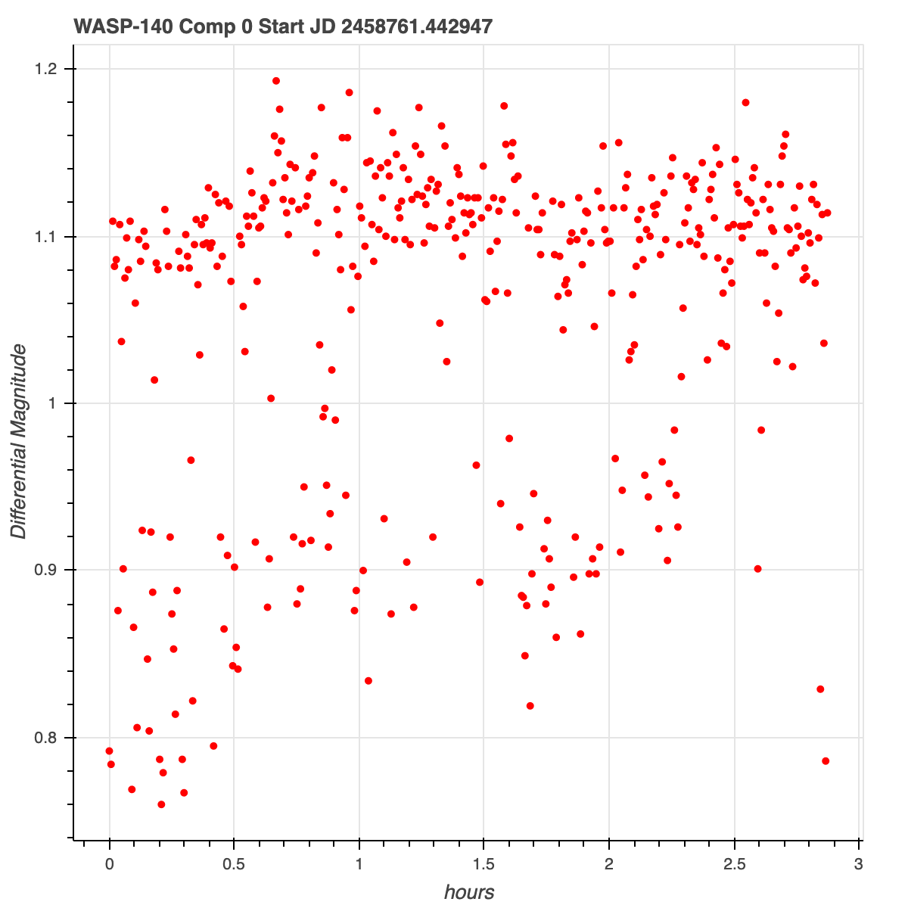
Lightcurves different photometries - WASP140b
Differential Magnitude
apt
sek
Differential Magnitude
Differential Magnitude
sex
Hours
Hours
Hours
*Good*(PSX)
Differential Magnitude
Differential Magnitude
Differential Magnitude
dop
*Not Good*
(DAO)
Hours
Hours
Hours
We’ll now take a closer look into these circled photometries
Notes:
Sujay

Slide 14
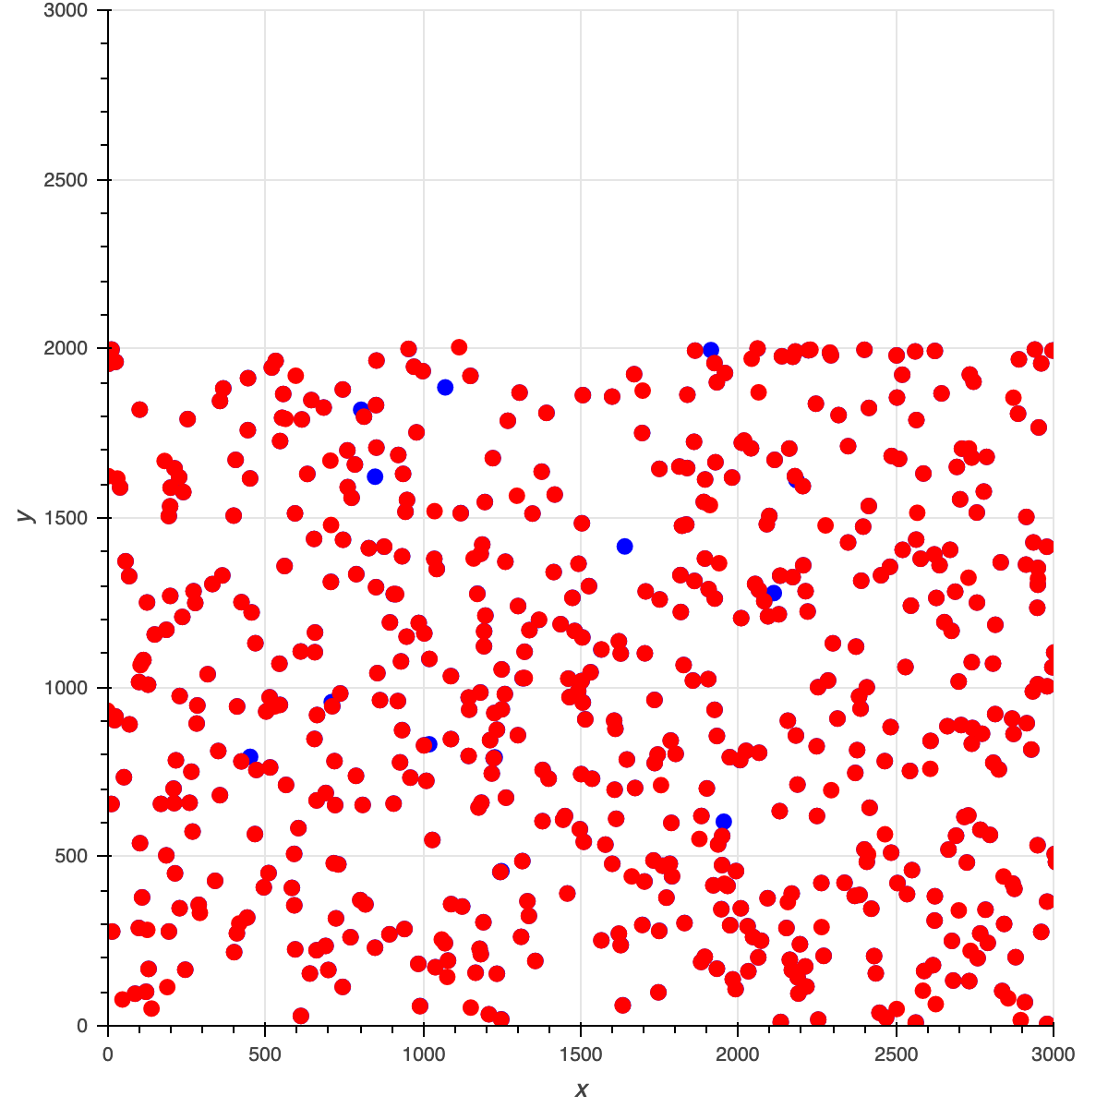
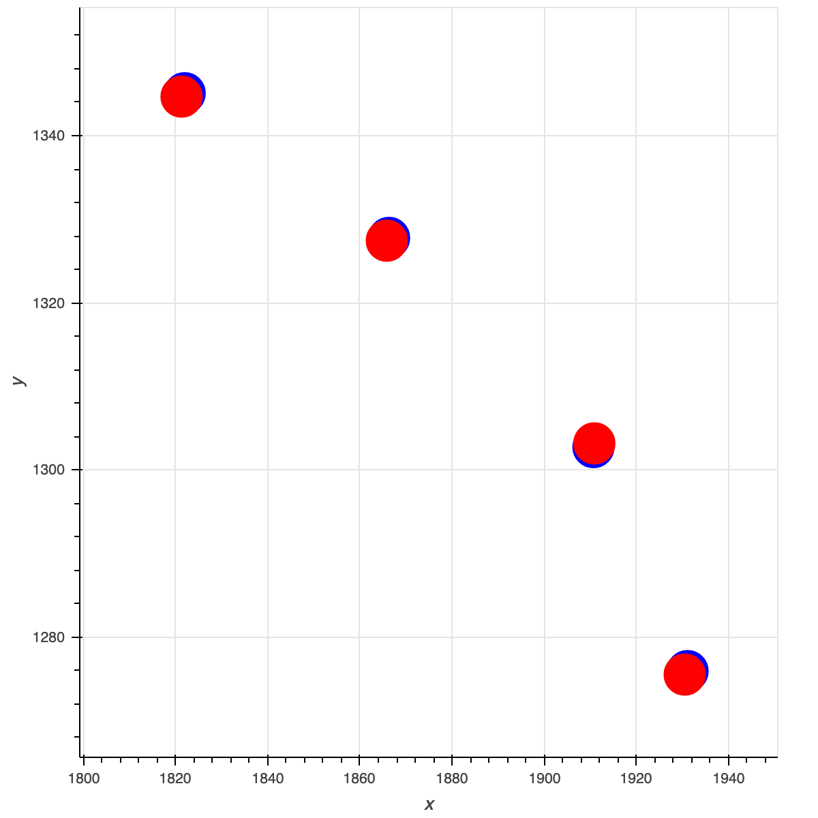
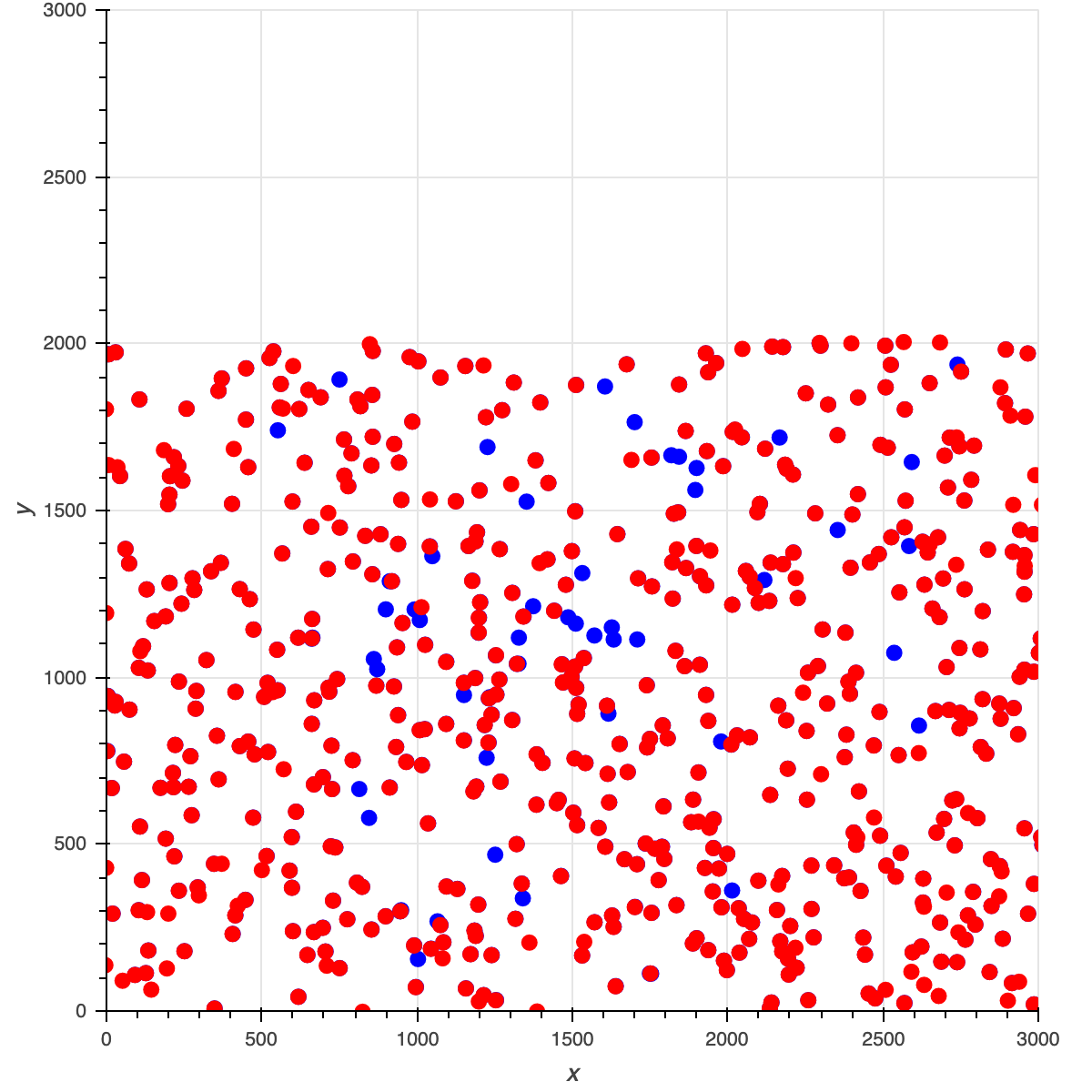
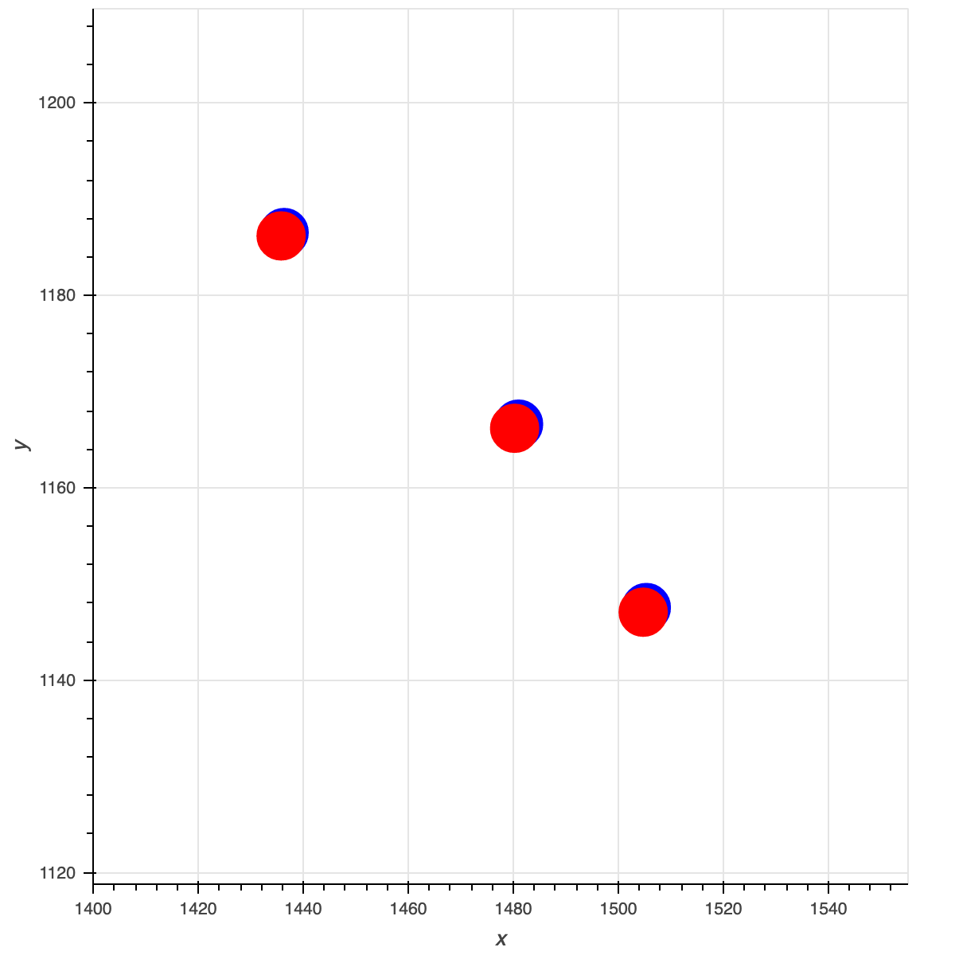
“Good” vs “Bad” Photometry
PSX vs DAO
Predicted Locations((x,y) pixels) on 2 randomly selected images:
Notes:
Sujay: check with me for how to make dot sizes bigger

Slide 15
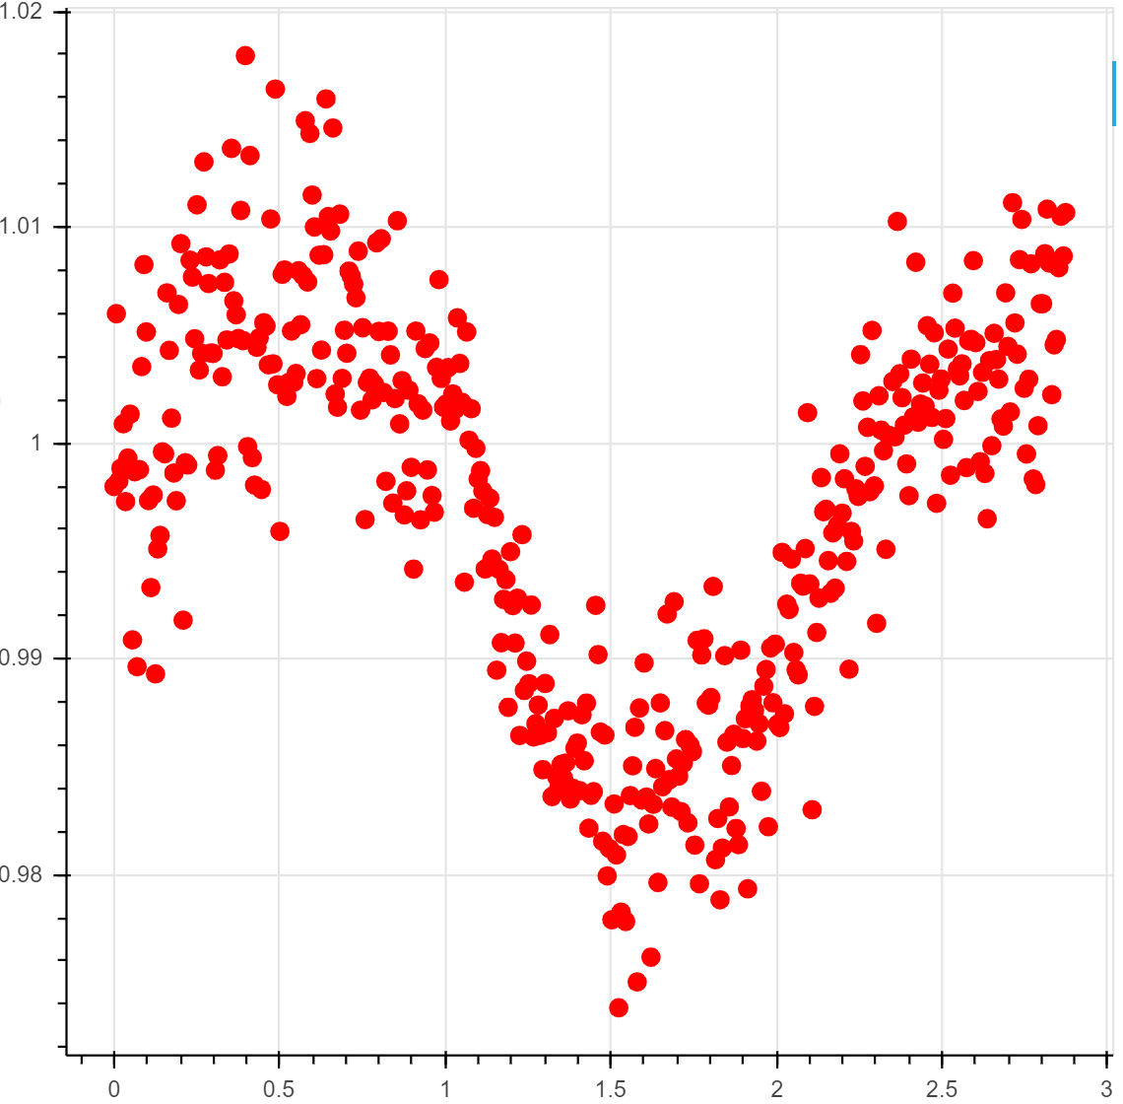
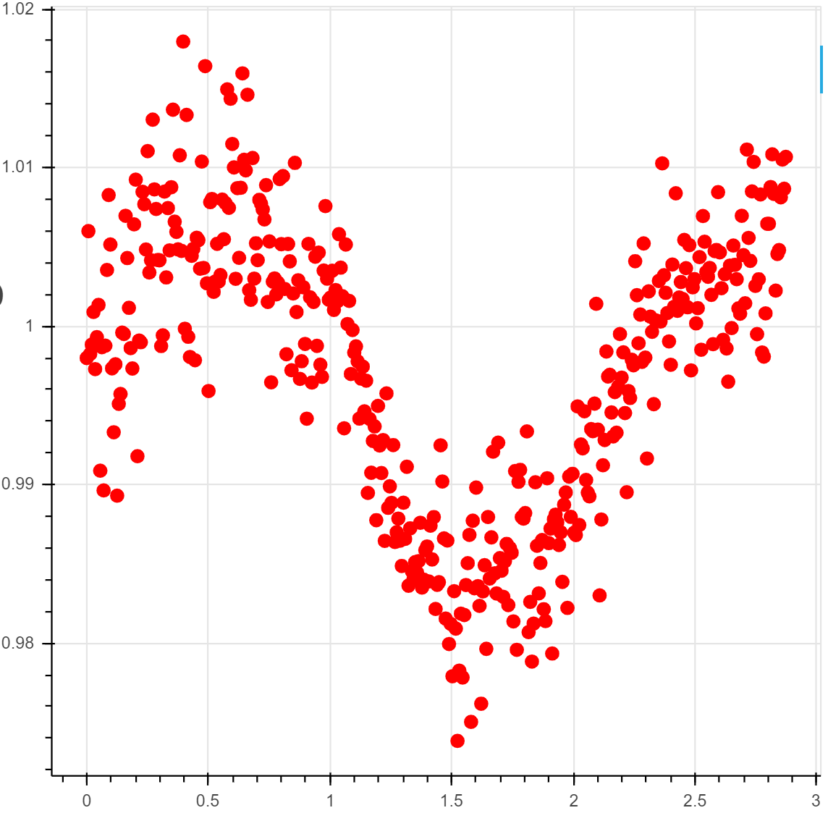
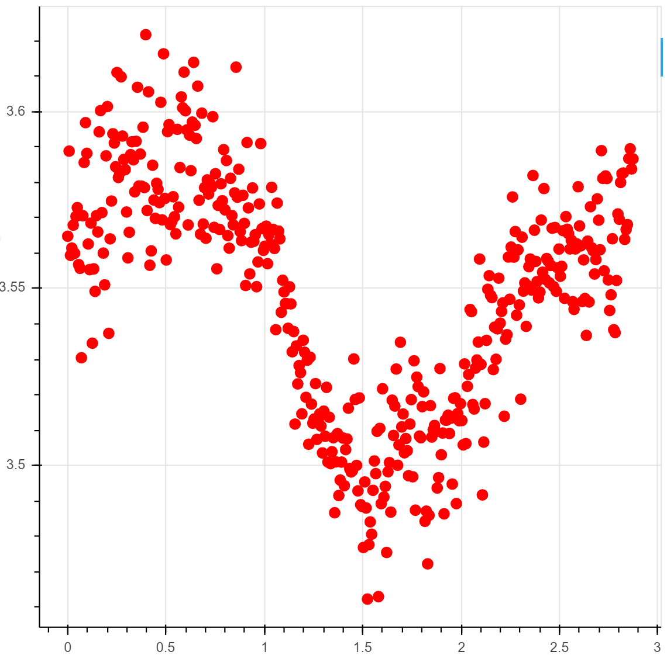
Merged Comp Stars Fluxes
Average of
5 best comps
Weighted Average of
5 best comps
Best comp
Differential magnitude
time
time
time
These lightcurves look similar!
Notes:
“Average” = average lightcurve using the 5 best comps. “Optimized weighted average” = weighted average of the best 5 comps that yields the lowest graph variability. Minimum variance lightcurve uses just the best comp.
Quinn

Slide 16
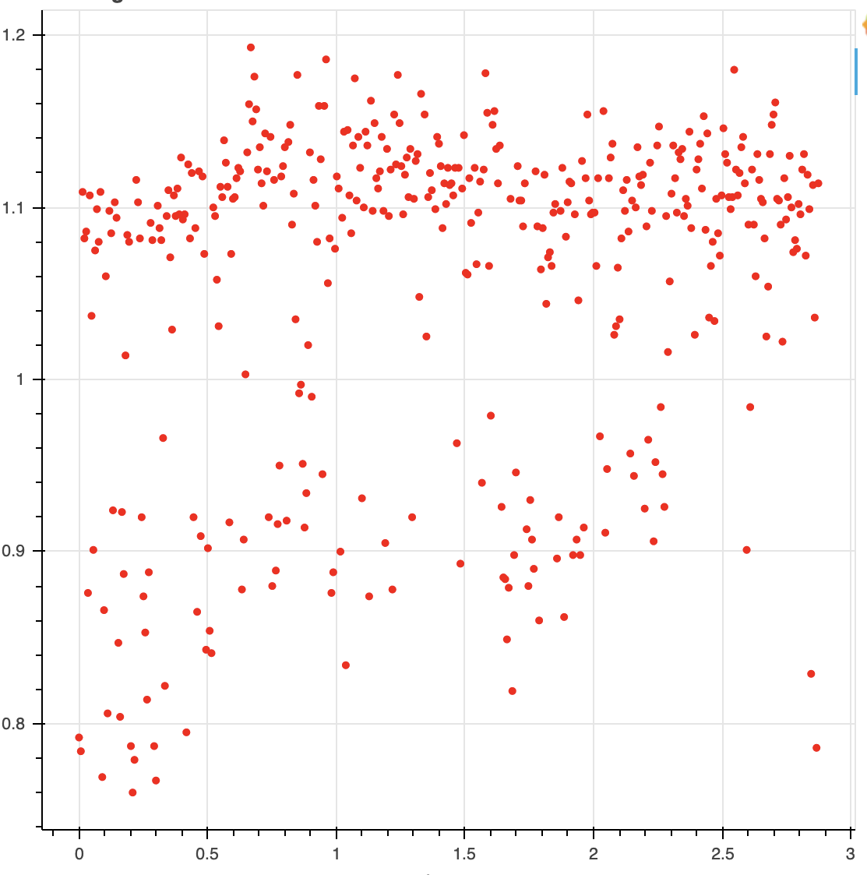
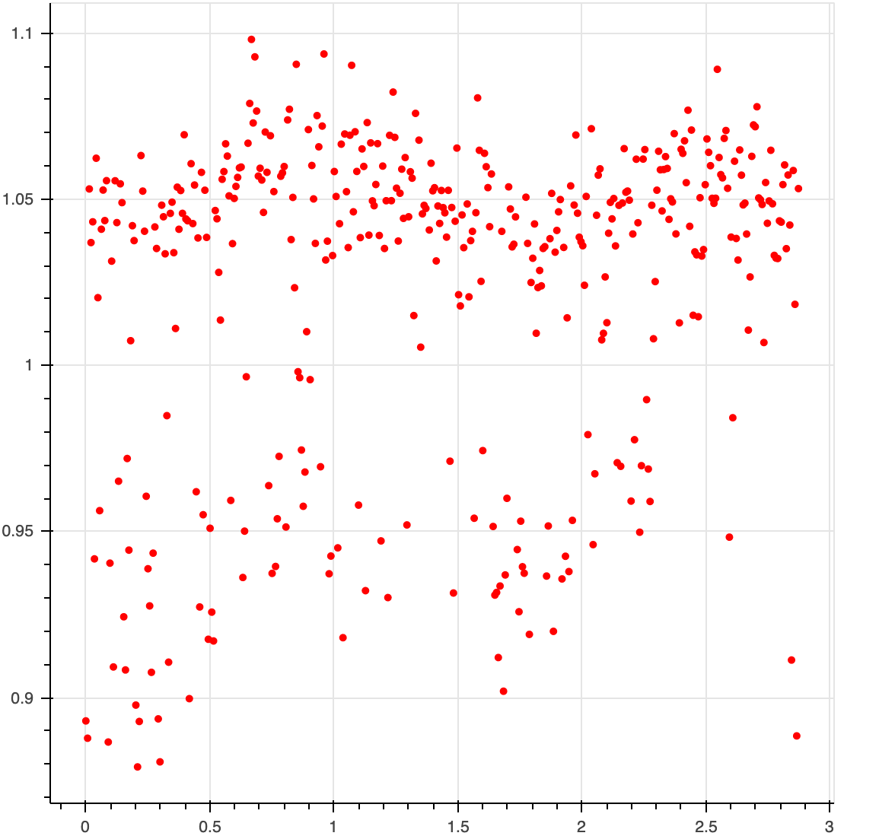
Averaging Photometries
Differential magnitude
Average
PSX & DAO
DAO alone
PSX alone
Time
Time
Time
Notes:
Sujay

Slide 17

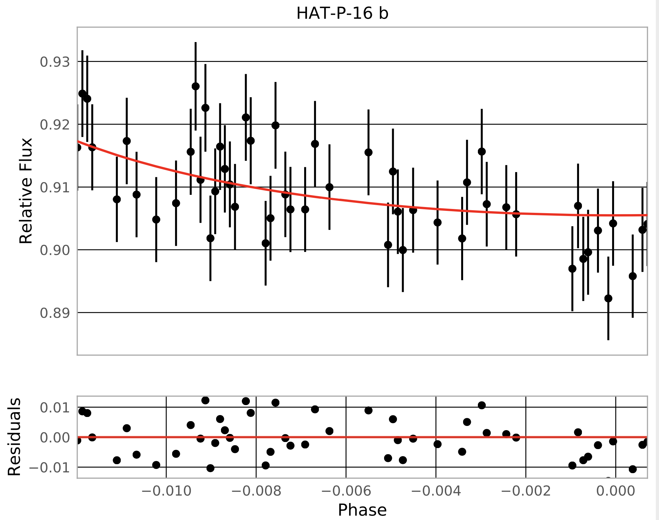
System | WASP-140b (whole) | HAT-P-16 b (half)
Transit Depth Uncertainty (%) PSX | 0.271 | 1.374
Residual Scatter PSX | 0.463 | 1.102
Transit Depth Uncertainty (%) EXOTIC | 0.187 | 2.25
Residual Scatter EXOTIC | .311 | 0.684
EXOTIC lightcurve
Notes:
Make this slide better formatted
Quinn

Slide 18
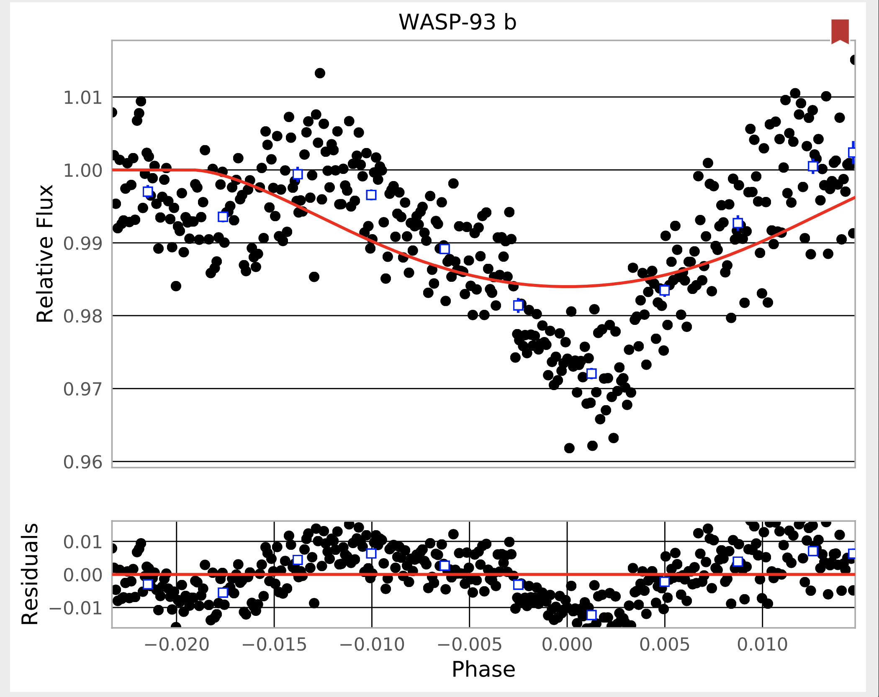
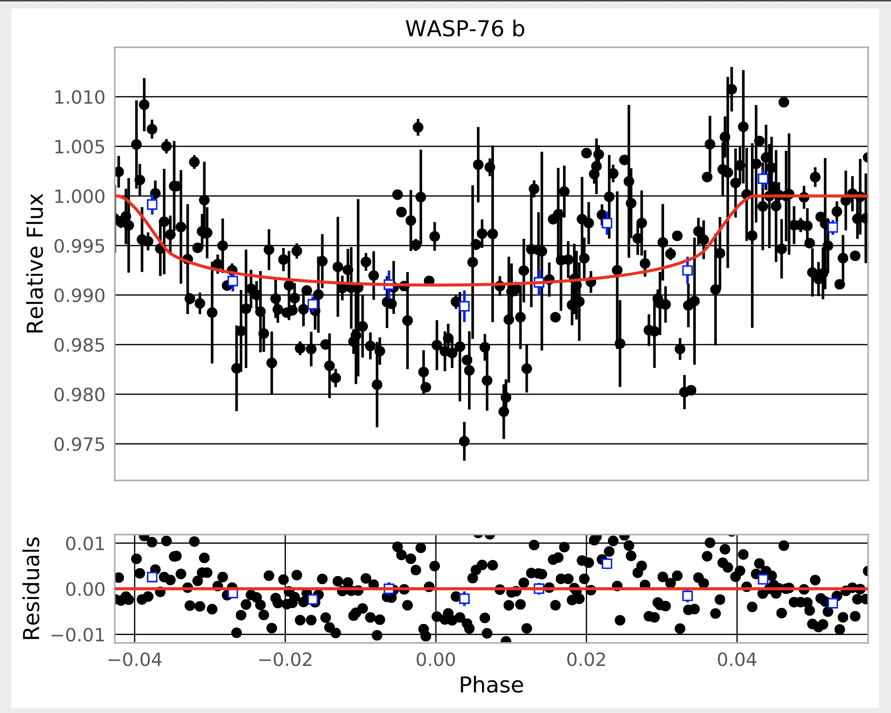
System | WASP-93b | WASP-76b
Transit Depth Uncertainty (%) EXOTIC | 0.322 | 0.131
Residual Scatter EXOTIC | .808 | 0.593
EXOTIC Lightcurve
Notes:
Sujay

Slide 19




Acknowledgements
Rob Zellem
Kalée Tock
Michael Fitzgerald
Edward Gomez
Bob Buchheim
Our Solar Siblings
NASA JPL
LCO
Notes:
Sujay

Slide 20
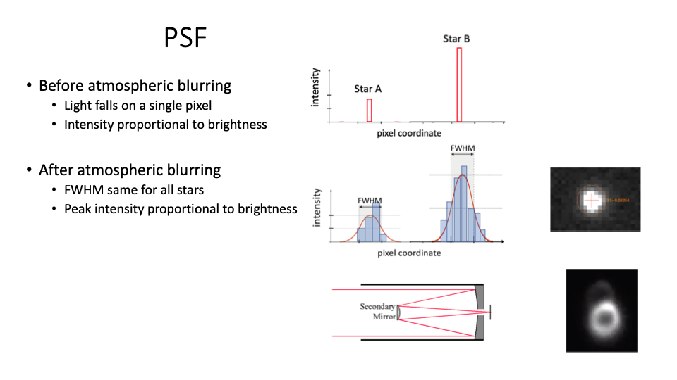
Notes:
http://www.astronomy.ohio-state.edu/~pogge/Ast161/Unit4/telescopes.html

