Slide 1
Student Astronomical Research
Bridging the Gap with CubeSats
Rachel Freed @RachFreed r.freed2010@gmail.com

Slide 2
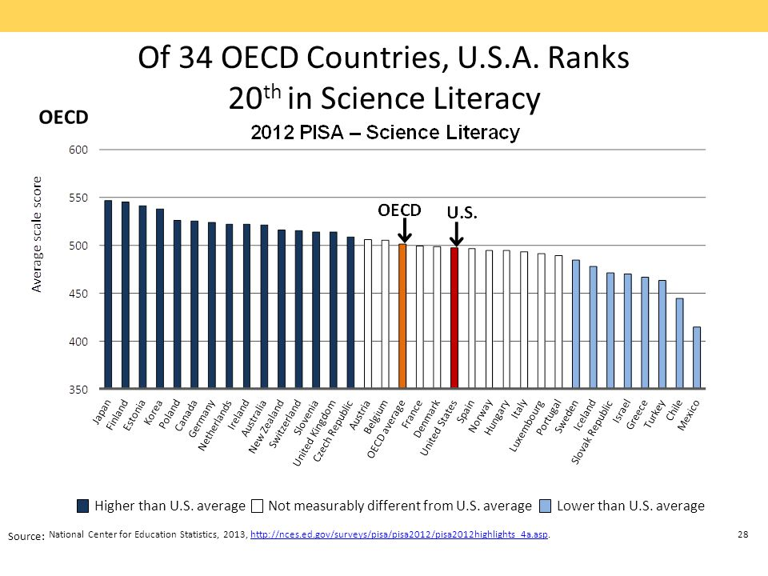
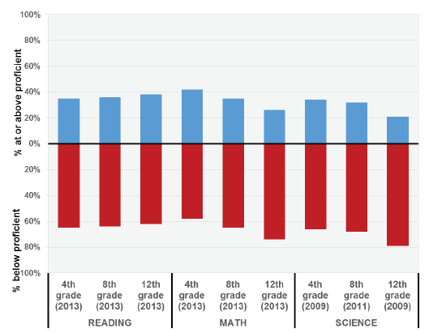
Why?
Notes:
Why? Why student astronomical research?
The NEED: US falling seriously behind in science, math, engineering, skills….
PISA & TIMMS Data, Obama’s call for increased science work force,
The Motivation: Astronomy captures the imagination, it inspires, it’s attainable, it teaches all the skills
Humanity: Astronomy bridges the many divides, examples: Hechter, Astronomers without Borders, Example from Garching…, ISS, International collaborations, aboriginal astronomy in Australia,

Slide 3
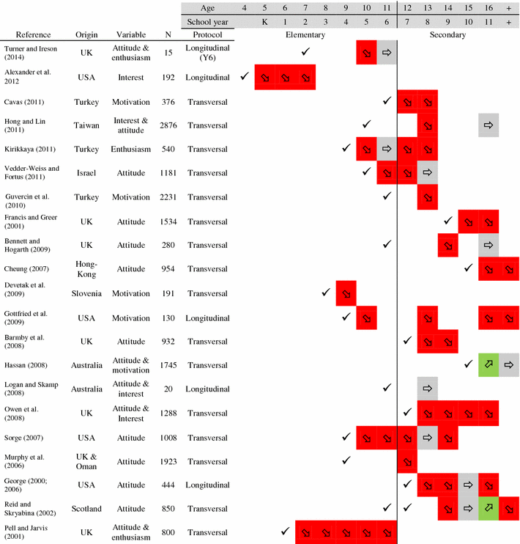
Analysis of the Decline in Interest Towards School Science and Technology from Grades 5 Through 11
Potvin, P., & Hasni, A. (2014). Analysis of the Decline in Interest Towards School Science and Technology from Grades 5 Through 11. Journal of Science Education and Technology
Notes:
Why? Why student astronomical research?
The NEED: US falling seriously behind in science, math, engineering, skills….
PISA & TIMMS Data, Obama’s call for increased science work force,
The Motivation: Astronomy captures the imagination, it inspires, it’s attainable, it teaches all the skills
Humanity: Astronomy bridges the many divides, examples: Hechter, Astronomers without Borders, Example from Garching…, ISS, International collaborations, aboriginal astronomy in Australia,

Slide 4
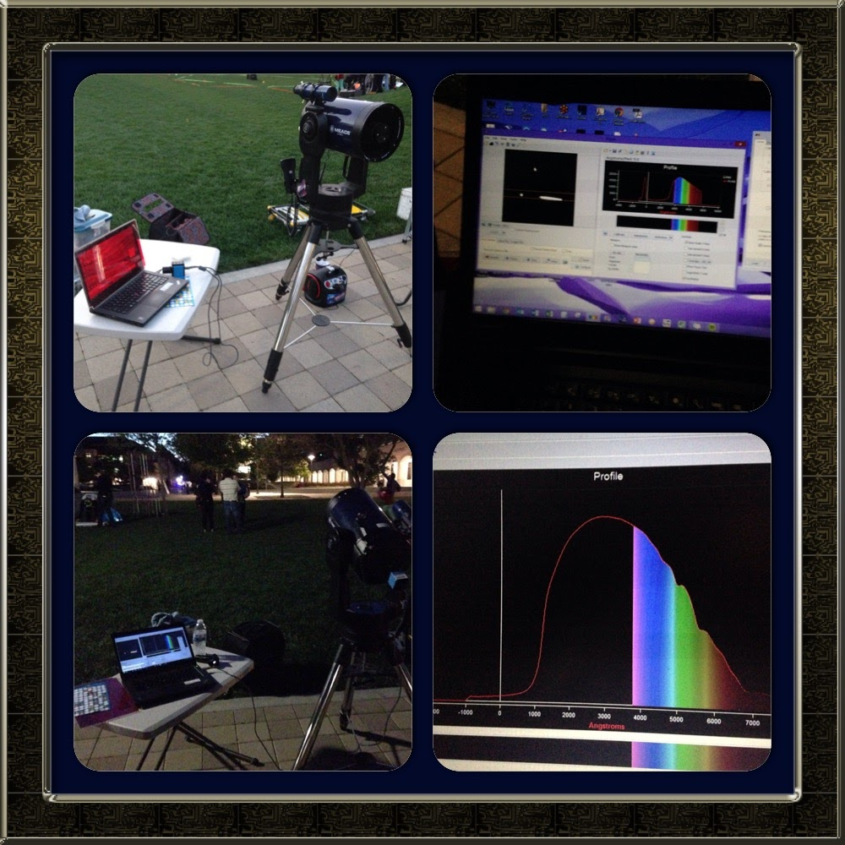
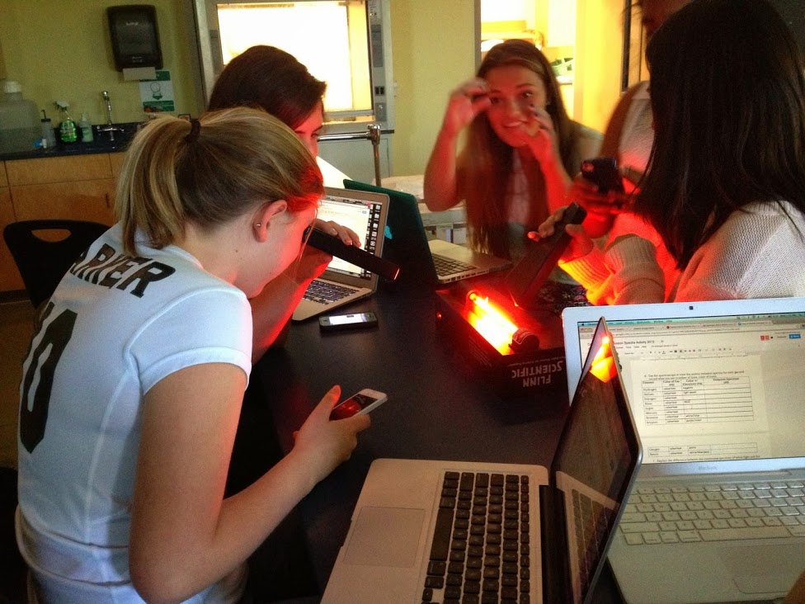
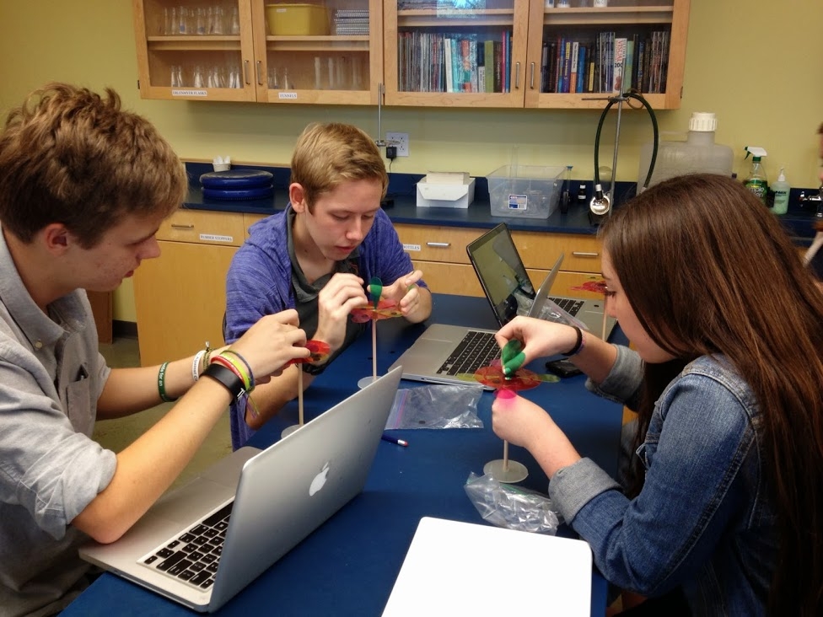
Notes:
Why? Why student astronomical research?
The NEED: US falling seriously behind in science, math, engineering, skills….
PISA & TIMMS Data, Obama’s call for increased science work force,
The Motivation: Astronomy captures the imagination, it inspires, it’s attainable, it teaches all the skills
Humanity: Astronomy bridges the many divides, examples: Hechter, Astronomers without Borders, Example from Garching…, ISS, International collaborations, aboriginal astronomy in Australia,

Slide 5
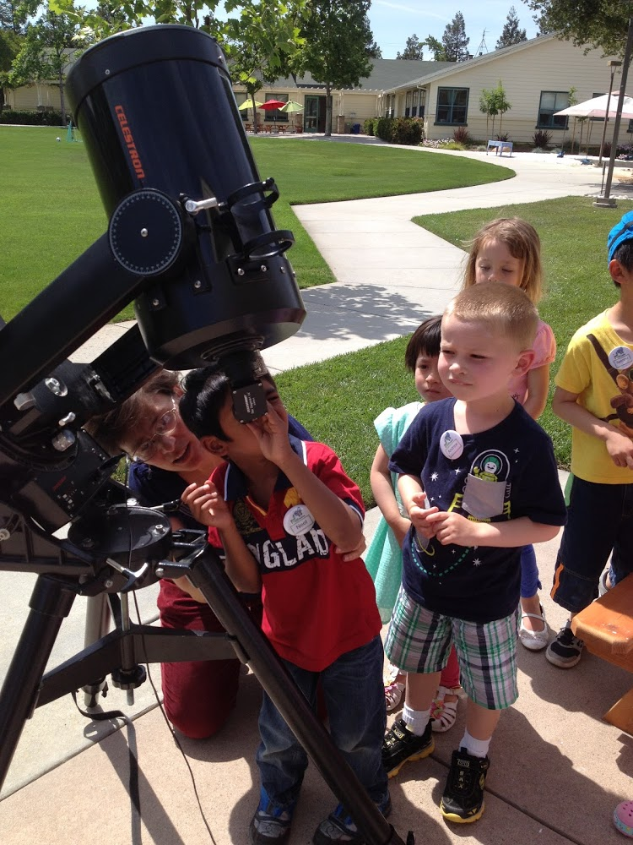
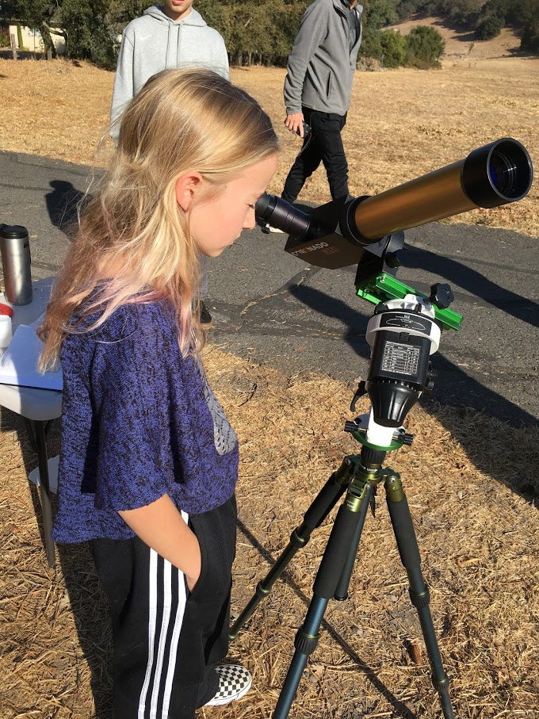
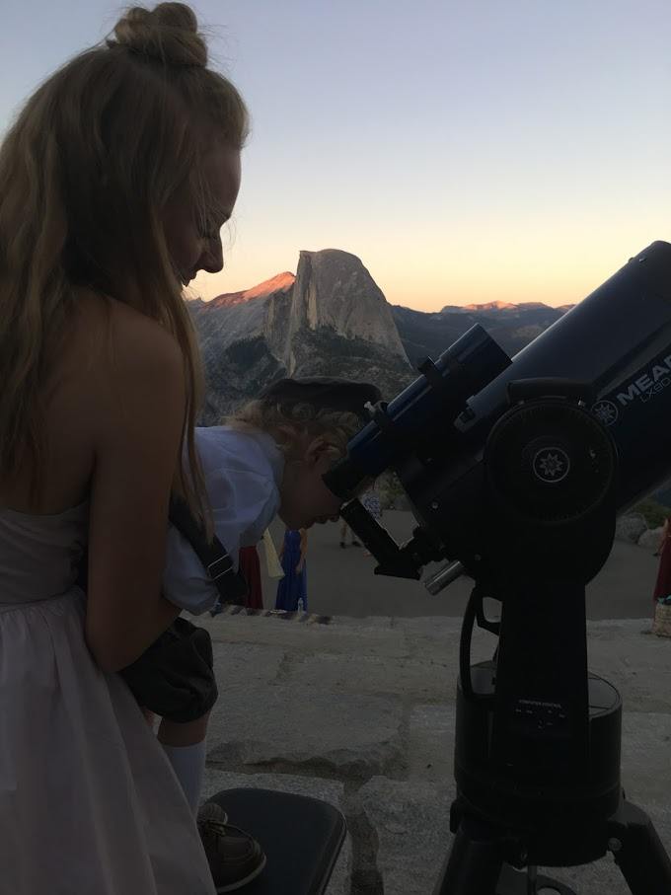
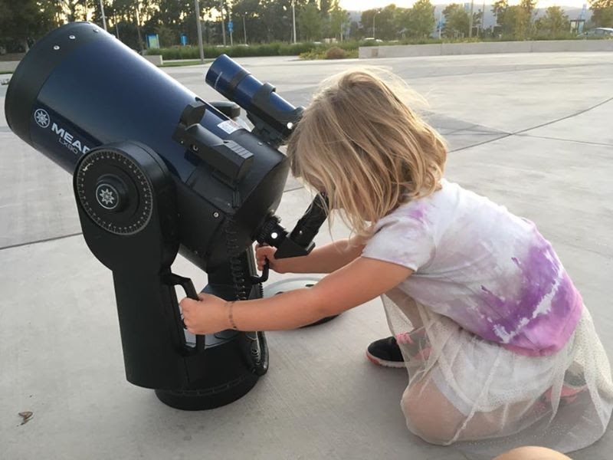
Motivation and Inspiration
Why?
Notes:
Why? Why student astronomical research?
The NEED: US falling seriously behind in science, math, engineering, skills….
PISA & TIMMS Data, Obama’s call for increased science work force,
The Motivation: Astronomy captures the imagination, it inspires, it’s attainable, it teaches all the skills
Humanity: Astronomy bridges the many divides, examples: Hechter, Astronomers without Borders, Example from Garching…, ISS, International collaborations, aboriginal astronomy in Australia,

Slide 6
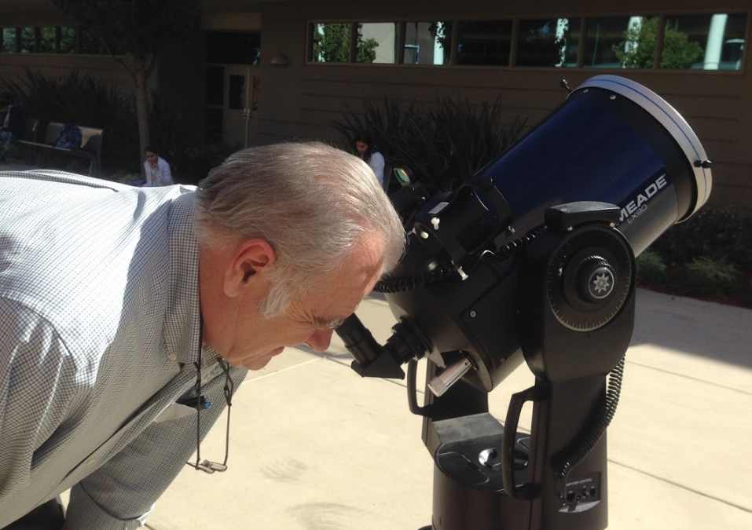
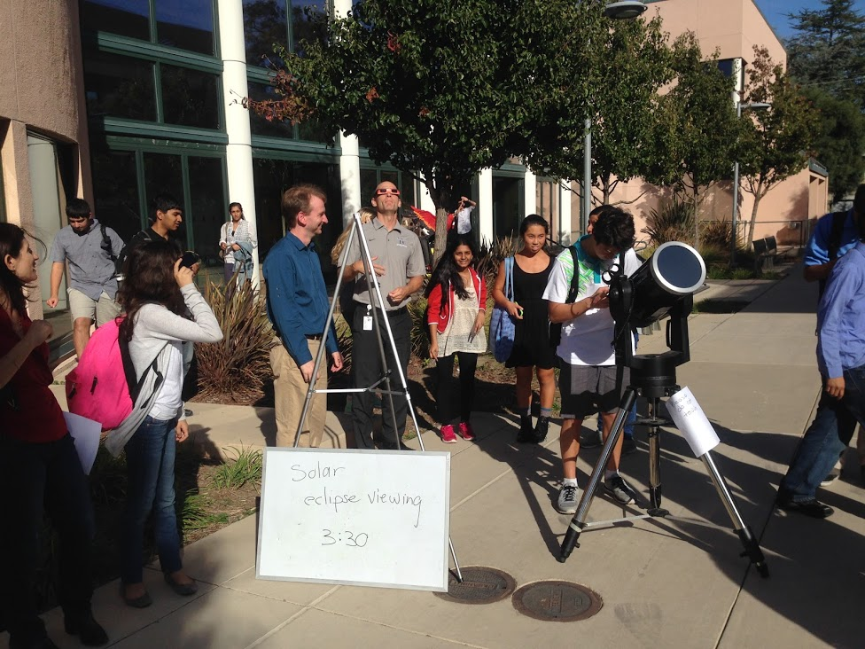
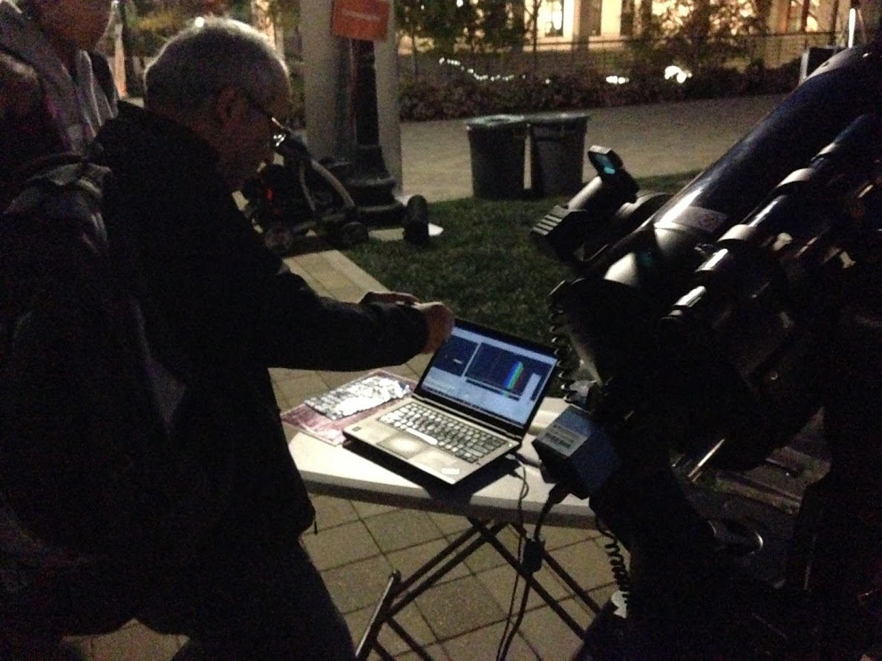
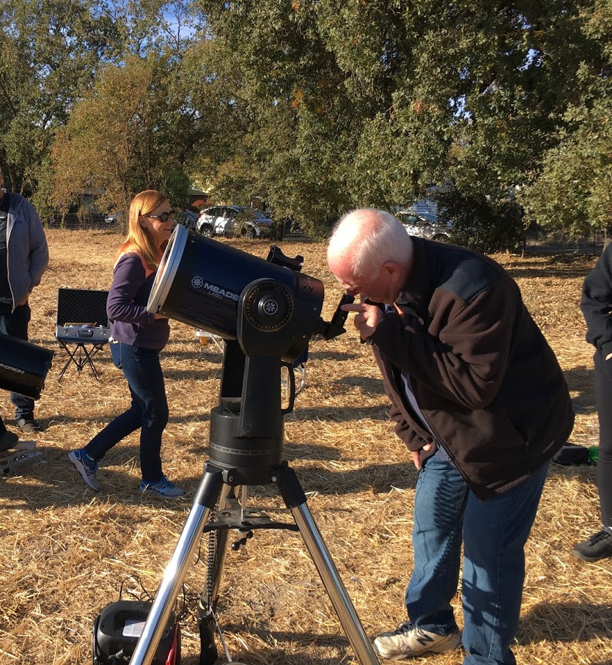
Motivation
Why?
Notes:
Why? Why student astronomical research?
The NEED: US falling seriously behind in science, math, engineering, skills….
PISA & TIMMS Data, Obama’s call for increased science work force,
The Motivation: Astronomy captures the imagination, it inspires, it’s attainable, it teaches all the skills
Humanity: Astronomy bridges the many divides, examples: Hechter, Astronomers without Borders, Example from Garching…, ISS, International collaborations, aboriginal astronomy in Australia,

Slide 7
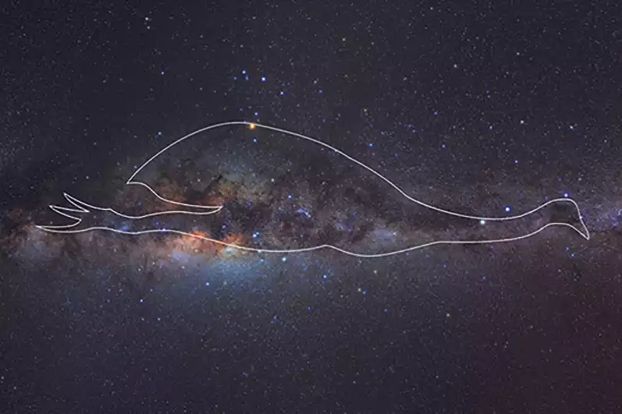
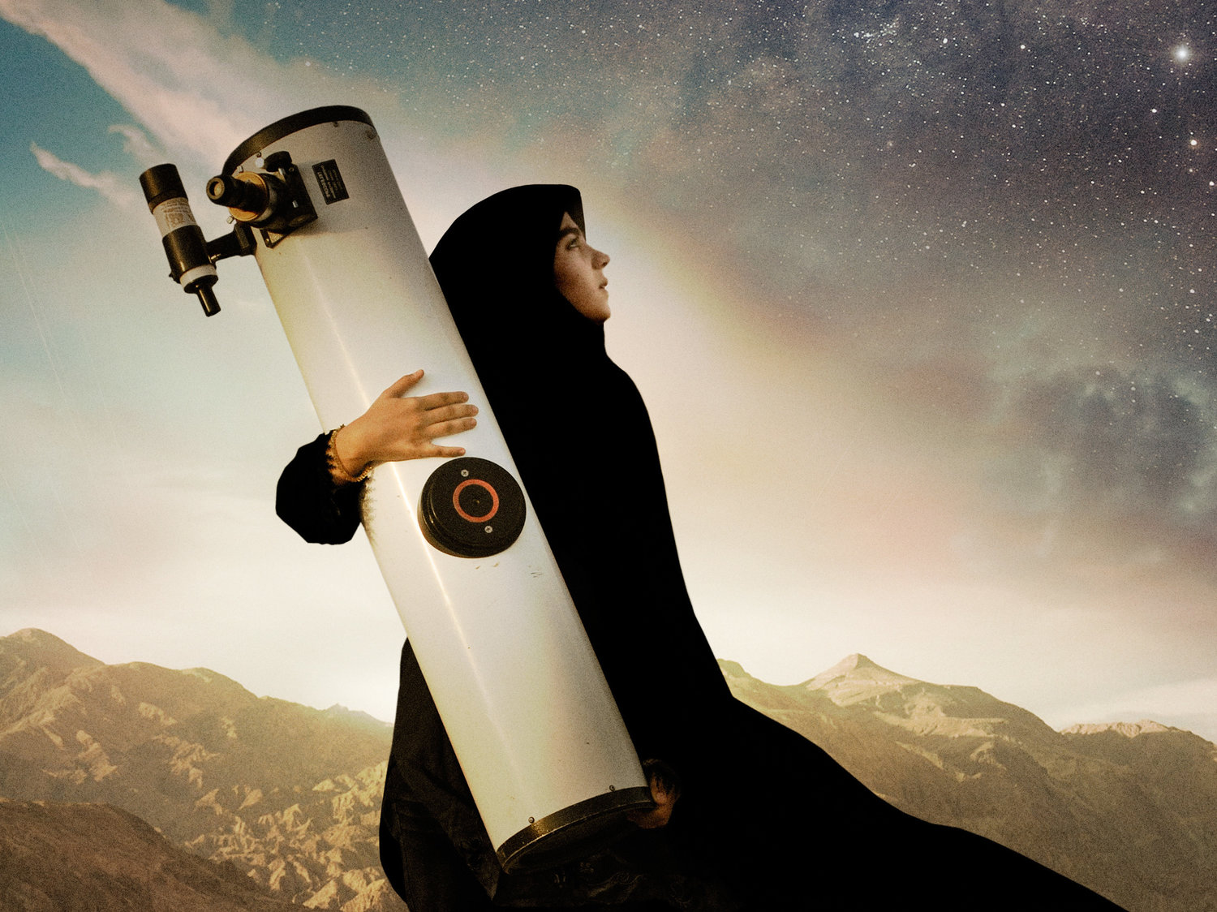
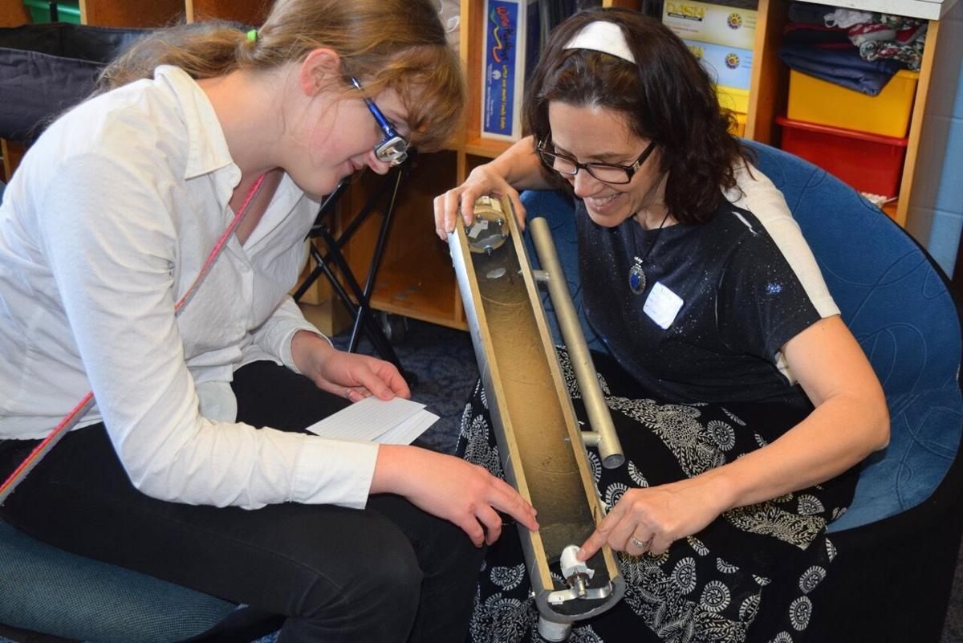
Notes:
Why? Why student astronomical research?
The NEED: US falling seriously behind in science, math, engineering, skills….
PISA & TIMMS Data, Obama’s call for increased science work force,
The Motivation: Astronomy captures the imagination, it inspires, it’s attainable, it teaches all the skills
Humanity: Astronomy bridges the many divides, examples: Hechter, Astronomers without Borders, Example from Garching…, ISS, International collaborations, aboriginal astronomy in Australia,

Slide 9
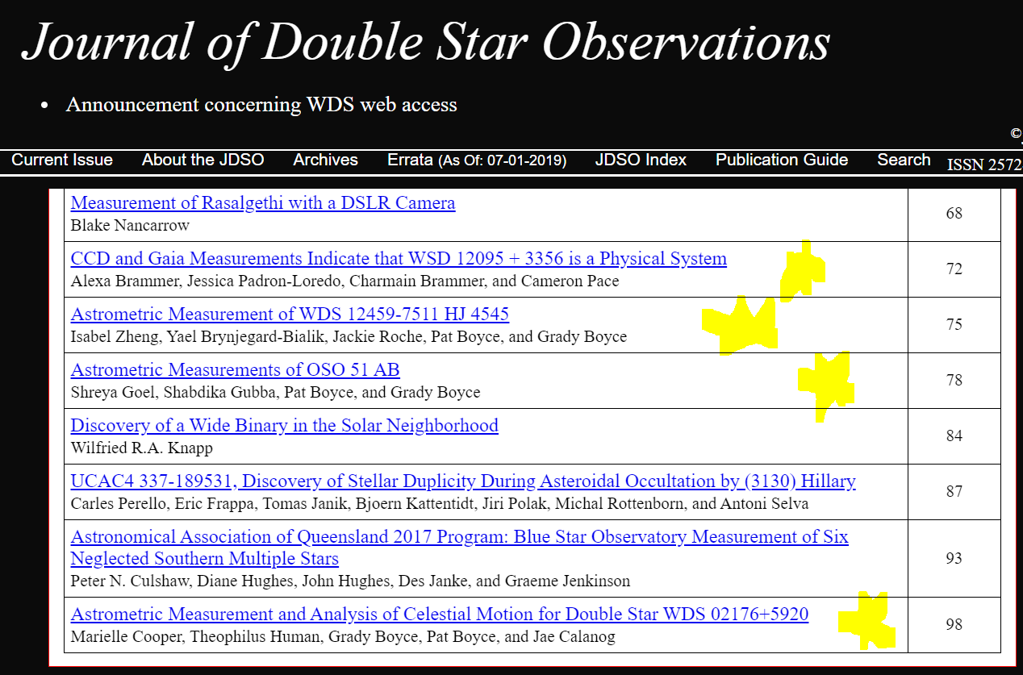
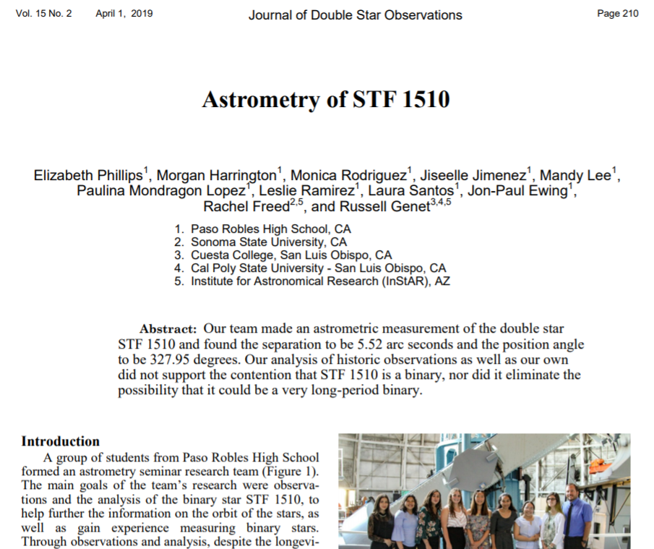
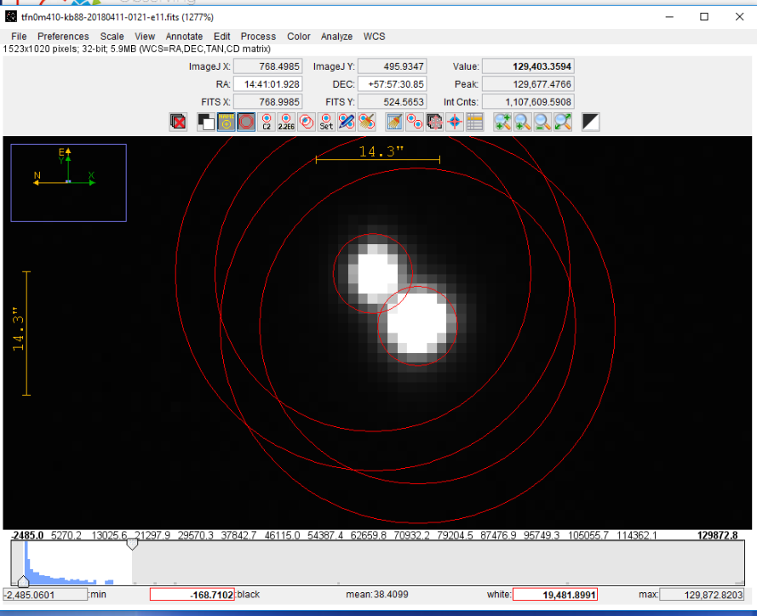
Student Research

Slide 10
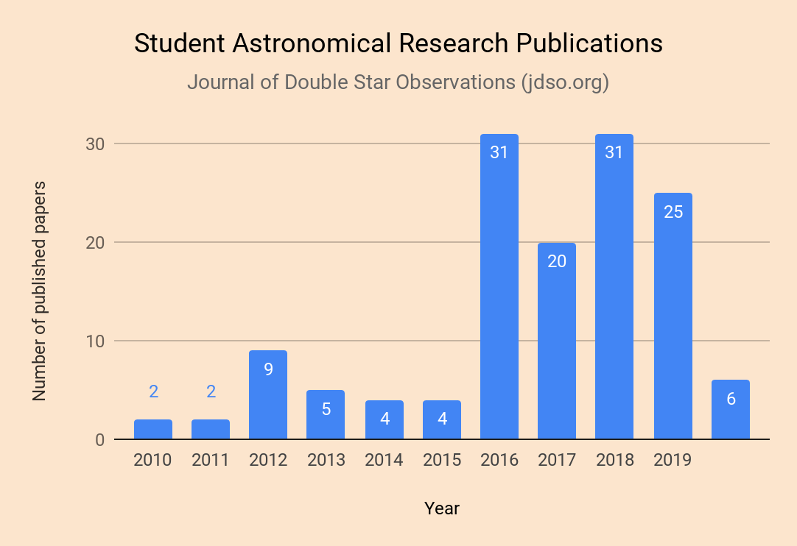
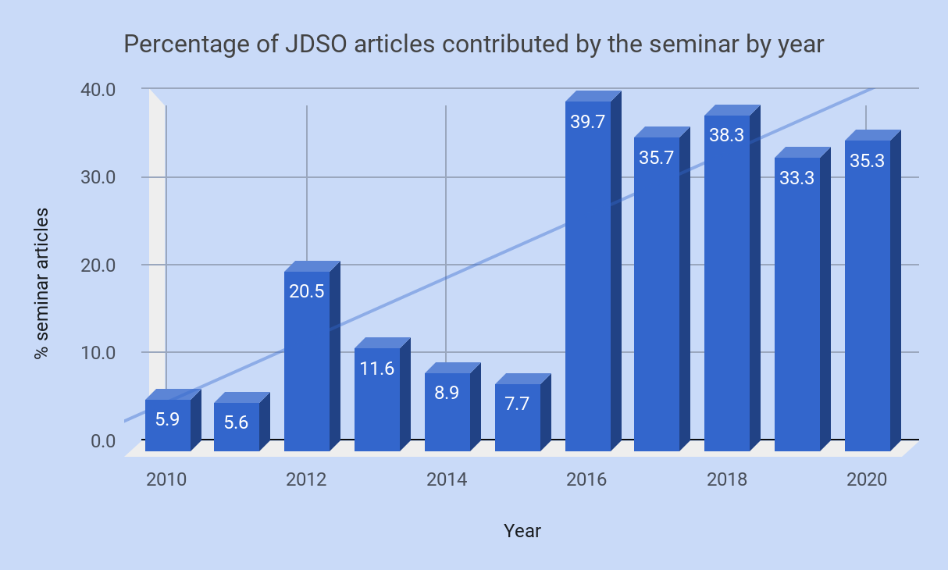
Student Publications in the Journal of Double Star Observations - JDSO - 142 (as of Jan 1, 2020)

Slide 11
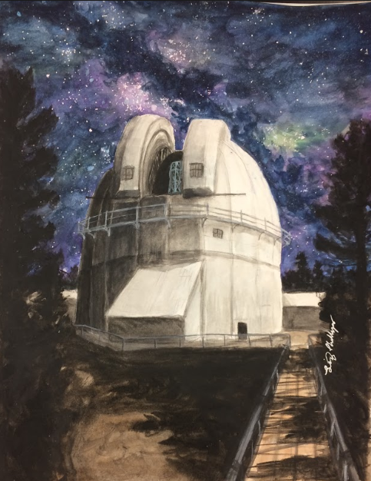

Slide 12
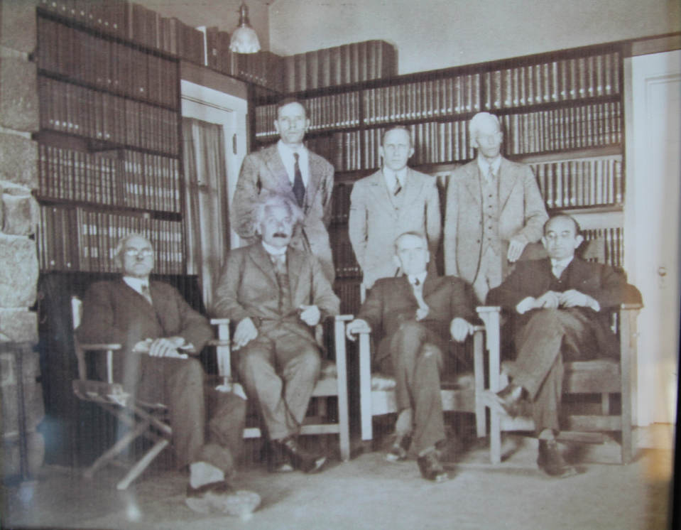
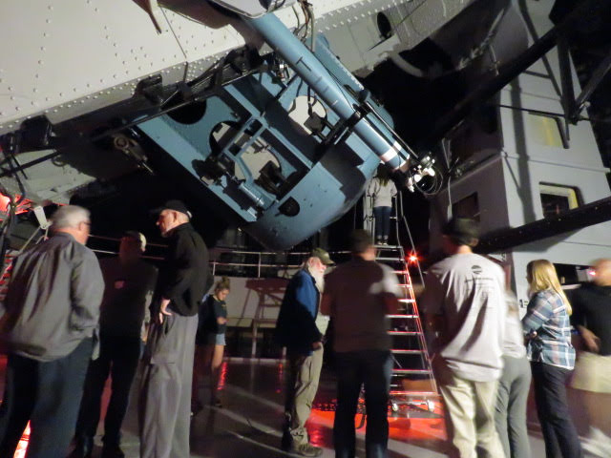
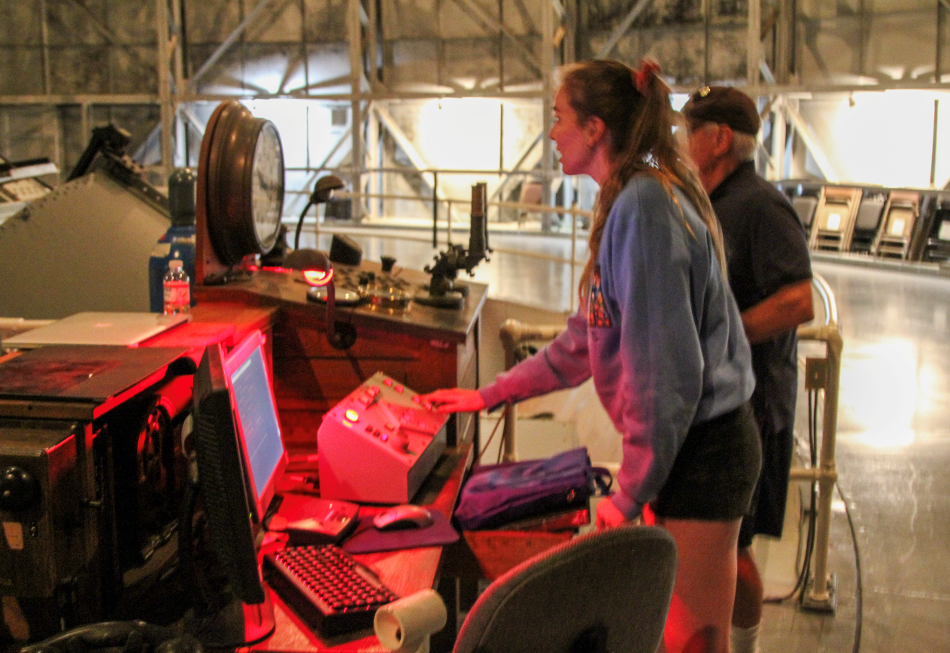
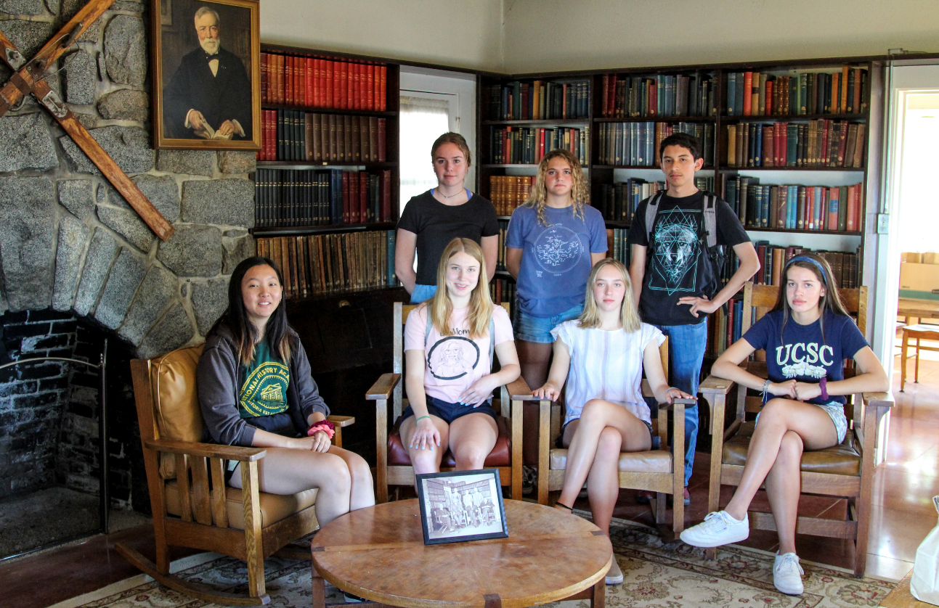
Student Research

Slide 13
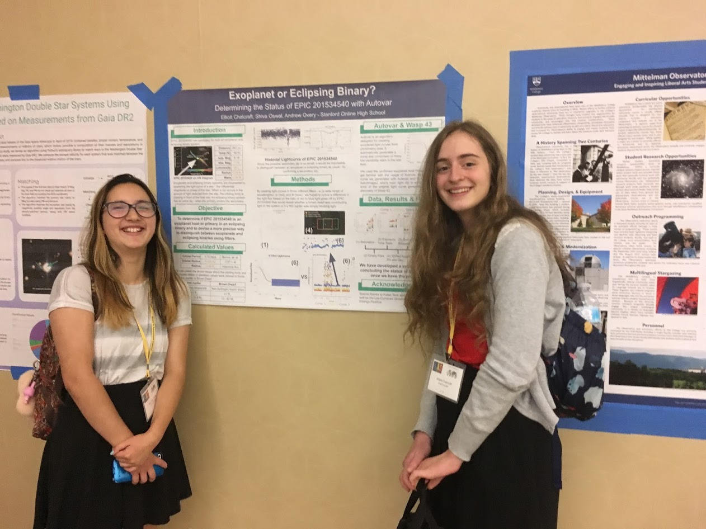
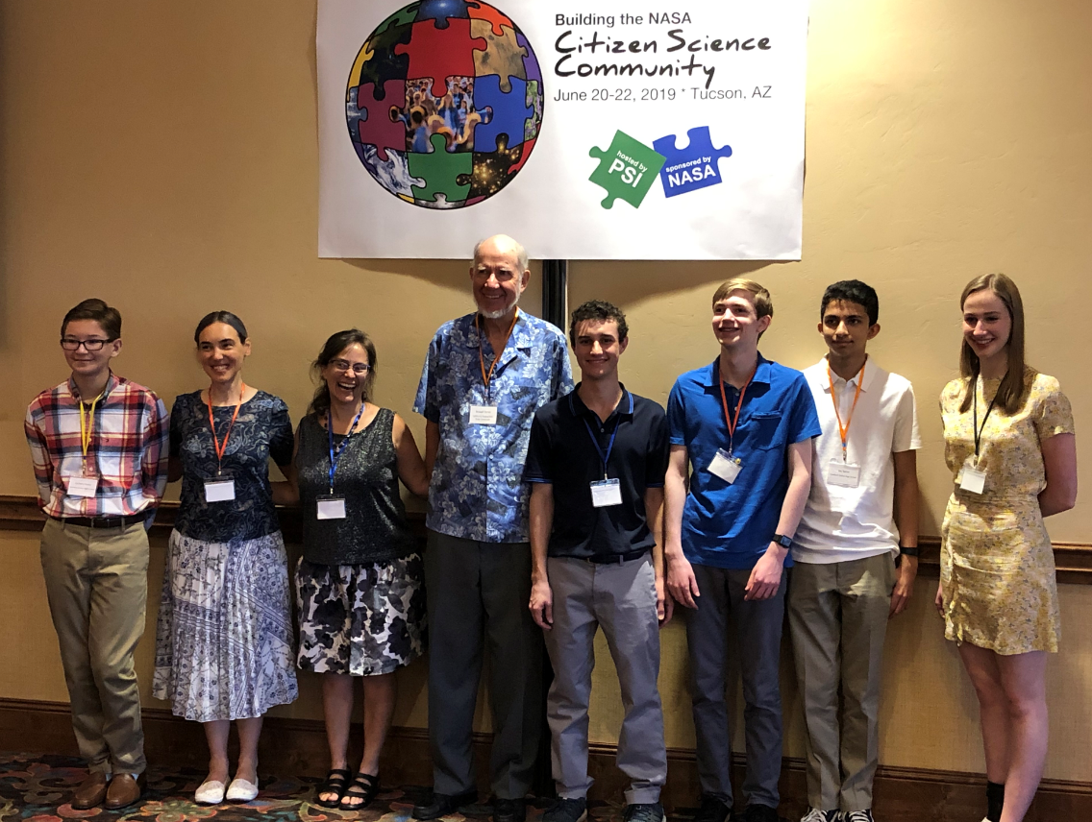
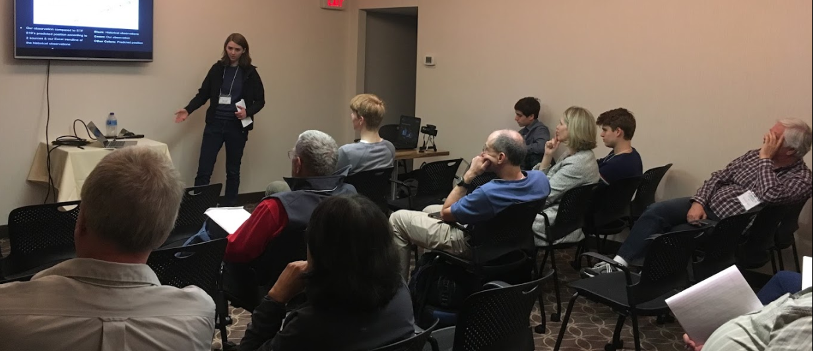
Student Research

Slide 14
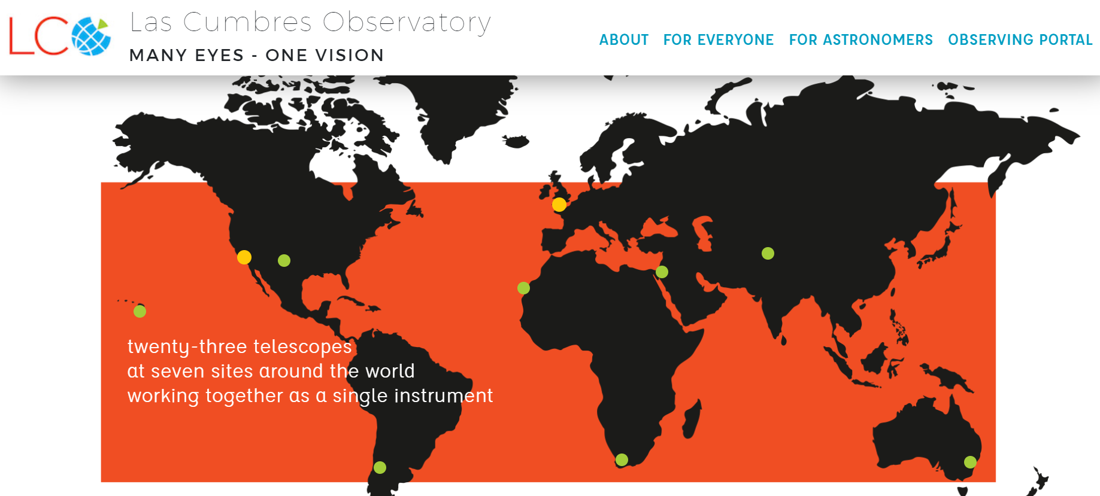
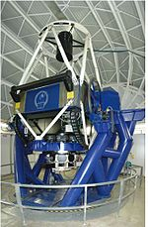
Student Research

Slide 15
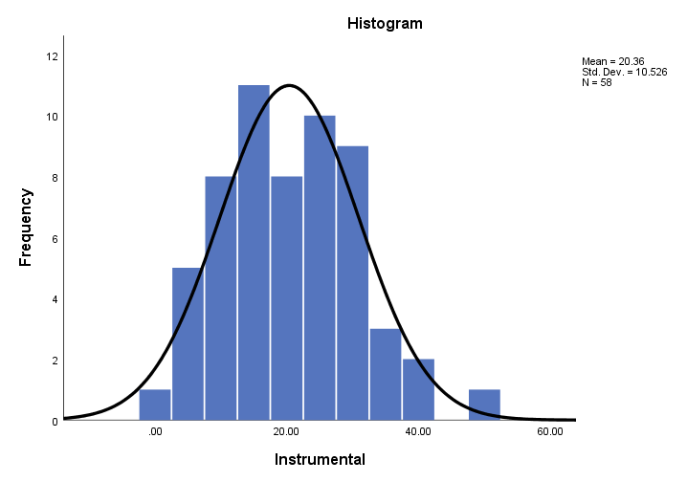
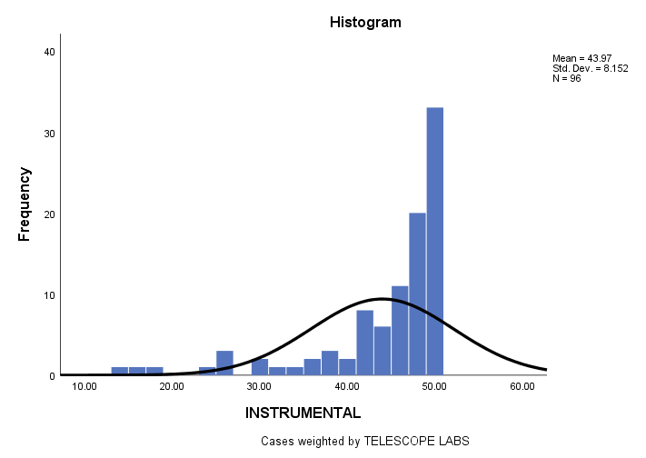
20.36 43.97
MEAN SELF-EFFICACY

Slide 16
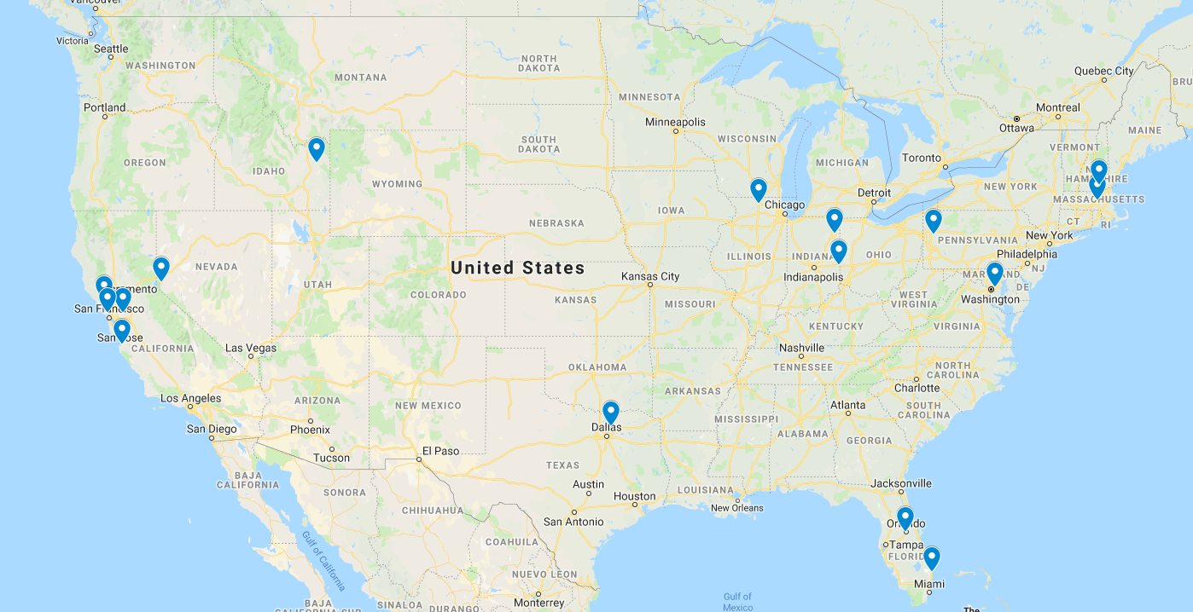
Providing Opportunities, Building a Community
Astrometric Measurements of Double-Star WDS 20437+3243(AB)
Don Adams¹, Thomas Herring^{1, 2}, Omar Garza¹, Stephen McNeil³
James C Davis Observatory (JCDO), Carson City, NV
Western Nevada College, Carson City, NV
Brigham Young University-Idaho, Rexburg, ID
Astrometry of WDS 05553+0443 (STF 818) and 00591+0523 (STF 78)
Dupuis, E.¹, Barlow, T.², Tobin, W.³, Struganova, I.⁴, Gugliucci, N.¹, Perkins Coppola, M.⁵, and Freed, R.⁶
St. Anselm College, NH
Leo HS, Fort Wayne, IN
Indiana University East, IN
Valencia College, FL
Purdue University, IN
Institute for Student Astronomical Research, CA

Slide 17
GAIA and CCD observations indicate that Herschel double star 10134-5054 HJ 4299 is not gravitationally bound
Karl Schmidt, Branson School, CA
Astrometric Analysis of WDS00115+2949/MLB441AB
Charles Togneri¹, Griffin Majer, Ciara Firth, Anne Atwater, Reed Prior, Rachel Freed²
Hudson High School, Hudson, MA
Institute for Student Astronomical Research
Astrometric Analysis of Double Star System WDS 01180-0420
Amber Mistry¹, Zoe Krishtul¹, Kevin Zheng¹, Rachel Freed², Seferino Fierroz¹
Oxbridge Academy of the Palm Beaches
Institute for Student Astronomical Research
Astrometric observation of double star system (WDS 07438-3952)
Gabrielle Kizer¹, Cody Brant¹, Mark Rothermund², Krishna Mukherjee¹
Slippery Rock University, PA
Western Carolina University, NC

Slide 18
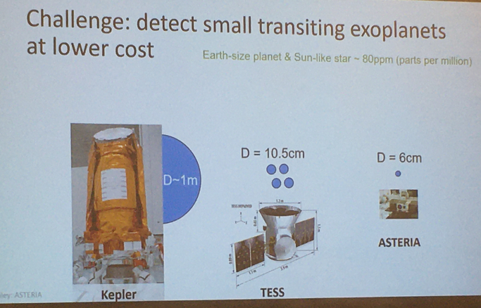
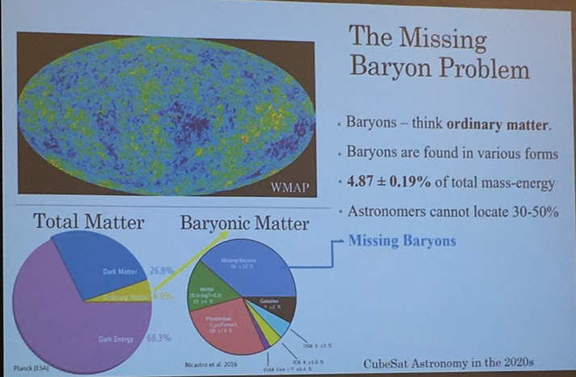

Slide 19
Building the Community

Slide 20
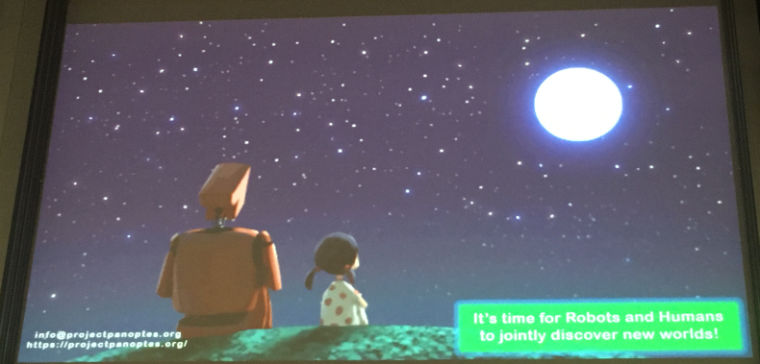
Thank you and keep looking up

