Slide 1
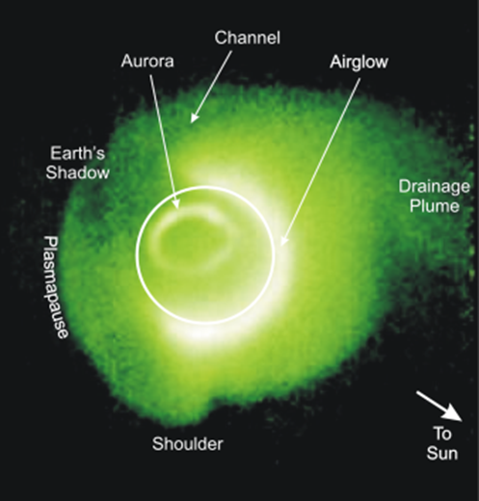
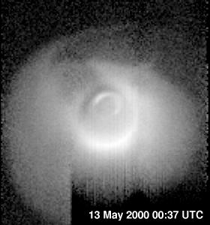
Mirror coatings for EUV and soft X-Ray imaging
BYU EUV Optics
Jan. 4, 2020
David D. Allred -BYU
Notes:
IMAGE was the first satellite mission dedicated to imaging the Earth's magnetosphere, the region of space controlled by the Earth's magnetic field and containing extremely tenuous plasmas of both solar and terrestrial origin. Invisible to standard astronomical observing techniques, these populations of ions and electrons have traditionally been studied by means of localized measurements with charged particle detectors, magnetometers, and electric field instruments. Instead of such in-situ measurements, IMAGE employs a variety of imaging techniques to "see the invisible" and to produce the first comprehensive global images of the plasma populations in the inner magnetosphere. With these images, space scientists are able to observe, in a way never before possible, the large-scale dynamics of the magnetosphere and the interactions among its constituent plasma populations.
http://pluto.space.swri.edu/IMAGE/

Slide 2
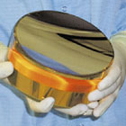
Our group has made spaces mirrors for Far, Extreme Ultraviolet (EUV)
Please give us your hard thin-film optics fabrication problems. They are very good for our students.
Google: EUV LPL
Thin Film or Multilayer Mirrors
EUV Astronomy
(more info: Sandel, B. R., et al., Space Sci. Rev., 109, 25, 2003.)
IMAGE spacecraft- NASA midex mission to Earth. ~2000
Imager for Magnetopause to Aurora global explorer.
EUV Instrument –
He+ trapped in Earth’s magnetosphere scatters EUV-30.4 nm
The Earth’s magnetosphere in the EUV-30.4 nm
http://pluto.space.swri.edu/IMAGE/
BYU EUV Optics
Jan. 4, 2020
Notes:
[Talk a lot about applications.]
***[Click]***
Extreme Ultraviolet optics have applications in many varied fields.
***[Click]***
For example, Ultraviolet optics are often used in astronomical observations. BYU currently has a uranium thin film mirror on the IMAGE satellite. This picture of the earth’s magnetosphere was taken in the EUV with the optics on board the IMAGE satellite.
***[Click]***
In addition, EUV optics may soon be of great benefit to the micro-processing industry. Current computer chips are made with deep ultraviolet wavelengths of light. This corresponds to a resolution of several hundred nanometers. These current methods are reaching an effective barrier, and microprocessor manufacturers will have to switch to reflective EUV and soft X-Ray optics within the next couple of years. Lithography at the wavelengths with which we are dealing could dramatically decrease the size of computer chip features.
***[Click]***
Future applications may include soft X-Ray [about 4 nm “water window”] microscopes. Current cellular microscopes rely on coating the specimens with gold atoms and studying the structure with a tunneling electron microscope. Since the gold coating process is lethal to microorganisms, this only gives an image of the organism after it has been dead for quite some time. EUV microscopes, while also potentially lethal to microorganisms, would give a much clearer view of the living cellular structure of the specimen.

Slide 3
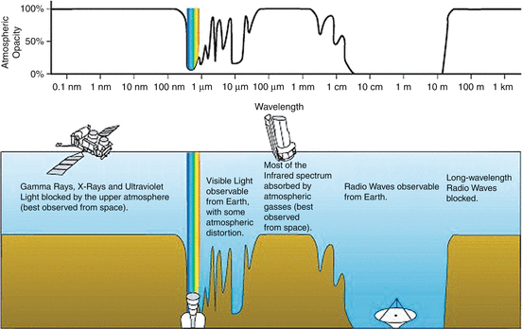
Effects of The Atmosphere on the Electromagnetic waves
Space mirrors because: Only part of the electromagnetic spectrum gets through the atmosphere.
http://www.wikiwand.com/en/Electromagnetic_radiation
Notes:
UV is from 100-400nm

Slide 4
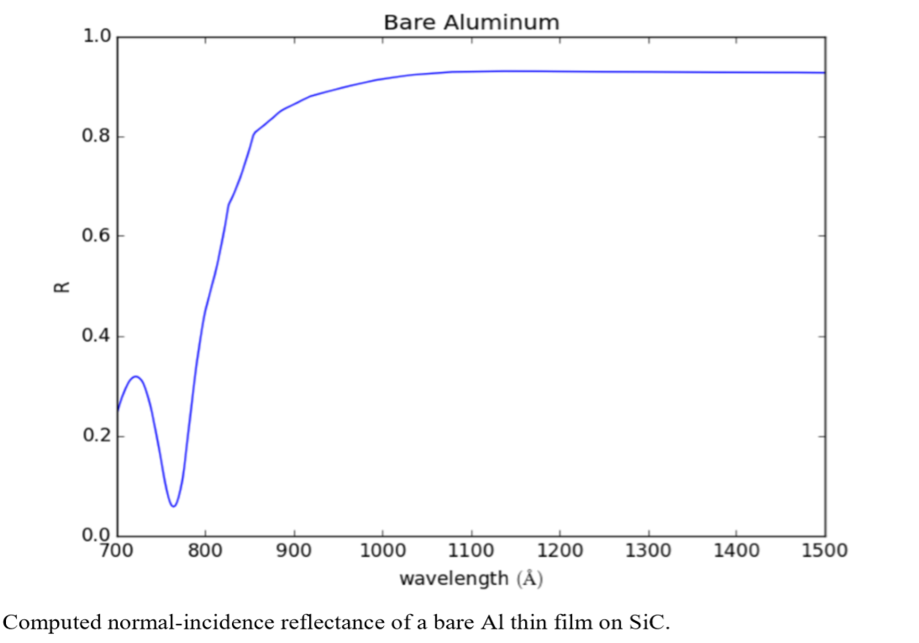
Three ways of getting mirrors. Plasma, low-angle reflectance & …
While no solid barrier layer is transparent below ~103nm, simulations show
Of all reflectors aluminum
has lowest λ plasma edge

Slide 5
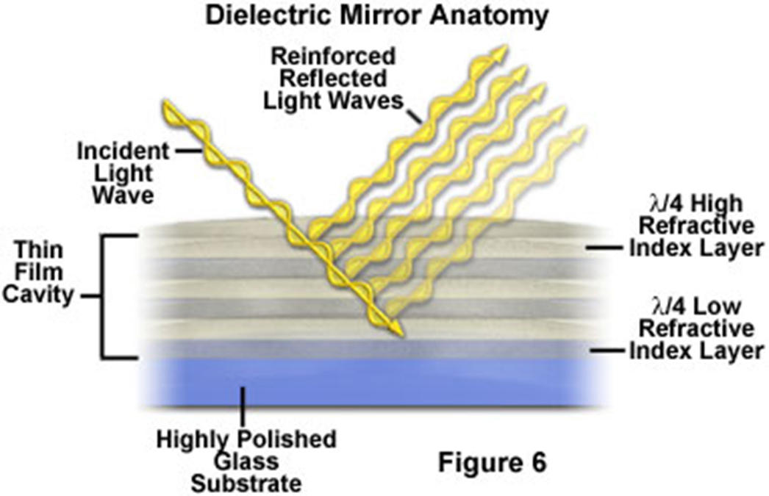
Obtaining High reflectance in EUV & x-ray
BYU EUV Optics
Jan. 4, 2020
2. Low angle
reflectance is high.
3. Multilayer reflectance
Wolter
By Andreas 9384 - Own work, CC BY-SA 4.0, https://commons.wikimedia.org/w/index.php?curid=54729753
Cube Sat Workshop- 235th AAS meeting Honolulu Hawaii-4 Jan. 2020

Slide 6
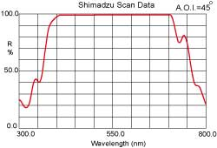
Two ways of getting mirrors.
Plasma & ML
Reflectance is proportional to amplitude squared.
http://physics.stackexchange.com/questions/216302/interference-of-light-in-a-dielectric-mirror
http://www.dichroic.com.tw/dielectric.htm

Slide 7
Mo/Si & Mo/Be ML are champions
BYU EUV Optics
Jan. 4, 2020
R (near normal)> 70% wavelength
~11 to 14 nm
many space-based solar observatories
<70 layer pairs each about 7nm
Total thickness < <1μm
Smoothing
SOA: Market pull
EUV Microlithography
Optical Elements
Size: Up to 1 m
Figure: to 0.1nm
Roughness <0.2nm
Many refinements
Manufacturers:
inhouse EUVL tool
Ovonyx
researchers: R. Soufli,
F. Delmotte, D. Windt, BYU
Cross-sectional TEM image of a 40-pair Mo/Si ML mask blank.
https://www.rigakuoptics.com/euv.php
https://www.researchgate.net/publication/253883863_Masks_for_extreme_ultraviolet_lithography/figures?lo=1
Cube Sat Workshop- 235th AAS meeting Honolulu Hawaii-4 Jan. 2020

Slide 8
Our group has made “space” mirrors for Far, Extreme Ultraviolet (EUV)
Thin Film or Multilayer Mirrors
U/Si ML 12.5 periods
U on (bottom and U on top.
R=16% @30.4 nm
Top U was an AR layer for 58.4 nm
(He-I) 8 mirrors,
“highly curved” f~1.5
3 flew .
As it tumbled mapped out 3π
made movies.
EUV
LPL UofAz
Take home perspectives:
1. ML means not broad.
2. Absorption – Refl. peak not tall. >50%
3. possible over most of EUV
4. Dual function mirrors are possible
EUV Instrument –
What might we see in Jupiter’s magnetosphere?
BYU EUV Optics
(From Sandel, B. R., et al., Space Sci. Rev., 109, 25, 2003.)
Jan. 4, 2020
Notes:
[Talk a lot about applications.]
***[Click]***
Extreme Ultraviolet optics have applications in many varied fields.
***[Click]***
For example, Ultraviolet optics are often used in astronomical observations. BYU currently has a uranium thin film mirror on the IMAGE satellite. This picture of the earth’s magnetosphere was taken in the EUV with the optics on board the IMAGE satellite.
***[Click]***
In addition, EUV optics may soon be of great benefit to the micro-processing industry. Current computer chips are made with deep ultraviolet wavelengths of light. This corresponds to a resolution of several hundred nanometers. These current methods are reaching an effective barrier, and microprocessor manufacturers will have to switch to reflective EUV and soft X-Ray optics within the next couple of years. Lithography at the wavelengths with which we are dealing could dramatically decrease the size of computer chip features.
***[Click]***
Future applications may include soft X-Ray [about 4 nm “water window”] microscopes. Current cellular microscopes rely on coating the specimens with gold atoms and studying the structure with a tunneling electron microscope. Since the gold coating process is lethal to microorganisms, this only gives an image of the organism after it has been dead for quite some time. EUV microscopes, while also potentially lethal to microorganisms, would give a much clearer view of the living cellular structure of the specimen.

Slide 9
Are EUV and soft x-ray good areas for cube sat applications for EUV and soft x-ray
BYU EUV Optics
Jan. 4, 2020
Yes
May be not there
No all sky observatory now
Provide long time baseline
Lots of interesting problems locally
Solar system – Jupiter,
how about looking at exoplanet environment.
Aperture comparable to Past missions
Cube sat observatory dedicated to one or few task
Technology:
Has advanced and
May advance technology readiness level.
EUVE did all sky survey
Absorption → EUV is a “niche” tool
Such as?
Limited to local region of galaxy
Small aperture
Hubble exists
YES!
Cube Sat Workshop- 235th AAS meeting Honolulu Hawaii-4 Jan. 2020

Slide 10
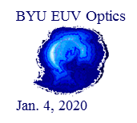
Future opportunities for cube sats: 1. Bare Aluminum
Aluminum
Bare Al - high reflectance to the Lyman break.
Yes. Evaporate Al is possible.
Effect of Fluoride (MgF2 etc.) over coat.
IR on left Visible UV Far UV
Effect of Aluminum oxide

Slide 11
Future opportunities for cube sats: 2. GET high reflectance to 20eV 60nm Bare Aluminum on a EUV mirror
BYU EUV Optics
Jan. 4, 2020
Concept
2. how?
Bare Al on EUV ML centered at ~80nm
Note the peak at 72 nm
Interference peak
Al “transparent” below plasma edge.
Cube Sat Workshop- 235th AAS meeting Honolulu Hawaii-4 Jan. 2020

Slide 12
Future opportunities: EUV or soft x-ray ML on bare Al mirror
While no solid barrier layer is transparent below ~103nm, simulations show
Logistic:
Have a ML mirror(s) on telescope surfaces.
Coat thin Al (~42 nm) in space.

Slide 13
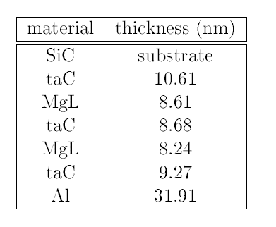
EUV mirror under an Al coating?
Peak in EUV- for example:
30.4 nm
Example 1: An exploratory design of
wide VUV-EUV & high 30 nm reflectance
Genetic Algorithm employed

Slide 14
An exploratory design of wide VUV-EUV & 20 nm- computed
Pioneering stage- more constants are needed.
Collaboration between those doing measurements & fabrication would help.

Slide 15
Could we reliably aluminize surfaces in space?
BYU EUV Optics
Jan. 4, 2020
We would like to help you coat your cube mirrors and gratings with EUV/soft x-ray function.
Whether it be standard or more challenging
such as the bare aluminum on EUV mirrors.
Evaporator with self contained power- Zecoat. David Sheikh,
Cube Sat Workshop- 235th AAS meeting Honolulu Hawaii-4 Jan. 2020

Slide 16
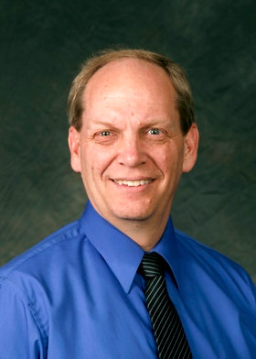
Allred- Turley –XUV-thin film Research Group
Our group loves designing, Fabricating, testing, understanding optical thin-films, and problems with and fixing them. Please give us your hard fabrication problems. They are very good for our students.
Steven Turley back from NSF 2-year appointment in education branch.
Acknowledge: financial support of the College of physical and mathematical sciences-BYU, the Utah NASA space grant consortium and the NSF-REU program.

Slide 17
History of All Sky EUV & Far UV
BYU EUV Optics
Jan. 4, 2020
EUVE 7-70nm June 1992 to Jan, 2001. ROSAT WFC and EUVE missions
Typical effective areas for the survey instruments ranged from ≈10–20 cm², glancing angle
FUSE 90.5 to 119.5 nm; June 99- Oct. 07-
4 near normal mirrors each about 39-by-35 cm (15.4-by-13.8 in) off-axis parabola
Galex 135–280 nm (Far Ultraviolet)
Hubble COS – has FUV 90-205 nm
NO EUV at present
Cube Sat Workshop- 235th AAS meeting Honolulu Hawaii-4 Jan. 2020

Slide 18
Cube sat applications for EUV and soft x-ray
BYU EUV Optics
Jan. 4, 2020
Yes
May be not there
No all sky observatory now
Provide long time baseline
Lots of interesting problems locally
Solar system – Jupiter,
how about looking at exoplanet environment.
Aperture comparable to Past missions
Cube sat observatory dedicated to one or few task
Technology:
Has advanced and
May advance technology readiness level.
EUVE did all sky survey
Absorption → EUV is a “niche” tool
Such as?
Limited to local region of galaxy
Small aperture
Hubble exists
Cube Sat Workshop- 235th AAS meeting Honolulu Hawaii-4 Jan. 2020

Slide 19
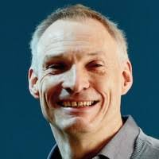
Are Cube and Small Sats an answer to an EUV astronomers’ plea?
BYU EUV Optics
Scattering/Absorption situation:
“The principal limitation is the absorption by the interstellar medium that defines the horizon within which sources can be observed. …
“Therefore, … EUV observations are … mostly restricted to a local region of our galaxy.
“… it may never be possible to justify an expenditure on future missions similar to the large X-ray or UV observatories.” Martin A. Barstow in
chapter “EUV astronomy in the 21st century,” of Extreme Ultraviolet astronomy. By Martin A. Barstow.
Jan. 4, 2020
https://gnuva.net/gnuva_barstowbio.htm
Applications? where understanding what is happening in local region of the galaxy may be important?
Planets in our own solar system?
Environment of extrasolar planets?
CUTE
Potential of Cubesat?
Cube Sat Workshop- 235th AAS meeting Honolulu Hawaii-4 Jan. 2020
Notes:
The Colorado Ultraviolet Transit Experiment (CUTE): A dedicated cubesat mission to study exoplanetary mass loss and magnetic fields
Brian T. Fleming, Kevin France, Nicholas Nell, Richard Kohnert, Kelsey Pool, Arika Egan, Luca Fossati, Tommi Koskinen, Aline A. Vidotto, Keri Hoadley, Jean-Michel Desert, Matthew Beasley, Pascal Petit
(Submitted on 8 Jan 2018)
The Colorado Ultraviolet Transit Experiment (CUTE) is a near-UV (2550 - 3300 Angstrom) 6U cubesat mission designed to monitor transiting hot Jupiters to quantify their atmospheric mass loss and magnetic fields. CUTE will probe both atomic (Mg and Fe) and molecular (OH) lines for evidence of enhanced transit absorption, and to search for evidence of early ingress due to bow shocks ahead of the planet's orbital motion. As a dedicated mission, CUTE will observe more than 100 spectroscopic transits of hot Jupiters over a nominal seven month mission. This represents the equivalent of more than 700 orbits of the only other instrument capable of these measurements, the Hubble Space Telescope. CUTE efficiently utilizes the available cubesat volume by means of an innovative optical design to achieve a projected effective area of 28 sq. cm, low instrumental background, and a spectral resolving power of 3000 over the primary science bandpass. These performance characteristics enable CUTE to discern transit depths between 0.1 - 1% in individual spectral absorption lines. We present the CUTE optical and mechanical design, a summary of the science motivation and expected results, and an overview of the projected fabrication, calibration and launch timeline. https://arxiv.org/abs/1801.02673

Slide 20
Cube sat applications for EUV and soft x-ray
BYU EUV Optics
Jan. 4, 2020
Yes
May be not there
No all sky observatory now
Provide long time baseline
Lots of interesting problems locally
Solar system – Jupiter,
how about looking at exoplanet environment.
Aperture comparable to Past missions
Cube sat observatory dedicated to one or few task
Technology:
Has advanced and
May advance technology readiness level.
EUVE did all sky survey
Absorption → EUV is a “niche” tool
Such as?
Limited to local region of galaxy
Small aperture
Hubble exists
Cube Sat Workshop- 235th AAS meeting Honolulu Hawaii-4 Jan. 2020

Slide 21
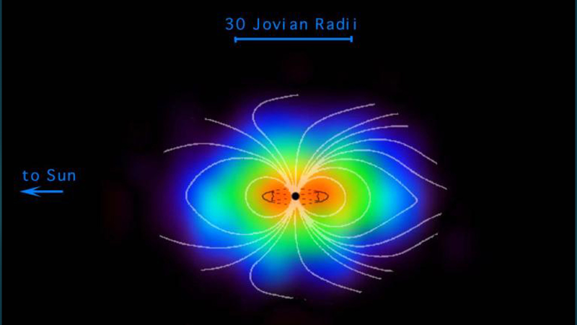
Past Applications & new opportunities
BYU EUV Optics
Jan. 4, 2020
Solar system and beyond
Moon
Planetary- Jupiter
S-L comet collision*
Magnetosphere The Io torus –”many emissions of sulfur, oxygen, and even sodium ions at wavelengths between 35 and 75 nm.”
20 years since EUVE- No current missions
When Hubble stops working? What then for far UV?
https://solarsystem.nasa.gov/resources/11663/jupiters-magnetosphere/
*EUVE Observations of Jupiter During the Impact of Comet Shoemaker-Levy 9
G. Randall Gladstone¹, Doyle T. Hall², J. Hunter Waite Jr., Science 16 Jun 1995, Vol. 268, Issue 5217, pp. 1595-1597- DOI: 10.1126/science.268.5217.1595
Cube Sat Workshop- 235th AAS meeting Honolulu Hawaii-4 Jan. 2020
Notes:
he Atmospheric Imaging Assembly (AIA) instrument onboard the Solar Dynamics Observatory (SDO) is an array of four normal-incidence reflecting telescopes that image the Sun in ten EUV and UV wavelength channels. We present the initial photometric calibration of AIA, based on preflight measurements of the response of the telescope components. The estimated accuracy is of order 25%, which is consistent with the results of comparisons with full-disk irradiance measurements and spectral models. We also describe the characterization of the instrument performance, including image resolution, alignment, camera-system gain, flat-fielding, and data compression.

Slide 22
Cube sat applications for EUV and soft x-ray
BYU EUV Optics
Jan. 4, 2020
Yes
May be not there
No all sky observatory now
Provide long time baseline
Lots of interesting problems locally
Solar system – Jupiter,
how about looking at exoplanet environment.
Aperture comparable to Past missions
Cube sat observatory dedicated to one or few task
Technology:
Has advanced and
May advance technology readiness level.
EUVE did all sky survey
Absorption → EUV is a “niche” tool
Such as?
Limited to local region of galaxy
Small aperture
Hubble exists
Cube Sat Workshop- 235th AAS meeting Honolulu Hawaii-4 Jan. 2020

Slide 23
Aperture considerations- Cube sats may not be too small
BYU EUV Optics
Jan. 4, 2020
w Grazing angle
Near normal incidence- ML
20 cm aperture telescopes are on the Atmospheric Imaging Assembly (AIA) instrument aboard NASA's Solar Dynamics Observatory (SDO)– “Using SiC for Lightweight EUV Space Optics,” Martinez-Galarce, Dennis S.; et al. https://ui.adsabs.harvard.edu/abs/2009SPD....41.1813M/abstract
Cube Sat / 10 cm aperture?
ROSAT WFC and EUVE missions
Typical effective areas for the survey instruments ranged from ≈10–20 cm², while the peak effective area of the EUVE spectrometer was ≈1 cm².
Cube Sat Workshop- 235th AAS meeting Honolulu Hawaii-4 Jan. 2020
Notes:
Although the ROSAT WFC and EUVE missions can be claimed as outstanding successes,
their telescopes were of comparatively limited aperture. Typical effective areas for the survey
instruments ranged from ≈10–20 cm2, while the peak effective area of the EUVE spectrometer
was ≈1 cm2. These figures can be contrasted with the >200 cm2 effective area of the
ROSAT XRT with its PSPC detector. Clearly, it would be desirable to construct new EUV
instrumentation with much higher effective areas than already flown.

Slide 24
Cube sat applications for EUV and soft x-ray
BYU EUV Optics
Jan. 4, 2020
Yes
May be not there
No all sky observatory now
Provide long time baseline
Lots of interesting problems locally
Solar system – Jupiter,
how about looking at exoplanet environment.
Aperture comparable to Past missions
Cube sat observatory dedicated to one or few task
Technology:
Has advanced and
May advance technology readiness level.
EUVE did all sky survey
Absorption → EUV is a “niche” tool
Such as?
Limited to local region of galaxy
Small aperture
Hubble exists
Cube Sat Workshop- 235th AAS meeting Honolulu Hawaii-4 Jan. 2020

Slide 25
Solar opportunities?
Nano flares?

Slide 26
https://solarsystem.nasa.gov/resources/11663/jupiters-magnetosphere/

Slide 27
Current Applications EUV are solar
BYU EUV Optics
Jan. 4, 2020
Solar
SOHO, STEREO
SDO | Solar Dynamics Observatory-
4 Normal incidence telescopes
multiple MLs
10 EUV and UV channels
Cube Sat Workshop- 235th AAS meeting Honolulu Hawaii-4 Jan. 2020
https://sdo.gsfc.nasa.gov/mission/instruments.php
Notes:
he Atmospheric Imaging Assembly (AIA) instrument onboard the Solar Dynamics Observatory (SDO) is an array of four normal-incidence reflecting telescopes that image the Sun in ten EUV and UV wavelength channels. We present the initial photometric calibration of AIA, based on preflight measurements of the response of the telescope components. The estimated accuracy is of order 25%, which is consistent with the results of comparisons with full-disk irradiance measurements and spectral models. We also describe the characterization of the instrument performance, including image resolution, alignment, camera-system gain, flat-fielding, and data compression.

Slide 28
Cube sat applications for EUV and soft x-ray
BYU EUV Optics
Jan. 4, 2020
Yes
May be not there
No all sky observatory now
Provide long time baseline
Lots of interesting problems locally
Solar system – Jupiter,
how about looking at exoplanet environment.
Aperture comparable to Past missions
Cube sat observatory dedicated to one or few task
Technology:
Has advanced and
May advance technology readiness level.
EUVE did all sky survey
Absorption → EUV is a “niche” tool
Such as?
Limited to local region of galaxy
Small aperture
Hubble exists
Cube Sat Workshop- 235th AAS meeting Honolulu Hawaii-4 Jan. 2020

Slide 29
Extras follow:

Slide 30
Two ways of getting mirrors. Reflector
Aluminum
When reflectance falls Al begins to transmit. Could there be a multilayer reflector to give you a broader reflector?
Effect of Fluoride (MgF2 etc.) over coat.
IR on left Visible UV Far UV
Effect of Aluminum oxide

Slide 31
Two issues- Scattering of light from rough surface & protecting Aluminum for oxidation to reach far UV
Aluminum
When reflectance falls Al begins to transmit. Could there be a multilayer reflector to give you a broader reflector?
Effect of Fluoride (MgF2 etc.) over coat.
IR on left Visible UV Far UV
Effect of Aluminum oxide

Slide 32
BYU EUV Optics
Jan. 4, 2020
Cube Sat Workshop- 235th AAS meeting Honolulu Hawaii-4 Jan. 2020

Slide 33
Multilayer mirrors for EUV & soft x-ray reflectors and gratings
BYU EUV Optics
Jan. 4, 2020
Light interacts strongly with matter
No solid material is entirely transparent < 100 nm
λ < Al plasma Edge
ML
EUV over stellar distances.
Cube Sat Workshop- 235th AAS meeting Honolulu Hawaii-4 Jan. 2020
Notes:
may be scattered or absorbed.

Slide 34
Multilayer mirrors for EUV & soft x-ray reflectors and gratings
BYU EUV Optics
Jan. 4, 2020
Light interacts strongly with matter
No solid material is entirely transparent < 100 nm
λ < Al plasma Edge
ML
EUV over interstellar distances.
Cube Sat Workshop- 235th AAS meeting Honolulu Hawaii-4 Jan. 2020
Notes:
may be scattered or absorbed.

Slide 35
Some potential targets: think of EUV Explorer, FUSE & Galex
BYU EUV Optics
Jan. 4, 2020
Solar system
Sun-
Jupiter & its moon’s
Return to Extrasolar
Since 2001
Cube Sat Workshop- 235th AAS meeting Honolulu Hawaii-4 Jan. 2020
Notes:
EUVU 7-70nm June 1992 to jan, 2001.
FUSE 90.5 to 119.5 nm near normal mirrors

Slide 36
Our goal is doubling* the effective bandwidth in space mirrors and gratings etc.
A multilayer VUV-EUV mirror below a thin (oxide-free) Al film
Common ground?
1. Understand corrosion under Barriers
2. Developing Barrier layers- Ultrathin & Engineered ML
3. Removable barrier layers is focus-
*From current 0 to ~10 eV to 0 to ~20 eV or 0 to 15 + another 5eV further on in EUV, such as 40-42eV & 47-49 eV or 60-70 eV
Notes:
Our goal is to create and provide knowledge to those who will be making decisions about how a doubling* the effective bandwidth for aluminum mirrors might be achieved.
Advance the technology readiness level for using bare aluminum mirrors and bare aluminum mirrors with EUV reflectance to and, for some, through TRL 3.

Slide 37
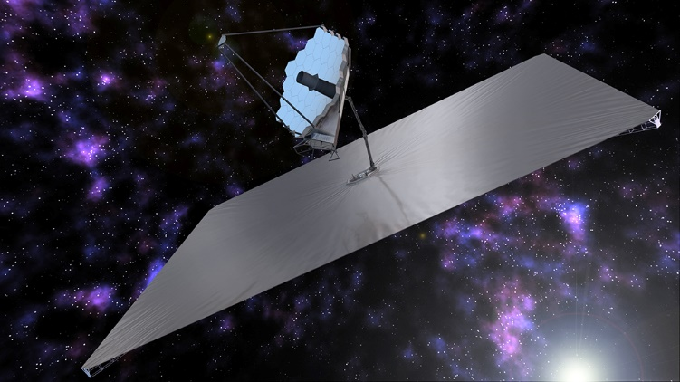
Motivation for Research
What is Hubble’s replacement for the UV community?
“LUVOIR”
The concept design of the LUVOIR space telescope at the L2 Lagrange point with its 15.1-meter primary mirror Image credit: NASA / LUVOIR concept team; Serge Brunier (background).
photo credit: NASA
Notes:
In 2020 in their next decadal survey, NASA will be considering for priority a new space telescope called LUVOIR. It’s called LUVOIR because it wil be large and will collect information in the ultraviolet, optical, and infrared wavelength ranges. The mirror for this telescope – which will be 8-16 meters in diameter – will need to be coated with an excellent broadband reflector.
This is an image of the James Webb telescope – which had a 6.5 m diameter mirror . You can see in the picture how big that is compared to the people working on it. LUVOIR wil be even bigger.

Slide 38
BYU EUV Optics
Jan. 4, 2020
Cube Sat Workshop- 235th AAS meeting Honolulu Hawaii-4 Jan. 2020

