Slide 1
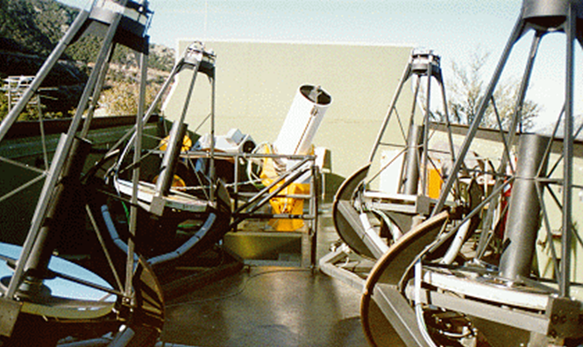
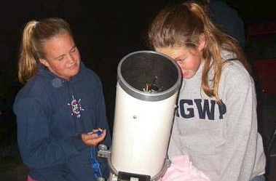
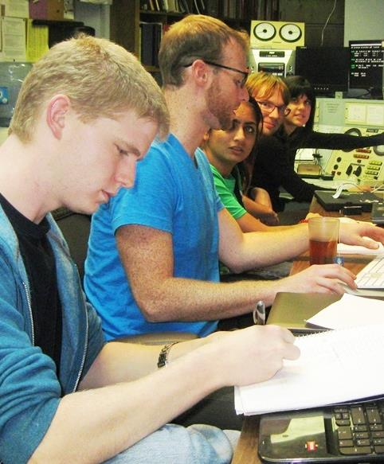
Robotic
Telescopes and
Student
Research
Russell M. Genet
California Polytechnic State University

Slide 2
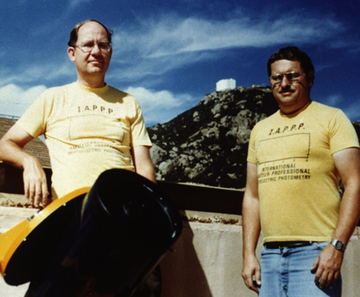
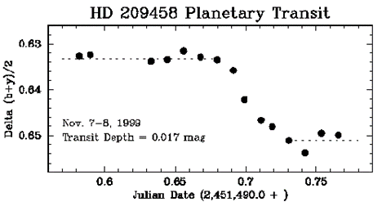
Robotic Telescopes
Advantages
  Lower operation cost / no observer
  Lower maint. cost / not disturbed
  Good weather and seeing sites
  Fast computer target selection
  Fast telescope control
  Fast slew (no human safety)

Slide 3
Extending Astronomical Research from
Ground Robots to Space CubeSats
  Affordable
  CubeSat technology / miniaturization
  Mass production
  Low launch costs
  Full autonomous operation both in space and on ground
  Complimentary
  UV and extreme UV / Perhaps soft X-ray
  IR / miniature cryogenic coolers

Slide 4
Astronomy Research Seminar
Original Concept
Same as professional research except:
Reduced research scope
Publish in second tier journals
Don’t have to obtain grants
Students researchers not paid

Slide 5
Astronomy Research Seminar
Each Student Team
Submits research proposal
Manages their own research
Obtains and analyzes data
Writes and rewrites team paper
Obtains an external review
Submits paper for publication
Gives public presentation

Slide 6
Astronomy Research Seminar
To Make This Possible
Research is within pro-am community of practice
Focus: narrow topic area / narrow but deep
Focus: produce high quality paper
Split up the work / no prerequisites
Research supervised but not led or managed
Experienced researchers support the seminar
Institute for Student Astronomical Research (InStAR)

Slide 7
Astronomy Research Seminar
Benefits
Self identity as scientists within a community of practice
Grit: passion & motivation to achieve long-term goals
Paper coauthor: school admissions & scholarships
Transferable skills

Slide 8
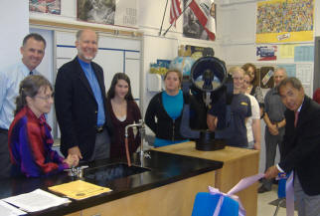
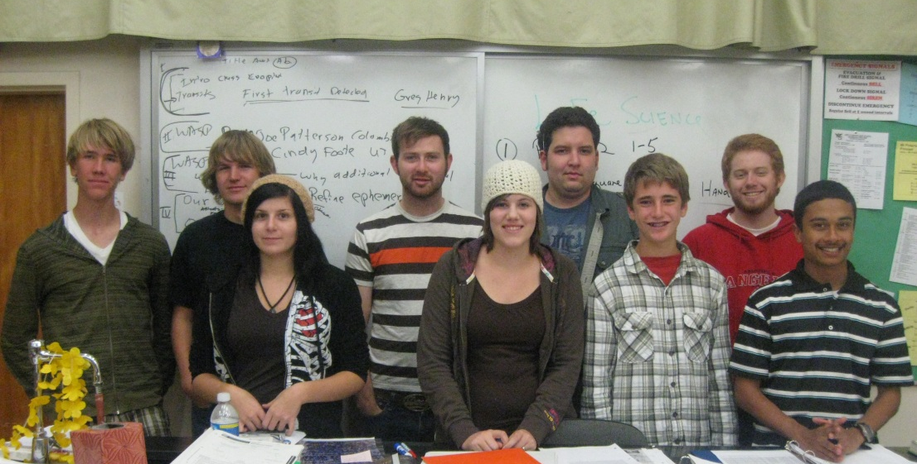
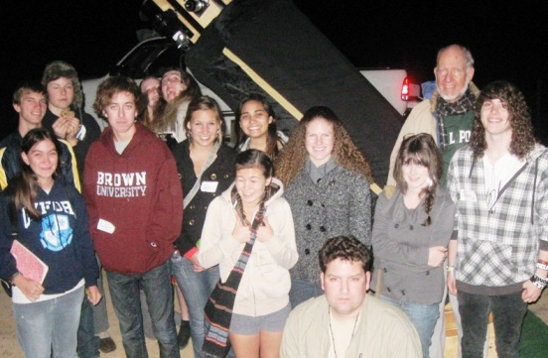
Student Astronomical Research Seminars

Slide 9
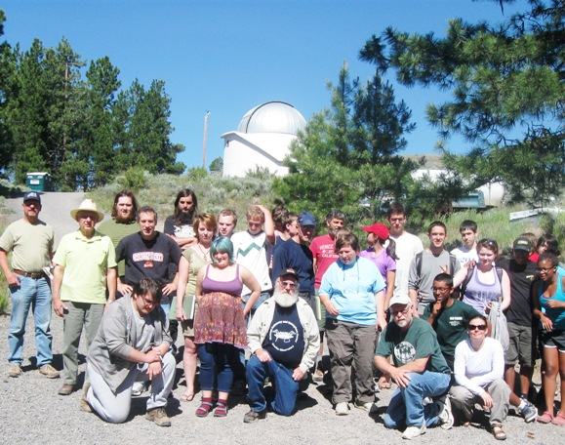
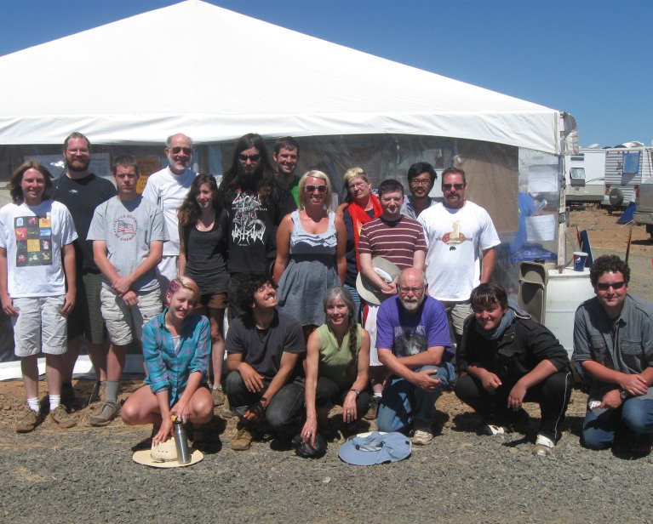
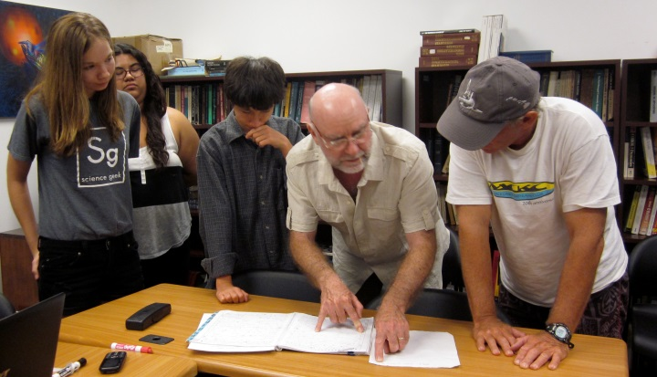
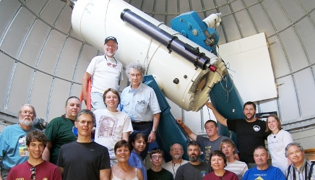
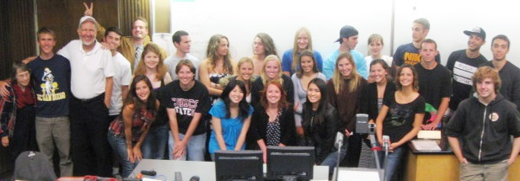

Slide 10
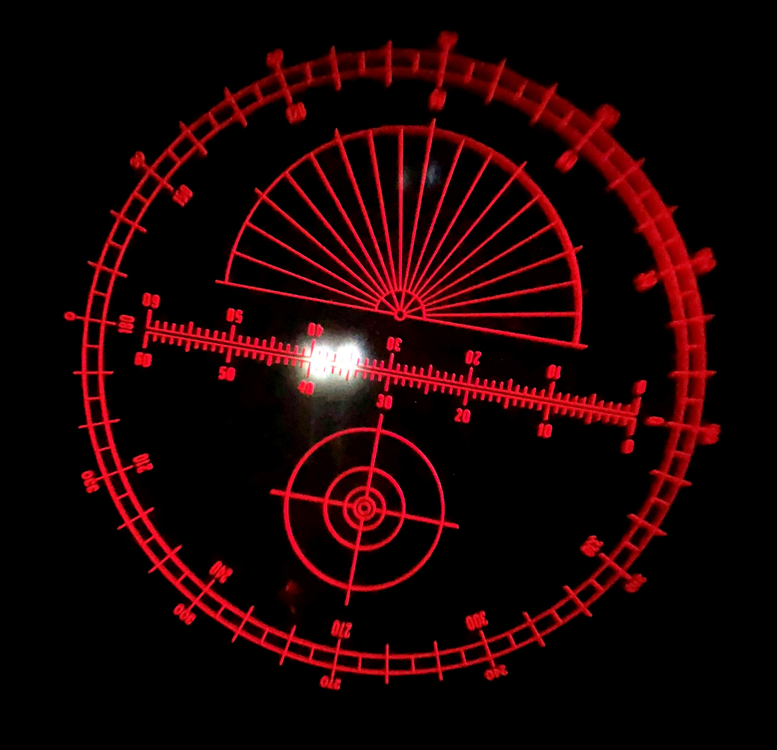
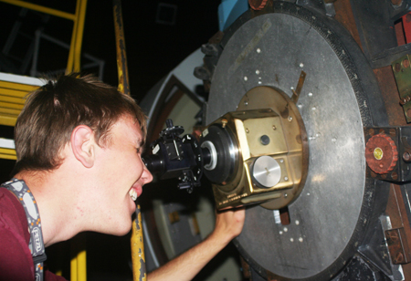
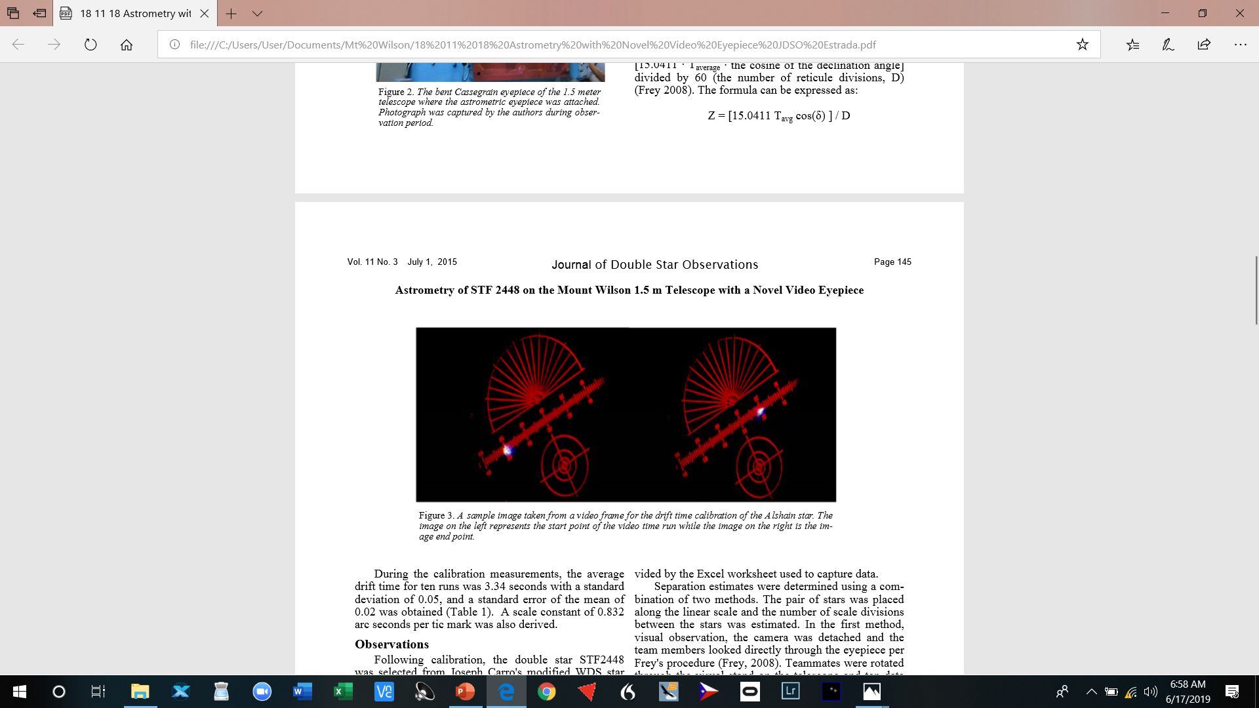
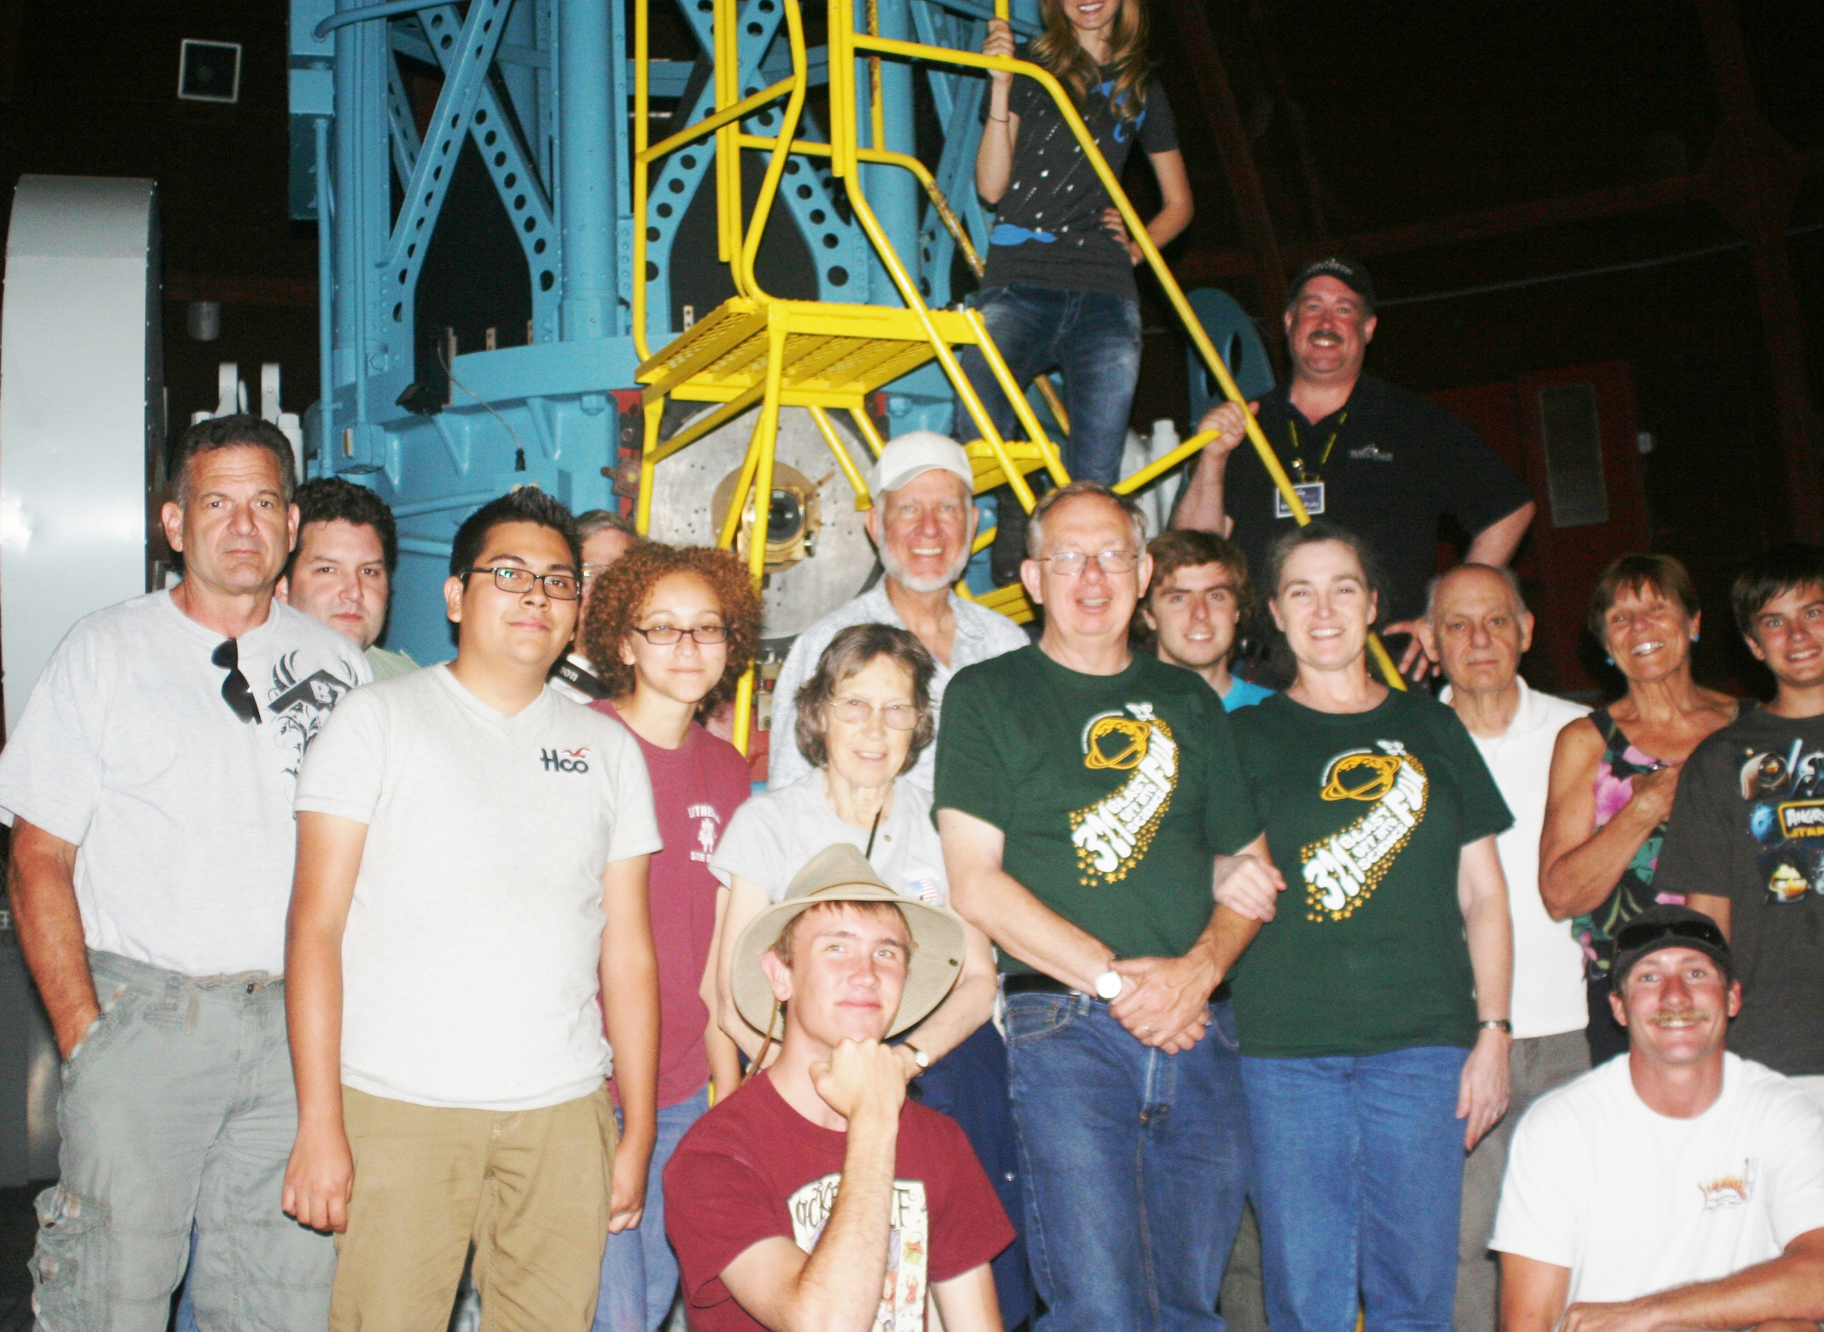
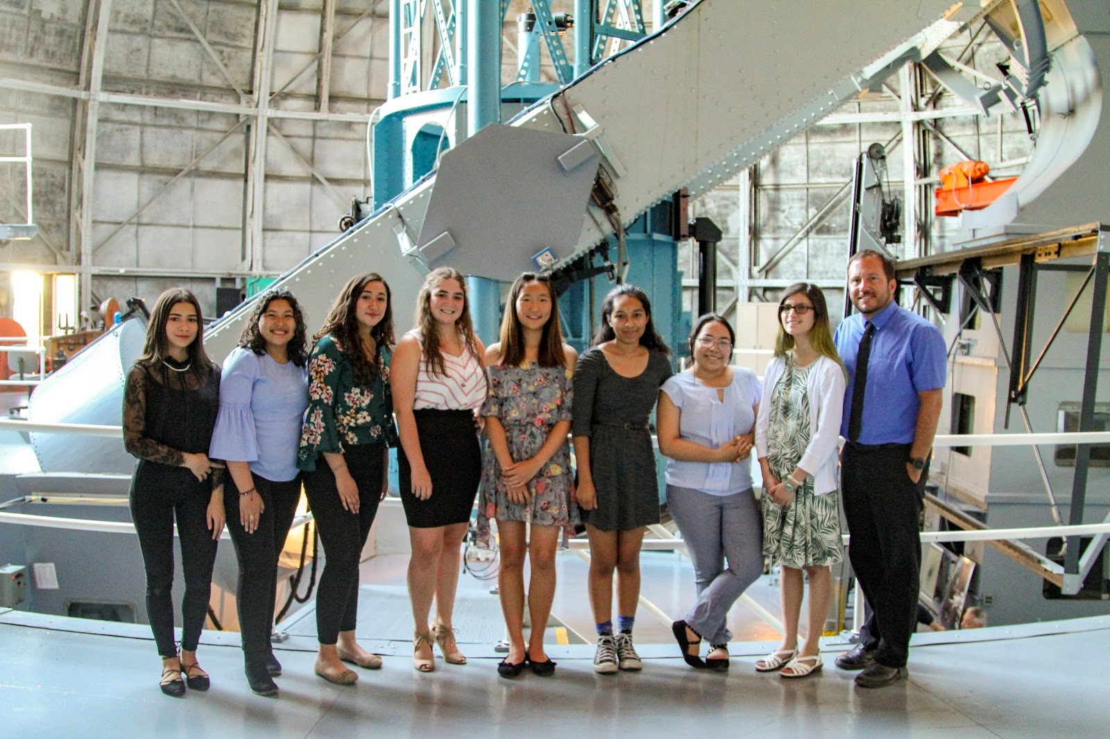

Slide 11
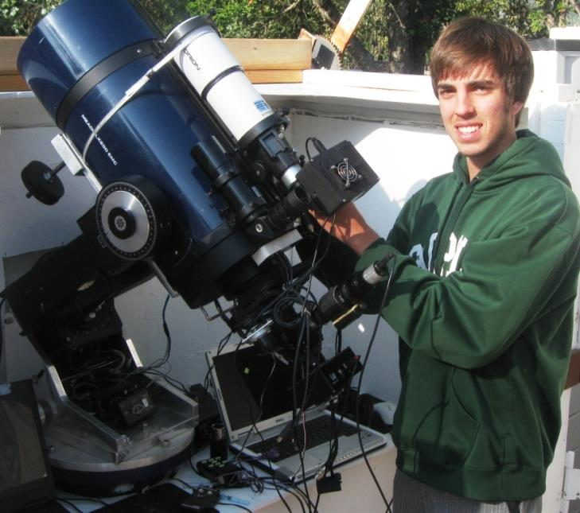
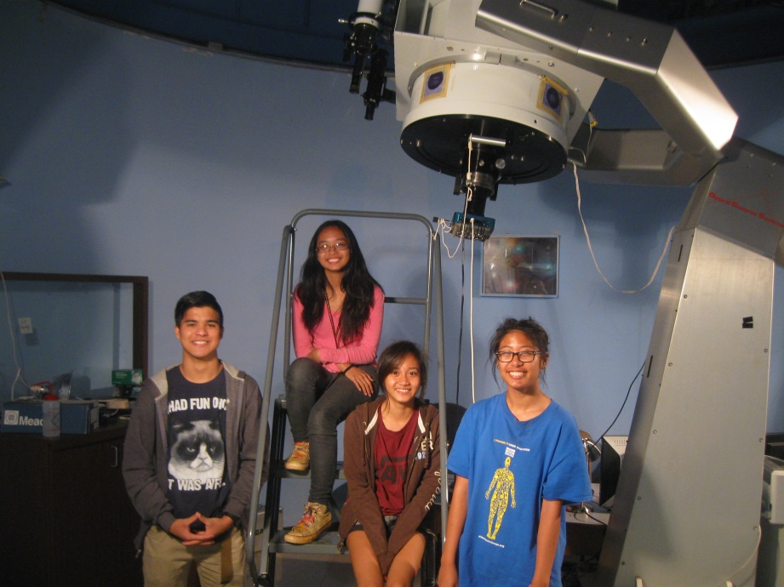
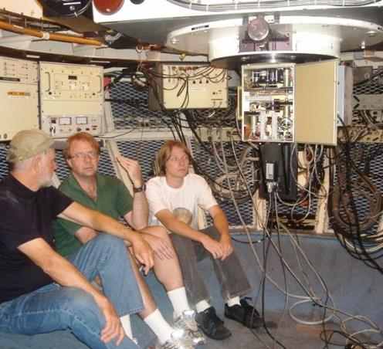
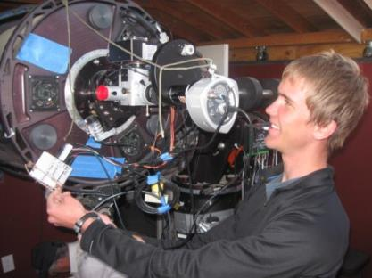

Slide 12
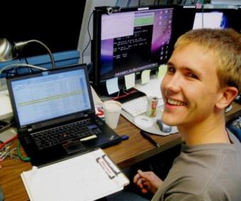
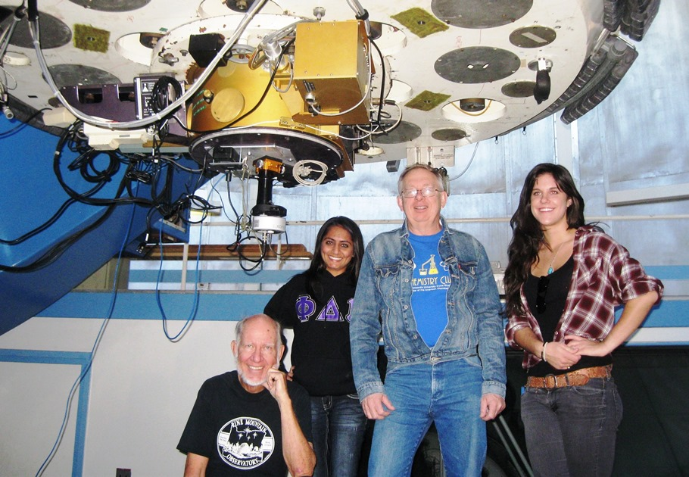

Slide 13
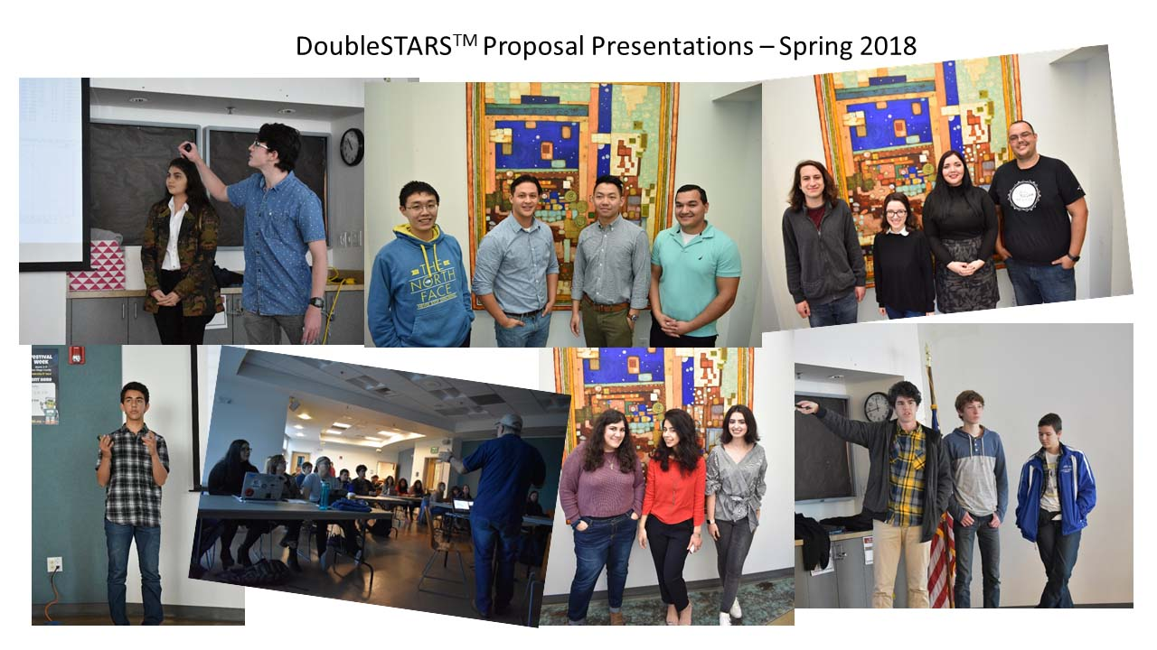
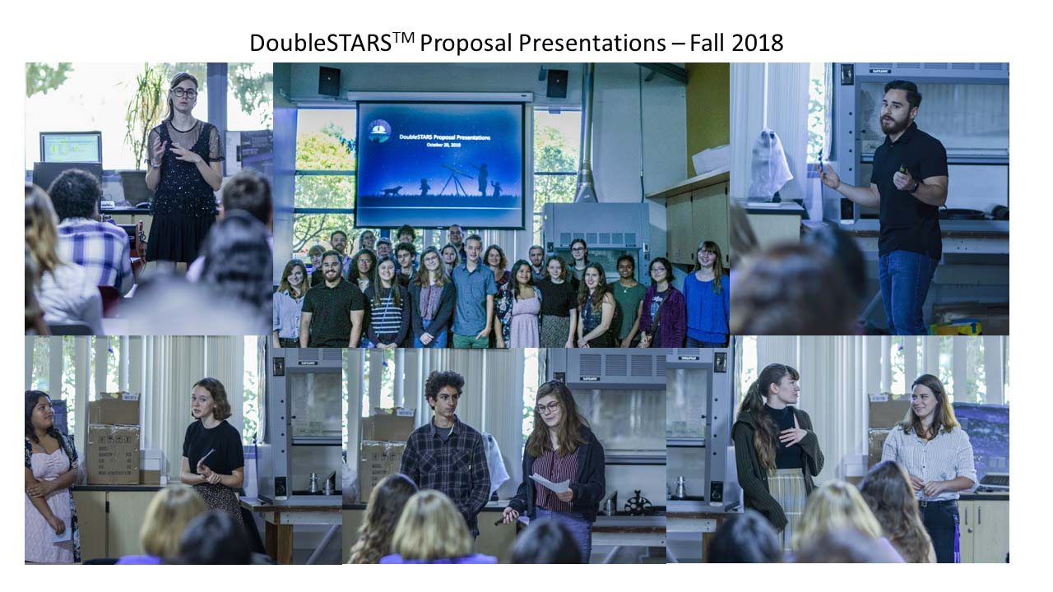
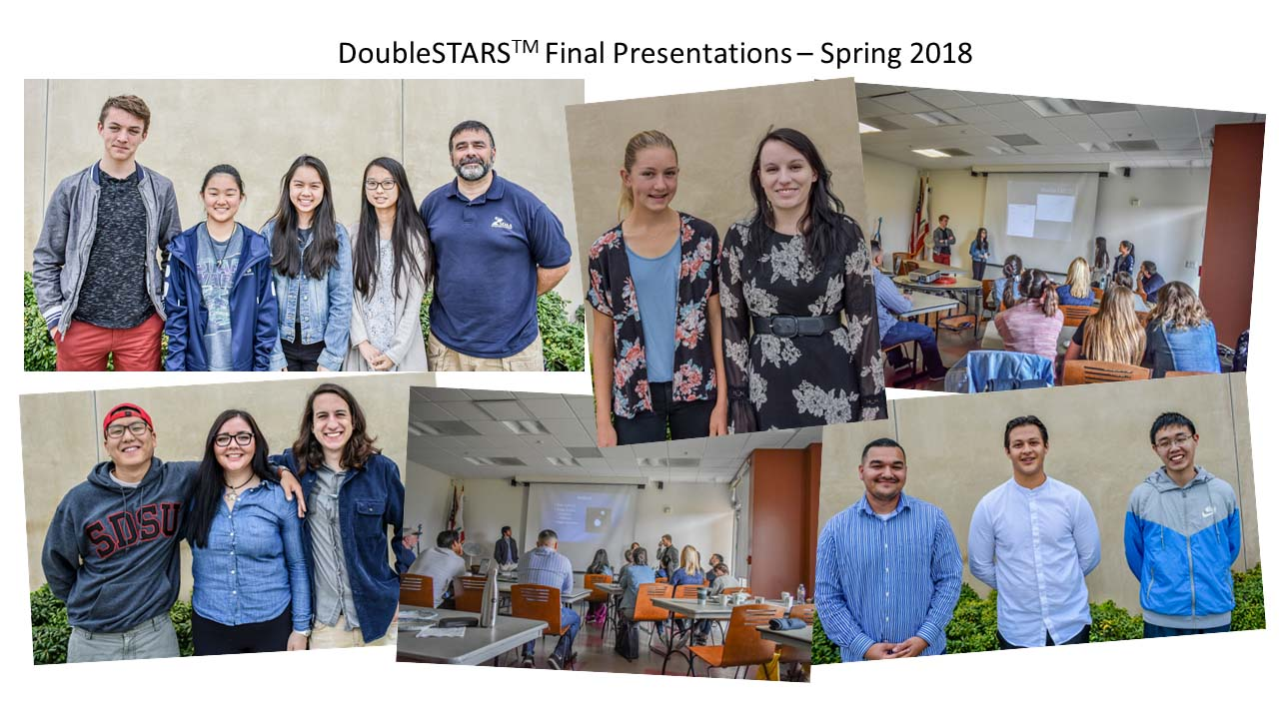
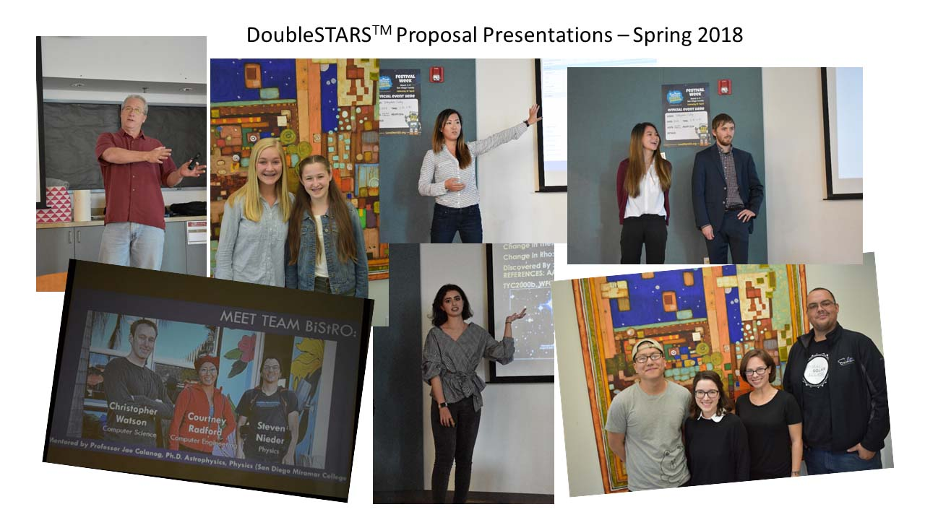
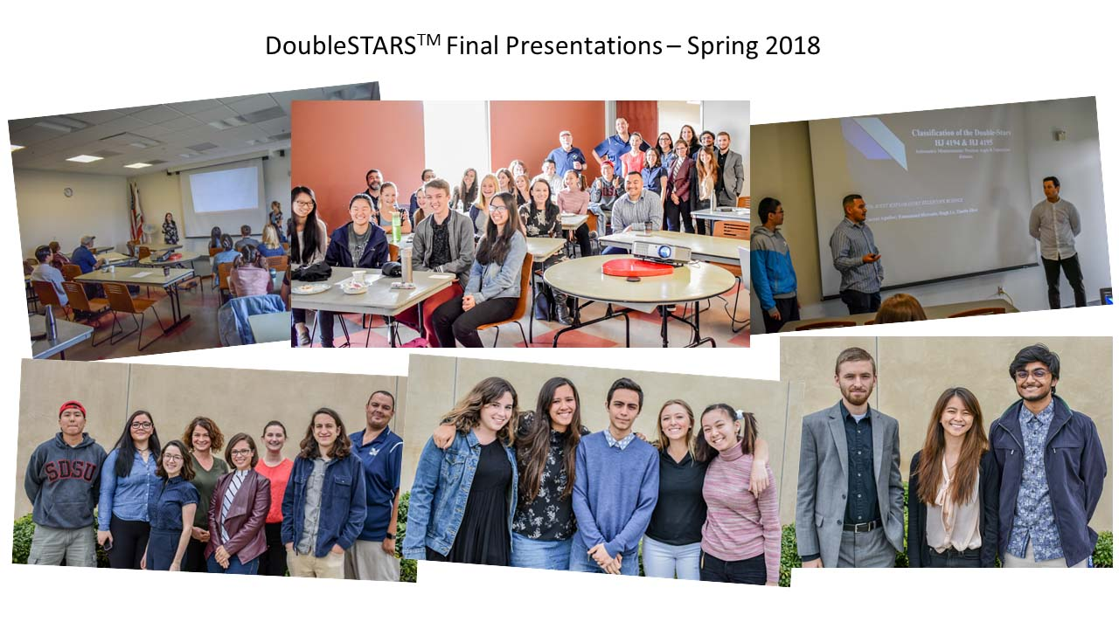
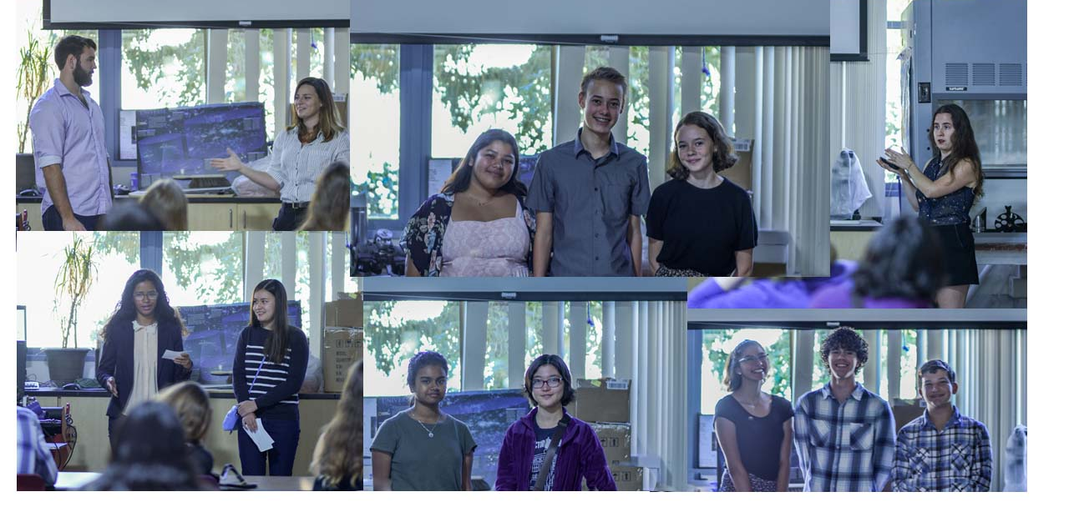
Boyce-Astro / San Diego

Slide 14
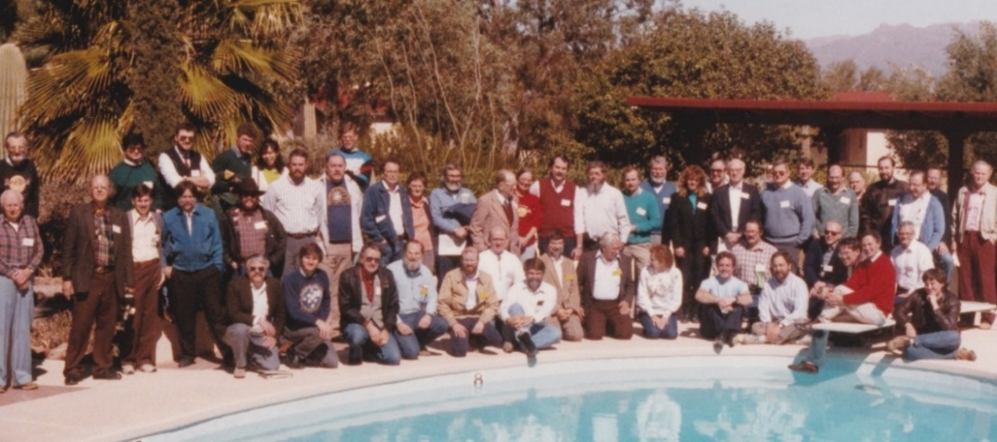

Building a Community of Practice
Research and Education with Robotic Telescopes, Arrays, and Networks
Past, Present, and Future
Three-day international conference, Adrian, Michigan, early fall 2022

